Slide 1
Conformance Testing of Machine Learning API
Chai Chaoweeraprasit
Development Lead Windows AI @ Microsoft
WebNN co-editor

Slide 2
Problems
Most known AI use cases relies on floating-point calculations
Modern ML models run on a wide variety of specialized hardware
Processing of deep neural networks unavoidably accumulates floating-point errors

Slide 3
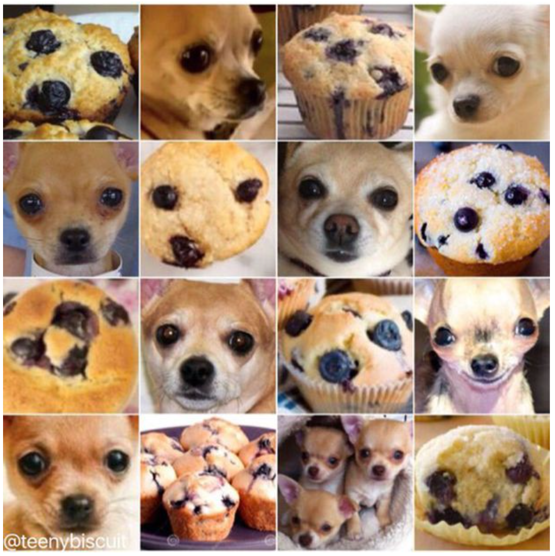
Is That a Muffin?
Karen Zack posted a series of bizarre photo quiz on her Twitter account (March 2016)
Her “Animals vs. Food” posts went viral and later became an AI challenge

Slide 4
Variability of Results
Precision differences
Data types e.g. half, float, double
Hardware differences
Architectural differences e.g. floating-point vs. fixed-point
Algorithmic differences
Any two convolution algorithms are never alike
Numerical differences
Non-deterministic computation or lossy conversions

Slide 5
Comparison Methods
Fuzzy comparison with epsilon introduces numerical differences on top of everything else
ULP “unit of least precision” is the distance between two consecutive floating-point values
ULP-based comparison removes numerical differences between the two values

Slide 6
ULP-based Compare

Slide 7
Baseline and Tolerances
Algorithmic differences is unavoidable
Tolerances are acceptable differences between the result (what-is) and the baseline value (what-should-be)
ULP-based tolerances remove both the hardware and numerical differences during a comparison
An “ideal” baseline is invariant and stable

Slide 8
Test Construction Strategy
Consider
Having both model-based and kernel-based testing
Consider
Establishing an “ideal” baseline results with which test results are compared
Consider
Using ULP-based comparison for kernel testing to avoid hardware and numerical differences
Consider
Different comparison tolerances based on algorithmic complexity
Consider
Top-K result comparisons for model-based testing

