Slide 1
Integrate WebNN-native into Chromium Browser
Junwei / Ningxin / Belem
27 Oct, 2021

Slide 2
Agenda
WebNN Overview
WebNN-native
Chromium Integration
Next Steps
The design doc of integrating WebNN-native into Chromium
Notes:
The presentation is based on the design doc of integrating WebNN-native into Chromium, you are welcome to review and give your comments.

Slide 3
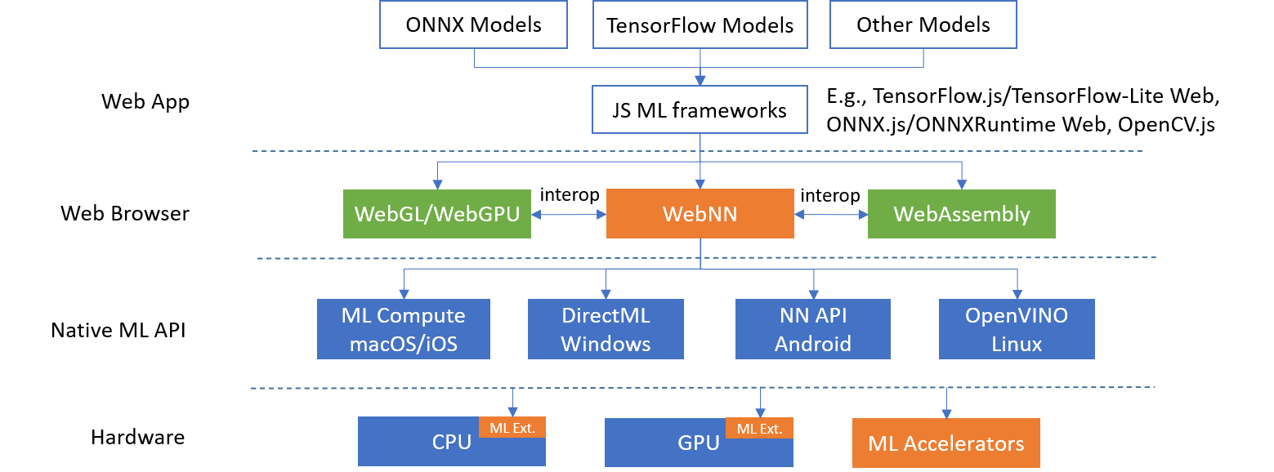
WebNN Architecture Overview
WebNN explainer and spec.
Notes:
WebNN is Webnn-native implemenation
Interoperater with WebGPU
CPU GPU dedicated accelerators

Slide 4
WebNN Execution Model
WebNN API
MLContext
default/cpu/gpu
Other Web API
create
Call flow
Association
MLGraphBuilder
build (with ops set)
Computational Graph
Compute Context
compile
compute
input
conv2d
tmp
add
tmp
relu
output
MLGraph
MLNamedInputs
Buffer
(CPU/GPU)
filter
bias
MLNamedOutputs
Buffer
(CPU/GPU)
Buffer
(CPU/GPU)
Buffer
(CPU/GPU)
Computational Graph Legend:
Input Operand
Constant Operand
Output Operand
Intermediate
Operand
operation
data flow
https://www.w3.org/TR/webnn/
Notes:
Accept GPU buffer, framework requirement for WebGPU

Slide 5
WebNN-native Architecture (based on Dawn)
WebNN Native
webnn.h
webnn_cpp.h
Base Impl
ContextBase
GraphBuilderBase
GraphBase
OperandBase
OperatorBase
Backend
Impl
ContextDML
ContextIE
ContextNNAPI
Another Context
GraphDML
GraphIE
GraphNNAPI
Another Graph
Native API
DirectML
OpenVINO
NNAPI
Another ML API
Hardware
CPU
GPU
VPU
GNA
Notes:
One implementation of webnn, i put the link here, you can go to join it.
This implementation is refer Dawn project, webnn and webnn_cpp is code generator from json that is one-to-one mapping with Webnn
We reuse the validation and error mechanise from dawn

Slide 6
WebNN-native Wire Layer (for IPC)
Create Client Objects
Serialize Command
Get Command Space
Flush Commands
Wire Client
Wire Server
Create WeNN Native Objects
Deserialize Command
Call WebNN API
Handle Commands
WebNN Native
webnn.h
webnn_cpp.h
Base Impl
ContextBase
GraphBuilderBase
GraphBase
OperandBase
OperatorBase
Backend
Impl
ContextDML
ContextIE
ContextNNAPI
Other Context Impl
GraphDML
GraphIE
GraphNNAPI
Other Graph Impl
Native API
DirectML
OpenVINO
NNAPI
Other ML API
Notes:
1， What’s wire layer
2, Dawn relationship
Wire is another component for GPU process

Slide 7
Chromium Integration of WebNN-native GPU Backend
WebIDL API
WebNNImplemenation
Render process
WireClient
WebNNCmdHelper
Conv2d, Add, Relu
mojom
Shared Memory
Shared Memory
CommandBuffer
WebNNDecoderImpl
WebNNCommand MailBoxCommand
Gpu process
WireServer
GPU Buffer
WebNN-native
Chromium Implementation Design Doc
GPU backend
Notes:
1, WebIDL is JS API implementation in blink
2, WebNNImplementation call WireClient to serialize commands, then add the WebNNCommand with WebNNCmdHelper
3, WireClient is to serialize command arguments in shared memory
4, WebNNCmdHelper is to add commands (WebNNCommand, mail box command) in shared memory
5, CommandBuffer is to flash commands to GPU process
6, WebNNDecoderImpl is to decode the commands sent from WebNNCmdHelper
7, WireServer is to deserialize WebNN commands and call WebNN native implementation
8, GPU buffer need to be shared with WebNN
E.g. BuildConv2d
FFPEG in Render porcess
Is it easy to Interoperate with WebGPU with Shared memory? Share memory with DirectML / D3D12 , command buffer to verify command, webnn is sync API, how to implement, CPU backend is an open,

Slide 8
Summary
Reuse Dawn infrastructure
Interfaces generated by IDL, focus on implementation
Wire layer for Inter-Process-Communication
Validation and error handling
Reuse Command Buffer
Interoperate with WebGPU to share buffer
Same security mechanism to access GPU device
Better performance for multi-commands
Call for review of the design doc:
Share Dawn infrastructure with WebGPU
Interoperate with WebGPU
Expose shmem as an ArrayBuffer to improve the IPC performance?
Run WebNN-native CPU backend in Render process?
Run WebNN-native AI accelerator backend in GPU process?
Support Async API?

Slide 9
Next Steps
Iterate the design with review feedbacks
Follow The Chromium process to launch a new feature
Step 0: Create a ChromeStatus entry, and choose your feature type.
Feature type of WebNN? “New feature incubation” or “Implementation of existing standard”
Call for mentors
Notes:
Common implementation between Dawn and WebNN
Based on Design doc, welcome to review and comments, what’s next step for the desing doc ,who is interest the , webassemly already there, that can reduce data exchange, AI accelators is a new hardware for chromium, no one did it before.

Slide 10
Backup

Slide 11
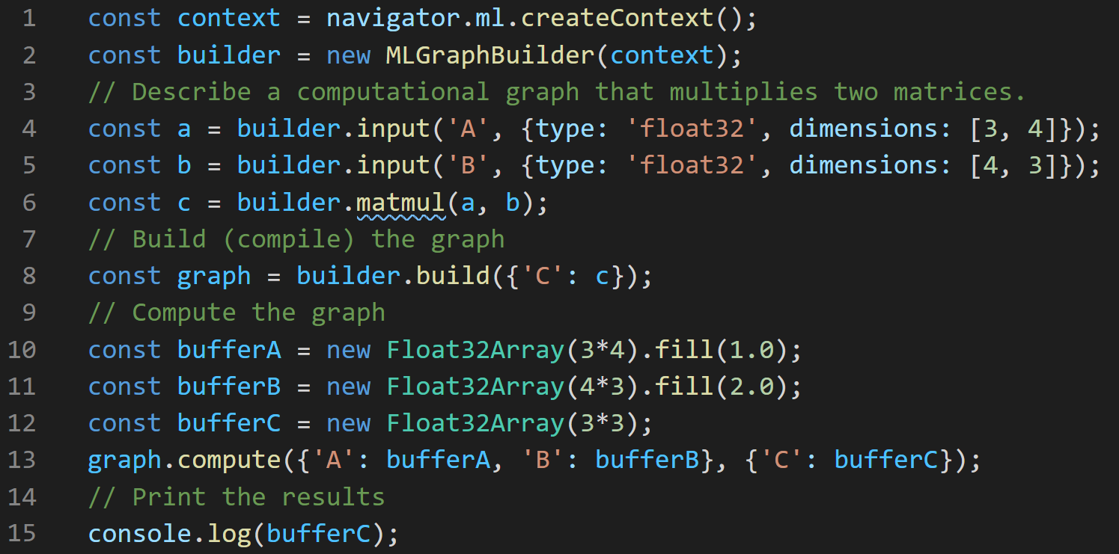
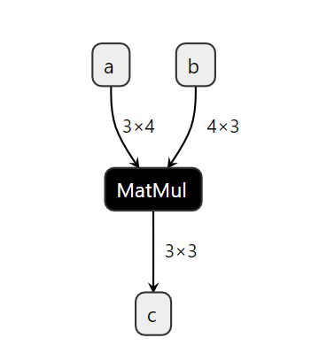
WebNN: Hello Tensors
Try it out in WebNN Code Editor.
‹#›

Slide 12
WebNN Architecture Overview
Web Applications
Legend
Application
Web standard and impl
Web ML Frameworks
(e.g., TF.js/TFLite, ONNXRuntime, OpenCV.js)
SW component
Hardware
A B
A uses B
WebNN
Web Browser
JS Runtime (e.g., Node.js)
WebNN-Native
Native ML APIs
(e.g., NNAPI, DirectML, OpenVINO)
Device Driver
(e.g., NNHAL)
WebNN API Spec
WebNN API Explainer
Landing page
CPU
GPU
AI (e.g., VPU)

