Slide 1
Connected Vehicle Access Control Policy Framework for Secure and Privacy-Preserving Vehicle to Everything (V2X) Communication Ashish Ashutosh
Supervisors: Prof. Dr. Lionel Brunie
Prof. Dr. Harald Kosch
Co-supervisor: Dr. Armin Gerl

Slide 2
Big Picture
How can we design a vehicle framework and share the data generated in vehicles while considering:
Security (access control)
Privacy (GDPR)?
Vehicle Data Platform and Cloud Services
Externally Shared Data
OEM Services
3rd Party Services
In-vehicle Generated Data
ECU
ECU
Bob

Slide 3
Vehicle Requirements
Arbitrary Signal Access (ASA)- read/write arbitrary signals (random location and time-based access).
Dissemination of Vehicle Data (DVD)- controlling distribution of vehicle data.
Polling Frequency (PF)- frequency of access to specific signals (static vs dynamic data).
Limited Computing Resources (LCR)- running 3rd party applications could increase competition for limited resources (CPU, storage) inside a vehicle.
 | Arbitrary Signal Access (ASA) | Dissemination of vehicle Data (DVD) | Polling Frequency (PF) | Limited Computing Resources (LCR)
Attribute based Access Control | (X) | - | (X) | (X)
Cryptography Methods | (X) | (X) | - | -
Role based Access Control | - | - | (X) | -
Traditional AC (DAC, MAC) | - | - | - | (X)

Slide 4
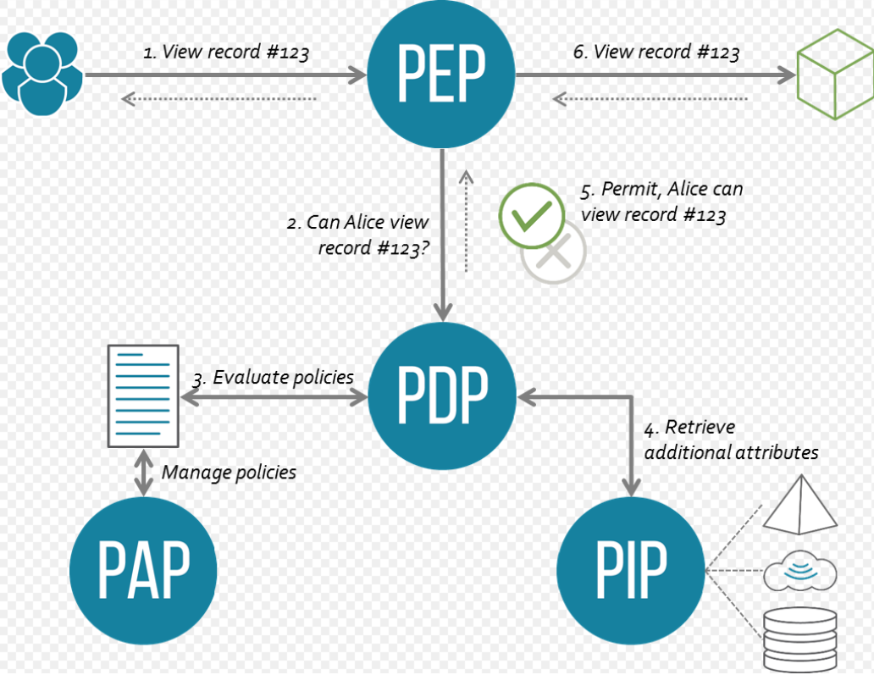
XACML Architecture (Data Flow Model)
By Axiomatics - Axiomatics, CC BY 3.0, https://commons.wikimedia.org/w/index.php?curid=48397652

Slide 5
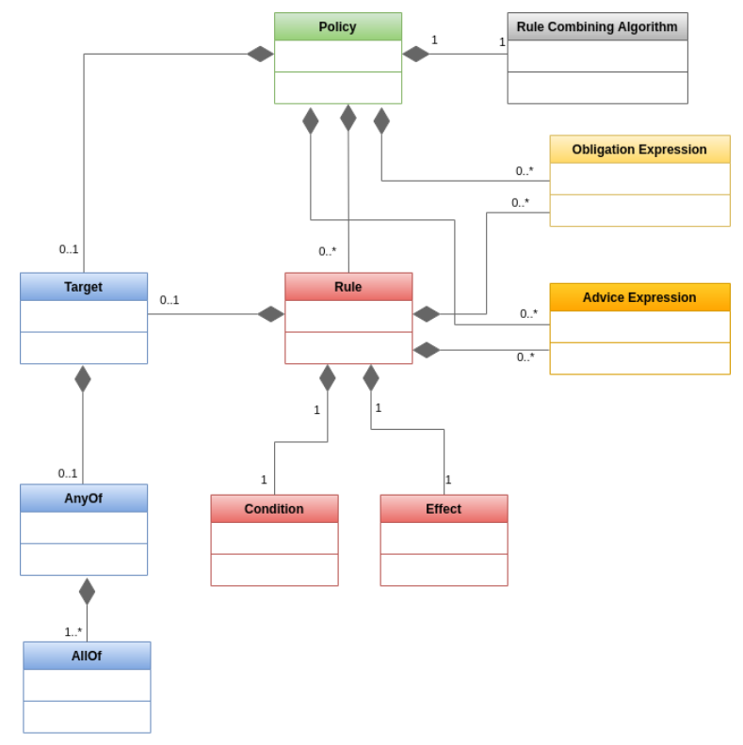
XACML Architecture (Policy Language Model)
https://medium.com/identity-beyond-borders/a-beginners-guide-to-xacml-6dc75b547d55

Slide 6
Decision Process
Arbitrary Signal Access: a service should not be allowed to read or write arbitrary signals (while also considering environmental factors for access, such as location, time and so on).
1
Policy Enforcement
8
Data Request
7
2
Policy Evaluation & Decision Algorithms
3
5
Policy Manager
Policy based Information
Resource
4
6
Policy Database
Req 1: Arbitrary Signal Access

Slide 7
Policy Model
1 : n
Rule
1 : n
Subject
1 : 1
1 : n
Entity
Resource
1:n
Policy Set
1 : 0..*
Policy Set
Policy
Env. factors
1 : 1
Priority
1 : n
Data
1 : 0..*
Anonymization

Slide 8
Requirement 2
Dissemination of Vehicle Data: data leaving the vehicle is vulnerable and a mechanism is required to prevent misuse / unauthorized sharing of data.
Sticky Policy approach offers accountability and Proxy re-encryption (PRE) protects the data.
Sticky Policy
Alice
Sticky Policy
Sticky Policy
Cloud Services

Slide 9
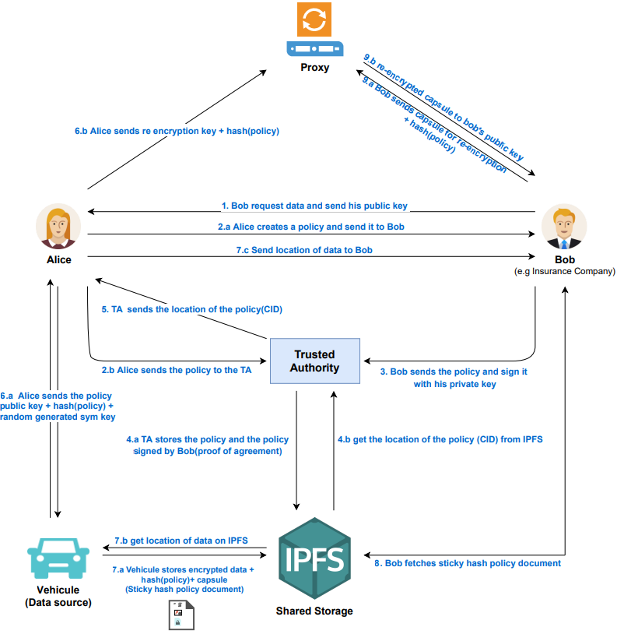
Sticky Policy with Proxy re-encryption (Ongoing Master Thesis)

Slide 10
Decision Process
1
Polling Frequency: services requesting access to vehicle data should not overtax or interfere with underlying control units. Frequency of access to critical functionality should be monitored and restricted.
Policy Enforcement
9
Data Request
8
2
Policy Evaluation & Decision Algorithms
3
5
Policy Manager
Policy based Information
Resource
4
7
6B
6A
Watchdog
Policy Database
Req 3: Polling Frequency

Slide 11
Policy Model
1 : n
Rule
1 : n
Subject
1 : 1
1 : n
Entity
Resource
1:n
Policy Set
1 : 0..*
Policy Set
Policy
Env. factors
1 : 1
Priority
1 : n
1 : 0..*
Data
Anonymization

Slide 12
Decision Process
1
Limited Computing Resources: computing resources inside a vehicle are limited. OEM services and 3rd party services compete for these resources within shared computing space. Access to resources need to be prioritized.
Policy Enforcement
9
Data Request
8
2
Policy Evaluation & Decision Algorithms
3
5
Policy Manager
Policy based Information
Resource
4
7
Scheduler
6B
6A
Watchdog
Policy Database
Memory Manager
Req 4: Limited Computing Resources

Slide 13
Policy Model
1 : n
Rule
1 : n
Subject
1 : 1
1 : n
Entity
Resource
1:n
Policy Set
1 : 0..*
Policy Set
Policy
Env. factors
1 : 1
Priority
1 : n
1 : 0..*
Data
Anonymization

Slide 14
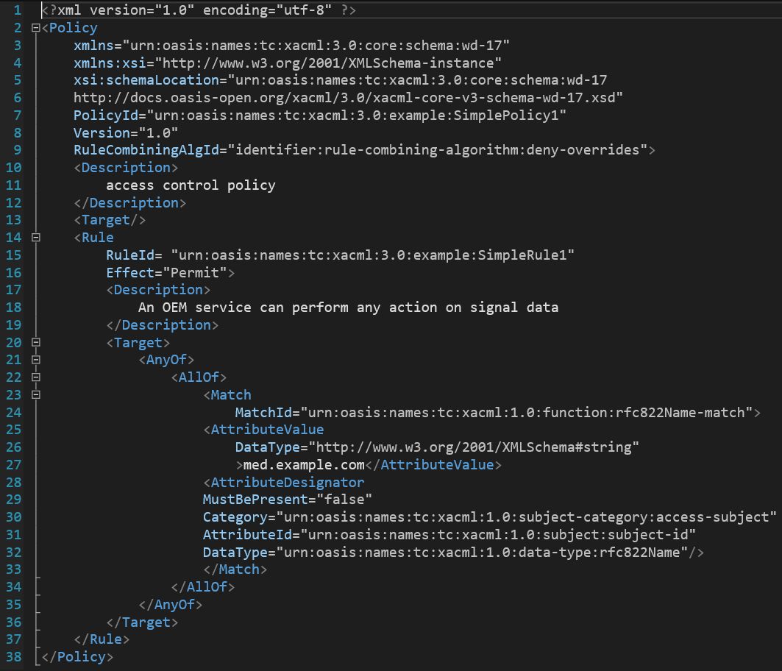
Sample Policy
Policy: An OEM service can perform any action on signal data

Slide 15
Evaluation
Qualitative Evaluation (for Policy Model):
Strictly define my requirements and use-case
Formal methods of evaluation
Quantitative Evaluation (for Decision Process):
# of Policies in a D/B, # of requests (positive, negative), priority requests
Measure latency, CPU overhead, Memory overhead
Baseline from existing XACML model compared with extended model OR literature work
Evaluation of Proxy re-encryption model: based on literature evaluation of crypto methods.

Slide 16
Possible Extension
Anonymization
1
Policy Enforcement
9
Pseudonymize
Data Request
Data Transformation
8
2
Crypto Methods
Policy Evaluation & Decision Algorithms
6A
6A
3
5
Policy Manager
Policy based Information
Resource
4
7
Scheduler
6B
6B
Watchdog
Policy Database
Memory Manager

Slide 17
Policy Model
1 : n
Rule
1 : n
Subject
1 : 1
1 : n
Entity
Resource
1:n
Policy Set
1 : 0..*
Policy Set
Policy
Env. factors
1 : 1
Priority
1 : n
1 : 0..*
Data
Anonymization
1 : n
Purpose

Slide 18
Thank You
/
Thank you for your attention!
Questions?
Ashish Ashutosh ashish.ashutosh@uni-passau.de
Notes:
Comments
*************
+ Give an example: why do vehicles communicate? What type of data they exchange? Give example for each type?
- Consistent example – Alice, Bob, Charlie

