Slide 1
Accessibility for Children
W3C Community Group

Slide 2
Welcome
The Chairs of the Community Group will Present at Today’s Breakout Session
Suzanne Taylor, Founder at Things Entertainment
Maud Stiernet, Owner at alittleliningcomes.com
Notes:
ST & no hand off

Slide 3
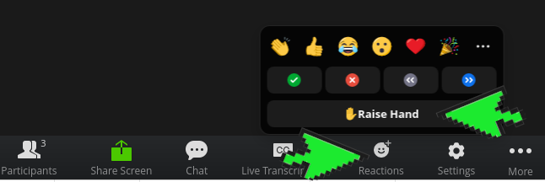
Please ask questions or make comments any time
Raise hand in Zoom
Or, if you are familiar with IRC:
#A11y4ChildrenIntro
q+
Notes:
ST

Slide 4
Why accessibility for children?
Different profiles than adults:
rhythms (need instant/fast support or feedback)
different exploration skills
less predictable
evolving competences
Research gap on disabled children as online users
Children need age/ level appropriate accessibility features
Notes:
MS

Slide 5
Active Participants
David Boulton, Learning Stewards (USA)
Emeline Brulé, University of Sussex (UK)
Chiara Cielo L, De Agostini (Italy)
Danielle Guzman-Orth, ETS (USA)
Kris Anne Kinney, ETS (USA)
Allison Johnson, Curriculum Associates (USA)
Melissa Malzkuhn, Motion Light Lab at Gallaudet University (USA)
AJ Polanco, ETS (USA)
(Chair) Suzanne Taylor, Things Entertainment (USA)
(Chair) Maud Stiernet, A Little Lining Comes (Belgium)
Notes:
ST

Slide 6
Current Activity: Defining “Accessibility for Children”
Differing International Definitions of Disability
Differing ages/standards for diagnoses
Acquired (learned) Learning Disabilities
Acquired (learned) Mental Health Concerns
Low Resource Environments
Learning Contexts vs. Information Contexts
Intersectionality
Notes:
MS

Slide 7
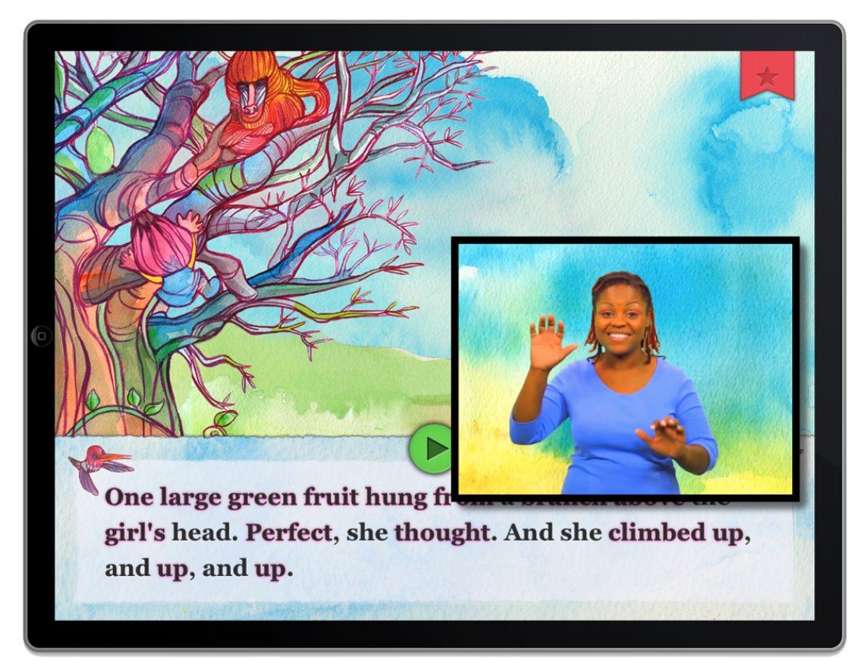
Current Activity: Learning About Members’ Work
David Boulton presented on Interactive Orthography on September 30th (https://bit.ly/3oYzSsw)
Melissa Malzkuhn will present on Bilingual Resources for Literacy Development October 28th
Notes:
ST

Slide 8
Scope
Web and Software
Problems and solutions from AI
Problems and solutions from XR
Assessments
Learning Contexts
Entertainment Contexts
Notes:
MS

Slide 9
Goals for 2021 and 2022
Document user needs for children with disabilities
Document kinds of learning needs unique to children learning online
Conduct literature review to see where enough research is already available to support accommodating these user needs
Identify open research questions and advocate for further research where needed
Document additional information to help inform implementation efforts
Notes:
ST

Slide 10
Example User Need:
Access to information without sound and without literacy
Captions don’t help if you can’t read them
Research Status: Need is clear, but research is needed for the techniques.
Can AI or adaptive tutorials help determine when this is needed and should be provided?
Possible Techniques:
ASL
other sign languages
visual cues
language-free UI
Notes:
MS

Slide 11
Example User Need:
Access to information with limited ability to read captions
Captions are not enough when you don’t have time to read them and watch the video or animation as well
Research Status: Need is clear, but research is needed related to when to provide or prioritize different accommodations
Determine the user need/preference at which captions become a. Helpful and b. Reliable
How adaptive interfaces can help students select these accommodations
If only one accommodation can be provided, how to determine which to provide
Can orthogonal hand spelling (emphasize shape of letter) prepare users to read the captions?
If captions are part of a test to measure comprehension and fluency, how might pausing or slowing down the experience impact these measurements?
Can there be images or other reading aids within the captions?
Techniques:
Slow down or Pause experience to be able to read the captions
Reduce the amount of caption text (careful default scripting, edited scripting, visual cues to supplement captions, game design to limit the amount of narration presented at a given time)
Training to use innovative captions
Notes:
ST & no hand off

Slide 12
Example User Need Category:
Right to be accurately assessed
Construct Relevance in Assessments:
Timing adjustable vs. High frequency words
Read aloud vs. Interpreting a graph or equation
Reading comprehension vs. Listening comprehension
Instruction
Opportunity to work with formats that will appear on assessments (fair scoring)
Opportunity to be given appropriate instruction based on accurate assessment (fair educational opportunities)
Notes:
ST

Slide 13
Example User Need Category:
Proficiency Prioritizing
Executive Functioning
Cognitive load
Memory (e.g., working memory)
Flexible Thinking
Following directions or instructions
Research Status:
Often develops with age
Implications for platform and task designs, accessibility tools, accommodation implementation
Notes:
MS

Slide 14
Intended Impact
In General
WCAG 3.x
Thanks to Jeanne Spellman and Janina Sajka for helping with this
Implementation Efforts
Products of participating organizations and others
Other Specific-Topic Initiatives such as
(pdf) UNICEF Policy guidance on AI for children DRAFT 1.0 | SEPTEMBER 2020
Notes:
ST

Slide 15
Invite to Participate
First meeting was September 2, 2021
We meet for one hour every other week on Thursday
13:30 UTC (GMT)
9:30 am Eastern Time (United States)
3:30 pm Central European Time
You can also participate asynchronously
You can join at the Community Group Home Page
Next meeting is October 28th
Notes:
MS

Slide 16
We’re Happy to Help
We are hoping to help Children’s Accessibility Needs to be incorporated into other initiatives and documents.
Let us know how we can help!
Contact the Chairs:
Suzanne.Taylor@ThingsEntertainment.net
Maud.Stiernet@ALittleLiningComes.com
Notes:
ST

