Slide 1
<div focusgroup> { toggle: … } and tabs
Proposals for affordances for common User Interface design patterns. A TPAC breakout session discussion.
21 October 2021 12:00 AM UTC and 3:00 PM UTC

Slide 2
Agenda
General overview
focusgroup concepts
toggle concepts
Use case: Tabs
Discussion

Slide 3
focus and state management improvements
Fundamental concepts of UI and control design
Both available in the platform, but not exposed as reusable concepts for general developer use

Slide 4
<div focusgroup>
Concepts
Detailed Explainer | Open UI presentation/overview

Slide 5
Concept: `TAB` stop redux
Faster webpage navigation for keyboard users.
Group related components of a control together with one TAB stop, use Arrow Keys to navigate between items in the group.

Slide 6
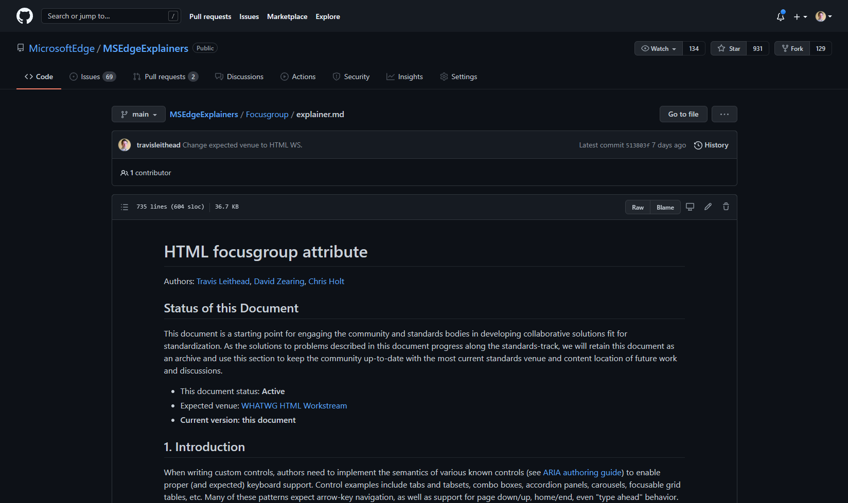
1
2
3
4
5
6
7
8
9
10
11
12
13
14
15
16
17
18
19
20
21
22
23
24
25
26
27
28
29
30
31
32
33
34
35
36
36
37
38
39
40
Notes:
General motivation (less tab stops, faster keyboard access). Note, we are aware of landmark navigation as well (F6 on Windows).

Slide 7
1
2
3
4
5
6
7
8
9
10
11
12
13
14
Notes:
Groups where arrow key navigation is enabled reduces need to have every control be a tab-stop. (40 -> 14)

Slide 8
Concept: navigate control groups
Logical Arrow Key navigation among related concepts (may or may not reduce TAB stops)

Slide 9
1
2
3
4
5
6
7
8
9
10
11
12
Notes:
Note: Grouping for arrow key navigation may not always reduce the number of TAB stops to 1 in the group. Real example from Microsoft Edge browser UI… Here each group encompass a set of related controls, all of which have multiple TAB stops within.

Slide 10
Concept: accessibility affordance
Keyboard navigation with Arrow Keys (or equivalent) is required for accessibility conformance in common controls (built-in or otherwise)

Slide 11
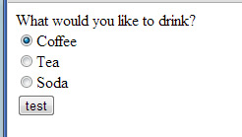
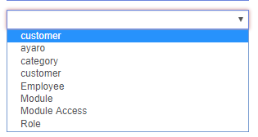
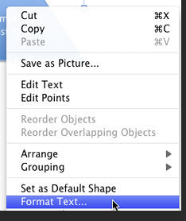
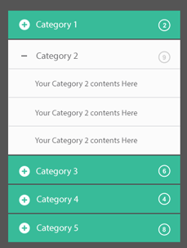
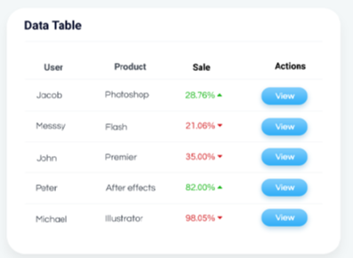
Radio button groups
Select menus
BUILT IN
(cycle forward with right/down;
cycle backward with left/up)
(up/down to change focused option; home/end; type-ahead to search)
s
role=tablist
CUSTOM
data table (role=grid)
role=menu
Accordion
Notes:
Expose a behavior native to specific HTML elements
To easily add expected keyboard support for many control patterns

Slide 12
Concept: focus vs state
Often combined, but separate concepts

Slide 13
Linked focus and state
Radio button groups
As focus moves, so does `checked` state

Slide 14
Focus and state separated
active/expanded tab
focused tab
focus allows exploration/navigation; activation on focused control changes state

Slide 15
Focusgroup proposal short summary
Enables existing focusable elements within a scope to respond to arrow keys, home/end, etc.
Does not change the focusability (or TAB order) of anything.
Intended for content navigation (not layout navigation)
Only deals with focus change (does not persist any state)
Has various options: wrap, horizontal/vertical nesting, table content based navigation
Notes:
For details, please read the full proposal

Slide 16
{ toggle: … }
Concepts
Proposal Draft

Slide 17
Concept: "toggleable" state
How to save your activated state
state=toggle

Slide 18
Built-in <input type=checkbox>
Includes persistent toggle (checked)
User can "activate" it with keyboard/mouse to change the state.
Developers can leverage the toggle state (e.g., to adjust UI)
:checked pseudo class
DOM-accessible state

Slide 19
Toggle
Add persistent toggle state
User can "activate" it with keyboard/mouse to change the state.
Developers can leverage the state (e.g., to adjust UI)
:toggle() pseudo class
DOM-accessible state (TBD)

Slide 20
Concept: non-boolean toggles
Support tri-level state toggles and beyond

Slide 21
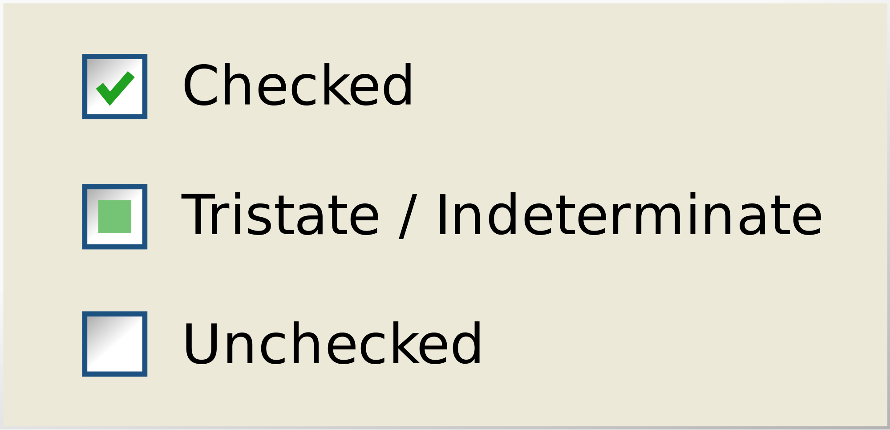
2
1
0
Notes:
Up to N toggle states via numbers: 0, 1, 2, etc., as many as desired.

Slide 22
"sticky" cycling
2
1
0
Notes:
Includes options for "sticky" cycling

Slide 23
Concept: toggle scopes
Activation element is separable from the toggle-containing element

Slide 24
parent node
element with toggle
previous siblings
next siblings
scope
User activation (e.g., click/enter key)
descendant node
Notes:
An element different from the element holding the state can be used as the "trigger" element which toggles the state element IF its in scope

Slide 25
parent node
element with toggle
previous siblings
next siblings
wide scope
User activation (e.g., click/enter key)
descendant node
Notes:
Wide scope includes adjacent next siblings in the scope.

Slide 26
Concept: linked toggle groups
i.e., like radio button groups

Slide 27
node establishing group scope
scope
related toggle elements are grouped under the scope
Notes:
An element different from the element holding the state can be used as the "trigger" element which toggles the state element IF it's in scope

Slide 28
Concept: n-toggles per element
Elements not restricted to only one toggle—can have as many toggles as needed

Slide 29
element with five toggles
toggles differentiated by name

Slide 30
Toggle proposal short summary
Grants toggleability to all elements
Toggles are named and have N states
Any number of toggles per element
Toggle "triggers" (toggle-set) make elements activatable
Named toggle groups link same-named toggles together under scope
Toggles can be selected with :toggle(<name>)
TODO
Provide toggle state names (currently numbers)
Provide DOM access to toggle state
Notes:
For details, please read the CSS Toggles unofficial draft spec

Slide 31
tabs
One use case: pulling it all together

Slide 32
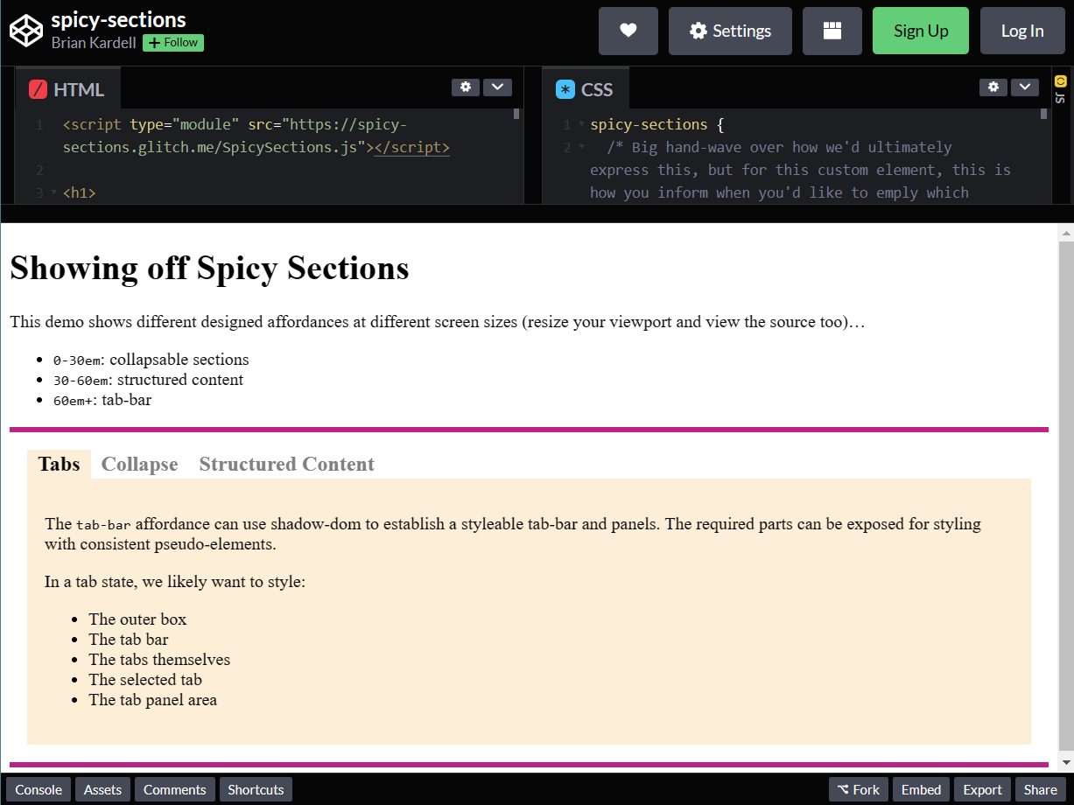
https://codepen.io/bkardell/pen/VwpJGGL
Notes:
Note: the demo site uses neither focusgroup nor Toggles today ☺. We'll use this as a concrete use case as well as an opportunity to explore how the two proposed features work together.

Slide 33
focusgroup keyboard behavior (with wrapping)
Notes:
A tab area wrap-around arrow-key navigation can be added with focusgroup.

Slide 34
Active toggle
toggles
toggle group scope
Notes:
[In theory] Each tab has a Toggle, and all three tabs belong to a Toggle group, enabling the toggle of any tab to "un-toggle" all others.

Slide 35
Observation: focusgroup and toggle "scope"
More…
Notes:
In this example, the focusgroup scope and the toggle group scope are the same, hinting that we could combine these concepts. However, there are many scenarios where having different scopes is relevant:
[extra tabs] button that logically belongs in a focusgroup, but doesn't share the toggle scope
Actual example seen earlier: Edge address bar

Slide 36
Scenario Gap*: tab stop for toggled item(s)
Tab stop from somewhere before…
<!-- abbreviated markup... -->
<spicy-sections affordance="tab-bar">
<h2 id="cp1" role="tab" aria-controls="cp2" tabindex="0">...</h2>
<div id="cp2" role="tabpanel"></div>
<h2 id="cp3" role="tab" aria-controls="cp4" tabindex="-1">...</h2>
<div id="cp4" role="tabpanel"></div>
<h2 id="cp5" role="tab" aria-controls="cp6" tabindex="-1">...</h2>
<div id="cp6" role="tabpanel"></div>
</spicy-sections>
Tab stop to somewhere after…
*Assumes a motivation to avoid JavaScript
Notes:
"Roving tabindex" technique handles this case by explicitly modifying the sequential keyboard navigation order so that the "toggled" tab will the designated tab stop.
focusgroup does not currently attempt to keep a "memory" of where the last focused item was located.
Toggles may make elements "activatable" but doesn't make clear what impact this may have on sequential focus navigation (other than to add the activatable items to the sequential focus order.

Slide 37
Scenario Gap*: toggle-on-focus
*Assumes a motivation to avoid JavaScript
Notes:
This [tab] example uses a linked focus and toggle model (like radio buttons)—as the focus is moved with the arrow keys, the toggle state changes
* Focusgroup allows focus to move within the group, but this wouldn't cause an "activation" to change a toggle. If the layout is controlled with focus, state, this works, but if controlled via :toggles, a separate "activation" action would be necessary.

Slide 38
Solution rough ideas…
Tab stop for toggled items: enable the active toggle (in a group) to participate in sequential keyboard navigation (inactive toggles wouldn't)
(replaces roving tabindex method)
Toggle-on-focus: provide a configuration for a toggle to be activated by focus or by [explicit action/click/enter]
(enables linked focus vs unlinked toggle selection)

Slide 39
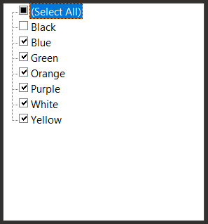
Other Toggle Scenarios (non-tab)
Multi-selection groups? Toggle groups with N>1 maximum active toggles
Ex: (Survey) Chose 3 of the following...
Select All/None linked Toggle
Ex:

Slide 40
CSS or HTML?
Should focusgroup be exposed via CSS?
Grouping mechanisms could be aligned?
toggle one-time creation in HTML?
toggle-create has unusual CSS semantics, may be better suited to HTML attribute?

Slide 41
Open Discussion

