Slide 1
In an (ontologically) perfect world...
COVID-19
Anti-body tests
Detected_by
Comorbid_with
94547-7
J96.X
Detected_by
PCR tests
94562-6
Treated_with
Diagnosed_as
94759-8
215470
U07.1
94500-6

Slide 2
Reality Check
In our non-ontologically-perfect world, a COVID-19 computable phenotype looks more like this.
This covers all the concepts, but:
Must be translated into a number of different data models and dialects
Must be continually manually updated to stay current
What would it take to be able to write one query script that:
Thoroughly covers all the concepts with the fewest possible codes?
Can be run at multiple institutions with few (or no) local changes?
Results in a consistently, accurately defined cohort?

Slide 3
Reality Check
clinical ontologies
What would it take to be able to write one query script that:
Thoroughly covers all the concepts with the fewest possible codes?
Can be run at multiple institutions with few (or no) local changes?
Results in a consistently, accurately defined cohort?
clinical ontologies
interoperable data models/technologies

Slide 4
Building Blocks
Literature, Current Practices, Existing Technologies

Slide 5
Computable Phenotyping
Computable phenotypes are algorithms used to query EHR data to identify patient cohorts with conditions or events relevant to some use case.
Important for research, but difficult to share across institutions in a machine-readable way.
Rely heavily on standard codesets (ICD-10, LOINC, RxNorm, CPT, etc.)
The ideal computable phenotype is shareable, data model agnostic, semantically unambiguous, machine readable, and publicly accessible.

Slide 6
The advantage presented by ontologies
Current state: exact code matches, from all over the hierarchy
Desired state: conceptual matches, powered by ontologies

Slide 7
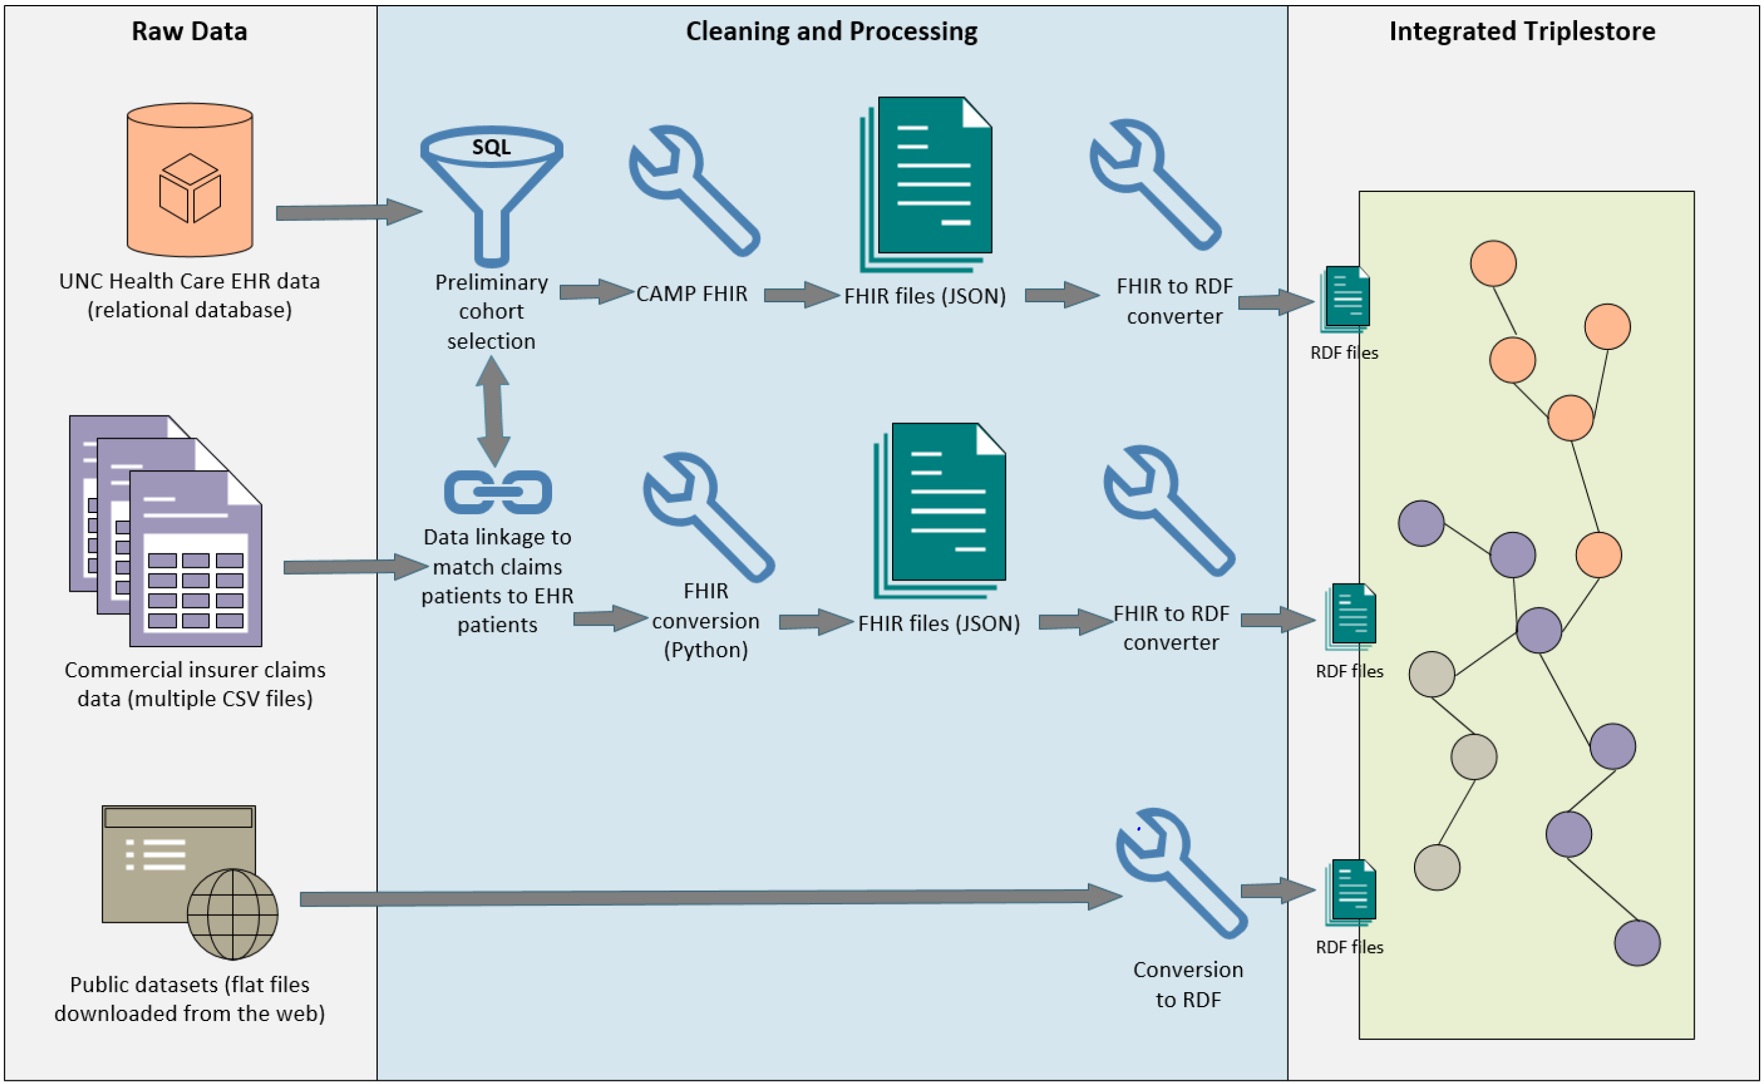
The Opioid Triplestore
Existing clinical dataset from a prior project*; a triplestore containing EHR, claims, and community-level data for post-surgical patients who were prescribed opioids.
*Collaborative project; see Acknowledgements slide for list of contributors and funding information

Slide 8
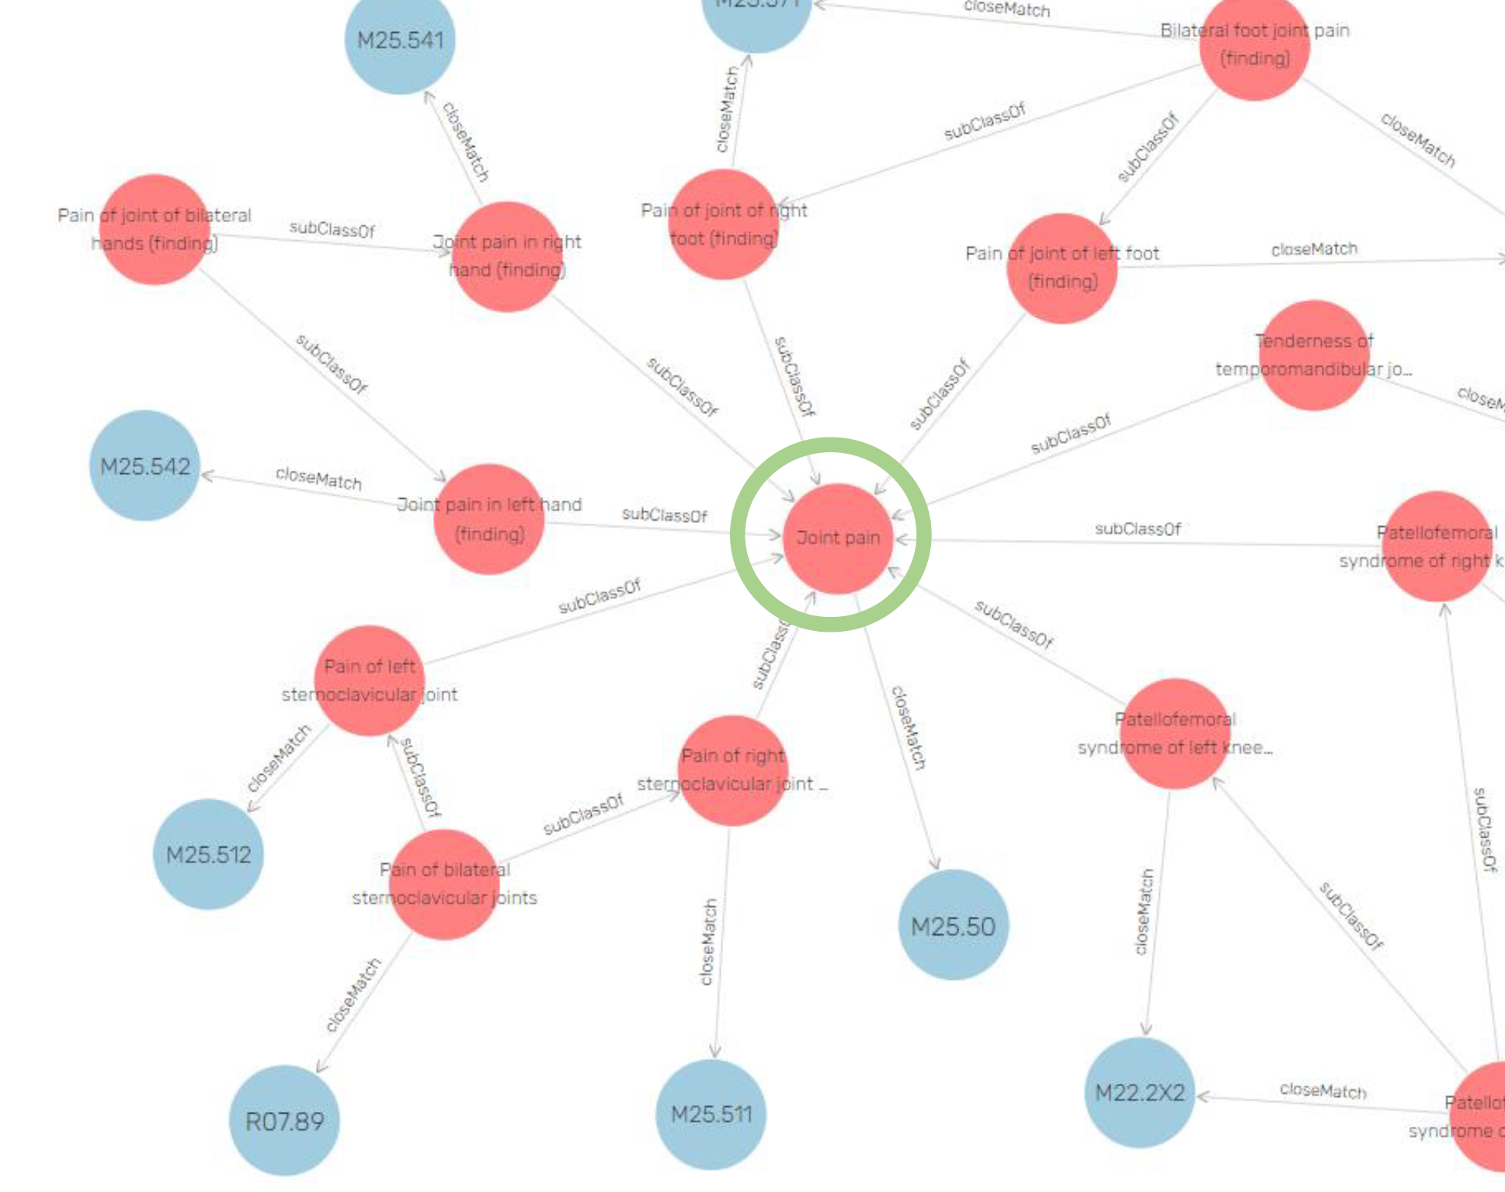
Experiments

Slide 9
Comparing Phenotype Performance: Ontology versus ICD-10-CM codeset
Consider two computable phenotypes: (1) depression, and (2) rheumatoid arthritis.
Objective is to compare the “coverage” of a computable phenotype defined by a list of ICD-10-CM codes (from PheKB) against a phenotype defined by a single concept (along with its child concepts) from the SNOMED or HPO ontology.
Measuring the sensitivity and specificity of the phenotype methods is not possible in this study, as there is no way to know who the “true” cases are—we can only know which patients are identified by each phenotyping method.
What is critical to measure, then, is the degree to which the two phenotyping methods overlap, as well as the degree to which they diverge.

Slide 10
Mapping SNOMED to ICD-10-CM
Required seventh digit mapping
Context-dependent mapping

Slide 11
Mapping SNOMED to ICD-10-CM

Slide 12
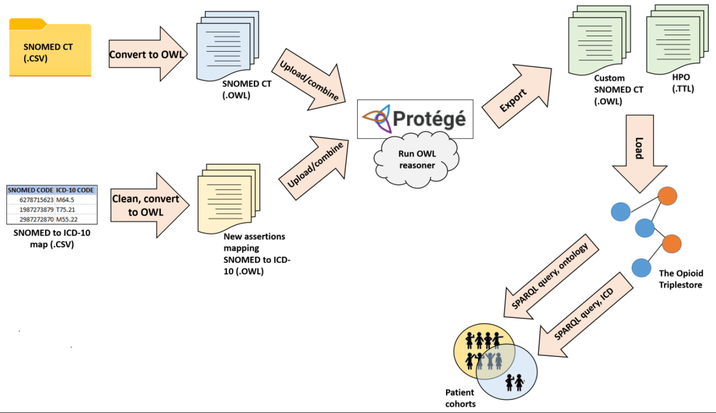
Transformation Pipeline

Slide 13
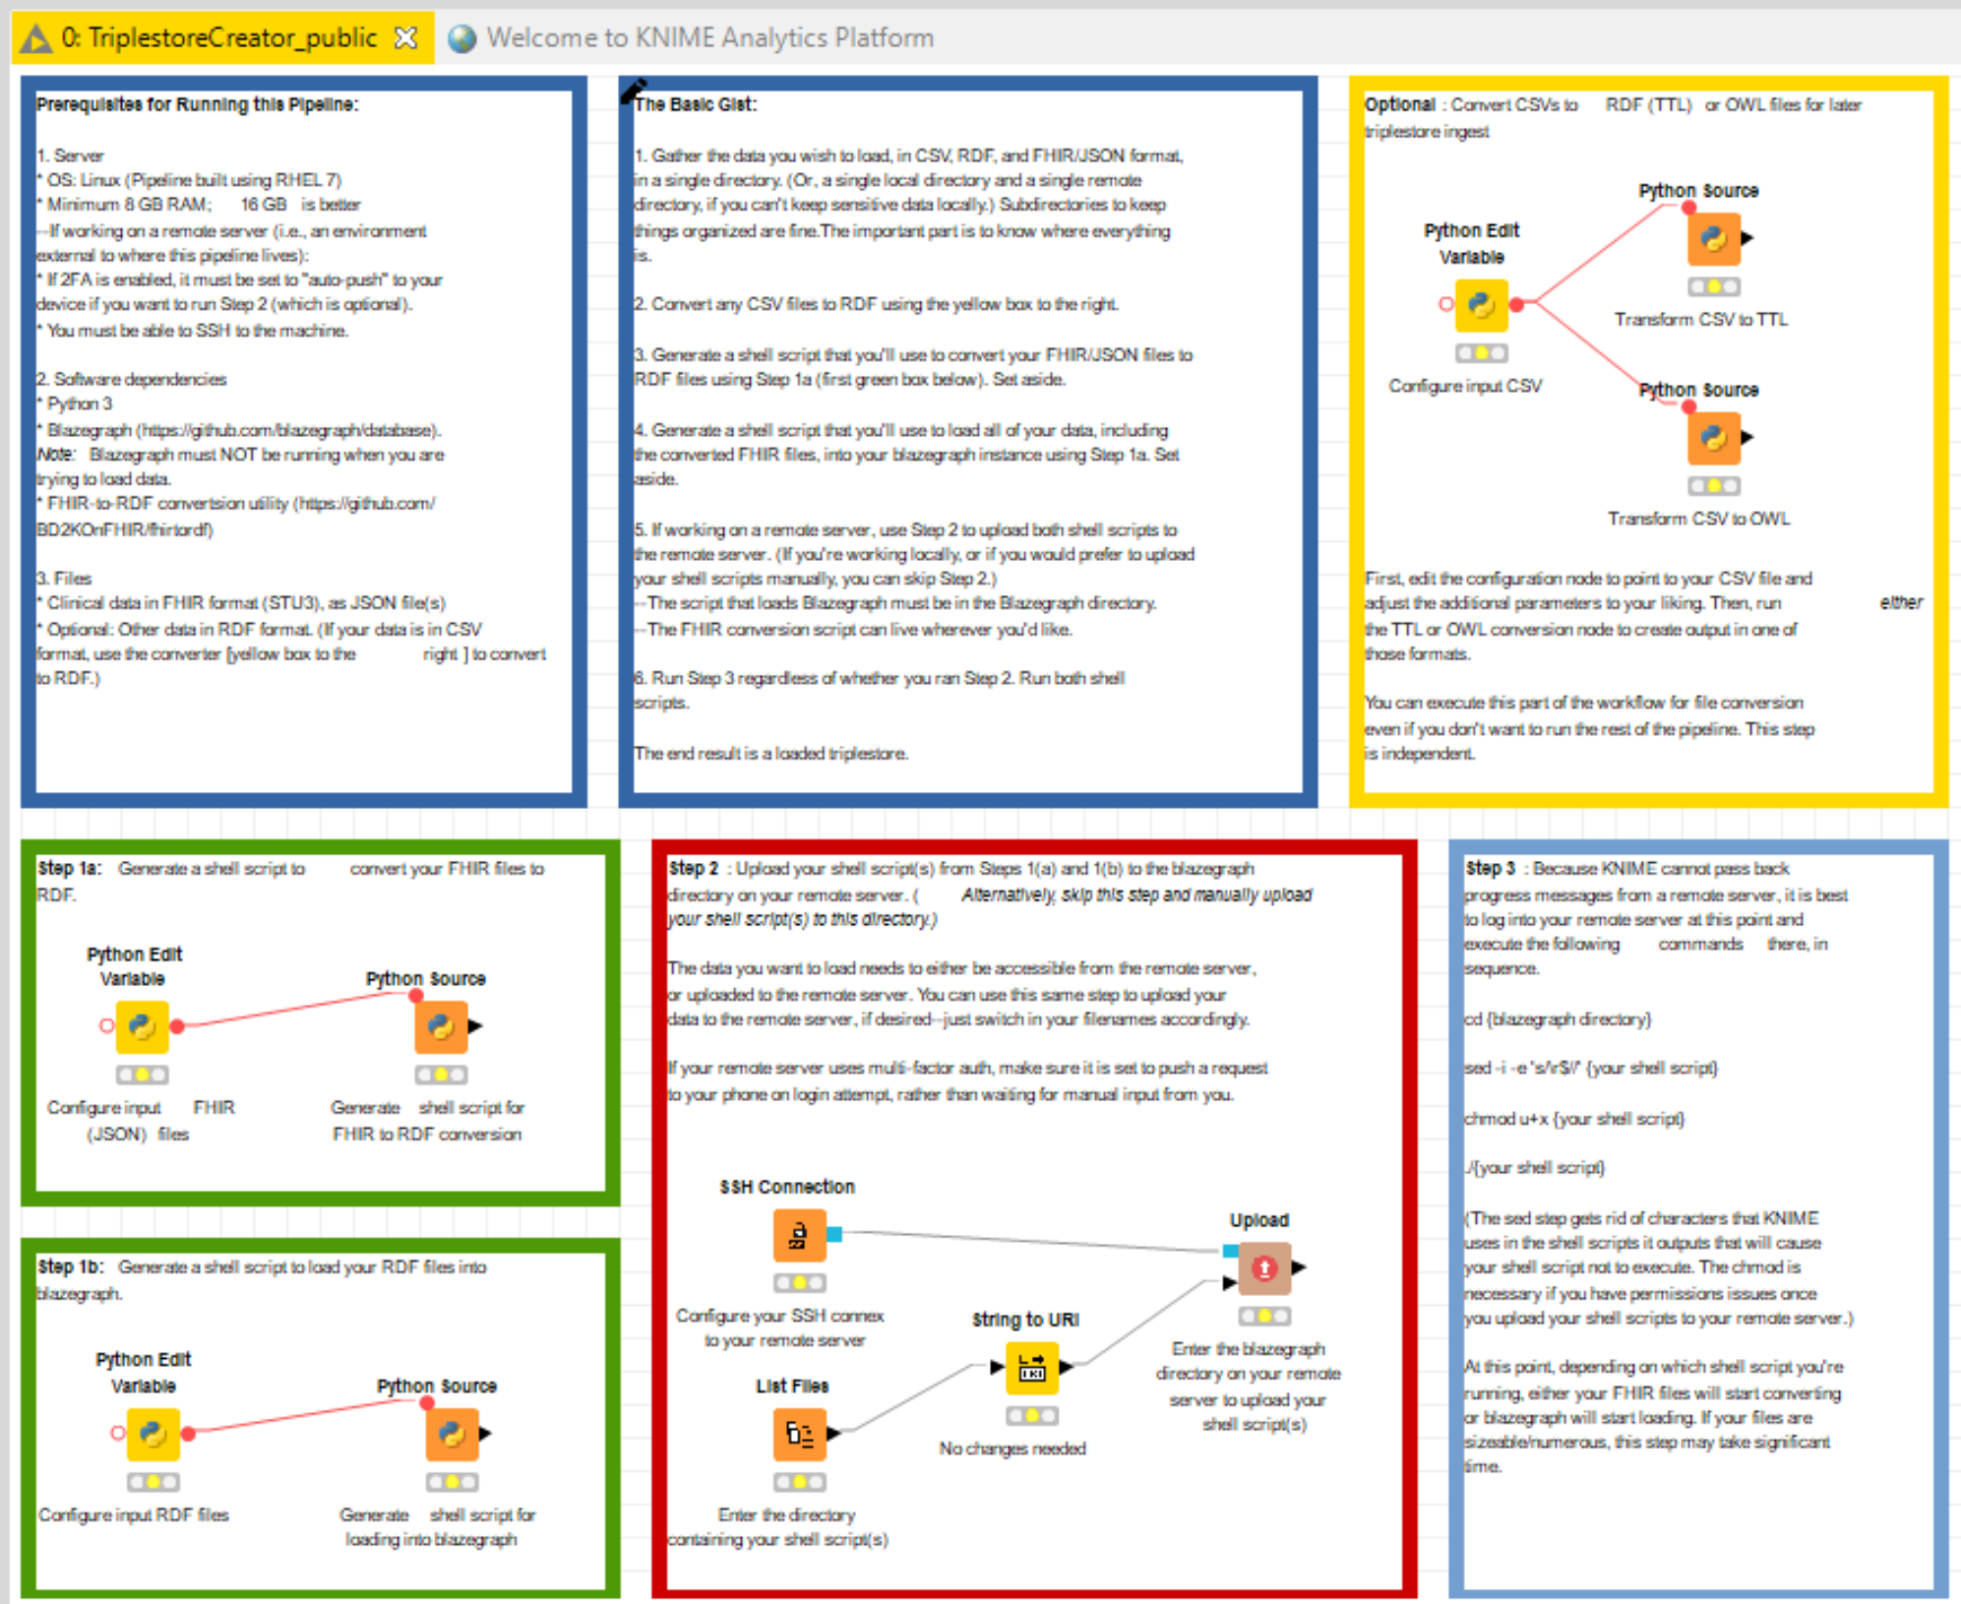
Implementing the Pipeline in KNIME
Documentation
CSV to RDF/OWL converter
FHIR to RDF converter
Triplestore loader
Data mover (optional)
A
A
B
C
E
D
A
Pipeline available for download at https://github.com/empfff/clinical-tripleizer

Slide 14
Experimental Steps (Each Phenotype)
Execute a SPARQL query in the Opioid Triplestore using the ICD-10-CM codeset from the PheKB phenotype to identify matching patients.
Execute a SPARQL query in the Opioid Triplestore using a single ontology concept (SNOMED or HPO*), as well as any child nodes, to identify matching patients.
Compare the ICD-10-CM codes in the subgraphs defined by #1 and #2.
Compare the patients captured in the subgraphs defined by #1 and #2
*Because HPO maps to SNOMED, though the queries differed, the results were the same.

Slide 15
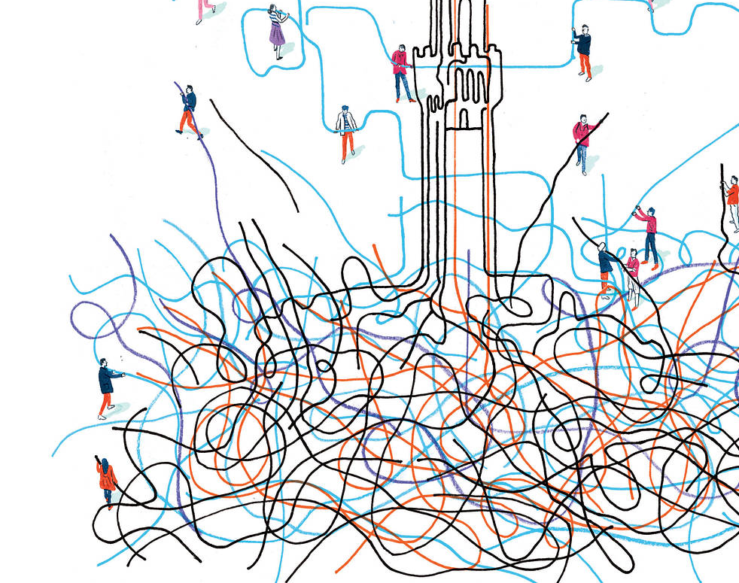
Results

Slide 16
Depression
In general, SNOMED/HPO is picks up more patients than the PheKB phenotype, with a broader definition of "depression."
SNOMED/HPO codeset included all but one of the PheKB codes (F43.21, adjustment disorder), and added more.
SNOMED/HPO includes several bipolar codes; PheKB phenotype specifically excludes them.
SNOMED/HPO graph contains two "problem codes": T81.89X (complications from procedure) and B94.9 (sequelae of unspecified disease).

Slide 17
Depression, continued
Of the "problem codes," B94.9 did not match with any actual patients in the Opioid triplestore. T81.89X? would have matched 47 more patients if the ? had been treated as a wildcard.

Slide 18
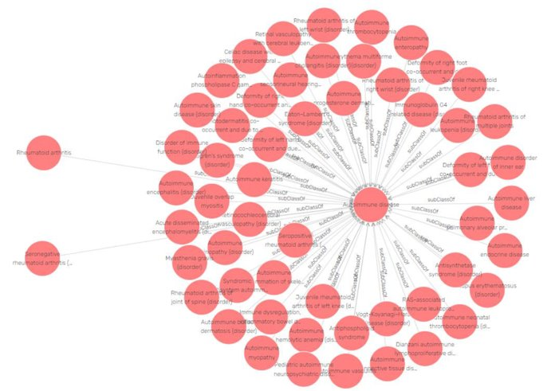
Rheumatoid Arthritis
Very different from depression cohort results; SNOMED/HPO was missing several valid codes in the M05*/M06* ranges. (Missing knees, hips, wrists, and ankles!)
Investigation revealed an issue with a subClassOf relationship in SNOMED, which has since been corrected!

Slide 19
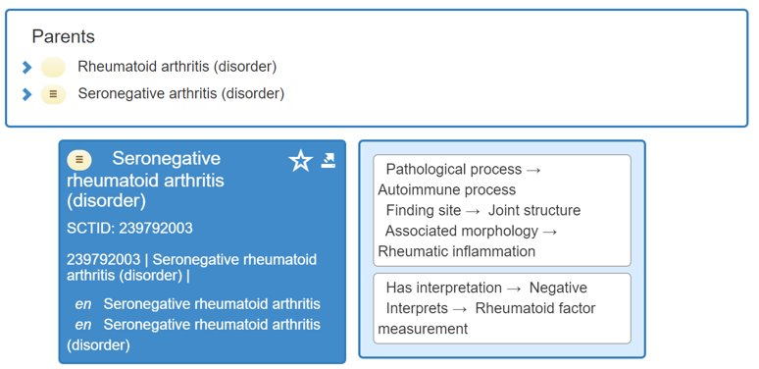
SNOMED Correction (9/20 edition)

Slide 20
Rheumatoid Arthritis, continued
SNOMED/HPO graph also contains two "problem codes": H20.10 (chronic iridocyclitis) and M25.80 (other specified joint disorders). Only the latter matched patients in the triplestore.

Slide 21
Discussion & Conclusion

Slide 22
Ontologies as a Remedy for Semantic Ambiguity
Research Question 1: Can clinical ontologies (specifically SNOMED CT and the Human Phenotype Ontology) offer a less semantically ambiguous mechanism to perform computable phenotyping than reimbursement-focused terminologies (specifically ICD-10-CM)?
ICD-10-CM serves an important purpose. As it is unlikely for its hierarchy to be modified, SNOMED/HPO provide a valuable augmentation, if not an alternative.
The superset of "Google-able" or already known ICD-10-CM codes and those in the SNOMED/HPO subgraph may be a good starting point for researchers trying to choose the right codes for their phenotype.
Using the superset fills in gaps in both SNOMED and ICD-10-CM.
I would argue that allowing researchers to keep or pitch codes from a longer list is preferrable to not providing the choice.

Slide 23
Semantic Web as a Driver of Interoperability
Research Question 2: Does the use of semantic web technologies and standards (e.g., Resource Description Framework (RDF), triplestores, the Web Ontology Language) in tandem with ontologies improve the interoperability prospects of computable phenotypes and the underlying clinical data?
The infrastructure for this project addressed three interoperability challenges:
Challenge: Inconsistent data models
Addressed By: FHIR, RDF
Challenge: Differing coding practices
Addressed By: Ontologies
Challenge: Integration with non-EHR data
Addressed By: RDF

Slide 24
Limitations
ICD-10-CM presents a bit of a catch-22—if it is the only diagnosis code type that will ever be attached to a patient, any phenotype method will eventually need to connect to ICD-10-CM. ("You're only as good as your worst ICD-10-CM code.")
Our two phenotypes performed very differently. If I ran two more, I suspect they would each have their own idiosyncracies. This is a common issue in phenotyping studies.

Slide 25
Acknowledgments
I want to thank my collaborators and co-authors on the Opioid Triplestore project:
Robert Bradford
Marshall Clark
Dr. Jim Balhoff
Dr. John Preisser
Rujin Wang
Kellie Walters
Dr. Matt Nielsen
The project was funded by a TraCS Institute pilot grant.
Thanks also to Dr. Ashok Krishnamurthy, my advisor and mentor.

Slide 26
Thank you!

