Slide 1
New proposal: <popup> element
Microsoft / Google / Salesforce
Open UI, January 2021

Slide 2
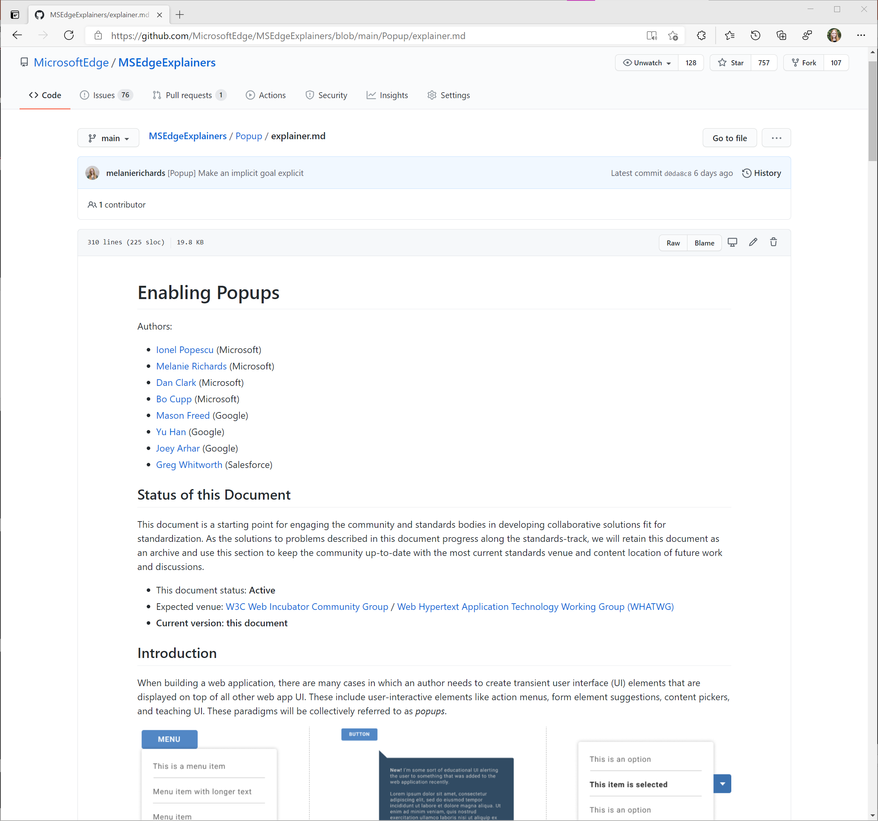
Full details on Microsoft Edge explainers

Slide 3
Transient, top-layer UI
Popover elements which light dismiss, typically only one is open at a time (with exceptions for child/chained popups)

Slide 4
Goals
Authors can efficiently create popups which:
Can contain arbitrary content
Can be fully styled, including properties which require compositing with other layers of the host web application (e.g. the box-shadow or backdrop-filter CSS properties)
Can be sized and positioned to the author’s discretion
Are rendered on top of all other content in the host web application
Include an appropriate user input management experience “out of the box”, with flexibility to modify behaviors such as initial focus
Are accessible by default, with the ability to further extend semantics/behaviors as needed for the author’s specific use case

Slide 5
Non-Goals
Solve all top-layer UI:
Some components may have significantly different expected behaviors or content models and need their own purpose-built element (e.g. custom tooltips)
Other top-layer UI may be more persistent: better fit for <dialog> or a net-new proposal

Slide 6
Proposed solution

Slide 7
A new <popup> element with…
show() and hide() methods; intent to further explore script-less invocation
Optional attributes for focus management (autofocus, delegatefocus)
Optional anchor attribute: used to tie <popup> to an activating element, will also be used in a to-be-published anchored positioning proposal
Light dismiss behaviors

Slide 8
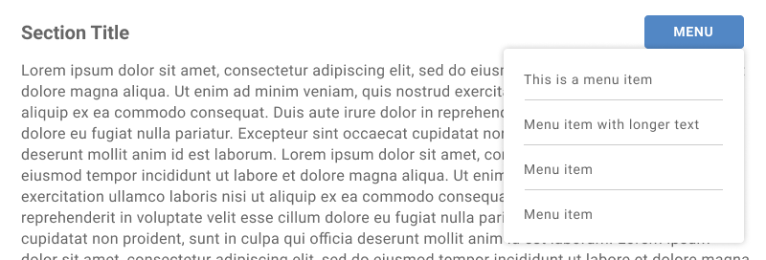
Basic example
<button aria-haspopup="true" aria-controls="menuPopup" id="menuButton">Menu</button>
<popup id="menuPopup" role="menu" anchor="menuButton">
<!-- Markup for menuitems goes here -->
</popup>
<script>
document.getElementById('menuButton').addEventListener('click', () => {
document.getElementById('menuPopup').show()
});
</script>

Slide 9
When a popup is shown…
Any other popups are removed from the browser-managed top-layer stack, unless the popup’s anchor element is a child of a currently-shown popup (basically, it should be possible to nest popups)
The popup renders in the top layer of the UI, unconstrained by ancestral elements. User agent stylesheet contains:
popup {
display: block;
position: fixed;
top: 0;
left: 0;
}
Focus stays on the anchor element but can be moved with an attribute

Slide 10
Send initial focus directly to the popup
<popup autofocus>...</popup>

Slide 11
Send initial focus to a specific child
<popup>
<button autofocus>My cool button</button>
</popup>

Slide 12
Send initial focus to the first focusable element
<popup delegatefocus>
<p>I am not a focusable element.</p>
<p>Nor am I.</p>
<button>I will be focused whenever the popup becomes focused.</button>
</popup>

Slide 13
Dismissing the popup: with hide()
// Author calls hide() according to some app logic
document.getElementById('menuPopup').hide();

Slide 14
Dismissing the popup: user interaction
Web platform can handle light dismiss behaviors for the author. Dismisses upon:
Hitting the escape key
Focus moves outside the popup and its anchor element (if applicable)
Layout changes to the popup or its anchor element

Slide 15
When a popup is hidden…
The popup (and any shown child popups) is removed from the top-layer stack
A non-cancellable hide event is fired on the popup

Slide 16
About this anchor attribute…
<button id="menuButton"…>Menu</button>
<popup anchor="menuButton"…>Content here</popup>

Slide 17
What does the anchor attribute do?
Creates a hierarchal relationship between the popup and anchor, separately from DOM
Enables events to bubble up from the popup to the anchor element (enabling composite widgets like comboboxes)
Enables nested popups
Will be used for a soon-to-be-proposed, CSS-based anchored positioning scheme

Slide 18
Alternate solutions considered

Slide 19
Extending <dialog> with new methods/options
Felt this would yield an overloaded “mash-up” API, where developers would inherit / have to work around behaviors.
Differences:
<popup> is inherently transient / has light dismiss behaviors; <dialog> more persistent, typically dismissed explicitly by the user
Only one <popup> can be shown at a time; <dialog> does not have this requirement
<dialog> can be modal
<dialog> dismisses <popup>; inverse isn’t true

Slide 20
Extending <dialog>
Felt this would yield an overloaded “mash-up” API, where developers would inherit / have to work around behaviors.
Differences:
<popup> is inherently transient / has light dismiss behaviors; <dialog> more persistent, typically dismissed explicitly by the user
Only one <popup> can be shown at a time; <dialog> does not have this requirement
<dialog> can be modal
<dialog> dismisses <popup>; inverse isn’t true

Slide 21
Areas for future exploration

Slide 22
To explore
Declarative invocation of popups (probably via an attribute)
Focus trapping
Animating state transitions with hide()

Slide 23
Next steps / Calls to action

Slide 24
Things happening in parallel
Early prototyping in Chromium to stress-test this idea
Early request for TAG review (Technical Architecture Group)
Cleanup of popup research PR for Open UI
Preparation of anchored positioning proposal
Responding to Github issues

Slide 25
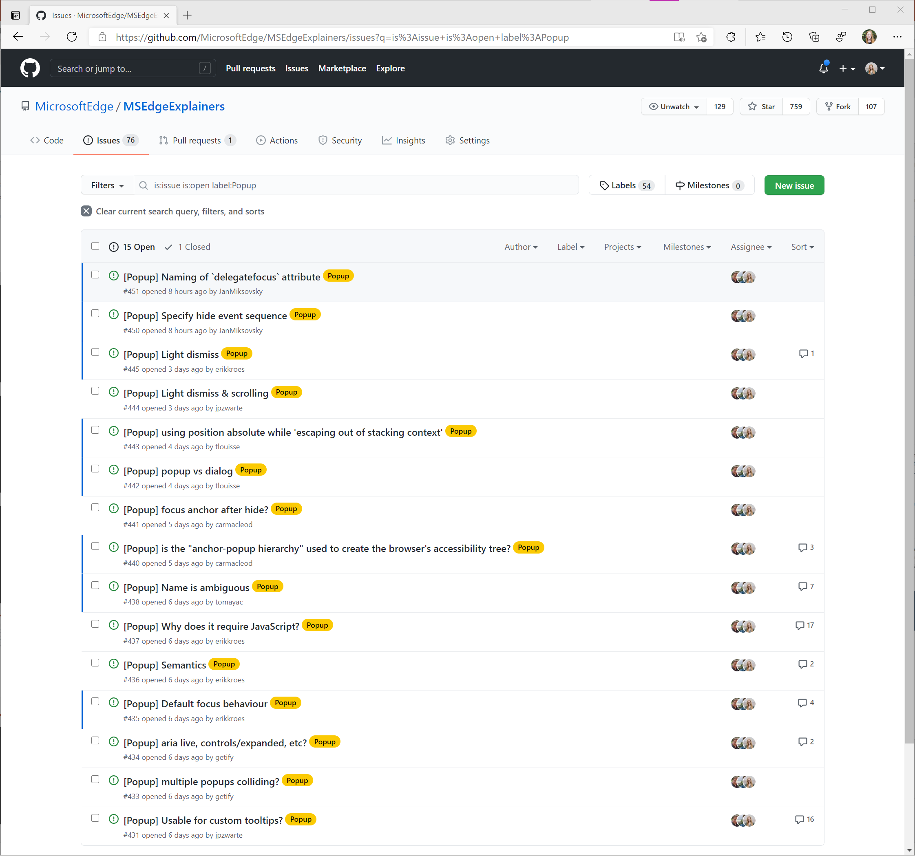
Please raise/participate in issues on Microsoft Edge explainers!

Slide 26
Thank you!
Questions? Comments?

