Slide 1
Online Harms
A European and UK perspective

Slide 2
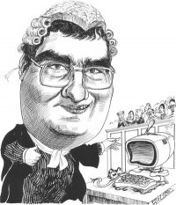
Alistair Kelman
Barrister (retired) and technologist
Patents, copyright, crime, hacking, internet-addiction etc.
www.alikelman.com
Email: ali.kelman@safecast.co.uk
Now working on child protection on TV and the internet via SafeCast
safecast.co.uk
SafeCast.Global
Anglo-Australian non-commercial initiative re child protection

Slide 3
Online Harms
Harmed by content on the internet
Viewing the content causes the harm to the viewer
Harmed by activities on the internet
Child abduction, co-ordination of criminal activities, criminal conspiracies, organised crime, terrorism

Slide 4
W3C and protecting children from inappropriate content
Early 1990s - W3C draws up metadata standard to protect children – PICS
1999 PICS superseded by the Protocol for Web Description Resources (POWDER)
Far too complicated - tried to integrate search engine capabilities
Commercial cost - implementations around $40 per device per child
Serious censorship issues - with no consensus on usage
Database design issues - separated content from its labels though pointers
Quality marks incorporated - in competition with professional content reviewers
Thus becomes the tool of ‘astroturfers’ and SEOs
PICS and POWDER abandoned around 2008

Slide 5
UK and EU Online Harms legislation
The AVMS-D Regulations - in force from 1 Nov 2020
The Age Appropriate Design Code from 1 Apr 2021
The Online Harms Bill – on its way … late 2021
The EC Digital Services Act – at an early stage of consideration – 2024?

Slide 6
Introduction
Children and vulnerable people need protection from being harmed by content on the internet
Without censorship
W3C can help make this happen
Within months not years
Using open standards
What groups and forums do the W3C have to support
the EU revised AVMS-D ?
family friendly filters for parents?

Slide 7
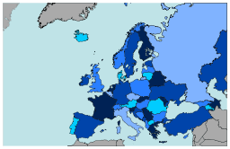
How we got here
Legislation runs behind technological change
EU- AVMS-D 2010
Broadcast TV highly regulated
Content which ‘might harm a child’ banned
On-demand video lightly regulated
Content which ‘might harm a child’ permitted

Slide 8
The Revised AVMS-D
Revised EU- AVMS-D 2018
Same standard for Broadcast TV and On-Demand video
Content which ‘might harm a child’ banned on both
Pan EU-directive
Mandated to be in force in EU27 and the UK by 19 Sept 2020 at latest
Then …

Slide 9
The UK and Online Harms
Audio Visual Media Services Regulations 2020
Content which ‘might harm a child’ banned on both Broadcast TV and On-Demand video
AVMS Regs. in force from 1 Nov 2020
But not to be implemented prior to 1 April 2021
Ofcom’s VSP consultation on Online Harms closed on 24 Sept 2020
Ofcom’s Report awaited

Slide 10
Video Sharing Platforms and the UK Regulations
Audio Visual Media Services Regulations 2020
VSPs must enforce their membership requirements (click-wrap) to protect children
No harmful or misleading advertising
No harmful content
Age verify their users
Register with Ofcom, pay fee and accept UK jurisdiction over content to UK citizens

Slide 11
How VSPs remove harmful content and advertising
Audio Visual Media Services Regulations 2020
AI and databases filter away anything which breaches the Regulations
Query - How do they do this?
Google SafeSearch
Symantec RuleSpace
Answer - Proprietary AI and database systems
UK Ofcom’s core principles include
Freedom of expression
Transparency
Detailed questions in Ofcom’s VSP consultation – closed 24 Sept 2020

Slide 12
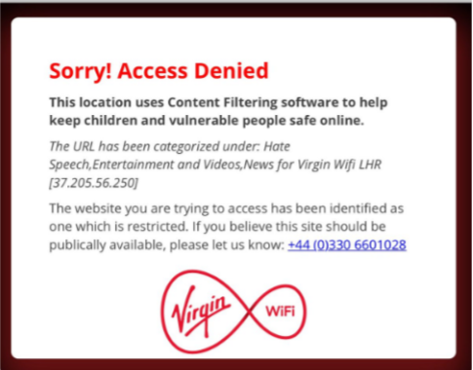
Family Friendly Filters
90% of UK families get their broadband from 4 ISPs
All four ISPs have family friendly filters on by default
100% of mobile networks have family friendly filters
Big retailers where children are present (McDonalds, Starbucks etc) have family friendly filters
Internet Watch Foundation (IWF) provides a DNS list to block child sex abuse material to these filters
New IETF protocol undermines the operation of these DNS filters – no solution yet offered by EDDI members

Slide 13
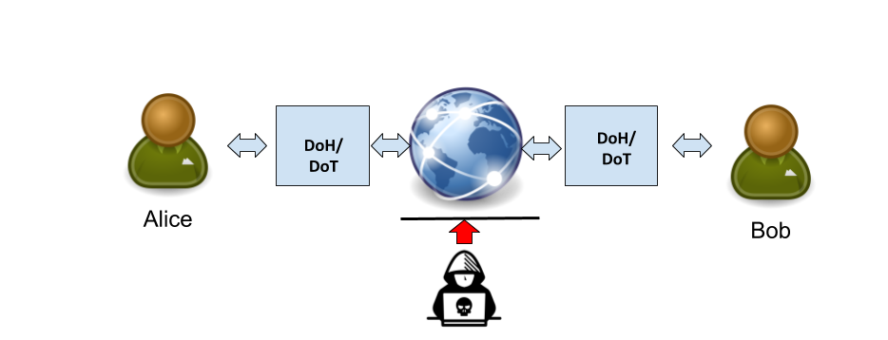
IETF - DoH and DoT
The new IETF standards protect against ‘man in the middle’ attacks by encrypting end to end
But there are unintended consequences …
Family friendly filters fail

Slide 14
Laws and Practices
Laws
Laws are made by Parliament
Bill
Second Reading
Committee Stages
Passing the Commons
Passing the Lords
Arrive on Statute Book
Come into effect
Lengthy, expensive, difficult processes, many loose ends and can also be lost
Laws can have unintended consequences
Waiting lists for medical appointments
Gaming the system
Difficult to interpret correctly
Judicial review
Practices
Are made by merchants and the business community
Experimental means of bringing about a desired effect
An established business practice can become a law via judicial interpretation and caselaw
Example of a Practice
Placing adult magazines on the top shelf in a newsagent as a means of stopping young children from perusing them
Not a law but a ‘best practice’
Practices can be become universal by the Network effect
Qwerty keyboard
GSM phones

Slide 15
A way that the W3C could help
Inspired by Prof Larry Lessig’s work
CopyLeft
Creative Commons
“Code is Law”
SafeCast’s proposals
Use of global technical standards as a proxy for new legislation to regulate the internet

Slide 16
SafeCast and child protection
2012 - SafeCast starts investigating content labelling to protect children
Built on work done in the 1960s and 1970s by IBA in the UK
Develops a “notification” standard which was equivalent to the TV Watersheds
Places its proposals before the European Commission and Ofcom for a self-applied content labelling system – initially as best practice

Slide 17
Safecast HeadCode | Child’s Age | Equivalent TV Watershed time | Comments
0 | No restrictions | No restrictions | Can be shown at anytime
1 | Age 6 and over | No restrictions but logged on device | Very young children should not see too much of this content - hence logging required in phones and tablets
2 | Age 7 and over | 7.30pm | Young children should not see too much of this content - hence logging required in phones and tablets. Also the restriction applies to advertising of high fat, high sugar products and services
3 | Age 11 and over | 9.00pm | Normal TV Watershed restrictions including on advertising of medicines, alcohol, gambling etc
4 | Age 14 and over | 10.00pm | Enhanced TV Watershed restriction used by UK schedulers
5 | Age 18 and over | 11.00pm | Highly enhanced TV Watershed restriction used by UK schedulers
6 | Age 18 and over | N/A | Not permitted to be broadcast or circulated without restrictions

Slide 18
Safecast HeadCode | Child’s Age | Key Stage mapping | Comments
0 | No restrictions | No restrictions | Can be shown at anytime
1 | Age 6 and over | Key Stages 1, 2, 3 and 4 can view this without restrictions | Very young children should not see too much of this content - hence logging required in phones and tablets
2 | Age 7 and over | Key Stages 2, 3 and 4 can view this without restrictions | Young children should not see too much of this content - hence logging required in phones and tablets. Also the restriction applies to advertising of high fat, high sugar products and services
3 | Age 11 and over | Key Stages 3 and 4 can view this without restrictions | Normal TV Watershed restrictions including on advertising of medicines, alcohol, gambling etc
4 | Age 14 and over | Key Stages 4 can view this without restrictions | Enhanced TV Watershed restriction used by UK schedulers
5 | Age 18 and over | Adults only | Highly enhanced TV Watershed restriction used by UK schedulers
6 | Age 18 and over | N/A | Not permitted to be broadcast or circulated without restrictions

Slide 19
SafeCast and child protection
2012 - SafeCast starts investigating content labelling to protect children
Built on work done in the 1960s and 1970s by IBA in the UK
Develops a “notification” standard which was equivalent to the TV Watersheds
Places its proposals before the European Commission and Ofcom for a self-applied content labelling system – initially as best practice
2013 SafeCast granted a UK patent for its metadata invention
The claims in the patent apply only to the automatic filtering of labelled advertisements in catchup or time-shifted viewing
This allows SafeCast to facilitate the automatic filtering of labelled content completely free of charge using the same software or app in the device

Slide 20
SafeCast’s Spectrum
Level 0
1
2
3
4
5
6
7.30pm
9.00pm
High sugar products
Medicines
Alcohol
Restricted goods and services

Slide 21
SafeCast and child protection
2012 - SafeCast starts investigating content labelling to protect children
Built on work done in the 1960s and 1970s by IBA in the UK
Develops a “notification” standard which was equivalent to the TV Watersheds
Places its proposals before the European Commission and Ofcom for a self-applied content labelling system – initially as best practice
2013 SafeCast granted a UK patent for its metadata invention
The claims in the patent apply only to the automatic filtering of labelled advertisements in catchup or time-shifted viewing
This allows SafeCast to facilitate the automatic filtering of labelled content completely free of charge using the same software or app in the device
2016 SafeCast granted a US patent for its metadata invention
2016 SafeCast gives a FRAND undertaking to the UK Government to allow its patents to effectively be Standard Essential Patents (SEPs)
2018 The UK IPO notifies SafeCast that it is prepared to mediate on royalty rates for the SafeCast patents if they cannot be agreed

Slide 22
SafeCast and the
SafeCast was asked to approach Facebook, YouTube etc to include the Safecast Headcodes in the uploading processes of their systems etc
In YouTube’s API the BBFC is coded as:
contentDetails.contentRating.bbfcRating
string
The video's British Board of Film Classification (BBFC) rating.
Valid values for this property are:
bbfc12 – 12
bbfc12a – 12A
bbfc15 – 15
bbfc18 – 18
bbfcPg – PG
bbfcR18 – R18
bbfcU – U
bbfcUnrated

Slide 23
SafeCast and the
SafeCast was asked to approach Facebook, YouTube etc to include the Safecast Headcodes in the uploading processes of their systems etc
In YouTube’s API the BBFC is coded as:
contentDetails.contentRating.bbfcRating
string
The video's British Board of Film Classification (BBFC) rating.
Valid values for this property are:
bbfc12 – 12
bbfc12a – 12A
bbfc15 – 15
bbfc18 – 18
bbfcPg – PG
bbfcR18 – R18
bbfcU – U
bbfcUnrated
The SafeCast HeadCodes (SCHC) can be given a similar syntax in YouTube uploading
contentDetails.contentRating.SCHCRating | string The SafeCast HeadCode rating. Valid values for this property are: SCHC0 – 0 SCHC1 – 1 SCHC2 – 2 SCHC3 – 3 SCHC4 – 4 SCHC5 – 5 SCHC6 - 6 (not for broadcast) SCHCUnrated

Slide 24
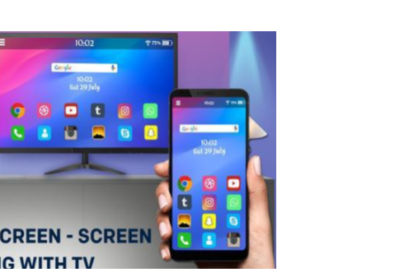
The Digital Object Identifer system TSP 2121 and ISO 26324
TSP 2121-1:2018 IMF Application DPP (ProRes)
Standards enable seamless mirroring etc between devices
Embedded metadata

Slide 25
Age Appropriate Design Code
in force from April 2021
ICO Age Appropriate Design Code (the Code)
section 123 of Data Protection Act 2018
Final Code said all advertising must comply with the CAP Code
Ownership, Provenance and Product Placement info required
UK regulated broadcasters in compliance
Facebook, YouTube, Twitter etc not in compliance
(WSJ feature article and New York Times report)
SafeCast’s Proposals:
To adhere to the CAP Code all advertising must contain metadata on Ownership, Provenance and Product Placement so that it can be filtered away for child protection purposes using the provisions of Section 104 of Digital Economy Act 2017
To enable lightweight content filtering without censorship all content (including advertising) should contain SafeCast HeadCodes to enable open standards based lightweight filtering for child protection purposes

Slide 26
Reinstating family friendly filters post DoH and DoT
Metadata label within an open standard enables lightweight filtering for child protection
Protects the family friendly internet in the UK and EU
Can be implemented nationally in accordance with digital sovereignty requirements of nation states
Saves EDDI members from becoming global censors

Slide 27
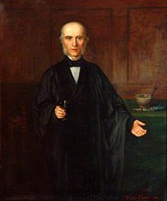
Digital Sovereignty
Allows nation states to harmonise technical issues in a consensual manner through the use of interoperable standards as a proxy for legislation with local variations
Removes friction from trade
Increases the volume of trade
Improves safety

