Slide 1
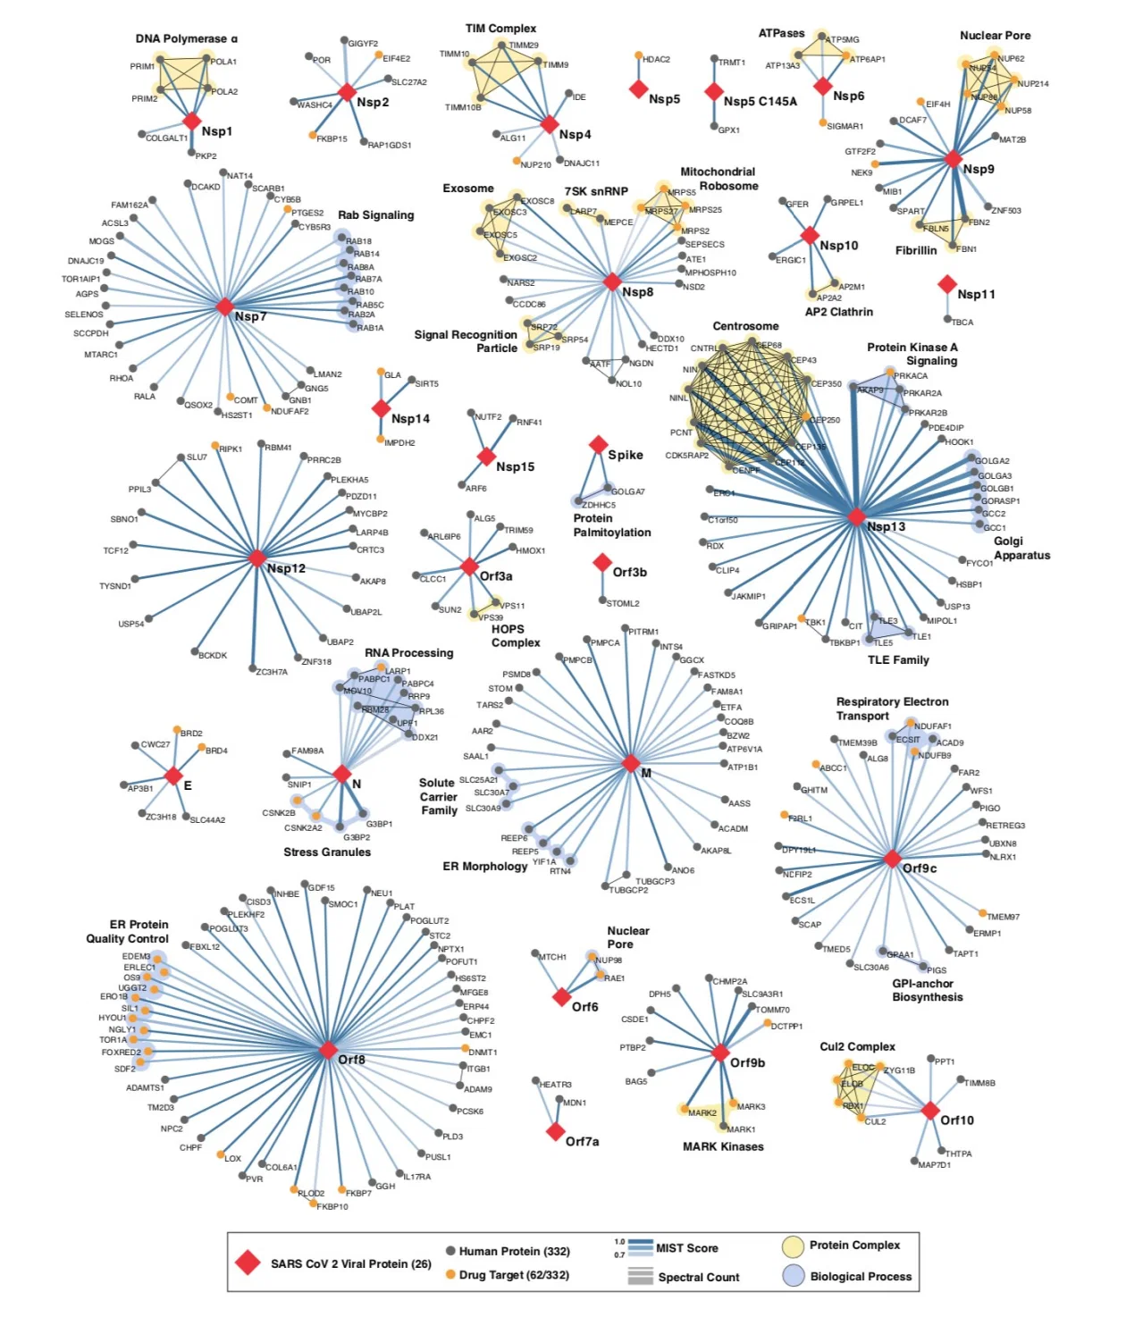
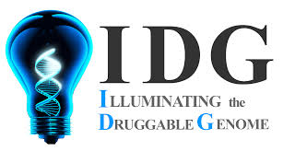
KG-COVID-19: a knowledge graph for COVID-19 response
https://github.com/Knowledge-Graph-Hub/kg-covid-19
Who we are:
Team from Lawrence Berkeley National Laboratory, Monarch Initiative, and IDG
Problem:
Lightweight construction and maintenance of knowledge graphs for COVID-19 drug repurposing efforts
Interests:
Annotation of molecular entities
New knowledge derived from literature
Graph learning
Gordon et al.
https://www.biorxiv.org/content/10.1101/2020.03.22.002386v1
Notes:
- purpose of this meeting/goals
- introduce each other
- explore using google cloud for this KG project
- other ideas for collaborations on COVID-19

Slide 2
Approach
Lightweight, structured ingest pipeline for standardized data
KGX tool for deduplication and merging
Automated builds
RDF/TTL download
http://kg-hub.berkeleybop.io/kg-covid-19.nt.gz
SPARQL endpoint if demand
Public
COVID-19
data
COVID-19
knowledge
graph
KG-COVID-19
KGX
COVIDscholar.org:
NLP effort at LBL
outgrowth of MATscholar.org
better approach to corpus
embedding applications
Knowledge graph
construction
Experimental data summaries and metadata mapping
Knowledge graph
construction
COVID-19
scientific literature
COVIDScholar
Named entities
Mapped entities
Named entity
recognition
Map terms to
ontologies
https://github.com/NCATS-Tangerine/kgx
Notes:
- walk through stack
- The step between ‘COVID-19 knowledge graph’ and ‘Embeddings’ will require a lot of compute to optimize hyperparameters for each experiment
- One “run” - order of 1 week CPU time for kg-covid-19
- To optimize hyperparameters using Guassian process: 1000s of runs
- Optimize for different experiments (drugs to all diseases, drugs to viral infections, drugs to ARDS)
- Tens of optimization runs? 1 for each experiment

Slide 3
KG-COVID-19 Knowledge Graph (May 2020)
Drugs
Genes (human + coronavirus)
Proteins (human + coronavirus)
Drug central
human
genes
STRING PPI
(human proteins)
human
proteins
PharmGKB
coronavirus
genes
IntAct PPI
(coronavirus
specific)
coronavirus
proteins
TTD
Ontologies
(ChEMBL)
drug
HPO
Publications
SARS-CoV-2
GO annotations
protein
SciBite
CORD19
publications
and
concepts
gene
MONDO
publication
phenotype
disease
GO
Links:
Wiki
Code
Graph
GO term

Slide 4
Graph learning
COVID-19
data (IGI and public)
IGI COVID-19
knowledge
graph
https://github.com/monarch-initiative/embiggen
COVID-19 predictions
KG-COVID-19
Embeddings
N2V
gaussian
process
KGX
N2V
knowledge
graph
construction
generate
embeddings
tune
hyperparameters
apply
classifiers
Experimental data summaries and metadata mapping
knowledge
graph
construction
concatenate
embeddings
COVID-19
scientific literature
CovidScholar
Ontology
lookup
Ontology-aware embeddings
Named entities
Mapped entities
CovidScholar
Linked
named entity
recognition
map terms to
ontologies

Slide 5
Acknowledgements
Justin Reese, LBNL
Deepak Uni, LBNL
Tiffany Callahan, UC Boulder
Luca Cappelletti, University of Milan
Monica Munoz-Torres, LBNL
Vida Ravanmehr, JAX
Peter Robinson, JAX
Chris Mungall, LBNL

