Slide 1
Accelerating DNNs for the Web with Edge Computing

Slide 2
Outline
  Overview of executing DNNs on the Web
  Accelerating DNNs for the Web with edge computing
  Thinking and Discussion

Slide 3
Overview of executing DNNs on the Web
Deep neural networks (DNNs) show great promise in providing more intelligence to the web applications.
Two typical DNNs execution schemes on the Web
Executing the whole DNNs on the remote Cloud
Large amounts of data (e.g., image, audio and video) are sent to the cloud
Increasing the computing pressure
Executing the whole DNNs on the Web
Caffe.js
ONNX.js
Keras.js
Raising new privacy concerns for users (e.g., home security cameras)
Tensorflow.js
WebDNN
  Limited computing resource
  Heavy DNN models (e.g., Tensorﬂow.js’s ResNet50 deep learning model, whose size can be up to 97.8 MB,)

Slide 4
Accelerating DNNs for the Web with edge computing
Partition-ofﬂoading dynamically distributes the computations between the Web and the edge server.
  Partitioning and performing the computation that can be done within the Web.
  Protecting data privacy and reducing the computing pressure of the edge server.
Benefits of the edge computing
High network bandwidth
Low transmission latency
Providing dynamic DNN partition to cope with various tasks, network conditions and the computing capacity of the Web

Slide 5
Accelerating DNNs for the Web
Adding an efﬁcient branch to the traditional DNNs for executing inference on the Web independently
  providing a collaborative mechanism with the edge server for accuracy compensation.
  Reducing model size and accelerating inference on the Web.
3) Otherwise, it asks the edge server for collaboration by posting outputs of the shared layer.
Measuring the conﬁdence of inference results using the normalized entropy.
Exiting from the lightweight branch if there is conﬁdence in the inference result.

Slide 6
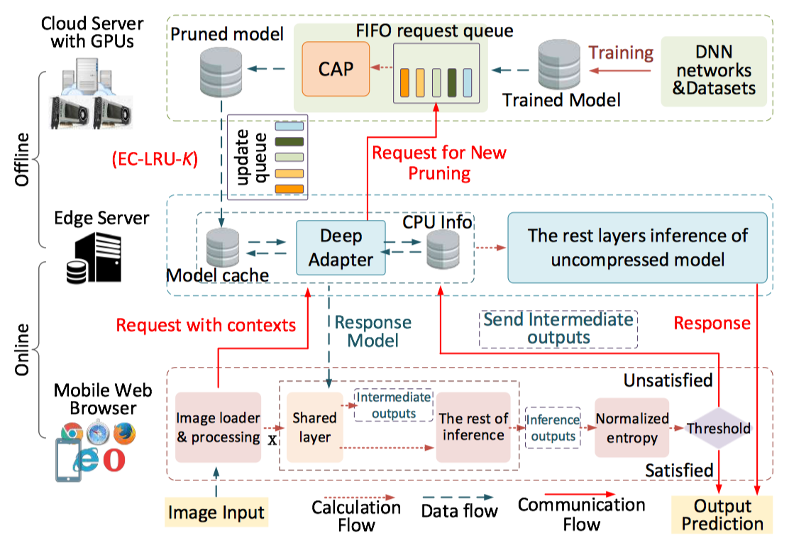
Accelerating DNNs for the Web
Providing a context-aware pruning algorithm that incorporates the latency, the network condition and the computing capability of the mobile device.

Slide 7
Thinking and Discussion
What role should the edge server play in providing processing support for intelligent web applications requiring heavy computation?
How to web developers use the edge server more easily for accelerating DNNs and collaborating with Web apps?
How can the edge server deploy and offload DNN computations more easily?
  How Web apps can monitor changes in network conditions, and response to the edge server?
  How the edge server can perceive the computing capability of the device, and distribute appropriate computations to Web apps for execution in real time?

