Slide 1
Multitasking
Guido Grassel, Huawei
Guido.Grassel@huawei.com
Related to proposal #15 - Multitasking
https://github.com/immersive-web/proposals/issues/15

Slide 2
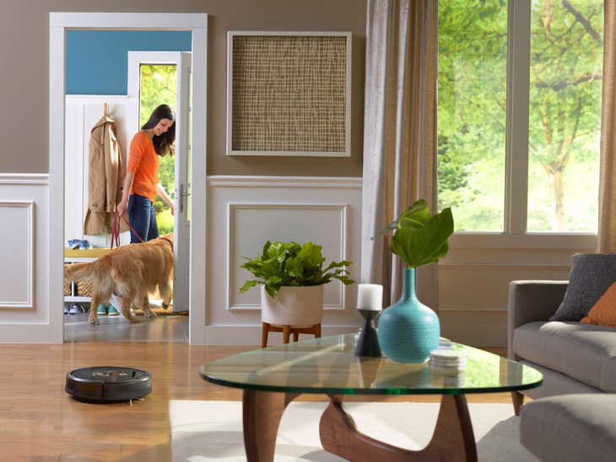
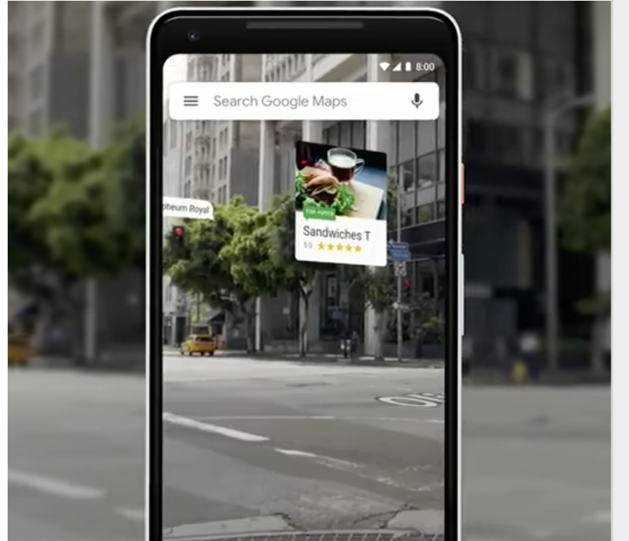
AR Scene + 3D object(s) with custom behavior from separate origin
Virtual Vacuum robot controls
Virtual info, advertising in a public space

Slide 3
What we already have
In JS main thread
Web XR Scene functionality in JS, especially onXRFrame callback
N * 3D model behavior
Developer may span workers to move some of their object behavior there.
Potential issues:
Overloading of the JS main thread leads to frame drop.
Cross site issues whenever the XR scene developer did not anticiate the domains fron where object behavior needs to be loaded.
Request an XR device
Request an XR session
Run rAF loop
Run rAF loop
Run rAF loop
Compose XR Layers
End XR Session

Slide 4
Solution ideas
Deliver XRFrameRequestCallback to more JS context(s), not just the JS main thread.
Layers -> DOM or 3D content composed into scene.
Run rAF loop
Request an XR device
Request an XR session
Run rAF loop
Compose
End XR Session
Run rAF loop

