Slide 1




VSSo: a car signal ontology
April 18, 2018 | Extension of the Vehicle Signal Specification
Benjamin Klotz
PhD student, BMW Group, EURECOM

Slide 2
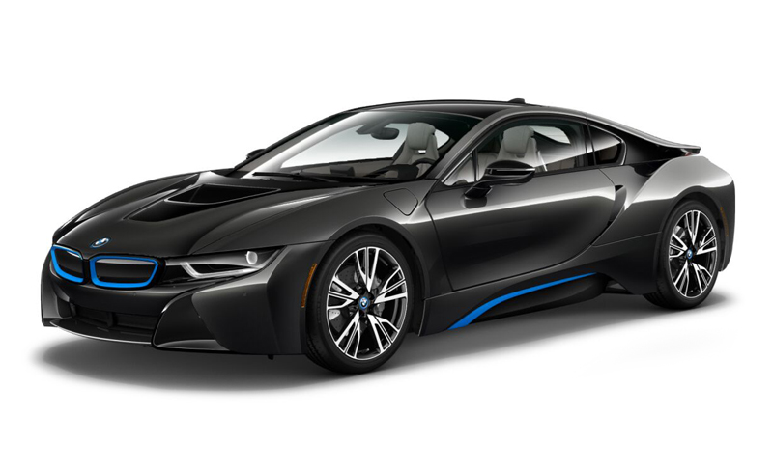
Initial context
Adapt infotainment from online use favorite playlists and volume.
Drive your car in front of the building you are leaving
…
{"name":"accelerator_pedal_position","value":0,"timestamp":1361454211.483000}
{"name":"fuel_level","value":23.478279,"timestamp":1361454211.485000}
{"name":"torque_at_transmission","value":1,"timestamp":1361454211.488000}
Temperature sensor
Adaptive cruise control
Front camera
Radar
Blind spot detection
Wheel speed sensor
Oil temperature sensor
Steering angle sensor
Park assistant
Tire pressure sensor
Vehicle height sensor

Slide 3
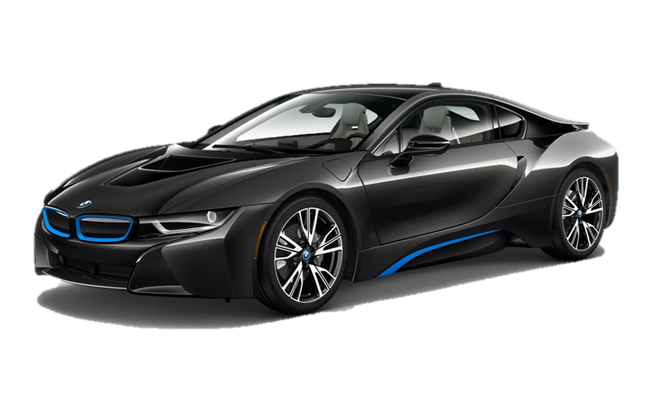
Driving context
Driving Contexts
Web services
Goals:
Personalization
Awareness
Data fusion
Smart home
Smart city
…
Signal data model

Slide 4
Enabling interoperability through the signal data model?

Slide 5
VSS in a nutshell
Signal/Attribute
Body
Raindetection
Intensity
ADAS
Type: UInt8
Unit: percent
Description: “…”
Value: restriction or free
Cabin
Chassis
Drivetrain
OBD
Vehicle
Weight
Attribute
Figure:
451 branches
1103 leaves:
  43 attributes
  1060 signals: including
    (700 seat-related),
    268 with unit
Signal
Signal entries
Examples:
Gearbox-sensed speed: .Drivetrain.Transmission.Speed
Engine speed: .Drivetrain.Engine.Speed
GPS-sensed speed: .Cabin.Infotainment.Speed
Left door lock: .Body.Row1.Door.Left.IsLocked
Right mirror tilt: .Cabin.Mirror.Right.Tilt

Slide 6
Ontologies for (car) signals [1]
A W3C and OGC recommendation (19 October 2017)
The Semantic Sensor Network (SSN) ontology
is an ontology for describing
sensors
and their observations,
the involved procedures,
the studied features of interest,
the samples used to do so,
and the observed properties,
as well as actuators, actuations...
SSN follows a horizontal and vertical modularization architecture by including a lightweight but self-contained core ontology called SOSA (Sensor, Observation, Sample, and Actuator) for its elementary classes and properties.
Supports a wide range of applications and use cases, including satellite imagery, large-scale scientific monitoring, industrial and household infrastructures, social sensing, citizen science, observation-driven ontology engineering, and the Web of Things.
[1] https://www.w3.org/TR/vocab-ssn/

Slide 7
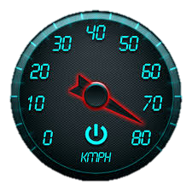
SOSA/SSN observation & sensor pattern
"2018-04-18T13:36:12Z"^^xsd:dateTime
48.1374300°
11.5754900°
sosa:phenomenonTime
sosa:Sensor
geo:lat
rdf:type
sosa:madeBySensor
geo:lon
sosa:Observation
sosa:isObservedBy
rdf:type
sosa:ObservableProperty
sosa:observedProperty
sosa:hasSimpleResult
:Speed
sosa:hasResult
sosa:Result
rdf:type
22,2km/h^^cdt:speed
Definition of a signal
Definition of a sensor
Well-defined units
Geolocation
qudt:unit
qudt:numericValue
BUT
qudt:KilometerPerHour
22,2^^xsd:double
No formal definition of:
“speed” or other observable properties
“speedometer” or other car sensors/actuators
“Car” or vehicle parts

Slide 8
SSN/SOSA with a VSS ontology
rdfs:subClassOf
sosa:Sensor
sosa:madeBySensor
vss:Speedometer
sosa:Observation
rdf:type
sosa:isObservedBy
sosa:ObservableProperty
sosa:hasSimple
Result
sosa:observedProperty
sosa:hasResult
rdfs:subClassOf
22,2km/h^^cdt:UCUM
vss:ObservableSignal
sosa:Result
rdf:type
rdfs:subClassOf
qudt:unit
qudt:numericValue
vss:Drivetrain
qudt:Unit
vss:Speed
22,2^^xsd:double
vss:hasSignal
vss:partOf
vss:partOf
:Speed
rdf:type
vss:Transmission
rdfs:subClassOf
vss:InternalCombustion
rdfs:subClassOf
vss:Branch
rdfs:subClassOf
vss:maxTorque
4Nm^^cdt:torque

Slide 9
What is required ?

Slide 10
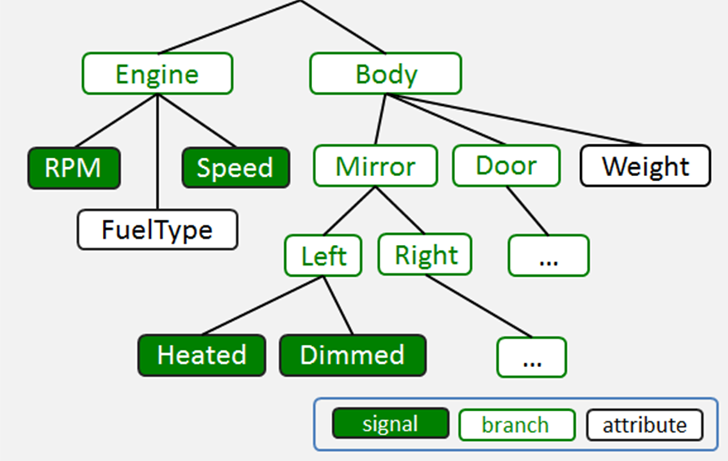
From VSS spec to the VSS ontology
Add sensors and actuators
Map to existing Ontologies
- SSN/SOSA
- QUDT (unit)
Apply consistency policies
Generate definition of VSS concepts
Manually validate and clean the generated ontology
VSSontology
VSS
Modeling policies
VSS concepts have unique names
All signals are either observable, actuable or both
All signals have either a sensor or an actuator
All branches are part of the top “vss:Vehicle” branch
All position-dependent branches have a property “position”

Slide 11
Modeling choice 1: unique names for unique concepts
Some signals represent the same phenomenon, sensed by different sensors
  Ex: Drivetrain.Speed (sensed by the gearbox) and Infotainment.Speed (sensed by the GPS)
vss:ObservableSignal
vss:Transmission
rdfs:subClassOf
rdfs:subClassOf
vss:Speedometer
vss:Branch
sosa:isObservedBy
vss:hasSignal
rdfs:subClassOf
vss:VehicleSpeed
sosa:Sensor
rdfs:subClassOf
vss:hasSignal
rdfs:subClassOf
sosa:isObservedBy
vss:Infotainment
vss:GPS
“vss:VehicleSpeed” is a unique phenomenon
observed by different sensors
  Producing different signals
Names are clarified to avoid homonymy

Slide 12
Modeling choice 2: signals are observable, actuable or both
Some signals are attached to sensors, other to actuators, or both. For instance
  Drivetrain.Transmission.Speed observes a speedometer
  Mirror.Right.Heating only acts on a heater
  Infotainment.Media.Volume observes/acts on the media volume
sosa:Sensor
sosa:madeBySensor
sosa:Observation
sosa:isObservedBy
sosa:ObservableProperty
sosa:observedProperty
vss:ObservableSignal
rdfs:subClassOf
vss:VehicleSpeed
rdfs:subClassOf
vss:MediaVolume
sosa:Actuator
sosa:madeByActuator
sosa:Actuation
rdfs:subClassOf
sosa:isActedBy
vss:Heating
vss:ActuableSignal
sosa:ActuableProperty
sosa:actsOnProperty
rdfs:subClassOf
Page 12

Slide 13
Modeling choice 3: all signals have a sensor or actuator
vss:Branch
vss:ObservableSignal
vss:hasSignal
rdfs:subClassOf
rdfs:subClassOf
vss:VehicleSpeed
vss:Transmission
vss:partOf
vss:Vehicle
Sensors/Actuators
Branches and parts
Signals
sosa:Sensor
rdfs:subClassOf
Produced by [sensor]
Consumed by [actuator]
Contains
(vss:partOf)
vss:Speedometer

Slide 14
Modeling choice 4: all branches are vss:partOf vss:Vehicle
Signal
Body
ADAS
Cabin
Chassis
Drivetrain
OBD
Vehicle
vss:Vehicle
vss:partOf
vss:Branch
vss:ADAS
vss:Body
rdfs:subClassOf
vss:OBD
vss:Cabin
vss:Drivetrain
vss:Chassis
Current VSS structure
VSSontology structure

Slide 15
Modeling choice 5: position ≠ branch
Ex: Door.Left.IsLocked, Mirror.Right.Tilt
Branches vss:Door and vss:Mirror have vss:hasPosition property with limited potential values (“Left”,”Right”,”Row1”, …)
vss:Signal
vss:Branch
rdfs:subClassOf
rdfs:subClassOf
Branch
rdfs:subClassOf
vss:DoorIsLocked
vss:hasSignal
rdfs:subClassOf
vss:Door
rdf:type
vss:MirrorTilt
vss:hasSignal
vss:Mirror
:LeftDoorLock
rdf:type
rdf:type
rdf:type
:RightMirrorTilt
:Door2
:Mirror3
vss:hasPosition
vss:hasPosition
Position
“Left”^^cdt
“Right”^^cdt

Slide 16
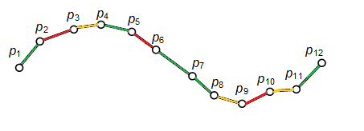
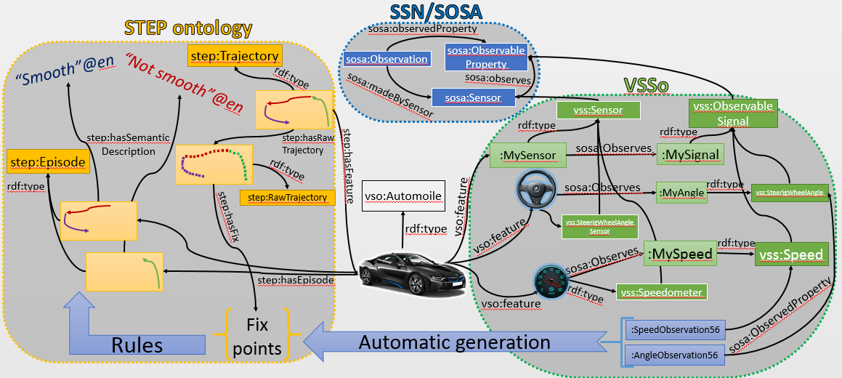

Application: linking signals to a heterogeneous context
Close event
Aggressive behavior
Neutral
Safe behavior
Traffic jam
Closed road
Driving Contexts
Web services
Smart home
Smart city
vso:Automobile

Slide 17
What about OEM-specific concepts ?

Slide 18
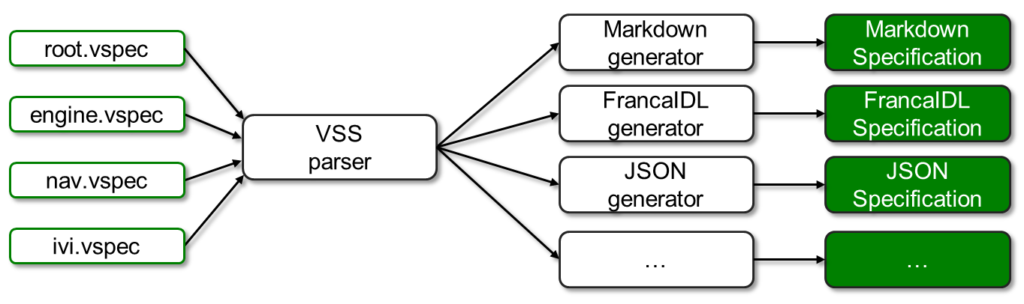
Ontological specification
VSSo
cookbook
Ontological specification
84 formally-defined vehicle parts
~300 formally-defined signals
~40 formally-defined attributes
Base VSSo

Slide 19
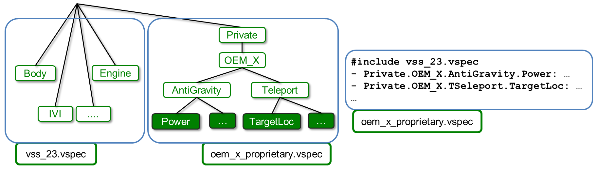
VSS private branch
Private branch
OEM-specific concepts
Extension of VSS
Merged into VSS when generating specifications
Private OEM-specific ontology cookbook:
Write VSS-compliant specification of private concepts (new signals, attributes and branches)
  Follow the VSS policies just as when creating a private branch
Generate the ontology using the existing tool
Validate the ontology
  Check the unicity of concepts and definitions (in the private branch and if possible with VSSo)
Define a private namespace for your ontology integrating VSSo

Slide 20
Do you have questions ?
Thank you for your attention

Slide 21
Branch examples
vss:Branch a rdfs:Class, owl:Class;
rdfs:label "Branch"@en;
rdfs:comment "Branch of the vehicle. Either a component (Body, Chassis...) or the complete vehicle"@en.
vss:ObstacleDetection a rdfs:Class, owl:Class;
rdfs:subClassOf vss:Branch;
rdfs:label "ObstacleDetection"@en;
rdfs:comment "Signal/Attribute.ADAS.ObstacleDetection : Signals form Obstacle Sensor System"@en;
rdfs:subClassOf [
a owl:Restriction;
owl:onProperty vss:partOf;
owl:allValuesFrom vss:ADAS
];
rdfs:subClassOf [
a owl:Restriction;
owl:onProperty vss:hasSignal;
owl:allValuesFrom [owl:unionOf vss:ObstacleDetectionIsActive, vss:ObstacleDetectionError]
].

Slide 22
Signal examples
vss:ObservableSignal a rdfs:Class, owl:Class;
rdfs:subClassOf sosa:ObservableProperty;
rdfs:label "Observable signal"@en;
rdfs:comment "All observable signals that can dynamically be updated by the vehicle"@en.
vss:AmbientAirTemperature a rdfs:Class, owl:Class;
rdfs:subClassOf vss:ObservableSignal;
rdfs:label "AmbientAirTemperature"@en;
rdfs:comment "Signal.Vehicle.AmbientAirTemperature : Ambient air temperature"@en;
rdfs:subClassOf [
a owl:Restriction;
owl:onProperty sosa:isObservedBy;
owl:allValuesFrom vss:Thermometer
];
rdfs:subClassOf [
a owl:Restriction;
owl:onProperty qudt:unit;
owl:allValuesFrom vocab:DegreeCelcius
].

Slide 23
Signal examples
vss:attribute a owl:ObjectProperty;
rdfs:label "Attribute"@en;
rdfs:comment "Attribute signals that do not change during the power cycle of a vehicle."@en;
rdfs:domain vss:Branch.
vss:driveType a owl:DatatypeProperty;
rdfs:subPropertyOf vss:attribute;
rdfs:label "DriveType"@en;
rdfs:comment "Attribute.Drivetrain.Transmission.DriveType : Drive type."@en;
rdfs:domain vss:Transmission;
rdfs:range [owl:oneOf("unknown"@en "Front-wheel drive"@en "Rear-wheel drive"@en
"All-wheel drive"@en)].

Slide 24
Thank you!
Visit GENIVI at http://www.genivi.org or http://projects.genivi.org
Contact us: help@genivi.org
GENIVI is a registered trademark of the GENIVI Alliance in the USA and other countries.
Copyright © GENIVI Alliance 2017.

