Slide 1
GPU Acceleration of SVG
November 2011
All SVG images in this deck are 100% GPU-rendered

Slide 2




NV_path_rendering OpenGL Extension
Goals
  Functionally complete for key standards: SVG, PostScript, TrueType etc.
  Much faster—often 4x to 100x faster than CPUs
  Enhanced quality avoiding approximations made by CPU renderers
  Lower power by leveraging dedicated hardware
  Mix 2D paths with 3D and programmable shading
Shipping today on all CUDA-capable GeForce/Quadro GPUs
  Coming to Tegra

Slide 3
Stencil then Cover Approach
Create a path object
  Cubic & quadratic Bezier segments, line segments, partial elliptical arcs
“Stencil” the path object into the stencil buffer
  GPU provides fast stenciling of filled or stroked paths
“Cover” the path object and stencil test against its coverage
  Application can configure arbitrary shading during the step
Functionality union of all major path rendering standards
  Includes all stroking embellishments
  Supports first-class text and font
  Mix traditional functionality with 3D and programmable shading

Slide 4




Excellent Geometric Fidelity for Stroking
Correct stroking is hard
  Lots of CPU implementations approximate stroking
GPU-accelerated stroking avoids such short-cuts
  GPU has FLOPS to compute true stroke point containment
GPU-accelerated
OpenVG reference
☑
☑
Cairo
Qt
☒
☒
Stroking with tight end-point curve

Slide 5
More Details
Point sampling for path filling is exact
  No approximations due to tessellation or subdivision
Path stroking is exact
  Line segments & quadratic Bezier segments stroking is exact
  G1 continuity of analytically curved stroked for arcs + cubics
    Strokes really rendered curved under arbitrary magnification
  All stroke cap + join styles supported
  Dashing fully supported
Minimal pre-computation required
  NO tessellation involved, NO recursive subdivision
  CPU pre-processing involved involves only local neighborhood of path
  Fast to animate, morph, or edit paths

Slide 6





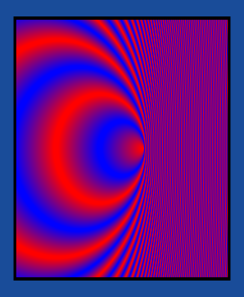
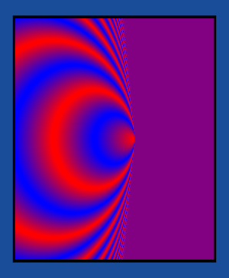
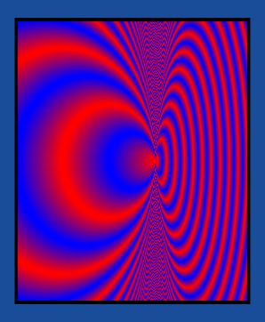
Enhanced Quality on GPU
☒
☒
☑
weird big holes
feathers?
Skia
Cairo
NV_path_rendering
☹ regular grid
on CPU - sub-optimal Antialiasing
☑ jitter pattern
on GPU for better Antialiasing
Stroking approximations avoided by GPU
GPU Offers Jittered Sampling for Free
☒ Qt
Moiré
artifacts
Similar
for Qt &
Skia
☑ GPU
yucky
color bleeding
☒ Cairo
☹ conflation artifacts on CPU
☑ conflation free on GPU
Eliminate Conflation Artifacts
Multiple color samples per pixel
Proper gradient filtering on GPU

Slide 7




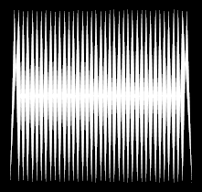





Performance of Some Benchmark Scenes
Tiger
Dragon
Round Dogs
Butterfly
Spikes
Coat of Arms
Cowboy
Buonaparte
Embrace
Japanese Strokes

Slide 8
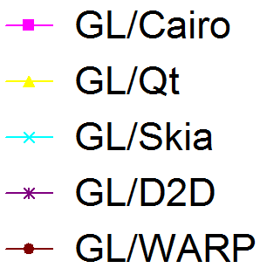
Performance: GPU vs. Alternatives
Speedup factor of GPU vs. alternatives—10 means 10x faster!
CPU
2.9 GHz i3
Nehalem
GPU
Fermi GTX 480
16 samples/pixel
Varying window
resolutions
from 100x100
to 1,000x1,000

Slide 9
Experimental SVG Renderer
NVIDIA believes all of SVG can be GPU-accelerated
  NVIDIA willing to assist and support
Partial SVG Renderer - pr_svg
  Filling, stroking, all stroking embellishments
  Constant color, linear & radial gradients, images
  Transforms, basic compositing, clipping
Stuff that’s missing from pr_svg
  Filter effects, Text, Animation, Markers, JavaScript integration
  Not hard, just best done in context of a browser

Slide 10


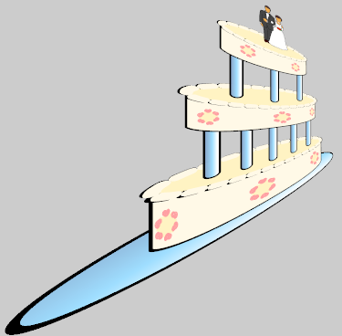






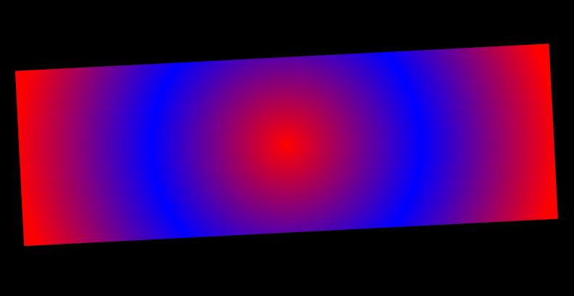
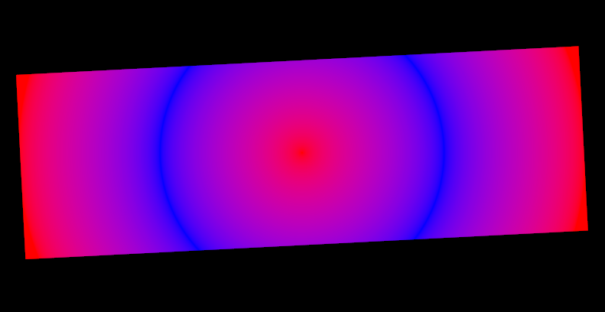

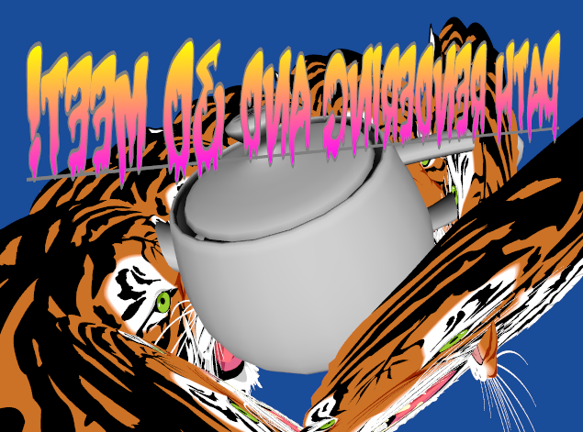
New Functionality
Projective
Transformation
Fast Arbitrary
Path Clipping
light source position
Programmable Shading
☹ linear RGB
transition between saturated red and saturated blue has dark purple region
☑ sRGB
perceptually smooth transition from
saturated red to saturated blue
Fully sRGB Correct Rendering
Mixing depth tested
Text, 3D, and Paths

Slide 11
GPUs influencing SVG
Paint in GLSL shaders
  Simpler, more flexible and faster than Filter Effects
Projective transforms
Mixing with 3D objects
Better gradient table filtering
Encourage more sRGB
Support images using GPU compression formats
Binary encoded path data for ease of transfer to GPU
Better match path commands of PDF ISO 32000
Novel touch interfaces using resolution-independent 2D when path rendering becomes 10x to 100x faster
Level-of-detail support

Slide 12
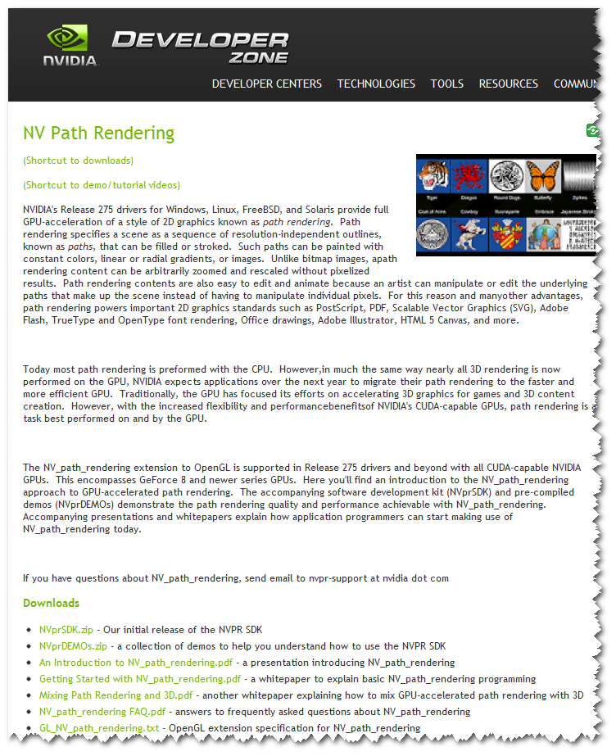
More Information
http://developer.nvidia.com/nv-path-rendering
“An Introduction to NV_path_rendering” presentation
  Good technical overview
“Getting Started with NV_path_rendering” whitepaper
  For programmers
NV_path_rendering OpenGL extension specification
  All the gory technical details
Source code and pre-compiled demos
  NVprSDK.zip has full source to 13 examples
  Includes the NV_path_rendering SVG renderer
  NVprDEMOs.zip has pre-compiled Windows binaries—ready-to-run
YouTube videos demonstrate various NVpr DEMOs
NVIDIA is willing in participate and assist in figuring out how to leverage GPUS for SVG

