Slide 1
Spreading the Web of Things
Soumya Kanti Datta, Research Engineer
Contact – dattas@eurecom.fr

Slide 2
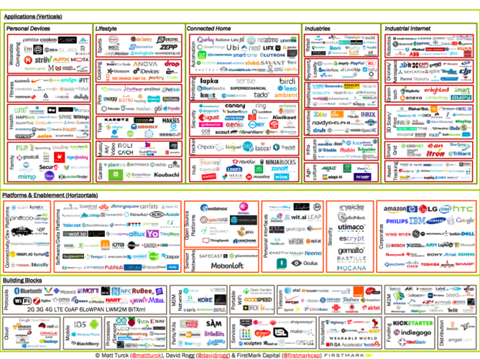
Introduction
Interoperability???

Slide 3
Existing IoT Systems

Slide 4
WoT – Horizontal Solution

Slide 5
WoT - Added Value
Defragmenting the IoT ecosystems.
Enabling open marketplaces for suppliers and consumers of services.
WoT applications that can adapt to variations in device capabilities and how these are exposed as Thing Description (properties, actions and events).
Based on semantic descriptions potentially leading to semantic interoperability.

Slide 6
W3C Web of Things

Slide 7
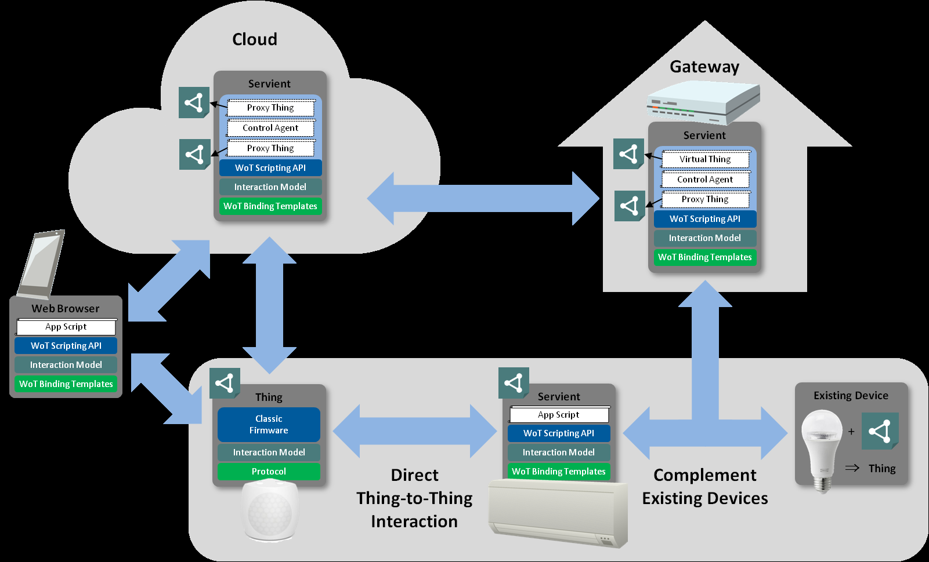
Things and Cloud
Source: https://www.w3.org/TR/wot-architecture/

Slide 8
Web of Things in Action
Two main domains
Smart Home
Connected Car

Slide 9
European Wide Positioning Service Platform
Delivering real time ITS services using WoT
European Wide Positioning Service Platform
Precision positioning as a service
Creating a Marketplace by bringing Stakeholders together
Takes advantage of Digital Single Market concept
Secure communication and data exchange
HIGHTS project has received funding from the European Union‘s Horizon 2020 research and innovation programme under grant agreement No. 636537.

Slide 10
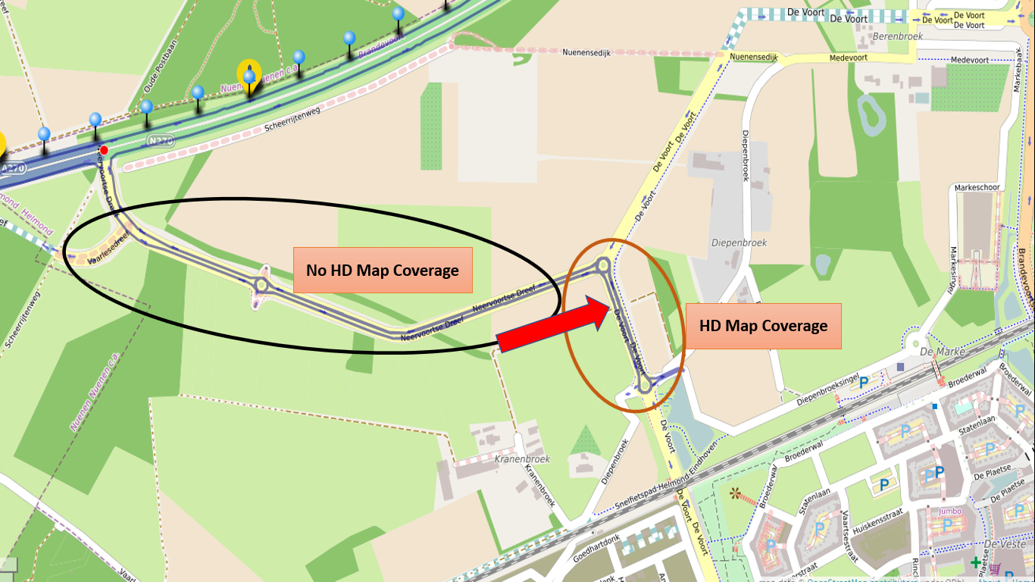
Best Algorithm for Positioning in Autonomous Vehicles
When HD Map is available, the vehicle can switch to a better positioning algorithm

Slide 11
Demonstration

Slide 12
Project Things by Mozilla
Source: https://iot.mozilla.org/about/

Slide 13
Speakers

