Slide 1
Hypermedia Design for Machine APIs: An Example
Michael J Koster
August 15, 2015

Slide 2
Hypermedia is Metadata
Application Semantics and Discovery
Describes intrinsic resources and controls at the application level using physical concepts like temperature, light intensity
Enables applications to discover the proper resources to link to
API State Machine Automation
Enables Common Web Client to interact with any device or virtual entity, regardless of schema or model structure, or protocol used
Hypermedia controls work like HTTP links and forms, but for functional abstractions of physical world items like on/off light switch controls
Context Integration
Contextual information like installed location, what is being measured and controlled, also used in application resource discovery
Using Web Linking, Relations, and Attributes

Slide 3
Models and Bindings
Thing Description models are high level abstractions for the Actions, Events, and Properties of things
Action, event, and property resources have defined bindings to M2M APIs, either through common patterns or through specialized interaction templates (like html forms)
High level functional abstractions for controls (Actions in the W3C thing model) map to machine operations at the (REST) API level
Example based on a set of controls for professional lighting
Actions are mapped to operations on IPSO Lighting objects (OnOff, Level, and Color actuators)
Level control (Brightness) object is used as an example

Slide 4
Lighting Model - Control Actions
thing
actuators
actions
parameters
application actions {parameters}
change
newState:
{enum:off,on}
light.onOff.change
{newState:on}
onOff
toggle
targetValue:{units:%}
change
transitionTime:{units:s}
light
level
step
stepSize
transitionTime
light.level.change
{targetValue:45,transitionTime:10}
move
rate:{units:%/s}
stop
(colorspace)
targetValue:{units:K,range:2700-5500}
HS
change
transitionTime:{units:s}
color
temperature
step
stepSize
transitionTime
XY
move
rate:{units:K/s}
stop
light.color.temperature.change
{targetValue:2900,transitionTime:10}

Slide 5
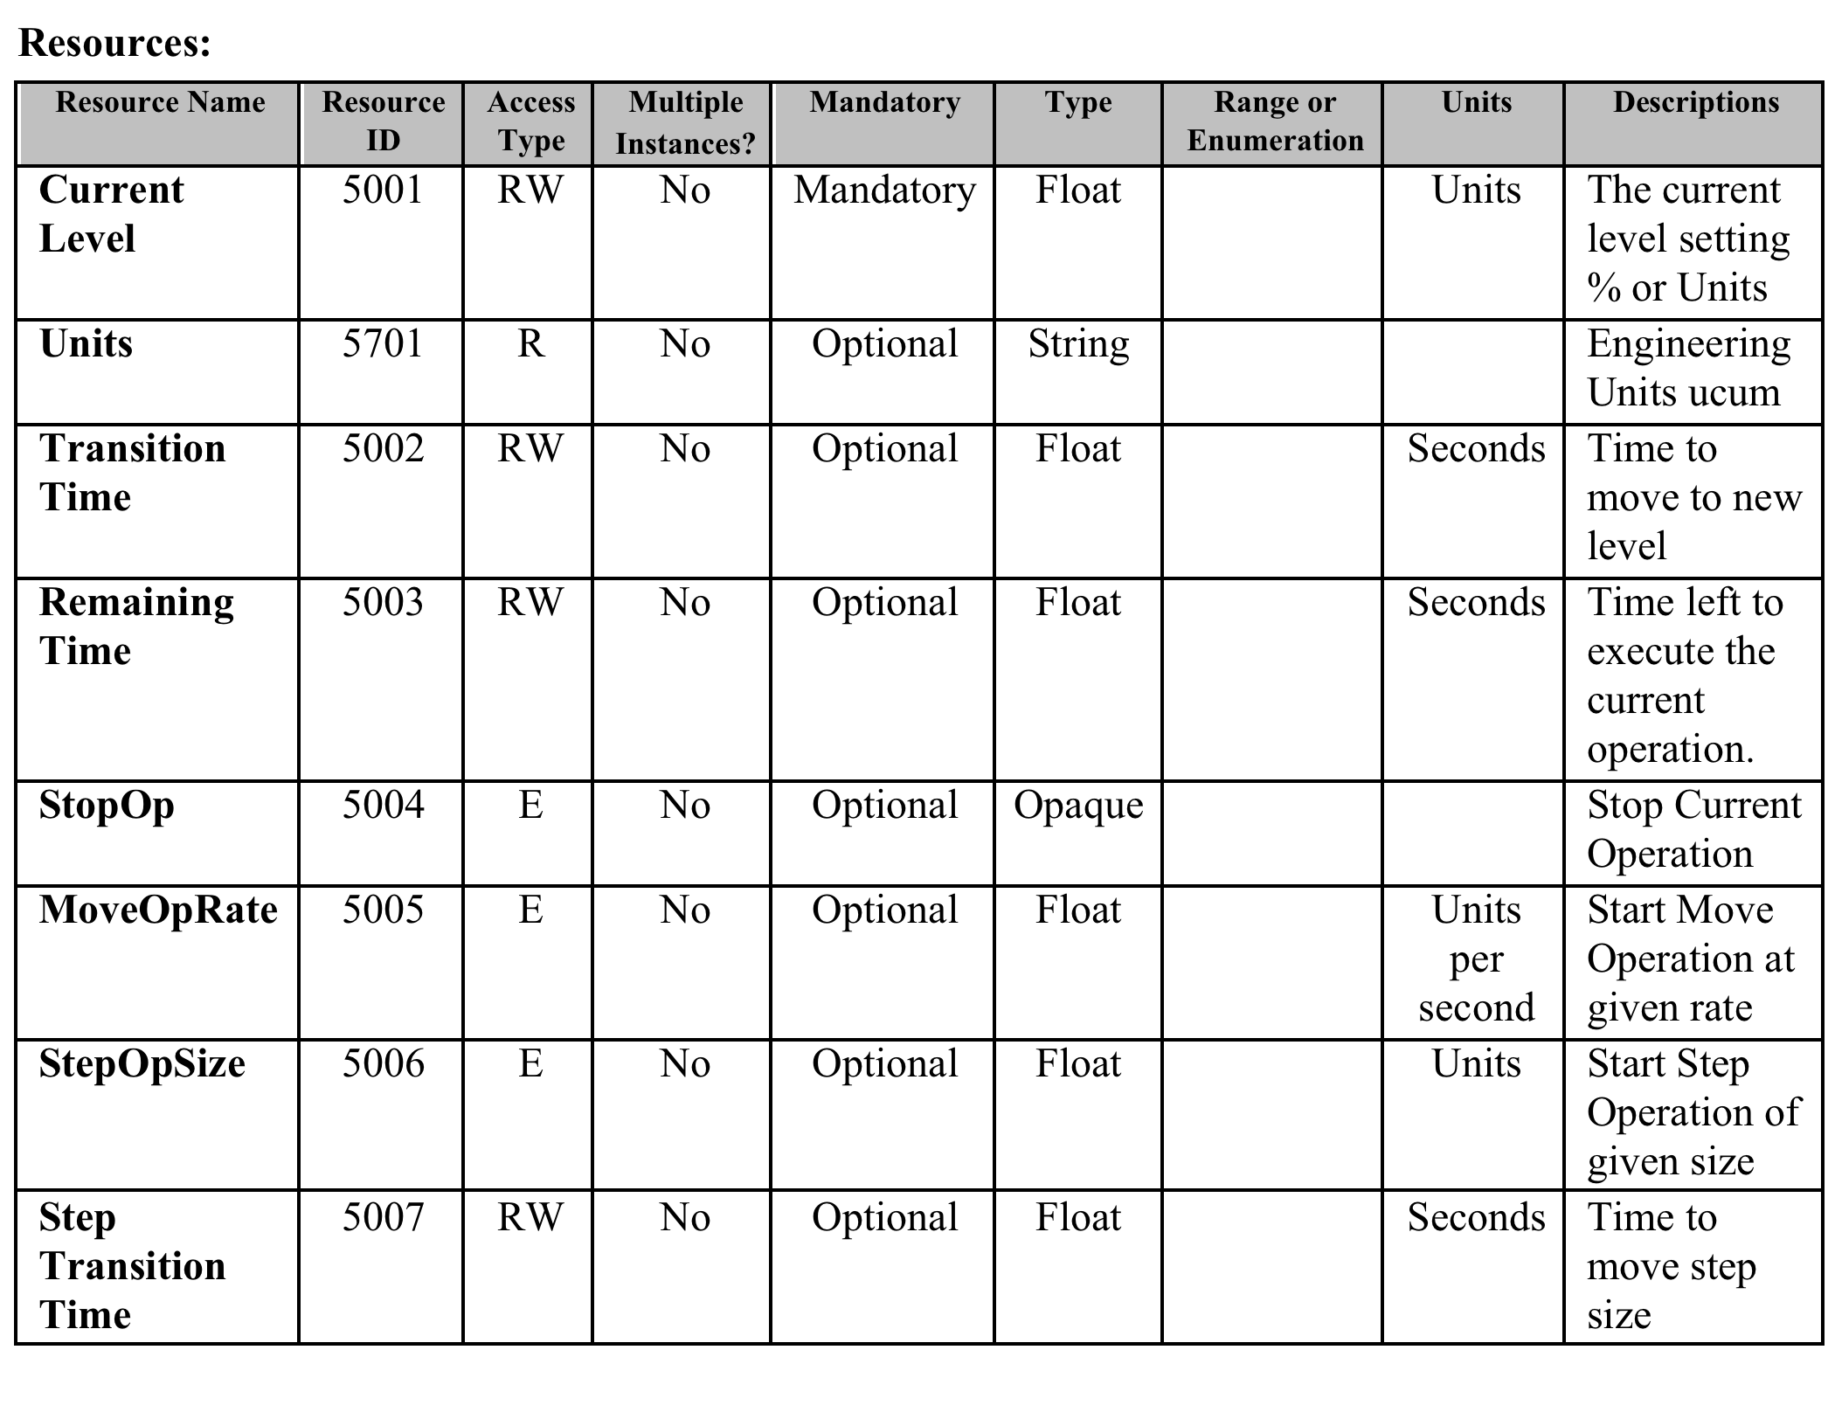
IPSO Level Control – Resource Model

Slide 6
Description => Protocol => Model
Semantic Binding, Thing Description
Actions
action
binding
datatype
Events
Subscribe Bindings
Properties
Get/Set Bindings
Resource Model
Instances of Schema
Protocol Binding
name
binding
href
datatype
method
mediatype
expects
returns
statuscodes
R
O
R
R
L
DT
O
R
L
R
O
R
R

Slide 7
Thing Description -TDL Fragment
{
“@context”: ”http://example.org/tdl/tdl.jsonld”,
“@type”: “thing”
{
“@context”: ”http://example.org/tdl/professionalLighting.jsonld”,
“_thing”:
{“type”:”light”},
“_actions”: {
“brightness”: {
“change”: { ⬅ indexed in context, reference by “light.brightness.change”
“parameters”: [
{“name”: “targetValue”:
“type”:”brightnessValueType”}, ⬅ TDL abstract types
{“name”: “transitionTime”,
“type”: “timeValueType”},
“bindings”: [
{“type”: ”ipso+coap”,
“describedBy”: “protocols.ipso+coap#light.level.change”}]
} } }
} }

Slide 8
Binding for protocols.ipso+coap
“light”: {
“level”: {
“change”: {
“parameters”: [
{“name”: “targetValue”:
“datatype”:”decimal”,
“units”: “%”,
“range”: “0-100”},
{“name”: “transitionTime”,
“datatype”: “decimal”,
“units”: “s”} ],
“method”: ”post”,
“href”: “3001/0”,
“mediatype”: “application/senml+json”,
“expects”: {“template”: “{\“e\”:[
{\“n\”:\“5001\”,\“v\”:{targetValue}},
{\“n\”:\“5002\”,\“v\”:{transitionTime}}]}” },
“statusCodes”: [
{“code”: ”2.01”,
“status”: “success”},
{“code”: “4.04”,
“status” “failure”},
{“code”: “4.09”,
“status” “retry”} ]
} } }

Slide 9
Questions and Follow On Work
What do the hypermedia descriptions of events, actions, and properties look like?
What are the functional abstractions that will be used to enable vertical specialization while still providing broad interoperability?
How does discovery integrate with API automation?
What are the metadata constructs for connecting constrained hypermedia to higher level abstractions?
Prototype using constrained lighting objects with LWM2M and IoT Toolkit open source python framework
Reference WoT client using Node-RED + extensions

Slide 10
Deployment with LWM2M Devices
Web Applications
Common Client
Discovery
Pub-Sub
Hypermedia
Discovery
REST API
Catalogs
Brokers
Pub-Sub
WoT Servient
Virtual Entity
LWM2M
Device Connector
M2M API
ConstrainedDevices

