Slide 1
Semantic Sensor Network A short overview with respect to W3C WOT TD
Darko Anicic

Slide 2
Credit to:
Michael Compton et al.: The SSN ontology of the W3C semantic sensor network incubator group, Web Semantics: Science, Services and Agents on the World Wide Web, 2012
Cory Henson: W3C Semantic Sensor Networks Ontologies, Applications, and Future Directions, IERC AC4 Semantic Interoperability Workshop, 2012
Raúl García-Castro: Overview of the W3C Semantic Sensor Network Ontology

Slide 3
W3C Semantic Sensor Network XG
Goal: To begin the formal process of producing ontologies that define the capabilities of sensors and sensor networks
Duration: March 2009 – June 2011
Continuity: W3C Semantic Sensor Networks CG (Since Feb. 2012)
24 Participants from 14 institutions:
CSIRO, Wrigth State University, University of Surrey, Universidad Politécnica de Madrid, Monterey Bay Aquarium Research Institute, Fraunhofer Gesellschaft, Pennsylvania State University, The Open University, University of Southampton, Open Geospatial Consortium, DERI at the National University of Ireland, Ericsson, Boeing, Fundación CTIC
Outcomes:
Final report
http://www.w3.org/2005/Incubator/ssn/XGR-ssn/
Semantic Sensor Network (SSN) ontology
http://purl.oclc.org/NET/ssnx/ssn

Slide 4
What is SSN Ontology?
Describes sensors in terms of capabilities, measurement processes, observations and deployments
In scope: sensors, the accuracy and capabilities, observations and sensing methods, operating and survival ranges, performance, deployment lifetime, sensing purpose etc.
Out of scope: units of measurement, locations, hierarchies of sensor types, feature and property hierarchies etc.
Different perspectives:
A sensor perspective - what senses, how it senses, and what is sensed;
An observation perspective - observation data and related metadata;
A system perspective - systems of sensors and deployments;
A feature and property perspective - focus on a particular property or observation.
Scope of UCs:
data discovery and linking
device discovery and selection
provenance and diagnosis, and
device operation, tasking and programming
W3C SSN XG followed the Semantic Technology approach

Slide 5
Why Semantic Technologies?
Provide a means to enable interoperability for sensors and sensing systems;
Can be used in isolation or in augmenting non-semantic approaches, e.g., OGC SWE (provides syntactic interoperability);
Can assist in managing, querying, and combining sensors and observation data;
Enable users to operate at higher abstraction levels (domain concepts), above the technical details of format, integration etc.;
Machine-interpretable semantics allows (semi-) autonomous agents to assist in collecting, processing, discovering, reasoning about, and acting on sensors and their observations;
Enable data integration from multiple sources.

Slide 6
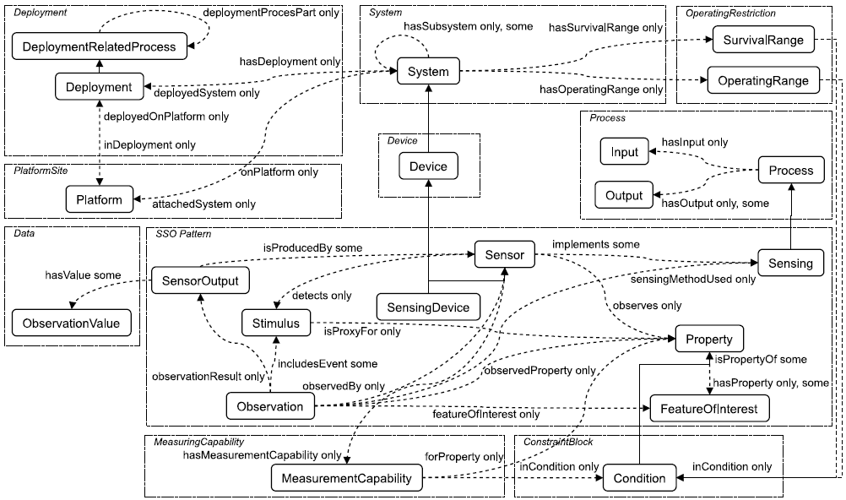
SSN Ontology: Key Parts

Slide 7
Further About SSN...
The SSN ontology:
Is compatible with the OGC standards
Is aligned with an upper ontology
Dolce Ultra Light (DUL)
Only includes core concepts; needs to be extended, e.g., QUDT, SWEET, MathML, location, events…
Does not need to be wholly reused
Only observations
Only sensors
TBox/Abox distinction, e.g. device manufacturers providing concept definitions for products and users specifying instances on deployment.

Slide 8
Relevance to W3C WoT TDL
SSN may serve for describing Things (when Things are sensors):
Events (e.g., stimuli, obesrvations)
Properties (e.g., capabilities, conditions, ranges)
SSN may be part of vocabularies used in TDs
The use of SSN demonstrates interesting scenarios for WoT, e.g., senasor discovery and Plug&Play, on-the-fly units conversion and integration of sensors with Web, lifecycle of deployed sensors, smart wearable devices etc.

Slide 9
Thing Ontology vs. Thingsonomies
 | Ontology (e.g., SSN) | Tags (e.g., Haystack)
Completeness vs. Complexity | Tends to be as complete as possible and complex | Simple, incomplete
Context, background knowledge | Rich context in which concepts and relations between them are defined | Context in which tags are to be used is not explicitly defined
Domain specific vs. non-specific models | Can cover the both | More useful for domain specific models
Available tools (for search, discovery, reasoning etc.) | Exist | Need to be tailored/developed for specific tasks
Applicability on constrained devices (Things) | Yes, if encoded in appropriate formats | Yes. Encoding may be needed

