Slide 1
OMA Lightweight M2M TS
Soumya Kanti Datta
Mobile Communications Department
Email: Soumya-Kanti.Datta@eurecom.fr

Slide 2
What is OMA LwM2M?
Defines an application layer protocol
Between a LwM2M server and LwM2M client
Client is located inside an M2M device
Includes device management and service enablement for resource constrained devices.
To achieve that the enabler makes use of
A lightweight protocol
An efficient resource data model

Slide 3
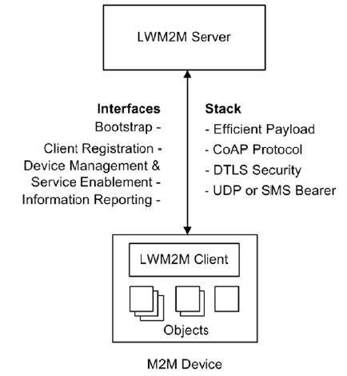
Client-Server Architecture
Uses CoAP with UDP or SMS bindings
DTLS provides security for UDP

Slide 4
Resource Model
Each piece of information made available by a LwM2M client is a resource.
Resources are logically organized into objects.
The LwM2M client may have any number of resources each of which belongs to an object.
Resources and objects have the capability to have multiple instances of the resource or object.

Slide 5
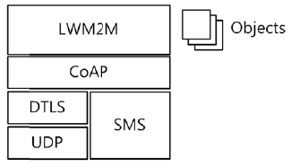
Protocol Stack

Slide 6
Interfaces Between Client and Server
Bootstrap
Client registration
Device management and service enablement
Information reporting

Slide 7
Bootstrap
Used for provisioning essential information into the LwM2M client
This enables the client to register itself into one or more LwM2M server(s).
Supported modes
Factory bootstrap
Bootstrap from smart card
Client initiated bootstrap
Server initiated bootstrap

Slide 8
Client Registration
Supported operations
Register, Update, De-register
The interface is used by LwM2M clients to
Register itself at one or more LwM2M server(s)
Maintain the registration and session (Lifetime)
Perform periodic update of registration information
De-register as necessary

Slide 9
Device Management and Service Enablement
This interface is used by the LWM2M Server to access object instances and resources available from the LWM2M Client.
Associate operations
Create, read, write, delete, execute, write attributes, discover
Discover operation is to get
Attributes of an individual resource
All the resources of an object instance
Return payload contains a list of CoRE Links for each resource
Including the attributes of the resource

Slide 10
Information Reporting
This interface is used by a LwM2M server to observe any changes in any resource of a LwM2M client.
Reporting is done as a notification.
This observation relationship is initiated by sending an “Observe” operation to the LwM2M Client for an object, an object instance or a resource.
An observation ends when a “Cancel Observation” operation is performed.

Slide 11
Reading Materials
[1] OMA LwM2M, http://technical.openmobilealliance.org/Technical/technical-information/release-program/current-releases/oma-lightweightm2m-v1-0
[2] A Lightweight Framework for Efficient M2M Device Management in oneM2M Architecture, http://goo.gl/PhGZil

Slide 12
Thank you!
Email: Soumya-Kanti.Datta@eurecom.fr
Webpage: http://www.eurecom.fr/en/people/datta-soumya-kanti/publications
Twitter: @skdatta2010

