Slide 1
W3C Web Authentication Extensions
G. Mandyam

Slide 2
Critical Issue for PR Transition
As per W3C Webauthn CR version (7 August 2018)
SOTD: “We will also have multiple interoperable implementations of the AppID extension, validating the extension framework. All other extensions are ‘at risk’. If there are not multiple interoperable implementations, each may independently be removed or made informative at Proposed Recommendation.”
Recommendations
Remove this SOTD statement from PR version
Keep following text in PR
Sec. 9: “All WebAuthn extensions are OPTIONAL for both clients and authenticators. Thus, any extensions requested by a Relying Party MAY be ignored by the client browser or OS and not passed to the authenticator at all, or the MAY be ignored by the authenticator. Ignoring an extension is never considered a failure in WebAuthn API processing …”
Retain all extension requirements currently in CR version as normative

Slide 3
Background
Webauthn extensions can be divided into two categories:
Client-terminated
Extension can be processed by User Agent
No interaction with an external entity (authenticator) necessary
AppID extension is an example
No authenticator processing required
Authenticator-terminated
Extension request handled partially by user agent
Pre-processing, Platform/CTAP messaging
Extension response ultimately provided by authenticator
Transaction authorization extensions are an examples
Only authenticator can provide evidence of transaction confirmation
All extensions are also recorded in the IETF Webauthn registry
https://tools.ietf.org/html/draft-hodges-webauthn-registries-01

Slide 4
Background: Interoperability
Source: K. Dubost, “Open Standards Interoperability”
https://www.w3.org/blog/2008/05/open-standards-interoperability/
“For W3C specifications, the entrance criteria to go to Proposed Recommendation is double implementations of each feature. This is not mandatory, but highly desirable. It really depends on the type of the technology and how the group has defined its own criteria.”
Current process guidance available at https://www.w3.org/2018/Process-20180201/#implementation-experience

Slide 5
Verifying Interoperability for Authenticator-terminated extensions
Two “independent implementations” is unclear when describing features supported by entities external to browser
Interpretation 1: two user agent implementations that allow a particular extension
Issue: Extension itself requires a supporting authenticator. User-agent interoperability without authenticator is not meaningful from a developer perspective.
Interpretation 2: two authenticator implementations that will process particular extension
Issue: interoperability requirements are for the benefit of the developer. If authenticator is not reachable through browser, verifying authenticator support alone is not meaningful either.
Note that many FIDO authenticators on the market already support certain extensions (e.g. FIDO UAF and transaction authorization).
Interpretation 3: two authenticator implementations that will process extension along with two user agent implementations that allow said extension.
Issue: developer cannot benefit from this type of interoperability if they encounter user agent where authenticator is not available (e.g. hot-swappable authenticators running on a PC). Interop will only be verified in a specific HW-dependent deployment scenario that may or may not be replicable.
Issue: what constitutes the implementation? Is it a unique combination of the user agent + authenticator? If so, aren’t 4 implementations necessary to verify interop?

Slide 6
Proposed CR remedies: Concerns
Assumptions:
It is difficult and potentially impossible for a user agent to prevent an authenticator from providing an unprompted extension
Authenticator-provided extensions should be in a pre-determined format
Allows RP’s to process extensions in a uniform manner
Allows user agents to inspect extension data and verify authenticators are adhering to ‘data minimization’ principle
Remedy 1: removal of extensions from spec
Authenticators/User Agents/RP’s have no common requirements; processing of extension data becomes difficult
Unprompted extensions could take on any form
Breaking the registry: see https://tools.ietf.org/html/draft-hodges-webauthn-registries-01
There are dependencies in the extension registry on the Webauthn spec for the initially-registered extensions
Remedy 2: making extensions non-normative
Extensions are already optional
Authenticator vendors may feel free to alter extension data
Fractures RP processing and user agent inspection
Breaking the registry: Section 3 of registry requires a specification document, which implies an enumeration of nominal requirements
Both remedies: they do not fix other interoperability areas where dependencies on external entities (authenticators) remain
Attestation, for example

Slide 7
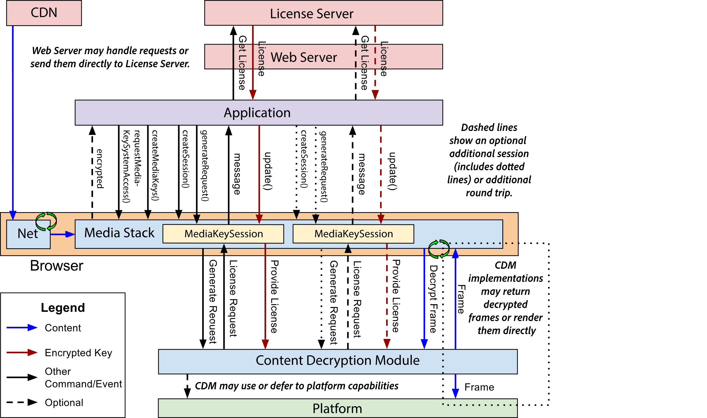
Comparsion to EME
EME also provides a means of an entity external to the user agent (CDM) sending data to a remote party (license server)

Slide 8
Comparisons to EME (cont.)
Feature | EME | Webauthn
External entity (to user agent) | CDM | Authenticator
Remote service provider | License server | Relying Party
In-band data transport between external entity and remote service provider | Media Key Session | Extensions/Attestation
Can user agent inspect messages between external entity and remote service provider? | No. CENC-based DRM systems encrypt messaging using inverse PKI. | Yes.
Is standards-conformance required for in-band data transport? | No. CENC-based DRM messages are proprietary | Yes
Discovery of in-band protocol | Yes. DRM system discovery possible through EME retrieval of Key System. | Yes. RP’s can use FIDO Metadata Service to pre-discover supported extensions.
Privacy/Security assurance through mandating Secure Context? | Yes | Yes

Slide 9
Comparsions to EME (cont.)
EME (Recommendation Status) has progressed without verifying interoperability or even defining message format for MediaKeySessions for different DRM systems
Has not been a deterrent to developer nor CDM adoption
Webauthn should be able to follow a similar model
Extensions are open standard – not opaque
Authenticator and RP’s can adopt
Verification of extension spec compliance through certification programs
Does not really exist for Media Key Sessions
Widevine/PlayReady conformance requirements not withstanding

Slide 10
Final Recommendations for PR
Continue to keep normative guidance in spec that all extensions are optional
Follow Sam’s suggestion to specify AAID extension as RECOMMENDED
Keep all extension text as normative
Overall: as per Process 2018, request Directorate for a waiver on Implementation Experience for extensions

