Slide 1
Protocol Proposals

Slide 2
Background
The Protocols subgroup was started in October 2021 and tasked to work out the details of an idea that encouraged organizations to go beyond minimal accessibility by giving “credit” for implementing accessibility guidance that was hard to measure.
The group was not able to reach consensus and is presenting two proposals with a comparison table of the main points of each proposal. The names of the groups are somewhat arbitrary and are used just to distinguish the proposals.

Slide 3
Reference Documents
Protocols and Assertions Proposal (aka Points for Protocols)
Evaluating Procedures Proposal
Comparison Table

Slide 4
Protocols and Assertions

Slide 5
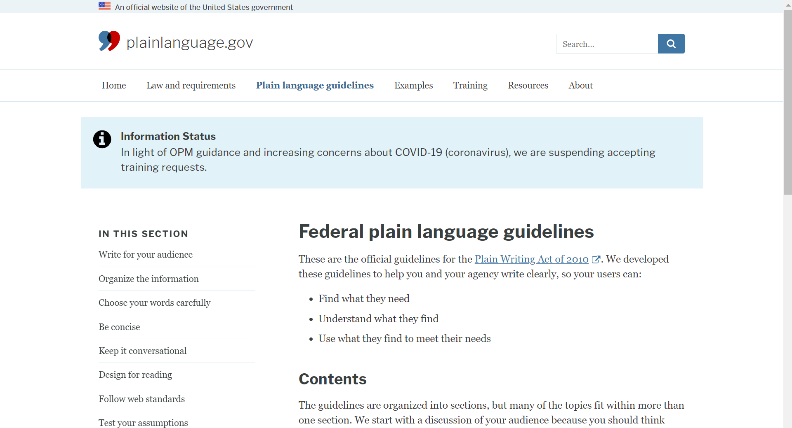
Protocols and Assertions Overview
Protocols already play a role in digital accessibility today!

Slide 6
Protocols and Assertions Overview
Unlike ACT-style tests, where a failure = a reduction in score, Protocol adoption rewards content producers by assigning ‘points’ or otherwise increasing the overall score of the content being evaluated/reported-on. (ref: carrot and stick)
Loosely based on the ISO 9000 Family of Quality Management concept, it qualifies principles while leaving the applicability to the contextual need of the entity who adopts the Protocol.
Protocols MUST be publicly posted and available for review.

Slide 7
Protocols and Assertions Overview
A Protocol has to solve a real problem as determined by the subject matter experts (AG members, taskforce members, impacted community in some way)
Used early to inform decisions at the UI/UX design stage - it is proactive and not reactive.
A programmatically linked Conformance Statement (the Assertion part) listing which Protocols have been adopted introduces “institutional risk” and is envisioned as the enforcement mechanism for legislators.

Slide 8
What is documented
A content creator will make a programmatically linked declarative statement:
Promise/commitment to adopt X protocol.
Steps that you have taken to meet the protocol (TBC)
Declarative statement of progress (TBC)
Timestamp. Date protocol was used (TBC) - Expiry date?
The Dutch have created an Accessibility Statement Generator of sorts. This documentation is a good example of what documenting Protocols effort might look like. (See: https://www.digitoegankelijk.nl/toegankelijkheidsverklaring/controle-door-logius)

Slide 9
Examples of Potential Protocols today:
Checklist: US Federal plain language guidelines https://www.plainlanguage.gov/guidelines/
Guideline: Write for your audience
Guideline: Organize the information
Guideline: Choose your words carefully
Guideline: Be concise
Guideline: Keep it conversational
Guideline: Design for reading
Guideline: Follow web standards
Guideline: Test your assumptions
Checklist: Making Content Usable for People with Cognitive and Learning Disabilities https://www.w3.org/TR/coga-usable/
Objective 1: Help Users Understand What Things are and How to Use Them
Objective 2: Help Users Find What They Need
Objective 3: Use Clear and Understandable Content
Objective 4: Help Users Avoid Mistakes and Know How to Correct Them
Objective 5: Help Users Focus
Objective 6: Ensure Processes Do Not Rely on Memory
Objective 7: Provide Help and Support
Objective 8: Support Adaptation and Personalization

Slide 10
Other Examples of Potential Protocols today:
WAI-EO alt text decision tree
Apple, Google, BBC design documents?
Adobe PDF creation documents?
Others?

Slide 11
Evaluating Procedures

Slide 12
Evaluating Procedures Overview
Protocols provide procedures that can be evaluated to meet WCAG3 Outcomes where the outcomes are not necessarily measured.
Protocols describe required inputs (similar to ISO 9001) such as:
Documentation of steps
Actions taken
Date Completed
Conformance claims
Some protocols are written by W3C but expects public self-defined protocols that meet requirements set by AGWG.

Slide 13
Evaluating Procedures Example
A hypothetical outcome for Clear Language could allow a protocol where the organization could use W3C Content Usable to meet the outcome.
The protocol would describe:
Reference to W3C Content Usable
Requirements for steps based on Content Usable
Requirements for training for authors and editors
How the org would evaluate whether they met Content Usable
How the org would (optionally) publicly report their process.

Slide 14
Comparison of Protocol Proposals

Slide 15
What is a Protocol?
Protocols and Assertions
Evaluating procedures
An instructional document that guides you through the process of making an informed decision.
The results of a protocol can’t be tested with any inter-rater reliability.
Adoption of vetted Protocols adds to a final conformance score.
A document written by an organization who wishes to meet a WCAG 3 outcome that allows their use.
Step or process oriented
Can publicly demonstrate the process was followed

Slide 16
Who Writes the Protocol?
Protocols and Assertions
Evaluating procedures
Protocols are written by subject domain experts, and approved by AG prior to use.
The proposal envisions a mechanism for 3rd Parties to propose specific Protocols to the Working Group for review and possible inclusion.
AG sets requirements that a protocol that is used for conformance must meet.

Slide 17
What is accepted as a protocol?
Protocols and Assertions
Evaluating procedures
Protocols will contain certain key components: an articulated Outcome, key expectations, User Stories or equivalent examples.
Both Making Content… COGA and plainlanguage.gov/guidelines provide visual examples of the anticipated format
The protocol must meet specific outcome-level requirements, which will be outlined in WCAG 3 for each outcome that allows use of protocols. (To be decided: We expect that not all outcomes will allow use of protocols.)

Slide 18
How do they fit into Conformance?
Protocols and Assertions
Evaluating procedures
Users will earn points by adopting Protocols, which contribute towards their total Conformance Score
This proposal abandons some current thinking around scoring and evaluating that is unworkable at scale or lacks transparency (the subjectivity problem)
Protocols describe inputs for procedures, but do not necessarily measure outcomes. The protocol must define a way to evaluate the quality of its implementation, which is expected to correlate to conformance with an WCAG3 outcome.

Slide 19
How stringent are the controls?
Protocols and Assertions
Evaluating procedures
The content creator will make a programmatically linked declarative statement.
Promise/commitment to adopt X protocol.
Steps that you have taken to meet the protocol (TBD)
Declarative statement of progress (TBD)
The protocol can only be used for a subset of outcomes, must meet W3C criteria, and must be able to be evaluated in order to be used for conformance.
Protocols used to support conformance claims must be publicly documented.

Slide 20
When is the protocol applied?
Protocols and Assertions
Evaluating procedures
Protocols and Assertions qualifies principles & outcomes while leaving the applicability to the contextual need of the entity who adopts the Protocol.
The goal here is to get vetted, “educational” content in front of dev teams at the earliest stages - before any content is created.
Orgs adopt protocols as part of developing their WCAG 3 conformance plan and execution. Evaluation of how well the protocol was followed is done when evaluation towards a conformance claim is done, or at other times as part of the org’s QA process.

