Slide 1
Current page – see suggestions on next two slides.

Slide 2
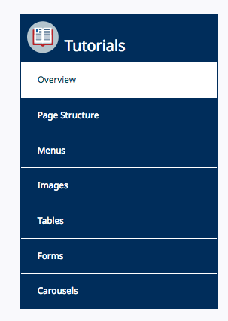
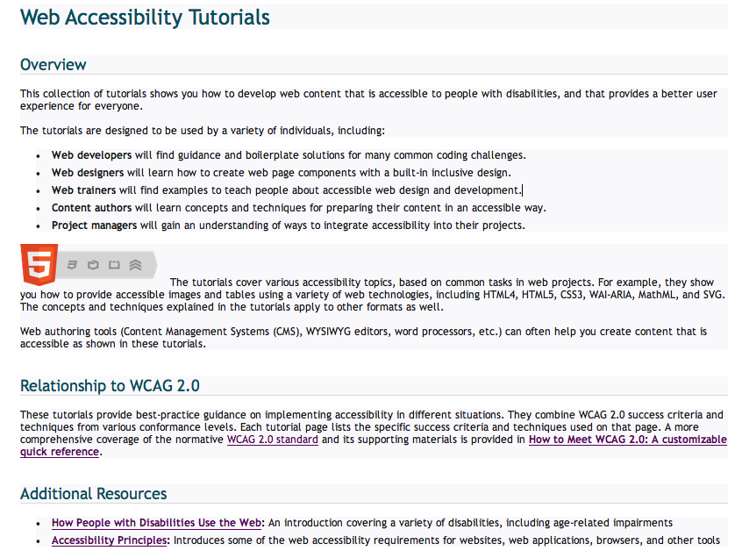
Approach 1: Add “Overview” as a subheading on the page, (same hierarchy and styling as “Relationship to WCAG 2.0”) so that when first visiting the page it is (more) evident that this is the overview. The menu functioned differently than I expected. I expected this page to be aligned with the title Tutorials, and that clicking overview would take me to a different page.

Slide 3
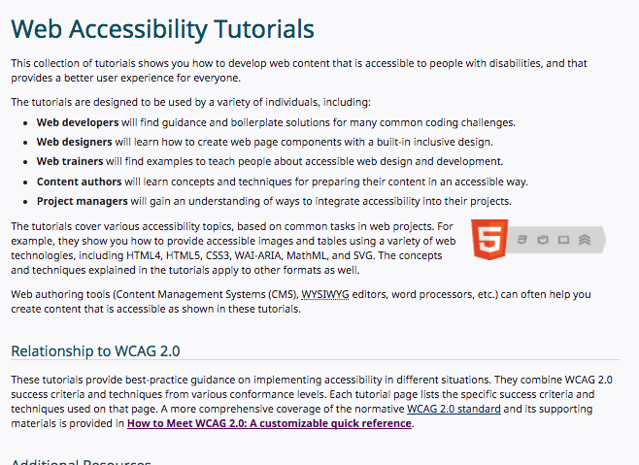
Tutorials
Page Structure
Menus
Images
Tables
Forms
Carousels
Approach 2: Remove “Overview” from the menu. Selecting overview in menu does not move you to new location/page – make title “Tutorials” link back to “Web Accessibility Tutorials” page.

Slide 4
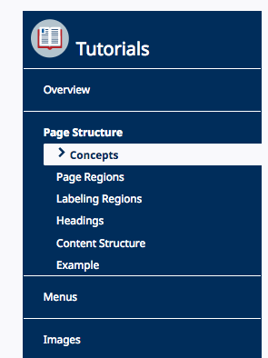
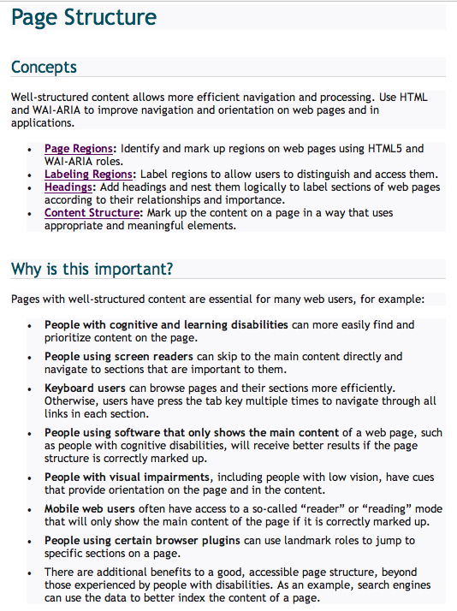
Match menu items better to page headings
Style “Concepts” as subheading under page title, matching style of Why is this important?”

