Slide 1
2014: A Celebratory Year World Wide Web’s 25 Year Anniversary W3C’s 20 Year Anniversary 10 June 2013

Slide 2
The Web Changed the World
Created major transformation in how we work, live, play and learn.
An enabling platform that’s not always apparent to users like agents or applications
It’s only been 25 years; 20 years for the consortium…
…but we’ve only just begun!

Slide 3
Use Opportunity to Raise W3C Visibility too
Google “Building the Web Together”
http://gizmodo.com/this-is-how-the-web-was-built-according-to-google-506808278
Mozilla Project
http://www.mozilla.org/en-US/mission/
Microsoft Vision
http://www.microsoft.com/office/vision/
Facebook positioning
http://news.cnet.com/8301-1023_3-57577987-93/facebooks-one-small-step-for-mankind/

Slide 4
Goals and Opportunities
Raise visibility of the Consortium with multiple stakeholders to enhance the institutional brand.
Position W3C as the natural, neutral leader championing the Open Web Platform.
Inspire stakeholders to work with W3C to envision the future and drive innovation of the Web.
Collaborate with The Web Foundation and CERN to leverage our collective strengths.

Slide 5
Global Celebration of the Web
Coordinate our organizations so our messaging aligns.
W3C’s
20th Anniversary
Web
Foundation
and the Web’s anniversary
CERN
60th Anniversary

Slide 6
Potential W3C Anniversary Theme
These are some currently under discussion:
One Web
The Web You Can Imagine
You Make the Web
needs more brainstorming

Slide 7
W3C Target Markets
Current members
Prospective members
Other associations with a stake in the Web’s future (e.g. Internet Society, GSMA, OpenStand, WWW, etc.)
Governments
Media
Developers
Youth (leverage other organizations’ existing ‘learn to code’ initiatives)
Everyman (creating a general buzz)

Slide 8
W3C Objectives
Raise global awareness about how the Web is transforming our world and that W3C is at the center of that transformation.
Help articulate/illustrate what new things we can expect from the Web in the next 5, 10, 20 years.
Invite participation in W3C.
Grow membership? Optional: Establish 50x5 or 20x1 membership campaign (some number of new W3C members in next _ years)

Slide 9
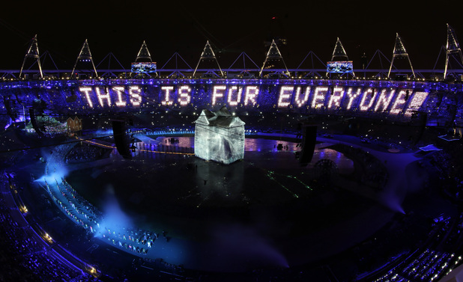
Strategy
Position as the world’s celebration
Stress global, unified, online
Seek viral opportunities by leveraging social media
Ask our supporters to help spread the word
-Members will be encouraged to display the Web and W3C anniversary logo(s) on their websites
- W3C to provide anniversary stickers, t-shirts, posters…

Slide 10
W3C Proposal as of 24-May
Use the Web in our celebration by creating a global online campaign with crowd-sourced stories about the Web. Storytelling campaign invites people around the world to define their vision for the future of the Web (for next 5, 10, 20 years). Show and tell, using power of the Web.
Other similar examples:
http://www.alsa.org/about-als/2013-aam/stories/tell-your-story.html
http://define.babson.edu what’s your definition of entrepreneurship?
Leverage existing W3C/WebFoundation/TimBL/JJ 2014 activities
See draft calendar in http://www.w3.org/wiki/Headlights2013/Anniversaries
Extend outreach through our Members, current and new partnerships, other associations (e.g. GSMA, OMA), and organizational friends
Amy offers these organizations as examples of friends: the Webby Awards, Internet Hall of Fame, The Internet Society, British Consulate, British Computer Society, Royal Society, American Academy of Arts and Sciences, The Science and Technology Foundation of Japan, an the American Society for Information Science and Technology, and of course, MIT/ERCIM/Keio/Beihang.
Optional: add a major event (TBD) where tech industry luminaries can physically stand with W3C, adding their star power? Perhaps TED conference in March 2014 in Vancouver might provide an opportunity.

Slide 11
Online Campaign Open Issues
Should we open up the campaign Web site/page to accept storytelling about the Web past, present, and future--or only about the future vision of, and wishes for, the Web?
Who should manage/own the site, W3C or TWF? Should each organization link its own anniversary celebration webpage from this site? Which other organizations or URLs should we list on the main page?
Should we curate/integrate a contest for the best submission?
Should we require people to register before we curate/approve uploaded content. If so, how should we treat /protect their data?

Slide 12
Marketing Approach
W3C web site home page anniversary banner ad or logo, blogs
Staff blogs
Member website home page anniversary banner ad or logo, blogs
Social media for viral push
Advertising (e.g. traditional media placements, W3C sponsorship of other industry events, public service announcements, etc.)
Auction on eBay? (e.g. Tim’s book?)
Public relations (earned media)

Slide 13
Resource Requirements
@@ $xx,000
@@ .x FTE for 12-18 mos.

