Slide 1
The W3C Voice Interaction Community Group: Standards for Interoperable Voice Applications
Deborah Dahl
Conversational Technologies
dahl@conversational-technologies.com
Co-Chair
W3C Voice Interaction Community Group

Slide 2
The landscape of conversational interaction platforms is large and growing
NVIDIA Jarvis
IBM Watson
Google Assistant
Apple SiriKit
Samsung Bixby
Microsoft LUIS
Rasa
Nuance Mix
Mycroft
Alexa Skills Kit

Slide 3
These platforms are the basis of thousands of voice applications
They enable users to access an incredible amount of information

Slide 4
But applications don’t have any way to cooperate
Each application is independent and self-contained

Slide 5
The problem
Applications can’t communicate or share data
Application development work can’t be shared

Slide 6
Compare Voice Applications to the World Wide Web
 | The Web | Voice Applications
Authoring language for applications | Standard HTML, CSS, JavaScript | Proprietary
Move between applications | Follow links | Only on the same platform (sometimes)
Applications can run on different platforms | Any standard browser can run any application | No
Finding applications | Search engines | No
Format for sending data | HTTP(S) | Proprietary

Slide 7
What if applications could communicate like web pages
NVIDIA Jarvis
IBM Watson
Google Assistant
Apple SiriKit
Samsung Bixby
Microsoft LUIS
Rasa
Nuance Mix
Mycroft
Alexa Skills Kit

Slide 8
Goals of the Voice Interaction Community Group
Promote interoperability of interactive voice applications through standards
Current activities
JSON Representation of Semantic Information
Intelligent Personal Assistant Architecture: Architecture and Potential for Standardization Version 1.0
Intelligent Personal Assistant Architecture: Intelligent Personal Assistant Interfaces

Slide 9
Problem 1: Each platform has its own format and vocabulary for semantic results
Entities, slots, concepts
Intents
Scores and confidence
Alternative results (nbest)

Slide 10
Proposal for Problem I: JSON Representation of Semantic Information
Represent semantics of user inputs in a common format
Make it easier to change toolkits if necessary
Promote development and back-end integration tools
Reduce training time for developers
https://w3c.github.io/voiceinteraction/voice%20interaction%20drafts/emmaJSON.htm
Published February 12, 2019

Slide 11
Problem 2: Platforms can’t cooperate
Applications are mostly self-contained
Sometimes they can hand off interaction to another application on the same platform
Can’t hand off to applications on other platforms

Slide 12
Proposal for Problem 2: Intelligent Personal Assistant Architecture Architecture and Potential for Standardization Version 1.0
Define architectural components of an Intelligent Personal Assistant Architecture ecosystem
https://w3c.github.io/voiceinteraction/voice%20interaction%20drafts/paArchitecture.htm
Published March 24, 2020

Slide 13
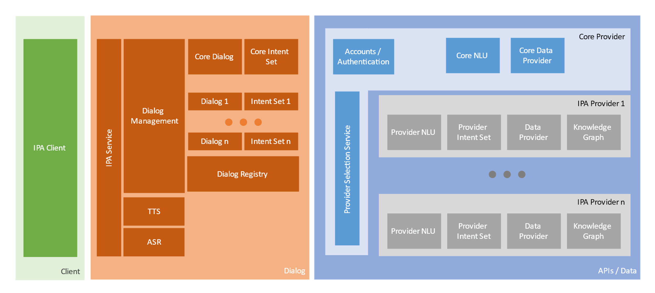
Intelligent Personal Assistant Architecture

Slide 14
Use Case: Travel Planning
A user plans a trip to an international conference and needs visa information and airline reservations.
The user asks an assistant (IPA Client, on the left of the diagram) about visa requirements
The IPA answers the question directly, getting the information from a web service that it knows about via the corresponding Data Provider.
Or, the generic IPA will identify a visa expert assistant application from the dialog registry.
It connects the user with the visa expert, one of the IPA providers on the right side.
The visa expert finds out from the user the dates and purposes of travel
informs the user of the visa process.
Once the user has found out about the visa, she tells the IPA that she wants to make airline reservations.
If she wants to use a particular service, or use a particular airline, she would say "I want to book a flight on American".
The IPA will either connect the user with American's IPA
Or, if American doesn't have an IPA, will inform the user of that fact.
If the user doesn't specify an airline, the IPA will find a general flight search IPA
The flight search IPA helps the user find appropriate flights.

Slide 15
Intelligent Personal Assistant Architecture Intelligent Personal Assistant Interfaces
Define standard interfaces between architectural components
Just getting started, not published yet
Draft available at:
https://w3c.github.io/voiceinteraction/voice%20interaction%20drafts/paInterfaces.htm

Slide 16
Summary
The goal of the W3C Voice Interaction Community Group is to define standards that will make intelligent assistant applications interoperable
Three activities are ongoing
JSON Representation of Semantic Information
Architecture
Interfaces

