Slide 1
ECIU University’s current approach to micro-credentials
Padmasheela Kiiskilä , Researcher, ECIU University, Tampere University
08.03.2022

Slide 2
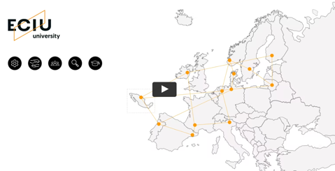
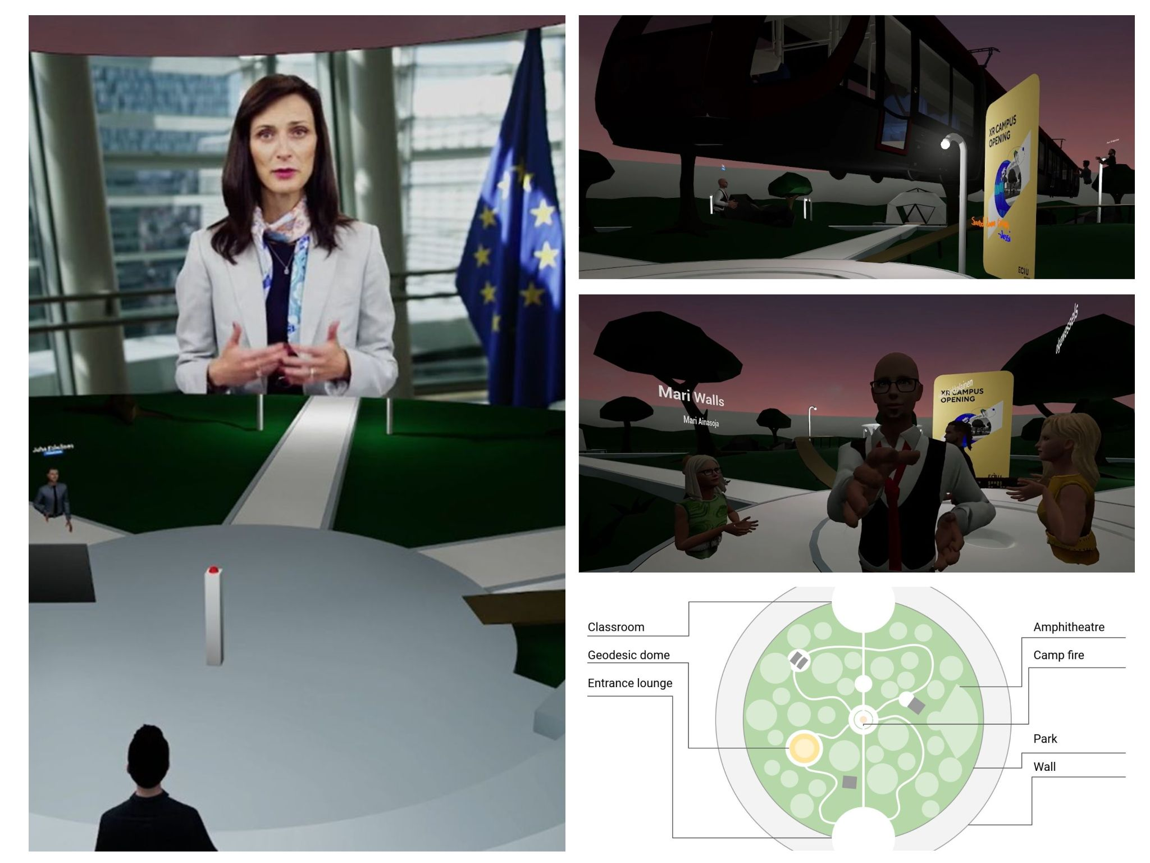
https://www.eciu.eu/about-eciu

Slide 3
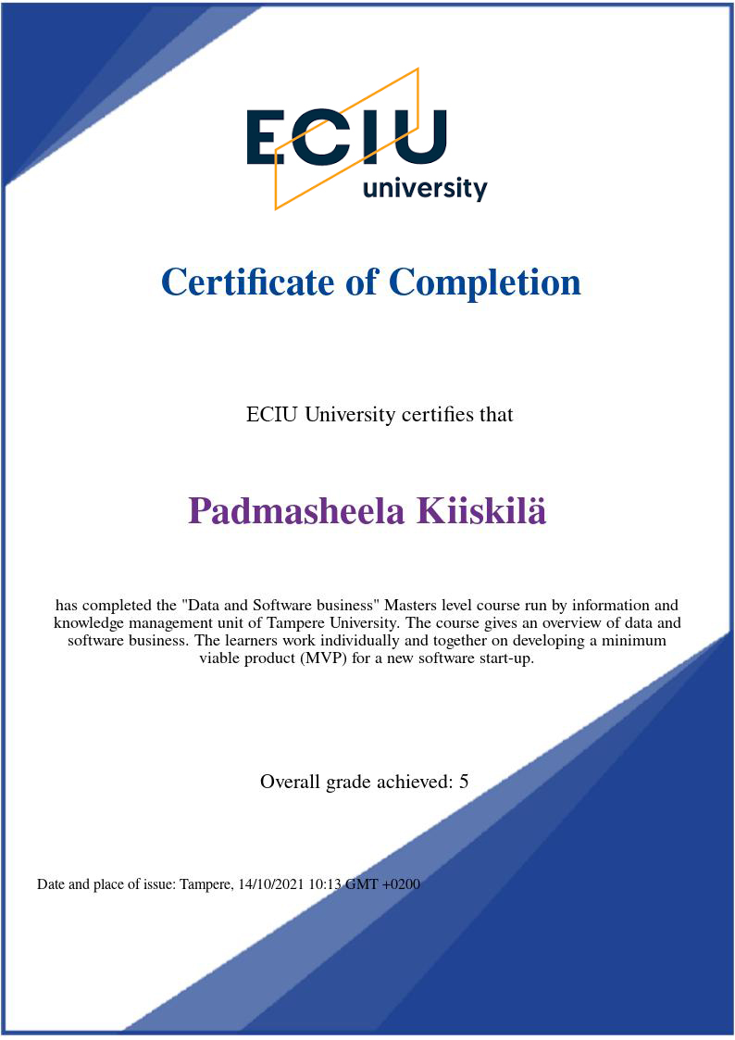
Micro-credentials in ECIU University
Learning Experience
Digital Credential
A record of the learning outcomes that a learner has acquired following a small volume of learning which have been assessed against transparent and clearly defined criteria
- EU commission

Slide 4
Broad range of learning
Offerings leading to
Digital Credentials
Current offers include
Challenges
May have ECTS
Hackathons and workshops that don’t carry ECTS
Micro-modules
Include learning offerings from partners
Co-created by partners for ECIU
Micro 1-3 ECTS, standard up to 8ECTS
Online or hybrid setting
Instruction in English
https://engage.eciu.eu/browse

Slide 5
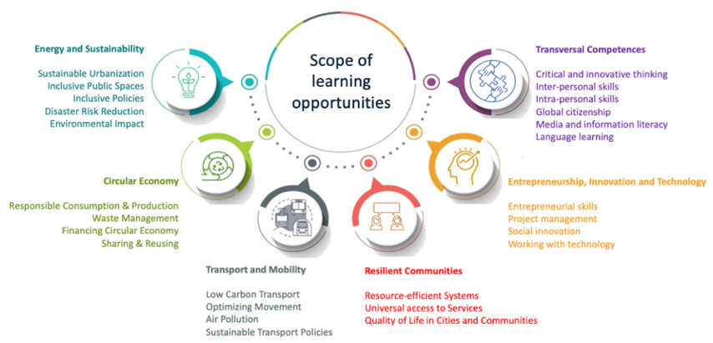
Micro-modules
"A micro-module is a short learning experience that is formally assessed and supports learners to fill their knowledge gaps and boost their capabilities in order to successfully engage in ECIU University challenge-based activities."
Characteristics (2021-2022):
Provided by an accredited institution or program (currently via ECIU network)
Preferably 1-3 ECTS (or unbundled from a larger module)
Is preferably master’s level, but can be also bachelor's level
Priority for online provision, offline possible
Provided in English
https://challenges.eciu.org/

Slide 6
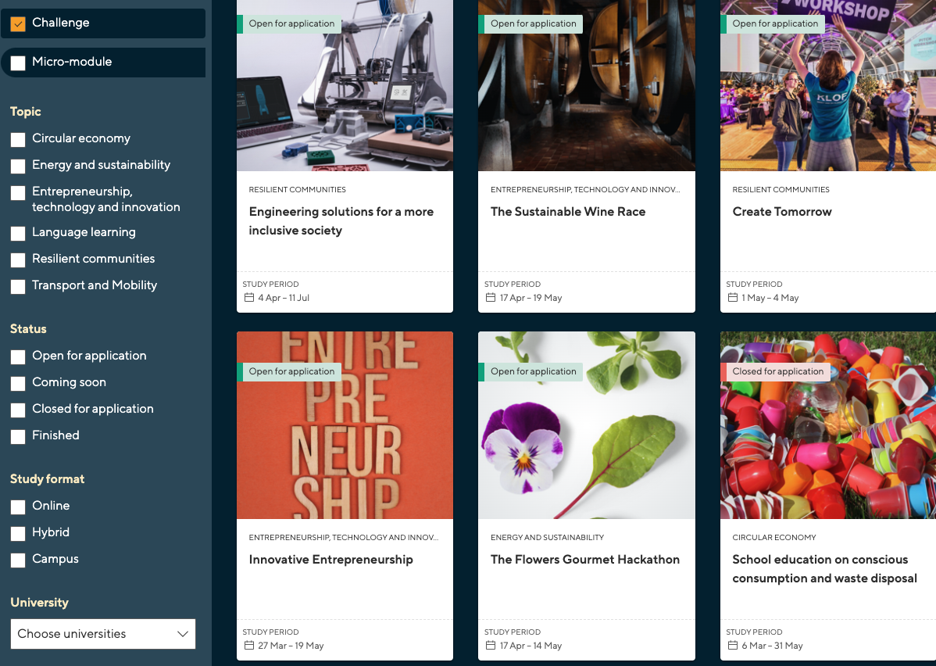
Challenges
SDG themes
Collaboration with
Industry
Cities
May have ECTS
Short non-formal opportunities (No ECTS)

Slide 7
Information included into the digital credential
Learning outcome
Activities/
Assessments
# of hours of work
Skills/competences
Domain specific
Transversal/Transferable
Language learning
Recognition of learning (formal or non-formal)

Slide 8
Digital Credentials for all learning opportunities

Slide 9
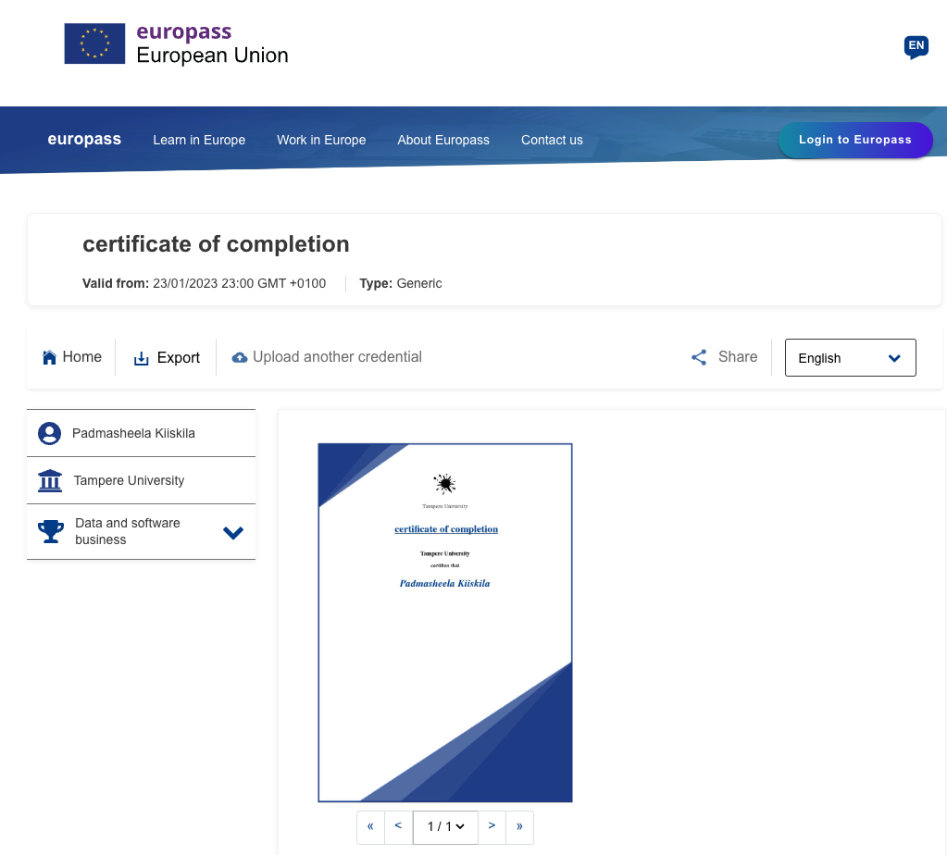
ECIU Early adopter program participation

Slide 10
Anna’s micro-credential journey
Flexible learning pathway with micro-credentials
ESSIF
In-house education
ECIU micro-credentials
Anna’s journey
Becoming a PhD student
Applying for the course “Data and software business”
Enroll into the challenge “Transition of a City Towards Circular Economy”
Completes challenge successfully
Receive academic credits
Issuers of
Verifiable Credentials
Tampere university (TAU)
Tampere university (TAU)
Kaunas University of Technology (KTU)
Anna’s wallet
Receives Academic ID
Receives Micro-credential (& academic credits at TAU)
Receives Micro-credential
Share
Verifiers of
Verifiable Credentials
(Anna shares her credentials)
Share
Share
Tampere university
Kaunas University of Technology (KTU)

Slide 12
European Digital Credentials
Achievement
ECTS (or # of hours)
Formal or Informal
Language
Learning Outcomes
Knowledge
Skills
Competences
Learning Activities
lectures
Project
Assessments
Individual assignment
Group work

Slide 13
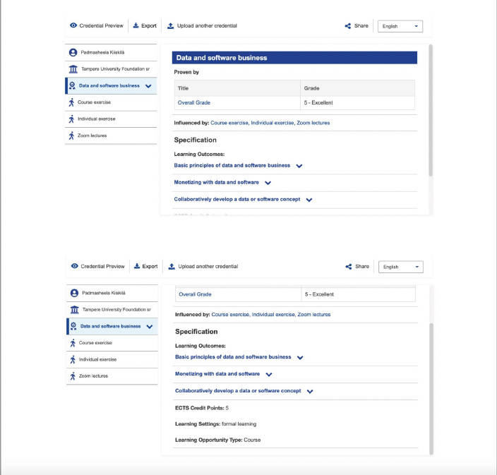

Slide 14
With the support of the Erasmus+ Programme of the European Union
The European Commission’s support for the production of this publication does not constitute an endorsement of the contents, which reflect the views only of the authors, and the Commission cannot be held responsible for any use which may be made of the information contained therein.
Some illustrations are from: www.icons8.com

