Slide 1
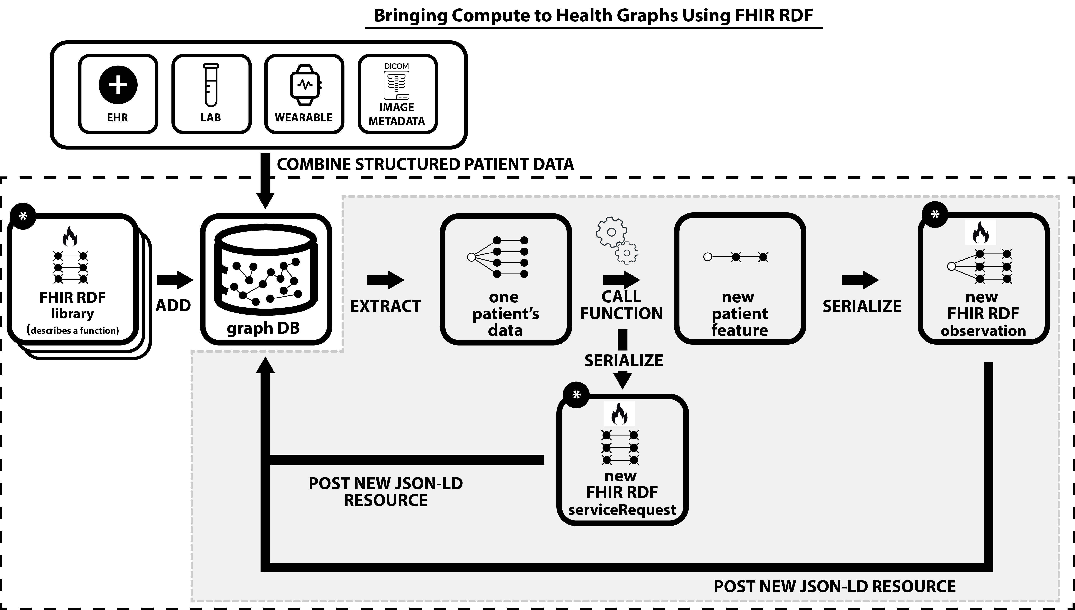
Centre for Addiction and Mental Health (CAMH)
and
University of Michigan Medical School
April 10, 2023

Slide 2
Use of FHIR RDF Resources Being Explored Now (without Enough Insight or Expertise!)
FHIR RDF LIBRARY
FHIR RDF OBSERVATION
FHIR RDF
SERVICE REQUEST
Our purpose is to:
Describe evidence-based computable functions about health
Our purpose is to:
Document the results generated by computing new patient features (e.g., risk scores)
Our purpose is to:
Document instances of requests and
responses to/from computing systems
Fit to purpose: GOOD
Fit to purpose: JUST OK
Fit to purpose: SO-SO
“The Library resource is a general-purpose container for knowledge asset definitions.”
EX Issues:
“Status” field fits lab results a little better
EX Issues:
“Intent” field for is healthcare services
Some Other Things We Have Looked At … Thought About … Wondered About
• How to arrive at RDF with URIs (URLs) that essentially always resolve to FHIR concept definitions
• Solbrig et al’s 2020 FHIR RDF R4 usability issues - @context files | Extra Bnode | JSON-LD 1.0 vs. 1.1
• FHIR JSON-LD Playground (https://fhircat.org/jsonld/playground/)
• The Function Ontology (fno.io)
• The PROV Ontology (www.w3.org/TR/prov-o/)

