Slide 1
Default Report
Min Info Model Intensity Questionnaire
September 24th 2018, 11:24 am EDT

Slide 2
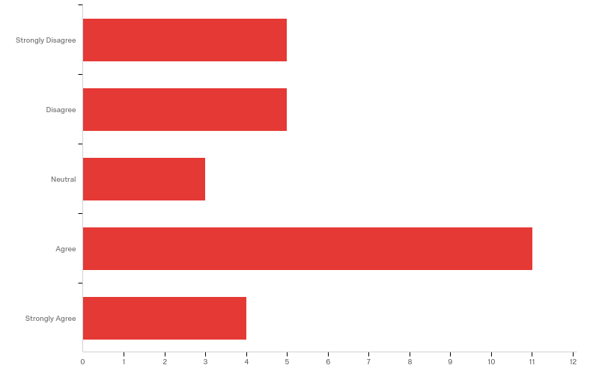
Q3 - Option 1) Keep the terms "Seriousness" and "Severity" Definitions: Seriousness - The degree to which a drug-drug interaction clinical consequence may result in harm and that will determine the type and speed of clinician intervention. Severity - The intensity of a drug-drug interaction clinical consequence. Examples: Seriousness: An adverse event is any undesirable experience associated with the use of a medical product in a patient. The event is serious and should be reported to FDA when the patient outcome is: Death Life-threatening Hospitalization (initial or prolonged) Disability or Permanent Damage Congenital Anomaly/Birth Defect Required Intervention to Prevent Permanent Impairment or Damage (Devices) Other Serious (Important Medical Events) Source: U.S. Food and Drug Administration. “What is a Serious Adverse Event?” http://www.fda.gov/Safety/MedWatch/HowToReport/ucm053087.htm (accessed August 19, 2016) Severity: “Severity is a more ambiguous term and describes the intensity of an adverse reaction in an individual. For example, a headache may be severe but not serious.” Source: Tilson H, Hines LE, McEvoy G, et al. Recommendations for selecting drug-drug interactions for clinical decision support. Am J Health Syst Pharm. 2016;73(8):576-85. Background Information: AHRQ DDI Work Group: Seriousness: “We recommend use of the term seriousness, rather than severity, to describe the extent to which a DDI can or does cause harm” Source: Scheife RT, Hines LE, Boyce RD, et al. Consensus Recommendations for Systematic Evaluation of Drug-Drug Interaction Evidence for Clinical Decision Support. Drug safety. 2015;38(2):197-206. DIDEO: Severe adverse event: serious adverse event is an adverse event that requires in-patient hospitalization, or prolongation of existing hospitalization, or that causes congenital malformation, or that results in persistent or significant disability or incapacity, or that is life threatening or results in death. DINTO: Severity – (it can take three values: {“major” , “minor” , “moderate”}): “Used of the degree of something undesirable e.g. pain or weather; also, strictness (NCIT). The potential severity of the interaction is particularly important in assessing the risk vs benefit of therapeutic alternatives. With appropriate dosage adjustments or modifications of the administration schedule, the negative effects of most interactions can be avoided. There are three degrees of severity: major, moderate and minor (Tatro).

Slide 3
Q3 - Option 1) Keep the terms "Seriousness" and "Severity" Definitions: Seriousness - The degree to which a drug-drug interaction clinical consequence may result in harm and that will determine the type and speed of clinician intervention. Severity - The intensity of a drug-drug interaction clinical consequence. Examples: Seriousness: An adverse event is any undesirable experience associated with the use of a medical product in a patient. The event is serious and should be reported to FDA when the patient outcome is: Death Life-threatening Hospitalization (initial or prolonged) Disability or Permanent Damage Congenital Anomaly/Birth Defect Required Intervention to Prevent Permanent Impairment or Damage (Devices) Other Serious (Important Medical Events) Source: U.S. Food and Drug Administration. “What is a Serious Adverse Event?” http://www.fda.gov/Safety/MedWatch/HowToReport/ucm053087.htm (accessed August 19, 2016) Severity: “Severity is a more ambiguous term and describes the intensity of an adverse reaction in an individual. For example, a headache may be severe but not serious.” Source: Tilson H, Hines LE, McEvoy G, et al. Recommendations for selecting drug-drug interactions for clinical decision support. Am J Health Syst Pharm. 2016;73(8):576-85. Background Information: AHRQ DDI Work Group: Seriousness: “We recommend use of the term seriousness, rather than severity, to describe the extent to which a DDI can or does cause harm” Source: Scheife RT, Hines LE, Boyce RD, et al. Consensus Recommendations for Systematic Evaluation of Drug-Drug Interaction Evidence for Clinical Decision Support. Drug safety. 2015;38(2):197-206. DIDEO: Severe adverse event: serious adverse event is an adverse event that requires in-patient hospitalization, or prolongation of existing hospitalization, or that causes congenital malformation, or that results in persistent or significant disability or incapacity, or that is life threatening or results in death. DINTO: Severity – (it can take three values: {“major” , “minor” , “moderate”}): “Used of the degree of something undesirable e.g. pain or weather; also, strictness (NCIT). The potential severity of the interaction is particularly important in assessing the risk vs benefit of therapeutic alternatives. With appropriate dosage adjustments or modifications of the administration schedule, the negative effects of most interactions can be avoided. There are three degrees of severity: major, moderate and minor (Tatro).

Slide 4
Q3 - Option 1) Keep the terms "Seriousness" and "Severity" Definitions: Seriousness - The degree to which a drug-drug interaction clinical consequence may result in harm and that will determine the type and speed of clinician intervention. Severity - The intensity of a drug-drug interaction clinical consequence. Examples: Seriousness: An adverse event is any undesirable experience associated with the use of a medical product in a patient. The event is serious and should be reported to FDA when the patient outcome is: Death Life-threatening Hospitalization (initial or prolonged) Disability or Permanent Damage Congenital Anomaly/Birth Defect Required Intervention to Prevent Permanent Impairment or Damage (Devices) Other Serious (Important Medical Events) Source: U.S. Food and Drug Administration. “What is a Serious Adverse Event?” http://www.fda.gov/Safety/MedWatch/HowToReport/ucm053087.htm (accessed August 19, 2016) Severity: “Severity is a more ambiguous term and describes the intensity of an adverse reaction in an individual. For example, a headache may be severe but not serious.” Source: Tilson H, Hines LE, McEvoy G, et al. Recommendations for selecting drug-drug interactions for clinical decision support. Am J Health Syst Pharm. 2016;73(8):576-85. Background Information: AHRQ DDI Work Group: Seriousness: “We recommend use of the term seriousness, rather than severity, to describe the extent to which a DDI can or does cause harm” Source: Scheife RT, Hines LE, Boyce RD, et al. Consensus Recommendations for Systematic Evaluation of Drug-Drug Interaction Evidence for Clinical Decision Support. Drug safety. 2015;38(2):197-206. DIDEO: Severe adverse event: serious adverse event is an adverse event that requires in-patient hospitalization, or prolongation of existing hospitalization, or that causes congenital malformation, or that results in persistent or significant disability or incapacity, or that is life threatening or results in death. DINTO: Severity – (it can take three values: {“major” , “minor” , “moderate”}): “Used of the degree of something undesirable e.g. pain or weather; also, strictness (NCIT). The potential severity of the interaction is particularly important in assessing the risk vs benefit of therapeutic alternatives. With appropriate dosage adjustments or modifications of the administration schedule, the negative effects of most interactions can be avoided. There are three degrees of severity: major, moderate and minor (Tatro).
# | Answer | % | Count
1 | Strongly Disagree | 17.86% | 5
2 | Disagree | 17.86% | 5
3 | Neutral | 10.71% | 3
4 | Agree | 39.29% | 11
5 | Strongly Agree | 14.29% | 4
 | Total | 100% | 28

Slide 5
Q4 - Please provide additional comments:
Please provide additional comments:
Both terms may also imply temporal consequences of the event. I think that that the above definition and seriousness of the adverse event are adopted by CTCAE and MedDRA (so, they are kind of established).
"Seriousness" and "Severity" are widely used in categorizing adverse events in clinical trials and in regulatory environments, but the term "severe" would make many clinicians think in terms of how serious the event is, and may require an intervention. The term "intensity" might make sense from a clinical standpoint.
The use of these two terms seems to create confusion probably because they are usually used as 'synonyms', even if they are not.
There is a lot of overlap in the concepts. Neither is really well-defined, particularly in any but the most serious/severe cases (e.g., what constitutes a moderate level of one or the other).
The key point is that seriousness (like criticality) is describing a POTENTIAL impact, whereas severity characterises a reaction that has been realised in an individual. This is supported by the quotation from Tilson (above) and highlights an important omission from the definition of severity which should conclude with the words, "...in an individual". Since the project is focussed on potential drug-drug interactions, you cannot then include an attribute (severity) that is describing a realised reaction because you are then no longer in the realm of the potential. Also, I'm not convinced that the seriousness alone will determine the speed of clinician intervention; I think this is more likely to be influenced by the severity of the individual's reaction.

Slide 6
Q4 - Please provide additional comments:
Please provide additional comments:
If Seriousness is an actual reporting field for the FDA, then it should be included. Even then, there are granularity problems with the definition, especially with "other serious" -> who decides? Similarly, I just don't see the value in Severity, which is has no criteria or any of the 3 categories that would enable consistent annotation. Severity should not be included.
To someone not previously familiar with this distinction, they are VERY close in meaning.
Seems similar definitions are sometimes used to define the two words. The use of severity as defined by DINTO and Tatro are commonly used but were first employed many years ago when there was less care with language. The three values for severity are hangovers from the "old" days of DI classification.
It seems to me that this is going to generate lot of confusion down the way, with consequences on data quality and the like. I understand the need to separate the two concepts, but proposing definitions for terms well known to recipients is a recipe for problems. Why not having a seriousness/severity term (requires hospitalisation or related) and a "degree/level/?" one?
It seems there is alignment of the definition and conceptual domain for 'Severity' between this body of work and the HL7 FHIR AllergyIntolerance Resource. The values associated with each are different, and we may want to consider alignment. Their values are 'mild', 'moderate', and 'severe': https://www.hl7.org/fhir/codesystem-reaction-event-severity.html I think that 'minor', 'moderate', and 'major' used here make more sense - in the HL7 model I don't know how one would know whether to use 'mild' or 'moderate' when recording an event. It appears their 'mild' is meant to mean the same thing as your 'minor'. It appears that the term 'Seriousness' here is synonymous to 'Criticality' from HL7. If so, I think there should be alignment between the 2 terms. I am not certain as to which one is 'better' than the other.

Slide 7
Q4 - Please provide additional comments:
Please provide additional comments:
Although the examples make the distinction more clear, the terms are closely related and likely to cause confusion when communicating with busy clinicians.
Seriousness for a particular event will always be patient-specific. It should be possible to use it to reason about risk (hazard/effect * likelihood) in a population, but this will not be possible, all the time an adverse event, by definition, is serious. In order to use seriousness, we would have to capture required or perceived hazard, not the actual outcome. Suggest that patient hazard would be interpreted as less dependent upon case-specific intervention outcome.
I think having both is definitely confusing and people (patients, providers, etc.) do not have the terms distinguished in their mind. Based on the definitions given above, I would recommend we align with the FDA's definitions first and foremost, since they are the regulators and gatekeepers for everything this project would be involved in. Also, if you look at DIDEO, it says it is defining Severe but then the first word in the definition is Serious, so there may be an error there.

Slide 8
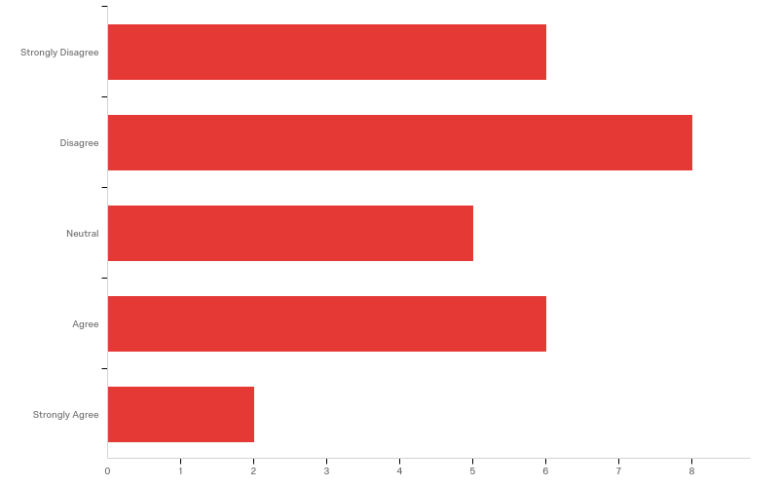
Q8 - Option 2) Use the terms "Life-Threatening" and "Intensity" Definitions: Life Threatening - The seriousness level to which a drug-drug interaction is clinically significant and has the potential to cause harm. Determines clinical intervention course of action. Intensity - The measurement of severity of a drug-drug interaction clinical consequence. Example: Life Threatening: An adverse event that is likely to put the patient’s life at risk due to concomitant drug use. Death Hospitalization (initial or prolonged) Disability or Permanent Damage Congenital Anomaly/Birth Defect Required Intervention to Prevent Permanent Impairment or Damage (Devices) Other Serious (Important Medical Events) Intensity: Degree at which the drug interaction occurs. i.e. a headache may be intense, but not life threatening Background Information: Refer to Option 1 "Seriousness" and "Severity"

Slide 9
Q8 - Option 2) Use the terms "Life-Threatening" and "Intensity" Definitions: Life Threatening - The seriousness level to which a drug-drug interaction is clinically significant and has the potential to cause harm. Determines clinical intervention course of action. Intensity - The measurement of severity of a drug-drug interaction clinical consequence. Example: Life Threatening: An adverse event that is likely to put the patient’s life at risk due to concomitant drug use. Death Hospitalization (initial or prolonged) Disability or Permanent Damage Congenital Anomaly/Birth Defect Required Intervention to Prevent Permanent Impairment or Damage (Devices) Other Serious (Important Medical Events) Intensity: Degree at which the drug interaction occurs. i.e. a headache may be intense, but not life threatening Background Information: Refer to Option 1 "Seriousness" and "Severity"
# | Field | Minimum | Maximum | Mean | Std Deviation | Variance | Count
1 | How strongly do you agree with the use of terms "Life-Threatening" and "Intensity"? | 1.00 | 5.00 | 2.63 | 1.25 | 1.57 | 27

Slide 10
Q8 - Option 2) Use the terms "Life-Threatening" and "Intensity" Definitions: Life Threatening - The seriousness level to which a drug-drug interaction is clinically significant and has the potential to cause harm. Determines clinical intervention course of action. Intensity - The measurement of severity of a drug-drug interaction clinical consequence. Example: Life Threatening: An adverse event that is likely to put the patient’s life at risk due to concomitant drug use. Death Hospitalization (initial or prolonged) Disability or Permanent Damage Congenital Anomaly/Birth Defect Required Intervention to Prevent Permanent Impairment or Damage (Devices) Other Serious (Important Medical Events) Intensity: Degree at which the drug interaction occurs. i.e. a headache may be intense, but not life threatening Background Information: Refer to Option 1 "Seriousness" and "Severity"
# | Answer | % | Count
1 | Strongly Disagree | 22.22% | 6
2 | Disagree | 29.63% | 8
3 | Neutral | 18.52% | 5
4 | Agree | 22.22% | 6
5 | Strongly Agree | 7.41% | 2
 | Total | 100% | 27

Slide 11
Q7 - Please provide additional comments:
Please provide additional comments:
In terms of semantics, I see a circular relation between severity and intensity: Severity: "The intensity of a drug-drug interaction clinical consequence." Intensity: "The measurement of severity of a drug-drug interaction clinical consequence."
While I think that "Intensity" better categorizes degrees, such as mild or moderate, I think that "Life-Threatening" is somewhat colloquial/ambiguous.
I think life-threatening is obvious; however, the intensity is not as good as severity with a definition.
The term 'life threatening' suggests that only those DDIs that can pose a risk for patients life should be considered, while other DDIs can cause great damage to the patient e.g., decreased activity of oral contraceptives or prolonged length of stay at hospital, among many others. Intensity can be measured only on patients' symptoms and would not be correct, in my opinion, to describe the 'intensity' of an increase on blood pressure or reduced activity (fail of contraceptive therapy, for example).
These terms are too narrow to represent the spectrum of potential clinical consequences of a drug-drug interaction.
Just using different words to describe the same characteristics as in Option 1 doesn't solve the underlying problem, i.e. that "severity/intensity" doesn't have any place in a model of potential drug-drug interactions.

Slide 12
Q7 - Please provide additional comments:
Please provide additional comments:
The definition of life threatening should probably indicate that it has the potential to be fatal. intensity is qualitative, even if it were on a discrete/continuous scale, one would need to define what that meant in this context. unusable in its current form
These are clearly understandable. The only question I have is whether disabling events will be understood as to be classified as life-threatening. (Life-threating/life-altering would be possible alternate language but I don't advocate for that.)
I am not an expert in medicine (I have a PhD in Computer Science) but I do have a personal opinion on labeling an interaction "life threatening" and treating it differently. An extreme example just to make my point: if the outcome is losing all limbs but the patient survives, does this make the outcome different from another one that results in death? or if the outcome is sever depression in a monitored environment (and so suicide is not a problem), then would not having the label "life threatening" make the outcome different?
Almost no DIs produce life threatening outcomes. The supplied definition of life threatening includes many outcomes that are not life threatening. The use of these terms would markedly limit the number of DIs that would fall into the highest risk category. Bad idea.
Like Life Threatening; but not intensity.

Slide 13
Q7 - Please provide additional comments:
Please provide additional comments:
What are the values for Life Threatening? Is it a boolean? Maybe 'Reaction Intensity' or would make it more clear that this is a property of the intensity of the adverse event, if I am reading it correctly.
This is better than serious vs. severe. I like intensity, but "life-threatening" captures just one aspect of harm, which is the likelihood of death.
Life threatening nicely complements previous suggestion of using "hazard" instead of "seriousness". "Life threatening" points to potential of serious outcome. Maybe then introduce "(perceived) hazard", "actual seriousness of outcome", "actual experienced intensity".
No prior precedent. Adopting new terms will just add to confusion.
I think these are clearer to the reader, but I don't love "life-threatening." The examples listed are actually "serious" but not necessarily life threatening, e.g. a birth defect may not be life threatening, not all hospitalizations are due to life threatening issues, etc. Also, life threatening to me is more of a "check box," either it is or it isn't, whereas Seriousness more adequately represented a continuum of possibilities. I think Seriousness + Intensity may be a better combination.

Slide 14
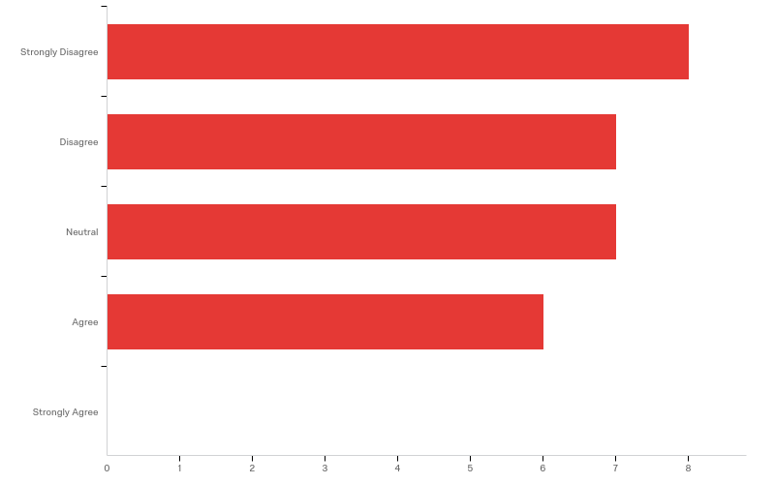
Q15 - Option 3) Use the terms "Criticality" and "Severity" Definitions: Criticality - A clinical judgment as to the worst case result of a future exposure (including substance administration). When the worst case result is assessed to have a life-threatening or organ system threatening potential, it is considered to be of high criticality. Severity - The intensity of a drug-drug interaction clinical consequence. Example: For example a patient might have a severe reaction to a medication (nausea) however that condition has a low criticality – e.g. the medication can still be prescribed if medically indicated. Conversely, a child may have a mild reaction on the first exposure to a peanut, however a repeat exposure to peanuts may be life threatening and therefore of high criticality. Background: The default criticality value for any propensity to an adverse reaction should be 'Low Risk', indicating at the very least a relative contraindication to deliberate or voluntary exposure to the substance. 'High Risk' is flagged if the clinician has identified a propensity for a more serious or potentially life-threatening reaction, such as anaphylaxis, and implies an absolute contraindication to deliberate or voluntary exposure to the substance. If this element is missing, the criticality is unknown (though it may be known elsewhere). Systems that capture a severity at the condition level are actually representing the concept of criticality whereas the severity documented at the reaction level is representing the true reaction severity. Existing systems that are capturing both condition criticality and reaction severity may use the term "severity" to represent both. Criticality is the worst it could be in the future (i.e. situation-agnostic) whereas severity is situation-dependent. Source: https://www.hl7.org/fhir/allergyintolerance-definitions.html#AllergyIntolerance.criticality

Slide 15
Q15 - Option 3) Use the terms "Criticality" and "Severity" Definitions: Criticality - A clinical judgment as to the worst case result of a future exposure (including substance administration). When the worst case result is assessed to have a life-threatening or organ system threatening potential, it is considered to be of high criticality. Severity - The intensity of a drug-drug interaction clinical consequence. Example: For example a patient might have a severe reaction to a medication (nausea) however that condition has a low criticality – e.g. the medication can still be prescribed if medically indicated. Conversely, a child may have a mild reaction on the first exposure to a peanut, however a repeat exposure to peanuts may be life threatening and therefore of high criticality. Background: The default criticality value for any propensity to an adverse reaction should be 'Low Risk', indicating at the very least a relative contraindication to deliberate or voluntary exposure to the substance. 'High Risk' is flagged if the clinician has identified a propensity for a more serious or potentially life-threatening reaction, such as anaphylaxis, and implies an absolute contraindication to deliberate or voluntary exposure to the substance. If this element is missing, the criticality is unknown (though it may be known elsewhere). Systems that capture a severity at the condition level are actually representing the concept of criticality whereas the severity documented at the reaction level is representing the true reaction severity. Existing systems that are capturing both condition criticality and reaction severity may use the term "severity" to represent both. Criticality is the worst it could be in the future (i.e. situation-agnostic) whereas severity is situation-dependent. Source: https://www.hl7.org/fhir/allergyintolerance-definitions.html#AllergyIntolerance.criticality
# | Field | Minimum | Maximum | Mean | Std Deviation | Variance | Count
1 | How strongly do you agree with the use of terms "Criticality" and "Severity"? | 1.00 | 4.00 | 2.39 | 1.11 | 1.24 | 28

Slide 16
Q15 - Option 3) Use the terms "Criticality" and "Severity" Definitions: Criticality - A clinical judgment as to the worst case result of a future exposure (including substance administration). When the worst case result is assessed to have a life-threatening or organ system threatening potential, it is considered to be of high criticality. Severity - The intensity of a drug-drug interaction clinical consequence. Example: For example a patient might have a severe reaction to a medication (nausea) however that condition has a low criticality – e.g. the medication can still be prescribed if medically indicated. Conversely, a child may have a mild reaction on the first exposure to a peanut, however a repeat exposure to peanuts may be life threatening and therefore of high criticality. Background: The default criticality value for any propensity to an adverse reaction should be 'Low Risk', indicating at the very least a relative contraindication to deliberate or voluntary exposure to the substance. 'High Risk' is flagged if the clinician has identified a propensity for a more serious or potentially life-threatening reaction, such as anaphylaxis, and implies an absolute contraindication to deliberate or voluntary exposure to the substance. If this element is missing, the criticality is unknown (though it may be known elsewhere). Systems that capture a severity at the condition level are actually representing the concept of criticality whereas the severity documented at the reaction level is representing the true reaction severity. Existing systems that are capturing both condition criticality and reaction severity may use the term "severity" to represent both. Criticality is the worst it could be in the future (i.e. situation-agnostic) whereas severity is situation-dependent. Source: https://www.hl7.org/fhir/allergyintolerance-definitions.html#AllergyIntolerance.criticality
# | Answer | % | Count
1 | Strongly Disagree | 28.57% | 8
2 | Disagree | 25.00% | 7
3 | Neutral | 25.00% | 7
4 | Agree | 21.43% | 6
5 | Strongly Agree | 0.00% | 0
 | Total | 100% | 28

Slide 17
Q16 - Please provide additional comments:
Please provide additional comments:
hard to interpret
Criticality is a word and concept that I have little exposure to. Thus, a neutral response.
Just use Severity.
I think that "Criticality" and "Severity" make sense when situation-agnostic and situation-dependent are included in their definitions, and "Criticality" may align better with clinical decision making.
I think it will lead to the same confusion caused by the used of severity and seriousness.
Criticality is defined in a narrow and highly subjective way.
As your example makes clear, the notion of criticality comes from the realm of allergy and intolerance. In that context, criticality is a binary artifact ("high" or "low"); in the context of potential drug-drug interactions I would think 3 values would be more appropriate (e.g. "high", "medium", "low" or some other equivalent terms). The last paragraph under "Background" above is helpful in supporting my argument that "severity" is an attribute of the reaction and therefore has no place in a model about potential interactions (hence the "strongly disagree" scoring)

Slide 18
Q16 - Please provide additional comments:
Please provide additional comments:
Criticality is interesting, but only because it is related to a life-threatening (or otherwise, what i consider to be a serious) event. Would i consider nausea to be severe? no. Would i consider anaphylaxis serious and potentially severe? yes.
These are still hard to distinguish.
Criticality sounds like a nuke is about to explode. It does not define the level of risk especially since almost no one in pharmacy / medicine uses it in this context.
As stated earlier, I like the alignment between these 2 activities and over time providers will get used to seeing the same types of data elements presented to them. I also like your values 'minor', 'moderate', 'severe' better than the HL7 counterparts, but that is just my opinion of 1. But I still think that Criticality in the context of DDIs needs more clinical validation - for example are there DDI situations where there is low criticality coupled with high severity (like nausea, headache) that would not warrant a change in the drug prescribed ?
I like criticality. Much better than seriousness and life-threatening. But I like intensity better than severity. The latter can still be confused with criticality. Why not "criticality" and "intensity"?
Criticality of an intervention should be related to risk of outcome, not only worst case seriousness. So a bit confusing if this is individualizable.

Slide 19
Q16 - Please provide additional comments:
Please provide additional comments:
as before. Unless there's precedent for the use of "criticality" , I would avoid.
I didn't like it when I read the pair initially, and after reading the second paragraph of the background, I'm more confused than I was before about what is meant. Not a good sign.

Slide 20
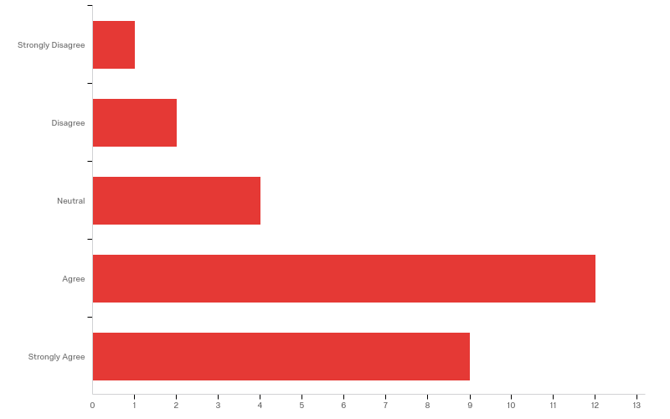
Q6 - Option 4) Operational classification based on management criteria that apply to a risk pathway. Definitions: Operational Class Assessment – Risk assessment based upon clinical management of drug interactions rather than clinical significance alone. Example using ORCA (see below for more about ORCA): Warfarin - NSAIDs The NSAIDs is topical diclofenac: Recommended Action: No special precautions The NSAID is NOT topical diclofenac but the patient is concomitantly taking a proton pump inhibitor or misoprostol: Recommended Action: Assess risk and take action if necessary The NSAID is NOT topical diclofenac, the patient is NOT concomitantly taking a proton pump inhibitor or misoprostol, and the patient has one or more of the following risk factors: History of upper gastrointestinal bleeding (UGIB) or peptic ulcer or age > 65 years old Recommended Action: Use only if benefit outweighs risk Concomitantly taking systemic corticosteroids, aldosterone antagonists, or high dose or multiple NSAID Recommended Action: Use only if benefit outweighs risk Two Example Operational Classification Criteria: OperRational ClassificAtion (ORCA) System for Classifying Drug Interactions: Contraindicated – No situations have been identified where the benefit of the combination outweighs the risk. Provisionally Contraindicated – The combination increases the risk of adverse effects. Avoid concurrent use unless interaction is desired or no alternative is available. If the combination is used, increased monitoring may be necessary. Conditional – Risk may be increased, depending on the clinical situation. Assess risk and take action as needed. Minimal Risk – Risk of adverse outcome appears small. No special precautions appear necessary. No interaction – Evidence suggests that drugs do not interact. ***Note: only top three are included in Top 100 Drug Interactions by John Horn and Philip D. Hansten LexiComp: A: No Known Interation - Data have not demonstrated either parmacodynamic or pharmacokinetic interactions between the specifid agents B: No Action Needed - Data demonstrate that the specified agents may interact with each other, but there is little to no evidence of clinical concern resulting from their concomitant use C: Monitor Therapy - Data demonstrate that the specified agents may interact with each other in a clinically significant manner. The benefits of concomitant use of these two medications usually outweigh the risks. An appropriate monitoring plan should be implemented to identify potential negative effects. Dosage adjustments of one or both agents may be needed in a minority of patients. D: Consider Therapy Modification - Data demonstrate that the two medications may interact with each other in a clinically significant manner. A patient-specific assessment must be conducted to determine whether the benefits of concomitant therapy outweigh the risks. Specific actions must be taken in order to realize the benefits and/or minimize the toxicity resulting from concomitant use of the agents. These actions may include aggressive monitoring, empiric dosage changes, or choosing alternative agents. X: Avoid Combination - Data demonstrate that the specified agents may interact with each other in a clinically significant manner. The risks associated with concomitant use of these agents usually outweigh the benefits. These agents are generally considered contraindicated.

Slide 21
Q6 - Option 4) Operational classification based on management criteria that apply to a risk pathway. Definitions: Operational Class Assessment – Risk assessment based upon clinical management of drug interactions rather than clinical significance alone. Example using ORCA (see below for more about ORCA): Warfarin - NSAIDs The NSAIDs is topical diclofenac: Recommended Action: No special precautions The NSAID is NOT topical diclofenac but the patient is concomitantly taking a proton pump inhibitor or misoprostol: Recommended Action: Assess risk and take action if necessary The NSAID is NOT topical diclofenac, the patient is NOT concomitantly taking a proton pump inhibitor or misoprostol, and the patient has one or more of the following risk factors: History of upper gastrointestinal bleeding (UGIB) or peptic ulcer or age > 65 years old Recommended Action: Use only if benefit outweighs risk Concomitantly taking systemic corticosteroids, aldosterone antagonists, or high dose or multiple NSAID Recommended Action: Use only if benefit outweighs risk Two Example Operational Classification Criteria: OperRational ClassificAtion (ORCA) System for Classifying Drug Interactions: Contraindicated – No situations have been identified where the benefit of the combination outweighs the risk. Provisionally Contraindicated – The combination increases the risk of adverse effects. Avoid concurrent use unless interaction is desired or no alternative is available. If the combination is used, increased monitoring may be necessary. Conditional – Risk may be increased, depending on the clinical situation. Assess risk and take action as needed. Minimal Risk – Risk of adverse outcome appears small. No special precautions appear necessary. No interaction – Evidence suggests that drugs do not interact. ***Note: only top three are included in Top 100 Drug Interactions by John Horn and Philip D. Hansten LexiComp: A: No Known Interation - Data have not demonstrated either parmacodynamic or pharmacokinetic interactions between the specifid agents B: No Action Needed - Data demonstrate that the specified agents may interact with each other, but there is little to no evidence of clinical concern resulting from their concomitant use C: Monitor Therapy - Data demonstrate that the specified agents may interact with each other in a clinically significant manner. The benefits of concomitant use of these two medications usually outweigh the risks. An appropriate monitoring plan should be implemented to identify potential negative effects. Dosage adjustments of one or both agents may be needed in a minority of patients. D: Consider Therapy Modification - Data demonstrate that the two medications may interact with each other in a clinically significant manner. A patient-specific assessment must be conducted to determine whether the benefits of concomitant therapy outweigh the risks. Specific actions must be taken in order to realize the benefits and/or minimize the toxicity resulting from concomitant use of the agents. These actions may include aggressive monitoring, empiric dosage changes, or choosing alternative agents. X: Avoid Combination - Data demonstrate that the specified agents may interact with each other in a clinically significant manner. The risks associated with concomitant use of these agents usually outweigh the benefits. These agents are generally considered contraindicated.
# | Field | Minimum | Maximum | Mean | Std Deviation | Variance | Count
1 | How strongly do you agree with the use of operational classifications? | 1.00 | 5.00 | 3.93 | 1.03 | 1.07 | 28

Slide 22
Q6 - Option 4) Operational classification based on management criteria that apply to a risk pathway. Definitions: Operational Class Assessment – Risk assessment based upon clinical management of drug interactions rather than clinical significance alone. Example using ORCA (see below for more about ORCA): Warfarin - NSAIDs The NSAIDs is topical diclofenac: Recommended Action: No special precautions The NSAID is NOT topical diclofenac but the patient is concomitantly taking a proton pump inhibitor or misoprostol: Recommended Action: Assess risk and take action if necessary The NSAID is NOT topical diclofenac, the patient is NOT concomitantly taking a proton pump inhibitor or misoprostol, and the patient has one or more of the following risk factors: History of upper gastrointestinal bleeding (UGIB) or peptic ulcer or age > 65 years old Recommended Action: Use only if benefit outweighs risk Concomitantly taking systemic corticosteroids, aldosterone antagonists, or high dose or multiple NSAID Recommended Action: Use only if benefit outweighs risk Two Example Operational Classification Criteria: OperRational ClassificAtion (ORCA) System for Classifying Drug Interactions: Contraindicated – No situations have been identified where the benefit of the combination outweighs the risk. Provisionally Contraindicated – The combination increases the risk of adverse effects. Avoid concurrent use unless interaction is desired or no alternative is available. If the combination is used, increased monitoring may be necessary. Conditional – Risk may be increased, depending on the clinical situation. Assess risk and take action as needed. Minimal Risk – Risk of adverse outcome appears small. No special precautions appear necessary. No interaction – Evidence suggests that drugs do not interact. ***Note: only top three are included in Top 100 Drug Interactions by John Horn and Philip D. Hansten LexiComp: A: No Known Interation - Data have not demonstrated either parmacodynamic or pharmacokinetic interactions between the specifid agents B: No Action Needed - Data demonstrate that the specified agents may interact with each other, but there is little to no evidence of clinical concern resulting from their concomitant use C: Monitor Therapy - Data demonstrate that the specified agents may interact with each other in a clinically significant manner. The benefits of concomitant use of these two medications usually outweigh the risks. An appropriate monitoring plan should be implemented to identify potential negative effects. Dosage adjustments of one or both agents may be needed in a minority of patients. D: Consider Therapy Modification - Data demonstrate that the two medications may interact with each other in a clinically significant manner. A patient-specific assessment must be conducted to determine whether the benefits of concomitant therapy outweigh the risks. Specific actions must be taken in order to realize the benefits and/or minimize the toxicity resulting from concomitant use of the agents. These actions may include aggressive monitoring, empiric dosage changes, or choosing alternative agents. X: Avoid Combination - Data demonstrate that the specified agents may interact with each other in a clinically significant manner. The risks associated with concomitant use of these agents usually outweigh the benefits. These agents are generally considered contraindicated.
# | Answer | % | Count
1 | Strongly Disagree | 3.57% | 1
2 | Disagree | 7.14% | 2
3 | Neutral | 14.29% | 4
4 | Agree | 42.86% | 12
5 | Strongly Agree | 32.14% | 9
 | Total | 100% | 28

Slide 23
Q9 - Please provide additional comments:
Please provide additional comments:
Well accepted in many organizations
Focusing primarily on clinical management and ignoring levels of intensity/severity does not fully capture the potential effect of the drug-drug interaction on the patient.
This group does not seem on the same dimension compared to seriousness and severity. This group included actions.
This can be the best way to define the potential risk of a DDI, although it should be considered that different scales can be used and that the same pair of drugs can be classified in very different ways in two sources.
This can be a valuable data point, but like other proposals may not be sufficient independent of any other data or rating.
It will perhaps depend on the use case, but for those that involve a clinician-patient encounter the more directive nature of these classifications is helpful.
This seems clear; I can only comment as an ontologist.
is this an alternative option? it seems that this can be used in addition to severity/seriousness or severity/criticality

Slide 24
Q9 - Please provide additional comments:
Please provide additional comments:
Both of these use risk to assess management. That seems like the best option to follow when providing patient care. BTW, the ORCA system does not use the word "contraindicated" since it has different implications to different users. Your "translation" of ORCA classification actions is not accurate and may bias evaluators. Why not use original ORCA class and risk management?
Overall, operational classifications have actionable information, which could be useful in driving decision support. However, there should be ways to tailor a DDI classification to a specific patient.
These are recommendations for responses, not classifications of the magnitude of risk.
I like this idea. I assume the suggestion is to ditch "seriousness" and "severity" and just give the ORCA class. If I give you seriousness and severity, you still have to determine what action that merits (basically, you have to come up with your own personal ORCA decision). The ORCA does the thinking for you (conservatively, of course).

Slide 25
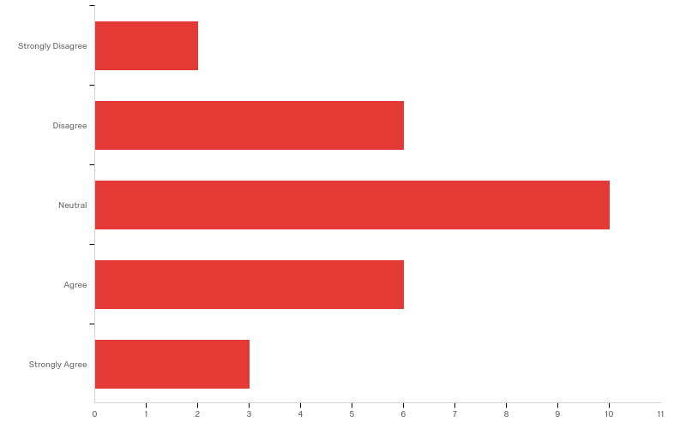
Q10 - Option 5) Use a scale from another organization Example of an interaction rated using one rating system: Warfarin - Diclofenac RATING D4 (D - Clinically significant interaction that should be avoided warfarin: enterally and parenterally diclofenac: enterally and parenterally; 4 - Data from controlled studies on relevant patient population) Medical consequence: Concomitant treatment with NSAIDs and warfarin may lead to severe bleeding. The risk of gastrointestinal haemorrhage is 2-3 times increased compared with warfarin alone. Example of 4 Rating Systems: SFINX: The interactions are classified with letter (A-D) and color for clinical significance, as well as the number (0-4) of the type of documentation as shown below: Clinical significance: A (green): The interaction has no clinical signifigance B (grey): The clinical significance of the interaction is unknown and / or varied C (yellow): Clinically significant interaction that can be managed with, for example, dose adjustment D (red): Clinically significant interaction that should be avoided ***Note that it is not a "severity scale". Both the B and C interactions can be at least as serious as a D interaction in terms of clinical outcome or clinical events. The classification A, B, C, D of the interactions is structured as support for the clinical treatment. Documentation Type: 0 = Data from studies of other medicinal products with similar properties. 1 = Data from incomplete case reports and / or in vitro studies. 2 = Data from well documented case reports. 3 = Data from studies in healthy subjects and / or pilot studies in patients. 4 = Data from controlled studies on relevant patient population. Modified by Folke Sjöqvist: A new classification system for drug interactions. Eur J Clin Pharmacol 52 (supplement) Abstract 377a 1997 Source: http://janusmed.sll.se/about/ominteraktioner/ PharmGKB: AA: Clinical effect (NS): Kinetic effect (NS) A: Minor clinical effect (S): QTc prolongation ( 168 hr), permanent symptom or invalidating injury E: Clinical effect (S): Failure of lifesaving therapy F: Clinical effect (S): death; arrhythmia; unanticipated myelosuppression. Source: https://www.pharmgkb.org/page/dpwg Micromedex: Contraindicated - The drugs are contraindicated for concurrent use Major - The interaction may be life-threatening and/or require medical intervention to minimize or prevent serious adverse effects Moderate - The interaction may result in exacerbation of the patient's condition and/or require alteration in therapy Minor - The interaction would have limited clinical effects. Manifestations may include an increase in the frequency or severity of the side effects but generally would not require a Major alteration in therapy Unknown - Unknown KNMP Rating System: Theoretical/hypothetical claims in Product Information: Low/no Priority → No Alert ~ 90-100% Drug A as victim: Product Information: drug A is substrate of CYPxxx, caution with inducers/inhibitors - no studies done Therapeutic window unknown Relation plasma level/AUC and effect/toxicity: Unknown Drug A is not a substrate ↓↑ drug A: no observed failure or unknown QTc: not on any Arizona CERT list / no effect Drug A as perpetrator: Product Information: inhibits/induces CYPxxx, caution with substrates - no studies done Moderate Priority → Alert ~ 50% Drug A as victim: Therapeutic window large or unknown Relation plasma level/AUC and effect unknown ↓↑ drug A ≥ 2x,:no observed failure/toxicity or unknown QTc Interval: Arizona CERT - Possible/conditional Risk of Torsades de Pointes Drug A as perpetrator: ↓↑ drug B (small therapeutic window) ↓↑ drug C (big/unknown therapeutic window) High Priority for Assessement → Alert ~ 90-100% Drug A as victim: Small therapeutic window Relation plasma level/AUC and effect / toxicity ↓↑ drug A → observed therapeutic failure/toxicity QTc Interval: Arizona CERT - Drugs with a Risk of Torsades de Pointes Drug A as perpetrator: ↓↑ drug B (with small therapeutic window) ≥ 2x

Slide 26
Q10 - Option 5) Use a scale from another organization Example of an interaction rated using one rating system: Warfarin - Diclofenac RATING D4 (D - Clinically significant interaction that should be avoided warfarin: enterally and parenterally diclofenac: enterally and parenterally; 4 - Data from controlled studies on relevant patient population) Medical consequence: Concomitant treatment with NSAIDs and warfarin may lead to severe bleeding. The risk of gastrointestinal haemorrhage is 2-3 times increased compared with warfarin alone. Example of 4 Rating Systems: SFINX: The interactions are classified with letter (A-D) and color for clinical significance, as well as the number (0-4) of the type of documentation as shown below: Clinical significance: A (green): The interaction has no clinical signifigance B (grey): The clinical significance of the interaction is unknown and / or varied C (yellow): Clinically significant interaction that can be managed with, for example, dose adjustment D (red): Clinically significant interaction that should be avoided ***Note that it is not a "severity scale". Both the B and C interactions can be at least as serious as a D interaction in terms of clinical outcome or clinical events. The classification A, B, C, D of the interactions is structured as support for the clinical treatment. Documentation Type: 0 = Data from studies of other medicinal products with similar properties. 1 = Data from incomplete case reports and / or in vitro studies. 2 = Data from well documented case reports. 3 = Data from studies in healthy subjects and / or pilot studies in patients. 4 = Data from controlled studies on relevant patient population. Modified by Folke Sjöqvist: A new classification system for drug interactions. Eur J Clin Pharmacol 52 (supplement) Abstract 377a 1997 Source: http://janusmed.sll.se/about/ominteraktioner/ PharmGKB: AA: Clinical effect (NS): Kinetic effect (NS) A: Minor clinical effect (S): QTc prolongation ( 168 hr), permanent symptom or invalidating injury E: Clinical effect (S): Failure of lifesaving therapy F: Clinical effect (S): death; arrhythmia; unanticipated myelosuppression. Source: https://www.pharmgkb.org/page/dpwg Micromedex: Contraindicated - The drugs are contraindicated for concurrent use Major - The interaction may be life-threatening and/or require medical intervention to minimize or prevent serious adverse effects Moderate - The interaction may result in exacerbation of the patient's condition and/or require alteration in therapy Minor - The interaction would have limited clinical effects. Manifestations may include an increase in the frequency or severity of the side effects but generally would not require a Major alteration in therapy Unknown - Unknown KNMP Rating System: Theoretical/hypothetical claims in Product Information: Low/no Priority → No Alert ~ 90-100% Drug A as victim: Product Information: drug A is substrate of CYPxxx, caution with inducers/inhibitors - no studies done Therapeutic window unknown Relation plasma level/AUC and effect/toxicity: Unknown Drug A is not a substrate ↓↑ drug A: no observed failure or unknown QTc: not on any Arizona CERT list / no effect Drug A as perpetrator: Product Information: inhibits/induces CYPxxx, caution with substrates - no studies done Moderate Priority → Alert ~ 50% Drug A as victim: Therapeutic window large or unknown Relation plasma level/AUC and effect unknown ↓↑ drug A ≥ 2x,:no observed failure/toxicity or unknown QTc Interval: Arizona CERT - Possible/conditional Risk of Torsades de Pointes Drug A as perpetrator: ↓↑ drug B (small therapeutic window) ↓↑ drug C (big/unknown therapeutic window) High Priority for Assessement → Alert ~ 90-100% Drug A as victim: Small therapeutic window Relation plasma level/AUC and effect / toxicity ↓↑ drug A → observed therapeutic failure/toxicity QTc Interval: Arizona CERT - Drugs with a Risk of Torsades de Pointes Drug A as perpetrator: ↓↑ drug B (with small therapeutic window) ≥ 2x
# | Field | Minimum | Maximum | Mean | Std Deviation | Variance | Count
1 | How strongly do you agree with the use of an existing DDI Rating System such as the examples mentioned? | 1.00 | 5.00 | 3.07 | 1.09 | 1.18 | 27

Slide 27
Q10 - Option 5) Use a scale from another organization Example of an interaction rated using one rating system: Warfarin - Diclofenac RATING D4 (D - Clinically significant interaction that should be avoided warfarin: enterally and parenterally diclofenac: enterally and parenterally; 4 - Data from controlled studies on relevant patient population) Medical consequence: Concomitant treatment with NSAIDs and warfarin may lead to severe bleeding. The risk of gastrointestinal haemorrhage is 2-3 times increased compared with warfarin alone. Example of 4 Rating Systems: SFINX: The interactions are classified with letter (A-D) and color for clinical significance, as well as the number (0-4) of the type of documentation as shown below: Clinical significance: A (green): The interaction has no clinical signifigance B (grey): The clinical significance of the interaction is unknown and / or varied C (yellow): Clinically significant interaction that can be managed with, for example, dose adjustment D (red): Clinically significant interaction that should be avoided ***Note that it is not a "severity scale". Both the B and C interactions can be at least as serious as a D interaction in terms of clinical outcome or clinical events. The classification A, B, C, D of the interactions is structured as support for the clinical treatment. Documentation Type: 0 = Data from studies of other medicinal products with similar properties. 1 = Data from incomplete case reports and / or in vitro studies. 2 = Data from well documented case reports. 3 = Data from studies in healthy subjects and / or pilot studies in patients. 4 = Data from controlled studies on relevant patient population. Modified by Folke Sjöqvist: A new classification system for drug interactions. Eur J Clin Pharmacol 52 (supplement) Abstract 377a 1997 Source: http://janusmed.sll.se/about/ominteraktioner/ PharmGKB: AA: Clinical effect (NS): Kinetic effect (NS) A: Minor clinical effect (S): QTc prolongation ( 168 hr), permanent symptom or invalidating injury E: Clinical effect (S): Failure of lifesaving therapy F: Clinical effect (S): death; arrhythmia; unanticipated myelosuppression. Source: https://www.pharmgkb.org/page/dpwg Micromedex: Contraindicated - The drugs are contraindicated for concurrent use Major - The interaction may be life-threatening and/or require medical intervention to minimize or prevent serious adverse effects Moderate - The interaction may result in exacerbation of the patient's condition and/or require alteration in therapy Minor - The interaction would have limited clinical effects. Manifestations may include an increase in the frequency or severity of the side effects but generally would not require a Major alteration in therapy Unknown - Unknown KNMP Rating System: Theoretical/hypothetical claims in Product Information: Low/no Priority → No Alert ~ 90-100% Drug A as victim: Product Information: drug A is substrate of CYPxxx, caution with inducers/inhibitors - no studies done Therapeutic window unknown Relation plasma level/AUC and effect/toxicity: Unknown Drug A is not a substrate ↓↑ drug A: no observed failure or unknown QTc: not on any Arizona CERT list / no effect Drug A as perpetrator: Product Information: inhibits/induces CYPxxx, caution with substrates - no studies done Moderate Priority → Alert ~ 50% Drug A as victim: Therapeutic window large or unknown Relation plasma level/AUC and effect unknown ↓↑ drug A ≥ 2x,:no observed failure/toxicity or unknown QTc Interval: Arizona CERT - Possible/conditional Risk of Torsades de Pointes Drug A as perpetrator: ↓↑ drug B (small therapeutic window) ↓↑ drug C (big/unknown therapeutic window) High Priority for Assessement → Alert ~ 90-100% Drug A as victim: Small therapeutic window Relation plasma level/AUC and effect / toxicity ↓↑ drug A → observed therapeutic failure/toxicity QTc Interval: Arizona CERT - Drugs with a Risk of Torsades de Pointes Drug A as perpetrator: ↓↑ drug B (with small therapeutic window) ≥ 2x
# | Answer | % | Count
1 | Strongly Disagree | 7.41% | 2
2 | Disagree | 22.22% | 6
3 | Neutral | 37.04% | 10
4 | Agree | 22.22% | 6
5 | Strongly Agree | 11.11% | 3
 | Total | 100% | 27

Slide 28
Q11 - Please provide additional comments:
Please provide additional comments:
I am not sure what I am suppose to agree with. these are all used, but do I like them all - no. There are attributes that are good and attributes that are not helpful.
These systems may help in creating an architecture for presenting clinical decision support to clinicians, but making clinicians learn an additional grading system on the user end may be difficult.
Not sure this group is comparable to seriousness and severity exactly.
Selecting one scale can be very difficult. Their scope can differ considerably and the same pair of drugs can be classified differently in various scales. The criteria to select the "right one" will depend on the final scenario. Providing information about the ratings for a pair of drugs in different scales can provide, however, a global overview of the potential risk of the DDI.
Any of these scales could yield important insight into a drug-drug interaction, but some blend concepts that would be better assessed independently and none present a clear advantage over the other proposals.
I don't think any of these are as helpful as those presented in Option 4.
This is ok but complex. It is not self-explaining and the use of letters would require a key. I don't think it's the best option.

Slide 29
Q11 - Please provide additional comments:
Please provide additional comments:
Again, I am not an expert in the domain and there is most likely a reason for all these rating systems to exist, but they don't seem universal to me. That is, there may not be enough data or prior studies to be able to provide a label for an interaction and for the PharmGKB case there might be more than one label assigned to one interaction. And again, are these alternatives to severity/seriousness or can be used in addition to them?
Most of these have severe limitations (general terms without clear definitions, use of odd limitations, reliance on degree of documentation, use of criteria that does not predict outcomes, overly complex) that make them mostly useless.
As long as the rating is tailored to the specific situation of each patient.
as per previous, some these mix recommendation and assessment.
I don't like the PharmGKB scale (I can hardly interpret it). I don't like the KNMP scale. The SFINX scale is interesting, although I would want to evaluate whether it could be confused with the GRADE scale for evaluating the quality of evidence. I like the Micromedex one the most, although it seems almost exactly like ORCA (which I also liked, so that's probably not a coincidence).

Slide 30
Q19 - That ends the 5 options. Please share any other comments that come to mind:
That ends the 5 options. Please share any other comments that come to mind:
I would have liked to see a summary of the 5 options before completing my ranking.
Great work!
forget severity. use clear health outcomes instead.
life-threatening seems the best option.
Disclaimer: I have a PhD in Computer Science and do not consider myself and expert in the domain so please feel free to disregard my response!
"Actionability". If you really want to make the alerts people see meaningful, having a rating that is based on how quickly and what kind of action the view should perform seems to be the best.
Thanks for doing this. Hope it helps to focus the discussion.
I think combining the severity/seriousness rating into one item will best serve the interests of end users who will have difficulty distinguishing any dichotomy.
The terms "Life-Threatening" and "Intensity" sounds somewhat clearer than the terms "Seriousness" and "Severity" but "Seriousness" and "Severity" are more commonly used terms in the field. So I am fine with both options 1&2. However, I would vote against options 3,4 and 5. Those drug classifications and use of the term "Critically" in this context are more confusing in my opinion.

Slide 31
Q19 - That ends the 5 options. Please share any other comments that come to mind:
That ends the 5 options. Please share any other comments that come to mind:
For decision support, any classification should allow for fast and frugal decision-making. Clinicians should be able to very quickly understand the situation (System 1/automated cognitive process).
I had thought that there was a suggestion of adopting seriousness alone, without severity. This approach might be worth considering.

