Slide 1
Named Node Expressions and Reifications
Kurt Cagle Managing Editor, the Cagle Report
kurt.cagle@gmail.com

Slide 2
What Is A Triple?
The purpose of this presentation is to propose a couple of changes to the Turtle language that would make certain types of operations easier for people working with RDF, would help to resolve the thorny issue of reification, and that would help to align Labeled Property Graphs (notably neo4J) and RDF more closely. To do that, however, I need to clarify what exactly is meant by a triple.
A triple is, at its core, an assertion within a graph.
From an academic standpoint, this means that there is an abstract conceptual space that is queryable and capable of performing inferiences.
From a pragmatic viewpoint, a triple is a data record within one or more indexes that has three (or more properly, four) fields – a subject, a predicate, and an object, along with an optional graph name field.
If an ntuple is not in the union of these graphs or indexes, then it cannot participate in queries or inferences.
These are important considerations when discussing bnodes and bracketed expressions.

Slide 3
BNoDES and Skolemization
When a Turtle file or stream is parsed, each URI becomes the identifier for the subject, predicate, or object nodes (this holds true for literals, which are a specialized form of URI).
In some cases, the construction of a node is passed to the parser, which usually creates a unique UUID. This is signalled in Turtle by the use of the underscore character for a namespace prefix (e.g., _:b1), which here will be referred to as bnode notation, or by the use of a bracket [ ], which will be referred to here as bracket notation.
In bnode notation, during parsing, the parser converts all identical instances of the bnode within the stream to the same system dependent, globally unique IRI. Different parsers will convert the same bnode to different identifiers, and the resulting identifiers may be distinct even from one parse to the next.
Such bnodes are not really anonymous. Rather they served, in Turtle, as a mechanism for creating a variable that could be used consistently with a parse session to represent an IRI that could preserve data structures isomorphically, without having to be concerned about namespace collision.
These URIs that these bnodes are converted to are described as being skolemized, meaning that they have been mapped to a system identifiable namespace that is platform dependent.

Slide 4
Bracket Notation
An alternative Turtle notation is the use of square brackets, and is referred to here as bracket notation to designate a given node.
The bracket notation differs from bnode notation in that the node identifier thus produced is anonymous and consequently unreferenceable within the context of the Turtle parse session. That is to say, in the expression [] :p :o . the braced expression is a bnode that cannot otherwise be referenced in Turtle.
In Turtle, the convention has evolved whereby enclosing predicate/object pairs within the brackets, separated by semi-colons, implies that they share this common reference. Thus, [ :p1 :o1; :p2 :o2 ] is isomorphic to the bnode expansion: _:bUnique :p1 :o1. _:bUnique :p2 :o2. where _:bUnique is not otherwise referenceable.
It is worth reiterating that a bracket expression always evaluates to a single node – the blank node - even if multiple triples are defined within. This gives rise to data structures.

Slide 5
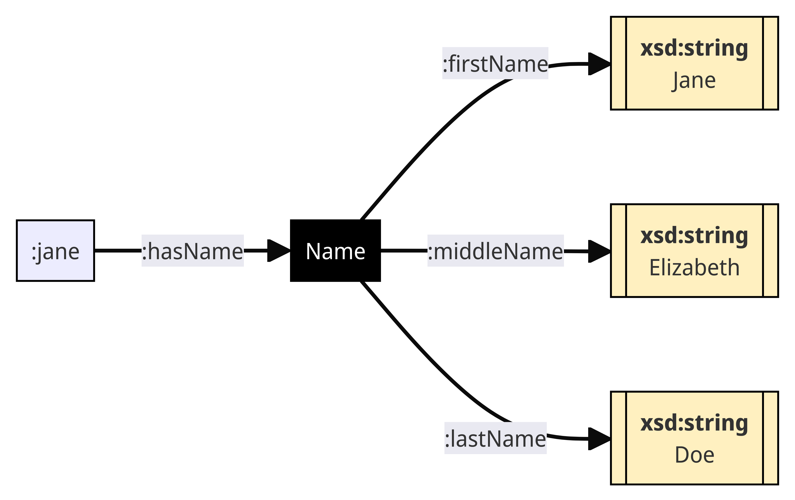
Bracket Notation and Data Structures
The bracket notation consequently is frequently used to specify data structures. For instance, :jane :hasName [ :firstName “Jane”; :lastName “Doe”; :middleName “Elizabeth” ]. produces a data structure of the form given at right, with the black box being the anonymous blank node.
Notice that such a blank node implicitly assumes that there is a shape or class that describes the collection of such predicates (such as “Name” here). This is equivalent to adding a rdf:type declaration to the bracketed expression: :jane :hasName [ a Name: ; :firstName “Jane”; :lastName “Doe”; :middleName “Elizabeth”; ].

Slide 6
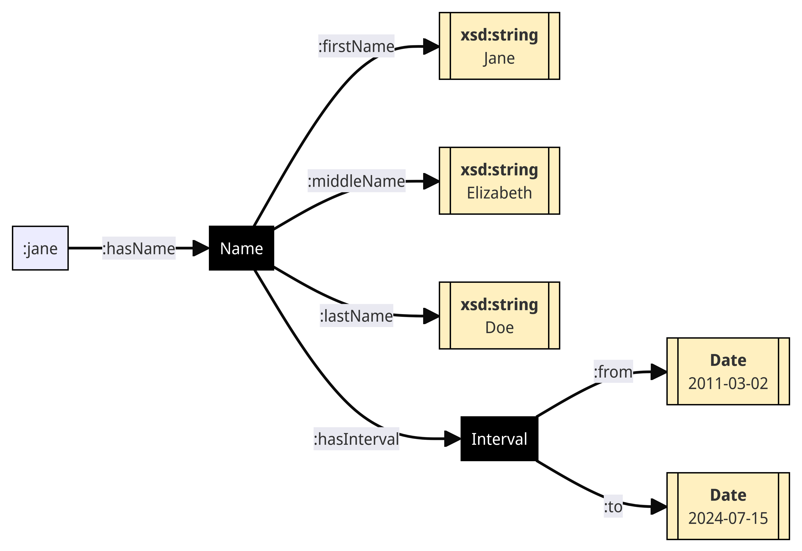
Bracket Nesting
Bracket notation similarly can be compositional (nested) :jane :hasName [ :firstName “Jane”; :lastName “Doe”; :middleName “Elizabeth”; :validInterval [ a Interval:; :from “2011-03-02”^^xsd:date; :to “2024-07-15”^^xsd:date ] ]. Bracket expressions consequently are key in building data shapes without the need to explicitly declare bnodes. This expands to baseline triples, as follows: :jane :hasName _:b1 . _b1 a Name: ; :firstName “Jane”; :lastName “Doe”; :middleName “Elizabeth”; :validInterval _:b2 . _:b2 a Interval : ; :from “2011-03-02”^^xsd:date; :to “2024-07-15”^^xsd:date .

Slide 7
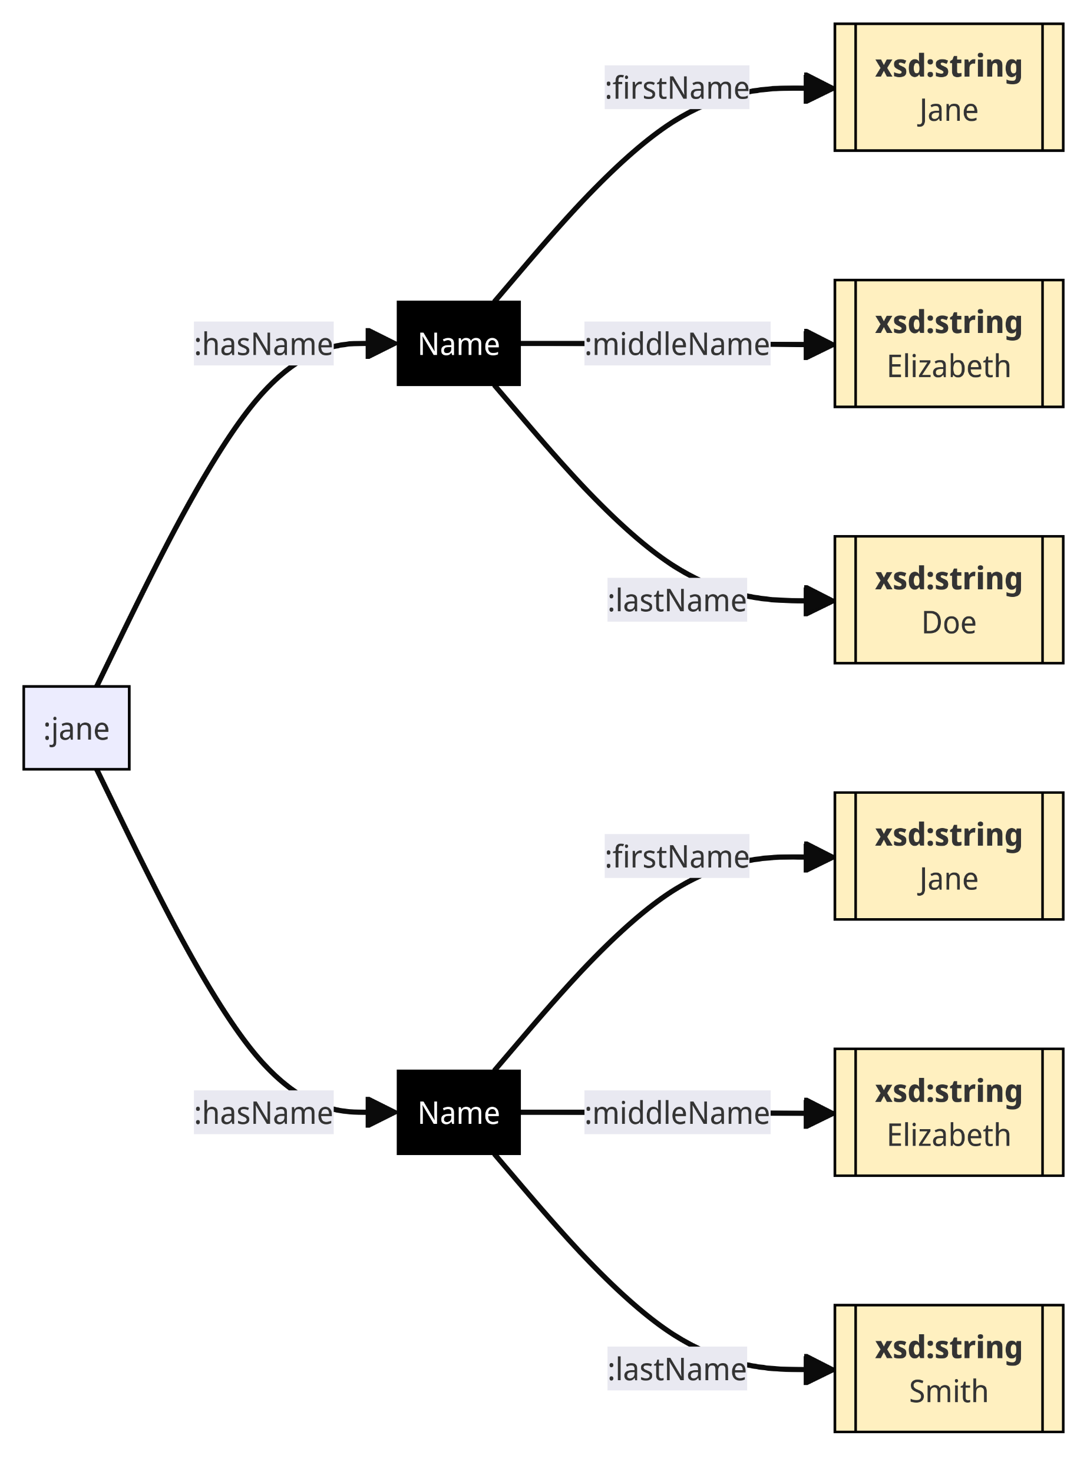
Multiple bracketed Nodes
Bracketed expressions frequently are used for items in a set, such as the following, where a person has name change: :jane :hasName [ :firstName “Jane”; :middleName “Elizabeth”; :lastName “Doe”; :reason :Birth ], [ :firstName “Jane”; :middleName “Elizabeth”; :lastName “Smith”, :reason :Marriage ]. However, such expressions have one major drawback: there is no way to refer to such substructures subsequently in Turtle.

Slide 8
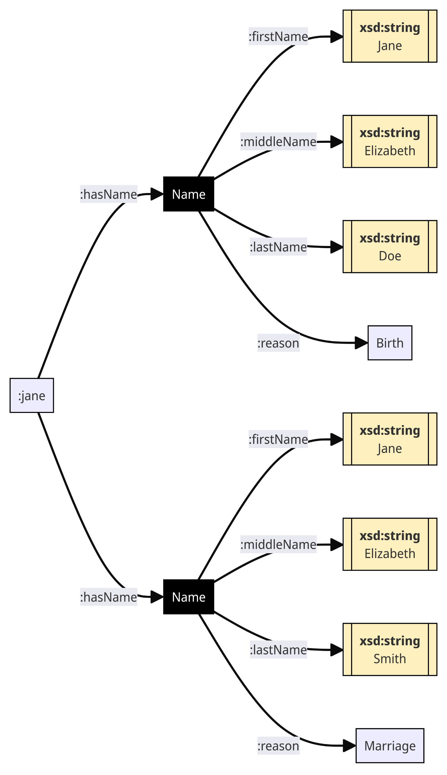
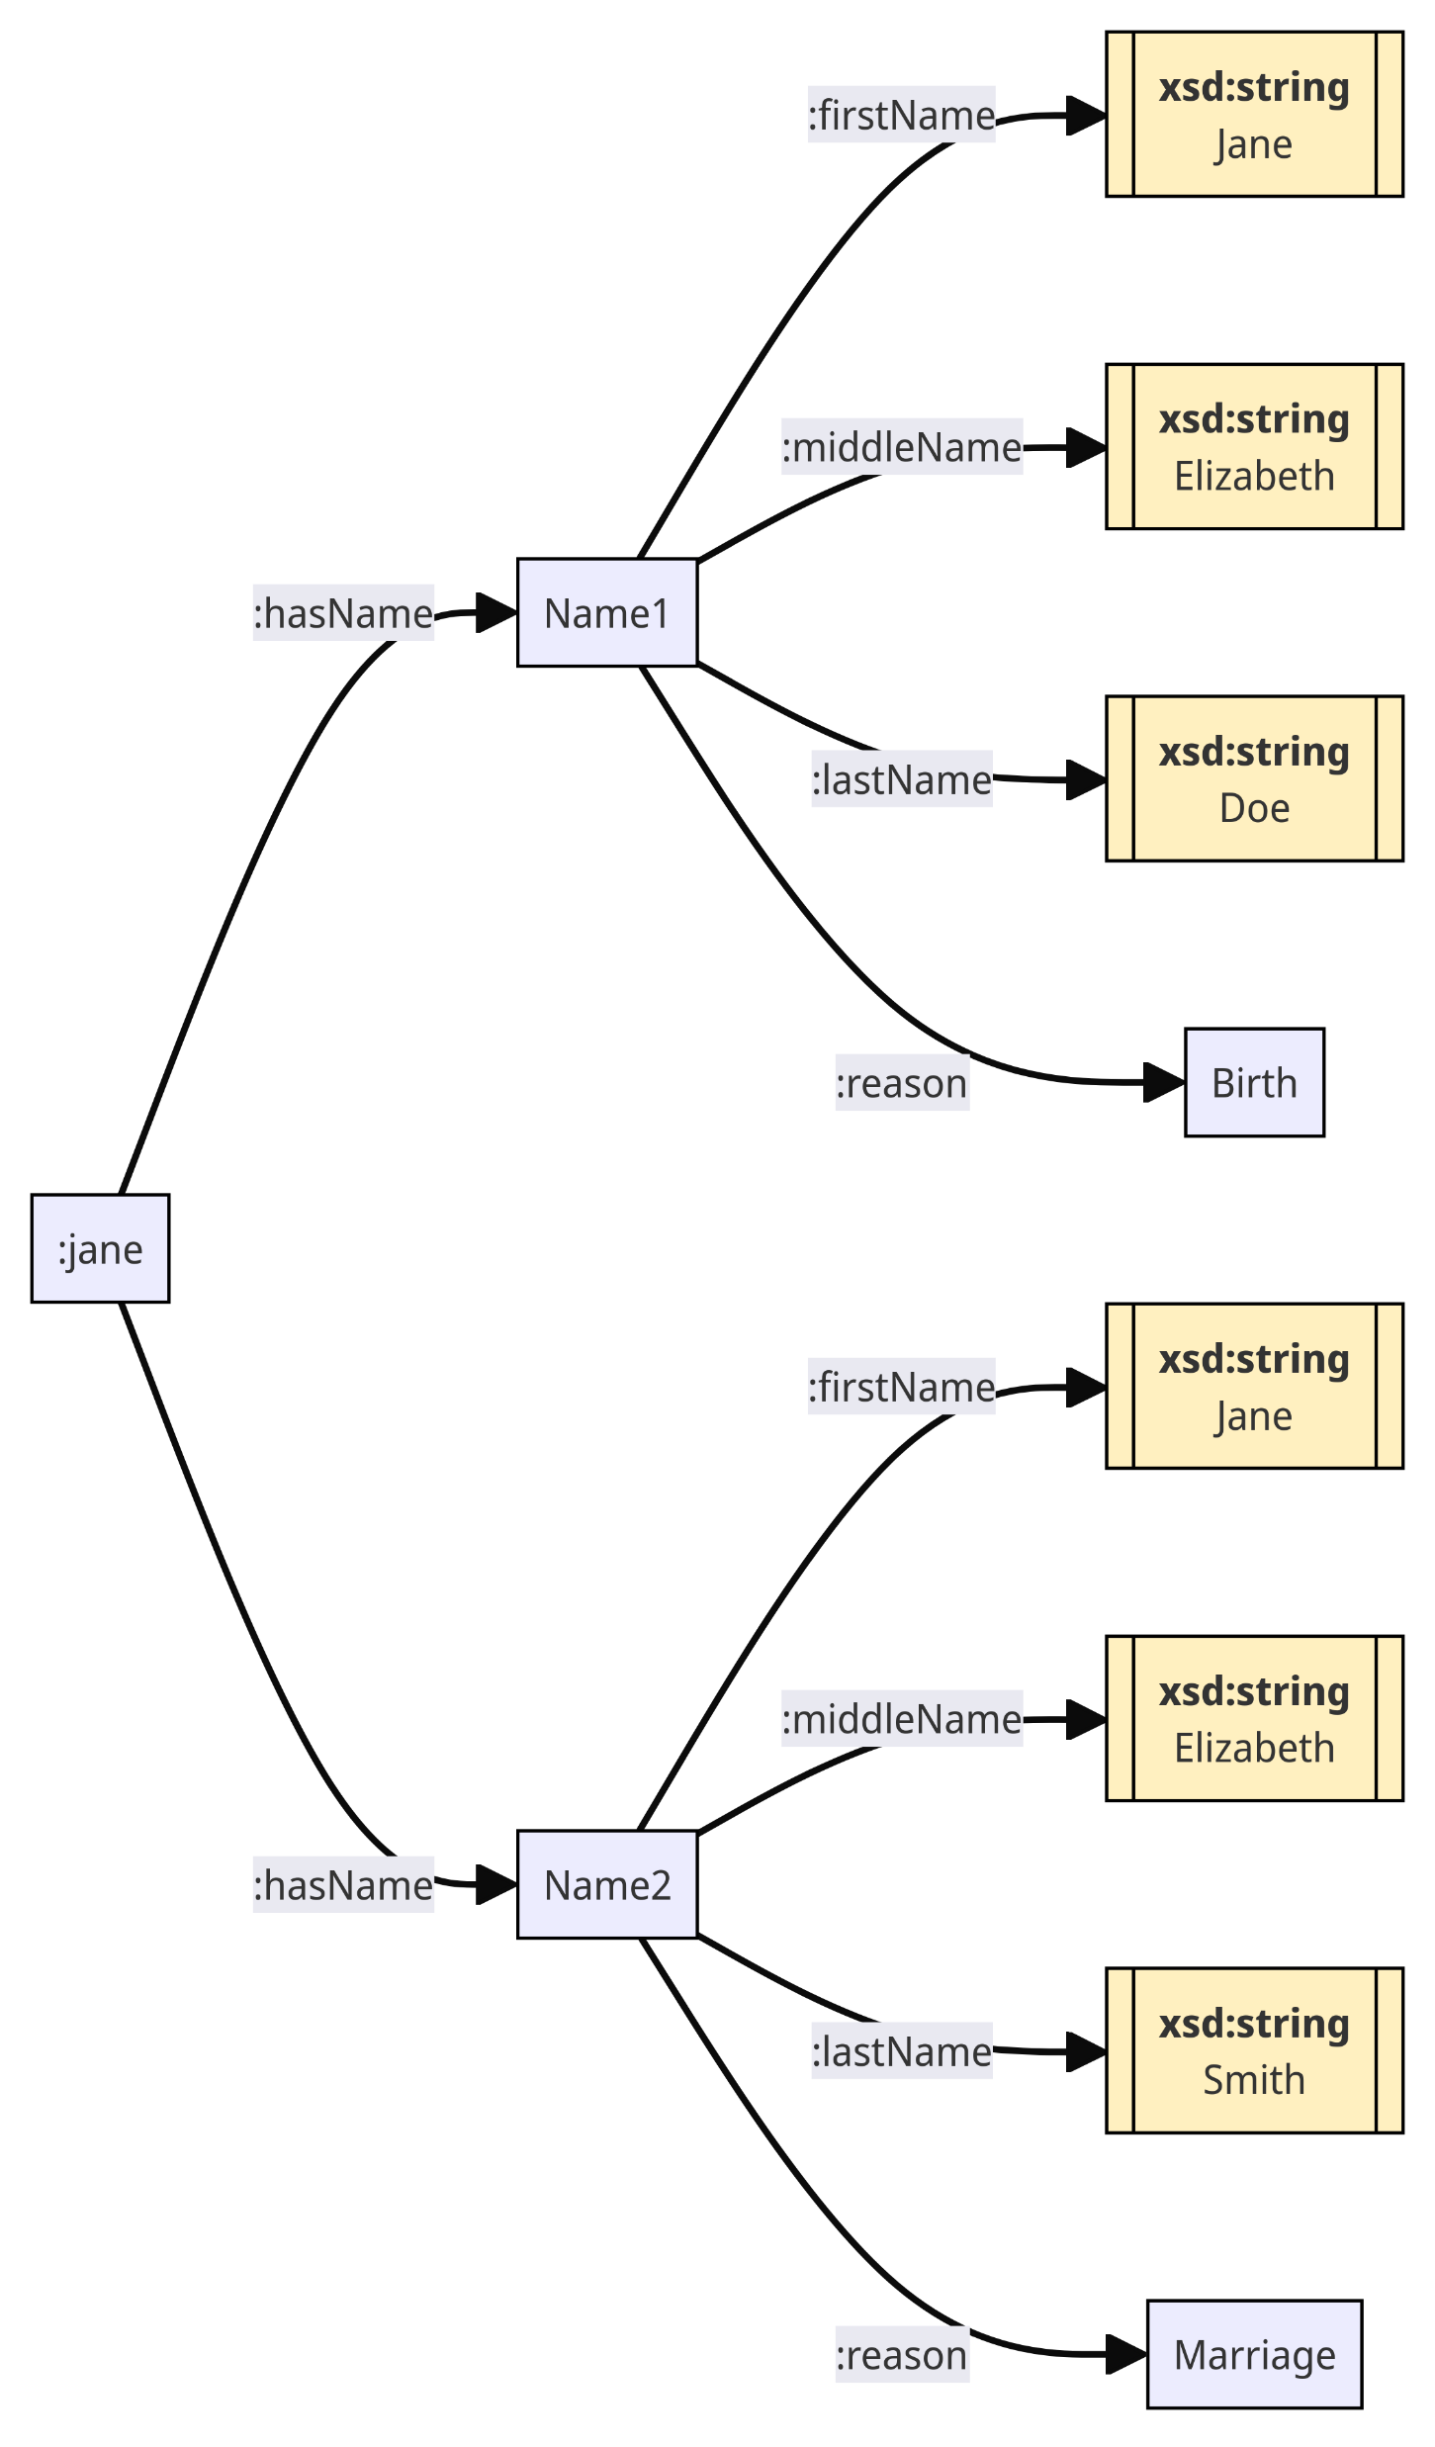
The problem with bracketed Expressions
The problem with bracketed expressions, however, is that there is no way to subsequently refer to these nodes within Turtle, without losing the convenience of bracketing. This isn’t an RDF problem, but a Turtle notational problem: :jane :hasName :name1, :name2. :name1 :firstName “Jane”; :middleName “Elizabeth”; :lastName “Doe”; :reason :Birth . :name2 :firstName “Jane”; :middleName “Elizabeth”; :lastName “Smith”, :reason :Marriage .

Slide 9
The Node Reference Problem
The primary issue with bracket notation is that there is no way, with a bracketed container, that you can currently assign a named node to such a bracket in Turtle.
This means that you cannot reference structure that have blank node subjects from within Turtle without having to build formal “by-reference” constructs.
This often translates into verbose Turtle datasets that can be difficult to write or debug, and adds to the perception that Turtle is complex and difficult to work with.
What’s needed, then, is a way to assign a name to a blank node.

Slide 10
Proposal: Named Node Expressions
A named node expression is a way to assign a named node (even if it is a bnode) preferentially to a bracketed expression.
The syntax for this expression is as follows: [ :nn -> :p1 :o1 ; :p2 :o2 ; … ] where :nn is a URI that becomes the default “name” of the subject of these expressions. For instance,
:janeDoe :hasInterval [ :interval1 -> :start “1999-03-01” ; :end “2024-04-03” ] .
This expands out to: :janeDoe :hasInterval :interval1 . :interval1 :start “1999-03-01” ; :end “2024-04-03” .
Note: in a previous version of this proposal, the | character was used as the delimiter. However, visually [ and | are too similar. Thus, the arrow glyph (->) is proposed here, as it is not only more distinctive, but it also serves to imply (correctly) that the subsequent bracketed expression is a structural definition.

Slide 11
Benefits of Named Node Expressions
The notation does not change RDF, only Turtle. It’s syntactical sugar upon parsing.
Named node expressions make anonymous nodes referenceable (e.g., if _:b1 is passed as a name to a named node expression, _:b1 will still generate a global GUID, but the GUID can be referenced.
The notation makes Turtle more compact and similar to JSON, providing a greater degree of interoperability in modelling.
It is consistent with reification notation (later in this deck).
It aligns more closely with LPGs, such as Neo4J.

Slide 12
Multiple bracketed Expressions Revisited
Named Node Expressions make referencing and revising content simpler to read, while still being consistent with RDF. :jane :hasName [:name1 -> :firstName “Jane”; :middleName “Elizabeth”; :lastName “Doe”; :reason :Birth ],[:name2 -> :firstName “Jane”; :middleName “Elizabeth”; :lastName “Smith”, :reason :Marriage ]. :name1 :start “1985”;end “2015”. :name2 :start “2015”.
This notation is especially useful if information about a given node is added via a subsequent update.

Slide 13
Named Node Expressions and Annotations
Named Node Expressions resolve one of the key problems of annotations – an annotation describes a concept, not a label. For instance, consider the following SKOS-XL assertion set: :red skosxl:prefLable [:redEnglish -> skosxl:literalForm “red”; :language “en”; a skos:Label], [:redGerman -> skosxl:literalForm “rot”; :language “de” ; a skos:Label], [:redFrench -> skosxl:literalForm “rouge”; :language “fr” ; a skos:Label]. The use of named node expressions here serve to consolidate (and annotate) the concept of each label, rather than simply a given assertion. This not only makes the Turtle more understandable, but it also makes commentary and other annotations more concise as well: :redEnglish :hasComment [ :comment1 -> :hasBody “This came from the Oxford English Dictionary”; :by :JaneDoe; :when “2024-04-05”; a Comment: ]. :comment1 :hasComment [ :comment2 -> :hasBody “This also agrees with Webster’s Dictionary”; :by :MikeRoe; :when “2024-05-21”; a Comment: ].

Slide 14
Named Node Expressions and Nesting
Named Node Expressions can also be nested. For instance, consider the following SKOS-XL assertion set: :red skosxl:prefLable [:redEnglish -> skosxl:literalForm “red”; :language “en”; a skos:Label; :hasComment [ :comment1 -> :hasBody “This came from the Oxford English Dictionary”; :by :JaneDoe; :when “2024-04-05”; a Comment: ; :hasComment [ :comment2 -> :hasBody “This also agrees with Webster’s Dictionary”; :by :MikeRoe; :when “2024-05-21”; a Comment: ] ] ], [:redGerman -> skosxl:literalForm “rot”; :language “de” ; a skos:Label], [:redFrench -> skosxl:literalForm “rouge”; :language “fr” ; a skos:Label]. This is isomorphic to the previous example.

Slide 15
Named Node Expressions As Predicates
Named node expressions work quite well as predicates: :Jane [:hasBusinessId -> rdfs:subPropertyOf rdfs:label] “JD12345”^^xsd:string.
This expands out to: :Jane :hasBusinessId “JD12345”^^xsd:string. :hasBusinessId rdfs:subPropertyOf rdfs:label.
This can even be used with bnodes for creating one-off properties: :Jane [_:hasCrazyCat -> a sh:PropertyNode; sh:path :hasPet; sh:minOccurs 1; sh:maxOccurs 1] :Felicia.

Slide 16
Named Node Expressions As Subjects
Named node expressions in the subject position are useful for type declarations. For instance, [ :Jane -> a Person: ; rdfs:label “Jane Doe”] :married [:John -> a Person: ].
This expands out to: :Jane a Person: ; rdfs:label “Jane Doe” ; :married :John . :John a Person: .
NNEs used as subjects in this way are identical to having no bracketed expression. For instance, [ :marriage1 -> :hasBride :Jane ; :hasGroom :John ; a Marriage: ] :start “1980-01-12” :end “2001-02-18” ; :endReason :divorce.
Is equivalent to
:marriage1 :hasBride :Jane ; :hasGroom :John ; a Marriage: ; :start “1980-01-12” :end “2001-02-18” ; :endReason :divorce.

Slide 17
Named Node Expressions & OpenCypher
OpenCypher
CREATE (charlie:Person:Actor {name: 'Charlie Sheen'})-[:ACTED_IN {role: 'Bud Fox'}]->(wallStreet:Movie {title: 'Wall Street'})<-[:DIRECTED]-(oliver:Person:Director {name: 'Oliver Stone’})
RDF with Named Node Expressions
[:charlie -> :name “Charlie Sheen” ; a [ Actor: -> rdfs:subClassOf Person:] ; :playedRole [ :budFox -> :name “Bud Fox”, a Role: ; :inMovie [ :wallStreet -> a Movie: ; :title “Wall Street”, :directedBy [ :oliver -> :name “Oliver Stone”; a [Director: -> rdfs:subClassOf Person:] ] ] ] ] ] .
Note that this could be compacted to a single line, but white spaces have been put in to make it more legible.

Slide 18
Reifications
Reification is the process of creating a reference to an assertion.
Reifications generally are used to annotate assertions (triples)
A reification is a data structure:
:r a rdf:Reification . :r rdf:subject :s . :r rdf:predicate :p . :r rdf:object: :o . Where :r is called a reifier. I would also advocate the use of rdf:s, rdf:p and rdf:o as replacements for rdf:subject, rdf:predicate and rdf:object, simply because their underlying semantics are well known in the RDF space. I’ll use the terser notation subsequently.

Slide 19
Reifications Are Not Triples
A reification is not a triple.
A reification is a graph that specifies a subject, predicate and object, but it makes no assumptions about whether the assertion is true, or even if it exists.
A reifier is an IRI or blank node that anchors the graph.
A reifier can be used as a subject or an object, and can establish both provenance and validity:
:r rdf:subject :liz ; rdf:predicate :married ; rdf:object :larry . :r :author :janeDoe . :r :published “2024-03-01”^^xsd:date . :r :publishedIn :proceedingsOfRDF . :r :statementIsValid false. :john :said :r .

Slide 20
Reifier Expressions
A reifier expression uses a similar approach. The notation: :s :p << :r | :s1 :p1 :o1>> Expands to: #full RDF URIs :s :p :r . :r rdf:subject :s1 ; rdf:predicate :p1 ; rdf:object :o1 .
This is equivalent to: : s :p [:r -> rdf:s :s1 ; rdf:p :p1; rdf:o :o1 ] .
Again, it should be noted that the reification is not a triple (i.e., the statement :s1 :p1 :o1 may possibly not be in the graph).
Also, note that, as with named node expressions, a reifier always maps to a single node.
#compact RDF URIs :s :p :r . :r rdf:s :s1 ; rdf:p :p1 ; rdf:o :o1 .

Slide 21
Reifier Expression Examples
:john :said [ << _:johnComment1 | :jane :hasPet :felicia >> | :madeOn “2024-04-05” ; :madeAt :JohnsDinnerParty ; :hasValidity [ _:validityJC1 | :value false; :reason “Jane has no pets.”]]. Expands to: :john :said _:johnComment1. _:johnComment1 rdf:subject :jane; rdf:predicate :hasPet ; rdf:object :felicia ; :madeOn “2024-04-05” ; :madeAt :JohnsDinnerParty ; :hasValidity _:validityJC ; .
_:validityJC1 :value false ; :reason “Jane has no pets.” .
Please note that the reifier _:johnComment1 is a bnode, but it is still referenceable.

Slide 22
Named Node Expressions and SHACL
[:jane | a Person: ; rdfs:label “Jane”] [ :hasPet | a sh:PropertyShape ; sh:name “pet” ; sh:path :hasPet ; sh:class Pet: ; rdfs:domain Person: ; sh:nodeKind sh:IRI] [:felicia | a Pet:; rdfs:label “Felicia”; :species :Cat ]. Expands to: :jane a Person:; rdfs:label “Jane” ; :hasPet :felicia; . :hasPet a sh:PropertyShape; sh:name “pet”; sh:path :hasPet ; sh:class Pet: ; rdfs:domain Person: ; sh:nodeKind sh:IRI ; . :felicia a Pet: ; rdfs:label “Felicia”; :species :Cat ; .

Slide 23
Named Node Expressions in SPARQL
Named Node Expressions in SPARQL follow similar notation to Turtle NNEs. SELECT ?nne where { ?s ?p [?nne -> ?p1 ?o1] . ?nne ?p2 ?o2 . } This would be mapped to: SELECT ?nne where { ?s ?p ?nne . ?nne ?p1 ?o1 . ?nne ?p2 ?o2 . }
It is possible that SPARQL could identify ?nne nodes as being bracket names (perhaps something like IsBracket(?nne)), but this would need to be determined at SPARQL parse time, as there should be no distinction from the node itself.

Slide 24
Reifications in SPARQL
The test isReification(?r) could determine whether a node is a reification by testing for conformance against a SPARQL query: ASK where { $r rdf:s ?s . $r rdf:p ?p . $r rdf:o ?o . } where ?r is passed as a parameter.
Similarly, a reification can be turned into a triple using SPARQL Update: INSERT {?s ?p ?o} WHERE { $r rdf:s ?s . $r rdf:p ?p . $r rdf:o ?o . filter(NOT EXISTS {?s ?p ?o}) } where $r is passed as a parameter, and the triple does not currently exist in the graph (if it does exist, there’s no need to add it).

Slide 25
Reifications in SPARQL 2
Finally, a triple can generate a reification using almost exactly the same query INSERT {?r1 rdfs:s $s;rdfs:p $p;rdfs:o $o} WHERE { bind(coalesce($r,bnode()) as ?r1) $s $p $o . } where ?s, ?p ?o and potentially ?r are passed as parameters, indicated by the $ sign.
Similarly, a reification can be turned into a triple using SPARQL Update: INSERT {?r rdfs:s ?s;rdfs:p ?p;rdfs:o ?o} WHERE { ?r rdf:s ?s . ?r rdf:p ?p . ?r rdf:o ?o . filter(NOT EXISTS {?s ?p ?o}) } where ?r is passed as a parameter, and the triple does not currently exist in the graph.

Slide 26
Comments
Again, this is not a change to RDF, but to Turtle and SPARQL.
Named node and reifier expressions can make modelling and establishing constraints easier.
Reification can be expressed as named node expressions (NNEs).
While the models are slightly different, NNEs can make LPG and OpenCypher-like queries easier to translate into RDF and vice versa.
Nesting of NNEs can better emulate complex data structures.
NNEs work extraordinarily well with shapes, especially one-offs.
The defined nodes rdf:s, rdf:p and rdf:o might be good synonyms to declare for rdf:subject, rdf:predicate and rdf:object respectively.
Named node expressions may be a better solution to managing reifications than trying to make reification components into triples within the graph.

