Slide 1
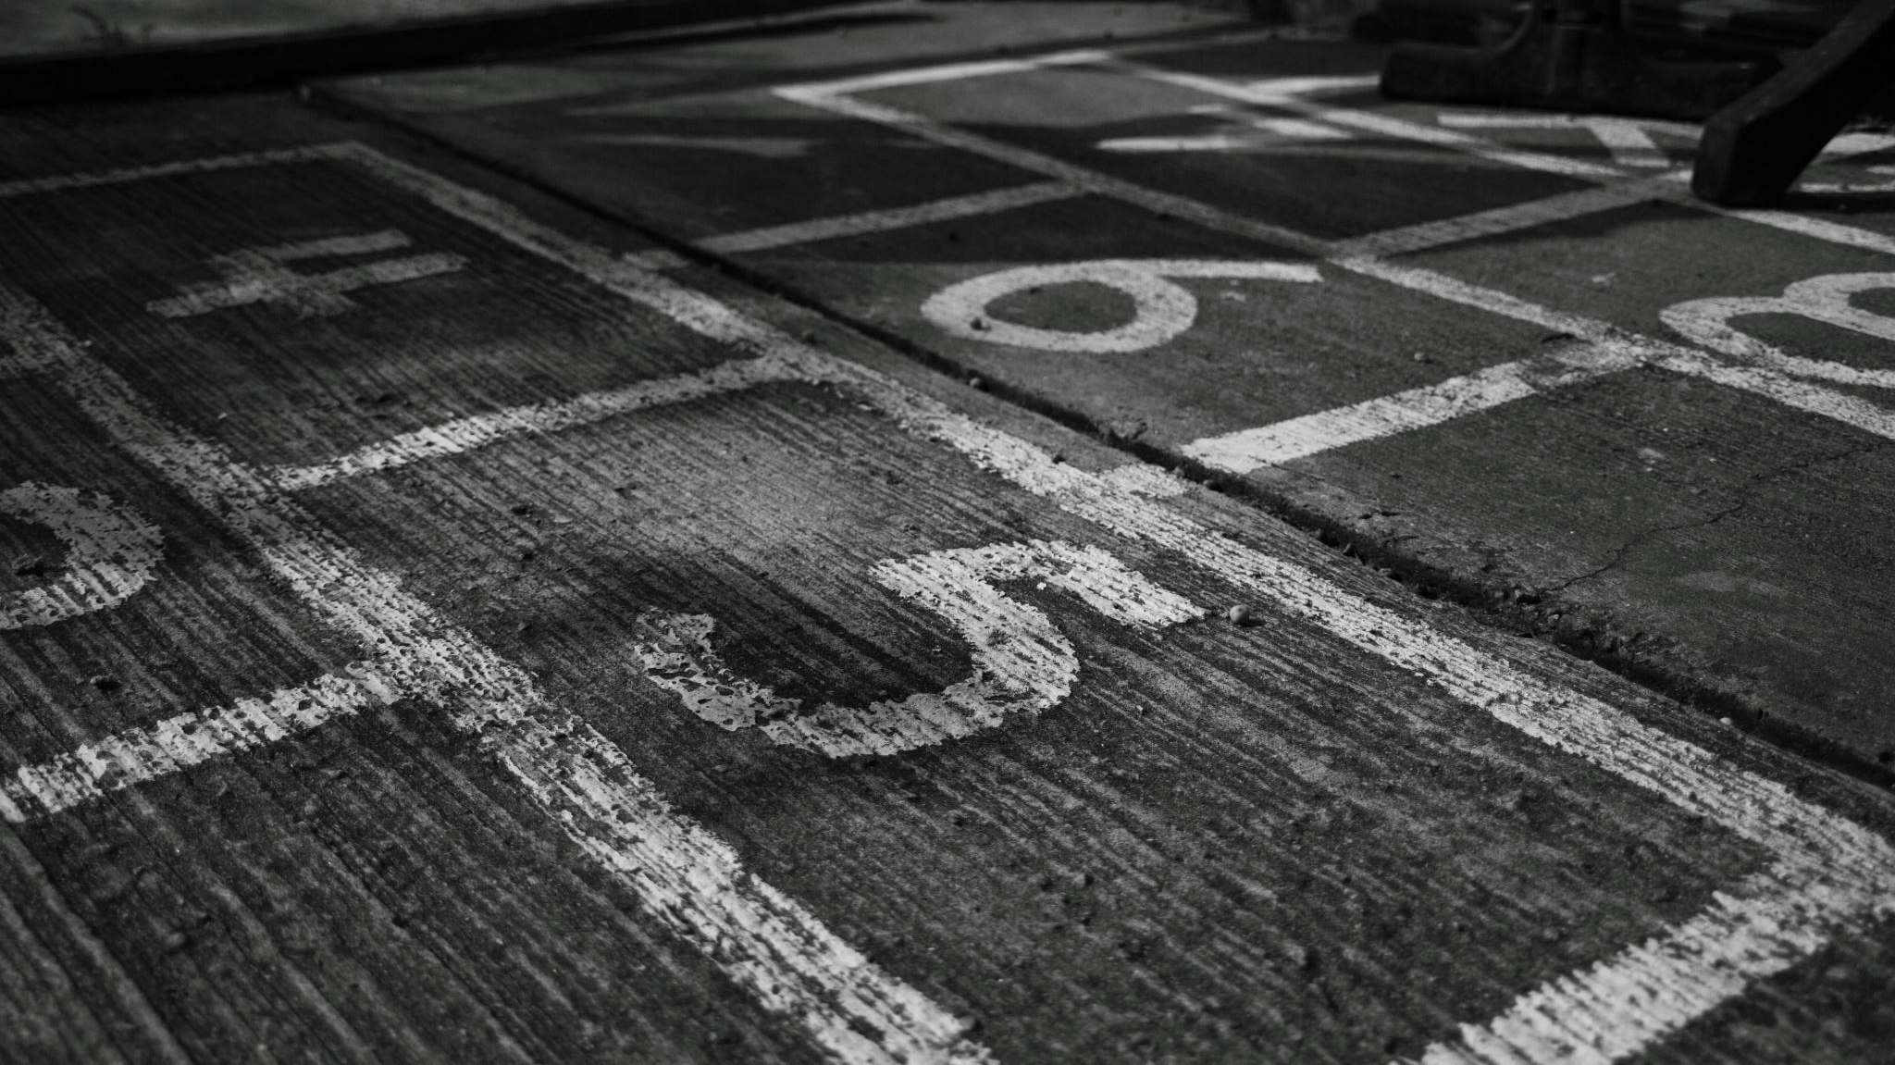
ISO/IEC JTC1/SC34 and its EPUB specifications
MURATA Makoto
Long-term member of both SC34 and W3C
Then member of the original XML WG
Then leader of the IDPF EPUB EGLS subgroup
SC34 Chair Elect (final confirmation expected this week)
CEO of Information Accessibility Institute

Slide 2
LCP
ISO/IEC 23078-2:2024 Information technology — Specification of digital rights management (DRM) technology for digital publications Part 2: User key-based protection

Slide 3
EPUB3 preservation
ISO/IEC TS 22424-1:2020Digital publishing — EPUB3 preservation Part 1: Principles
ISO/IEC TS 22424-2:2020Digital publishing — EPUB3 preservation Part 2: Metadata requirements
International Standardization is going on (ISO/IEC DIS 22424)

Slide 4
AHG1
It does not create specifications.
It is studying terms of references for a new working group for CSC.
Unless five countries say YES and five experts are nominated, no new work items can be created.

Slide 5
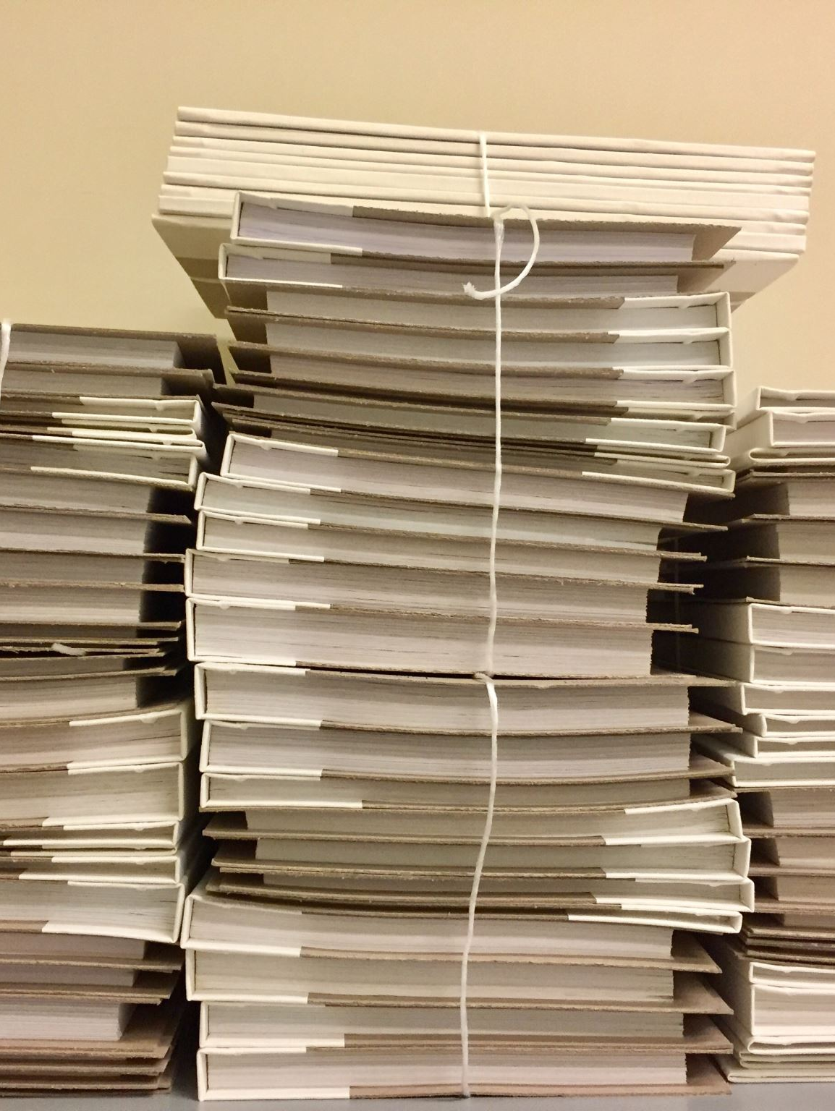
Liaisonship at the SC34/JWG7 level
Current liaisonship is between SC34/JWG7 and Publishing@WC. It is not between SC34 and this group.
Documents from SWG1 are not covered by the current liaisonship.

Slide 6
EPUB 3 and FXL (very old)
ISO/IEC TS 30135-1:2014
ISO/IEC TS 30135-2:2014
ISO/IEC TS 30135-3:2014
ISO/IEC TS 30135-4:2014
ISO/IEC TS 30135-5:2014
ISO/IEC TS 30135-6:2014
ISO/IEC TS 30135-7:2014

Slide 7
EPUB 3.0.1 (old)
ISO/IEC 23736-1:2020
ISO/IEC 23736-2:2020
ISO/IEC 23736-3:2020
ISO/IEC 23736-4:2020
ISO/IEC 23736-5:2020
ISO/IEC 23736-6:2020

Slide 8
EPUB A11Y from IDPF
ISO/IEC 23761:2021

Slide 9
Normal process and PAS/FT
Normal process
Standards are required to follow ISO/IEC Directives, Part 2.
PAS or fast-track
Standards can be published basically as is with the exception of cover pages, prefaces and TOCs.

Slide 10
Proposal for Coordinated Maintenance
1. Align specification status:
SC34 to withdraw superseded EPUB specifications once replacements are confirmed.
2. Ensure long-term accessibility and interoperability:
W3C to submit EPUB 3.3 and EPUB Accessibility 1.1 as PAS submissions to ISO/IEC.
3. Enable sustainable maintenance:
Establish a liaison relationship directly between SC34 and PMWG to allow formal exchange of documents and maintenance coordination.

