Slide 1
Variants
LexVariants or Lexically-related Variants
SenseVariants or Semantically-related Variants
MorphologicalVariants
FormVariants
TerminologicalVariants
TranslationVariants
Variation at the Form level
Different Lexical Entry and different LexicalSense
Same or different language (do vs. undo; constipated vs. constipado)
Different ontology entity
Variation at the Form level
Same Lexical Entry and same LexicalSense
Same language (FAO vs. Food and Agriculture Organization)
Same ontology entity
Variation at LexicalSense level (e.g., headache and cephalalgia)
Different LexicalSense, same Ontology reference
Same or different language (vientre de alquiler and mère porteuse, apart from being translations they can also be considered dimensional variants)
Same (or different) ontology entity (in the case of vientre de alquiler and mère porteuse, each could be referring to a different ontology entity)
Variation at the LexicalSense level
Different LexicalSense, same or different Ontology reference
Different language
Same or different ontology entity (there may be an ontology to which lexicons in different languages have been related, so payment method and método de pago may be referring to the same ontology entity; and lexicons associated to different ontologies in which LexicalSenses are related headache and dolor de cabeza

Slide 2
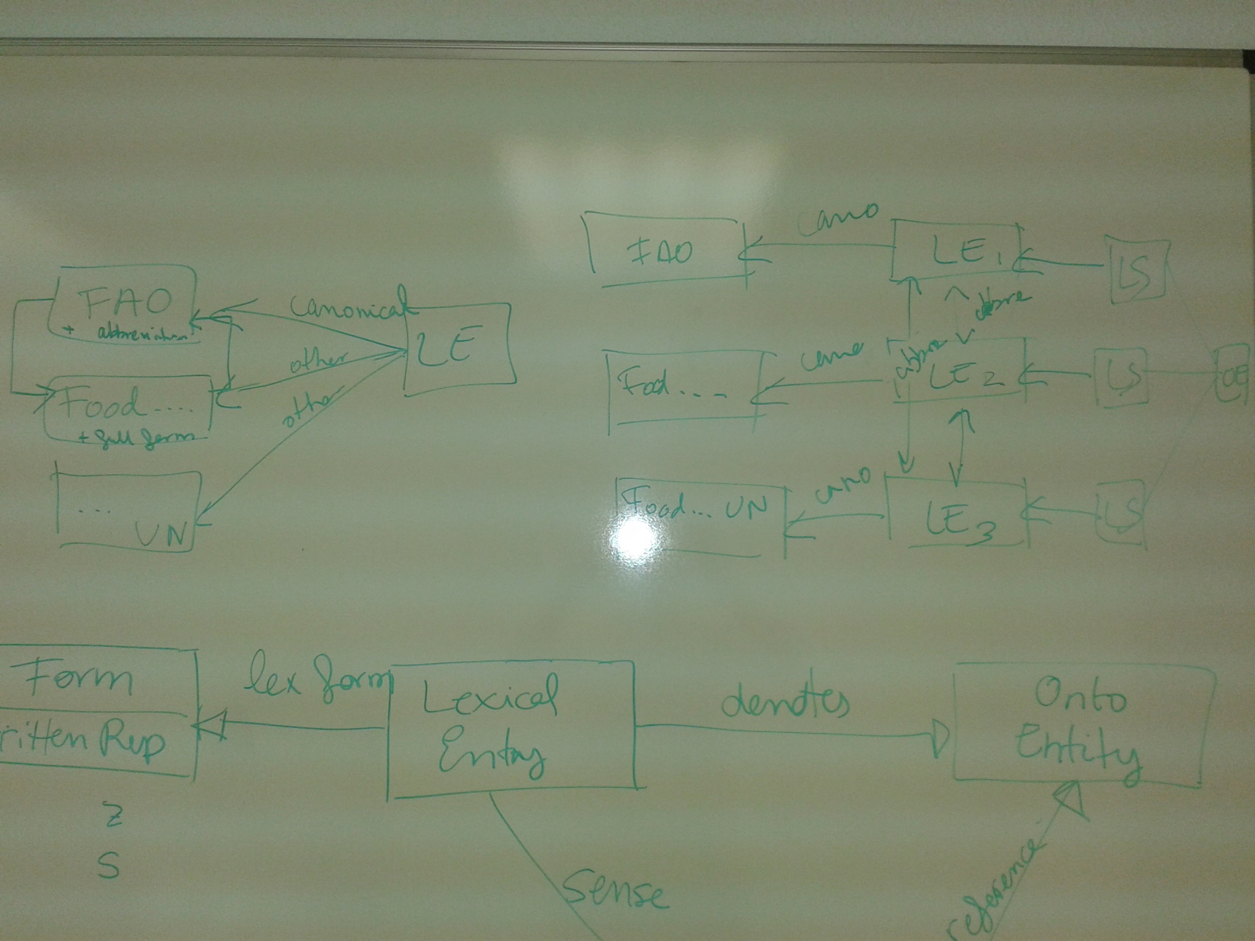

Slide 3
