Slide 1
Compliance Report Model & ODRL Evaluator
Wout Slabbinck
Beatriz Esteves

Slide 2
Agenda
Motivation
Compliance Report Model
ODRL Evaluator
Test Suite
Demo
Future Work

Slide 3
Agenda
Motivation
Compliance Report Model
ODRL Evaluator
Test Suite
Demo
Future Work

Slide 4
How I got to know ODRL
Started with Solid (where people have control over their data)
Hit limitations with the authorization specifications of Solid [1]
The two Authorization protocols (WAC and ACP) do not support fine-grained access
Adding fine-grained access and constraints such as time was discussed and proposed many times [2-5]
We could continue to try and gain consensus how to include fine-grained access.
We could start looking at other specifications/standards for this purpose.
[2] ACL Expiry, https://github.com/solid/web-access-control-spec/issues/10 (2016-04-17)
[3] Add time constraints to WAC rules, https://github.com/solid/web-access-control-spec/issues/87 (2019-07-29)
[4] Comment including TimeLimitedAuthorization, https://github.com/solid/specification/issues/56#issuecomment-872020854 (2021-07-01)
[5] https://solid.github.io/authorization-panel/authorization-ucr/#conditional-time
[1] Solid Protocol https://solidproject.org/TR/protocol
Notes:
Based on the separation of data and applications, the vision defines an ecosystem that facilitates the integration of data in different applications, while keeping people in direct control of their data.
https://solidlabresearch.github.io/WhatsInAPod/
Since some aspects have been proposed quite a while ago and are still not part of the spec, that approach seems not be the right path
Extra info: Also ODRL in Solid in data interoperability panel https://github.com/solid/data-interoperability-panel/issues/31
Timestamps and ACL caching, https://github.com/solid/web-access-control-spec/pull/37

Slide 5
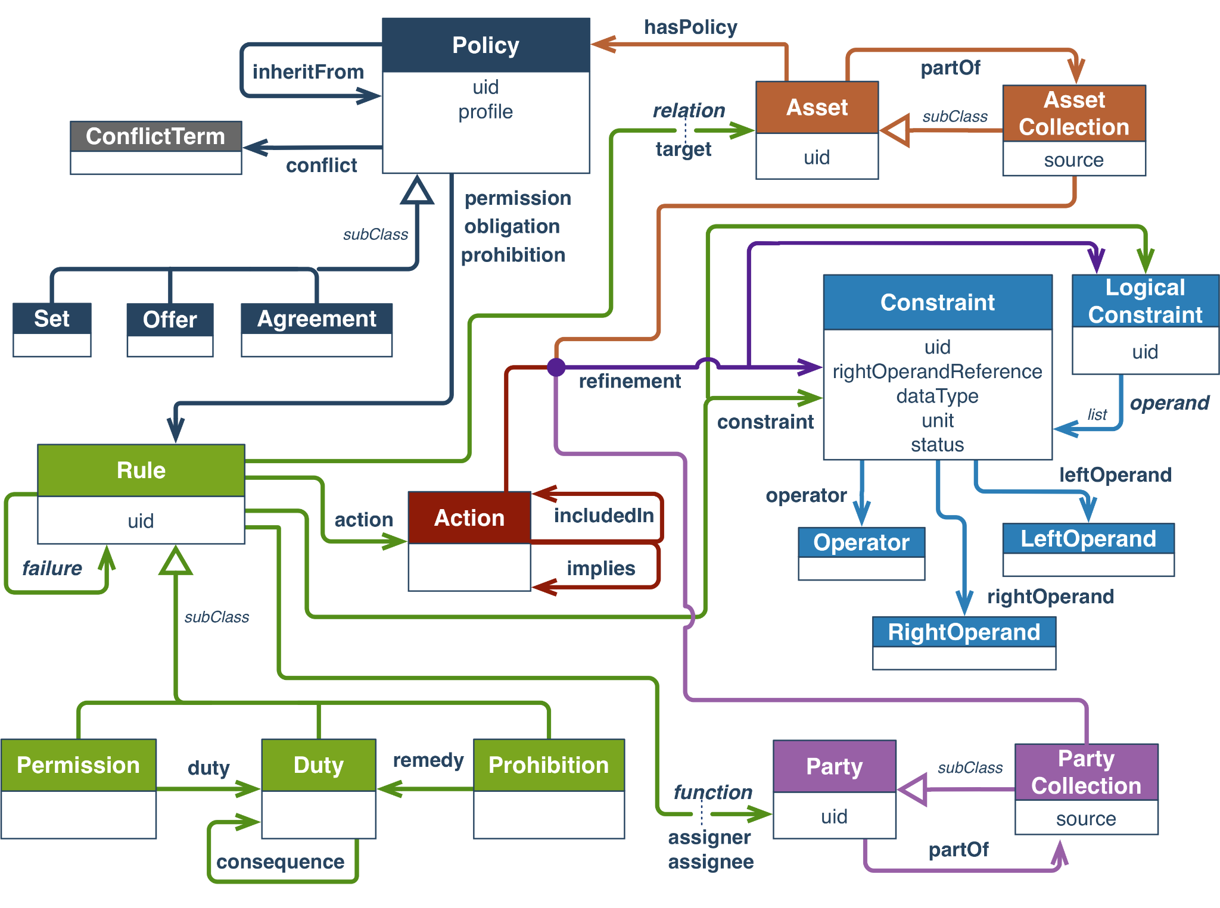
How I got to know ODRL
Hit the limitations with the way of authorization with Solid
Thanks to visiting researchers, I learned about ODRL
Try to combat the limitations of Solid authorization through using ODRL (has already been suggested [6])
Agent based approach [7]
Authorization Server approach [8]
Problem
How to systematically interpret these ODRL policies?
[6] ODRL in Solid https://github.com/solid/authorization-panel/issues/55 (2019-12-01)
[7] Agent-based Usage Control enforcement in Solid, sosy24: camera-ready paper, github code, demo
[8] UCP enforcement repository, interpreting ODRL: https://github.com/woutslabbinck/ucp-enforcement
Notes:
I myself got introduced mainly thanks to visiting researchers including
Harsh Pandit (October 2022) https://harshp.com/me
Sabrina Kirrane (Januari 2023) http://sabrinakirrane.com/
Ines Akaichi (May - June 2023)
Beatriz (March 2023) https://besteves4.github.io/

Slide 6
How to systematically interpret ODRL policies?
Standardized
Custom/ Not Standardized
ODRL Policy
Some code interpreting ODRL
Output
Input
Project specific
Conclusions unclear
Not reusable
Notes:
Due to non standardization, it would only work for that given project/software.
Even more problematic, others using that software might now know how we came to certain conclusions

Slide 7
ODRL Formal Semantics Community Group
Standardized
Custom/ Not Standardized
Formalizing
ODRL Policy
ODRL Evaluator
Request
Output
State of the world
Notes:
Make clear what is currently standardized:
ODRL Policy
What is being touched upon in the ODRL CG
ODRL Evaluator
State of the world
Output
What have I tried
Some engine (instead of evaluator)
Custom input
Custom output

Slide 8
Agenda
Motivation
Compliance Report Model
ODRL Evaluator
Test Suite
Demo
Future Work
Notes:
The is inspired by the formal semantics specification and our own learned lessons

Slide 9
Compliance report as output of an ODRL Evaluator
Our proposal
Requirements
Interoperability: Machine-readable with semantics
Transparency & Auditability: When was the policy evaluated?
Explainability:
Which policy?
Which rule of the policy?
What is the evaluation state?
Which constraints?
What is the evaluation state of those constraints?
In an access control scenario: Which Request?
Formalizing
ODRL Evaluator
Output
Compliance Report
Notes:
https://github.com/woutslabbinck/UCR-test-suite/blob/main/documentation/ODRL-Example.md -> assumptions, considerations and limitations

Slide 10
Compliance report as output of an ODRL Evaluator
Requirements
…
Assumptions
An odrl:refinement is just a odrl:constraint
ODRL profiles are out of scope
Reason: in the ODRL specification, we have not found formal examples of profiles
Notes:
ODRL profiles are out of scope, that is currently
Maybe in the future, we might extend our model to include profiles properly
**Motivation ODRL support of profiles**
There is nothing wrong with not using odrl profile, still a valid evaluator
Problem with profiles as well is that it is not formally defined in the spec what it means.
The profiles are just toy examples

Slide 11
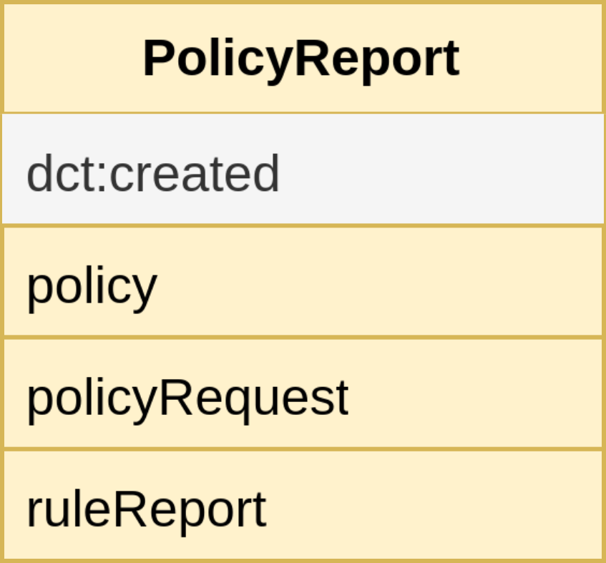
Compliance Report Model
Notes:
Transparency & Auditability: When was the policy evaluated -> Check!

Slide 12
Compliance Report Model
Notes:
Transparency & Auditability: When was the policy evaluated -> Check!
Explainability:
Which policy -> Check!
Access Control request scenario: Which request -> Check

Slide 13
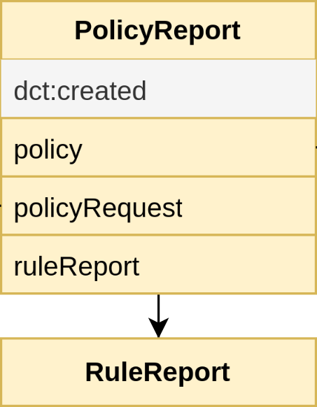
Compliance Report Model
Notes:
Transparency & Auditability: When was the policy evaluated -> Check!
Explainability:
Which policy -> Check!
Access Control request scenario: Which request -> Check
Which rule

Slide 14
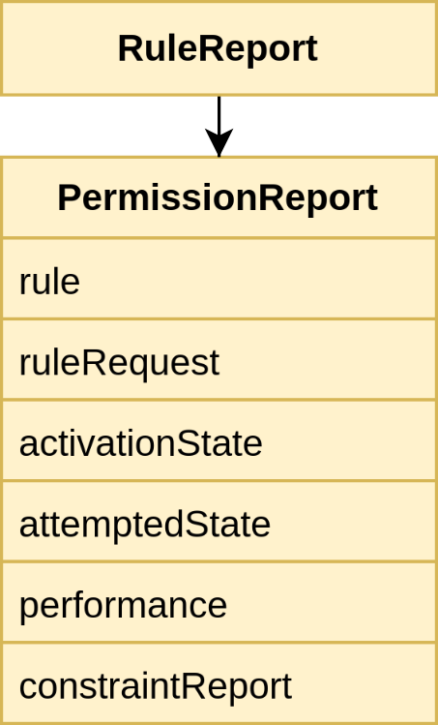
Compliance Report Model
Notes:
Transparency & Auditability: When was the policy evaluated -> Check!
Explainability:
Which policy -> Check!
Access Control request scenario: Which request -> Check
Which rule

Slide 15
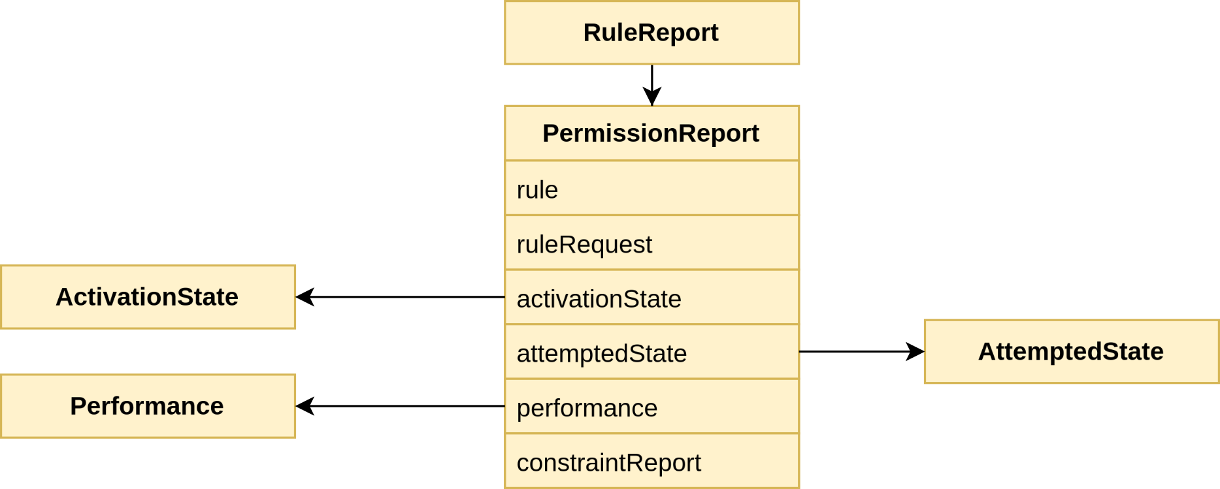
Compliance Report Model
Notes:
Transparency & Auditability: When was the policy evaluated -> Check!
Explainability:
Which policy -> Check!
Access Control request scenario: Which request -> Check
Which rule
What is the evaluation state -> Check!

Slide 16
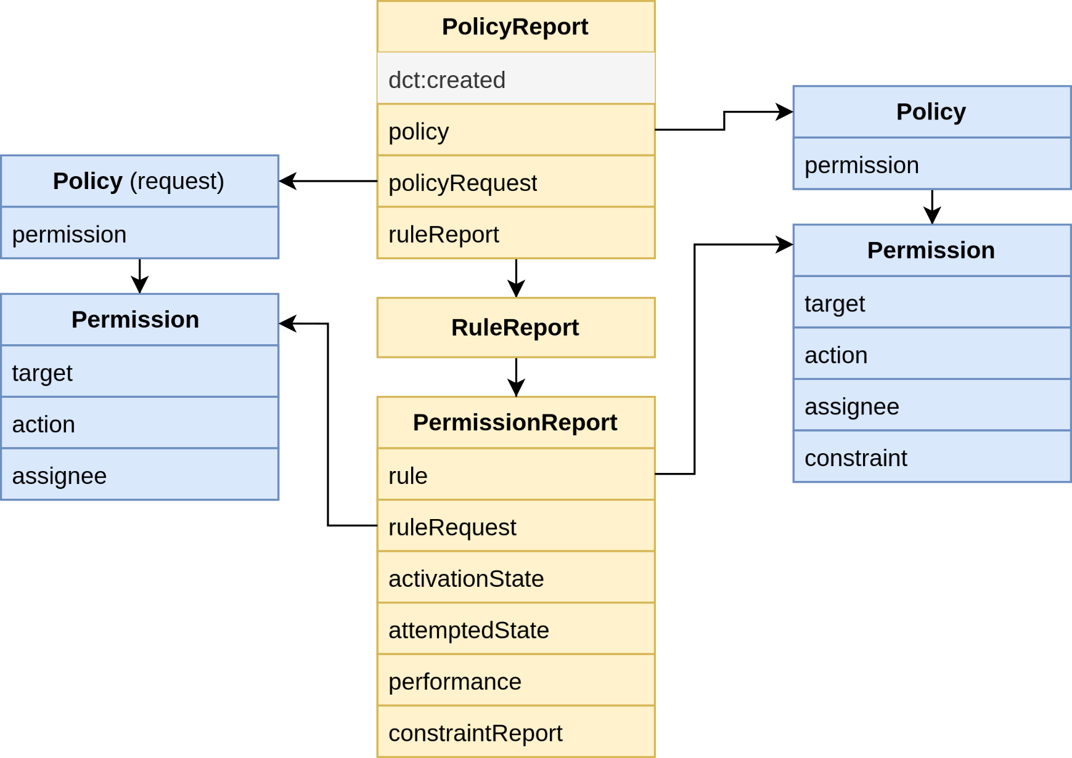
Compliance Report Model
Notes:
Transparency & Auditability: When was the policy evaluated -> Check!
Explainability:
Which policy -> Check!
Access Control request scenario: Which request -> Check!
Which rule -> Check!
What is the evaluation state -> Check!

Slide 17
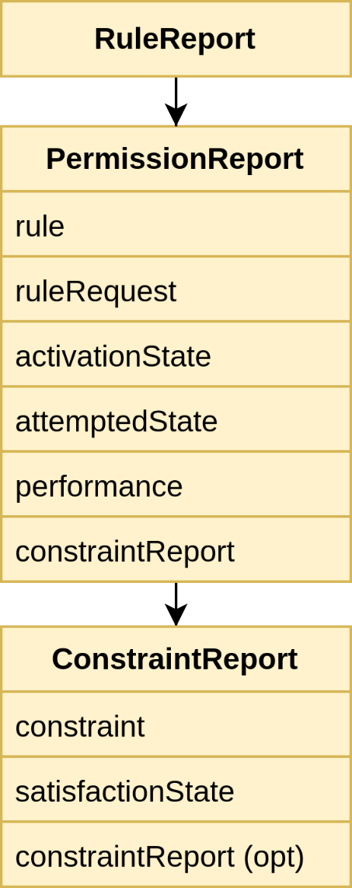
Compliance Report Model
Notes:
Transparency & Auditability: When was the policy evaluated -> Check!
Explainability:
Which policy -> Check!
Access Control request scenario: Which request -> Check!
Which rule -> Check!
What is the evaluation state -> Check!
Which constraints?

Slide 18
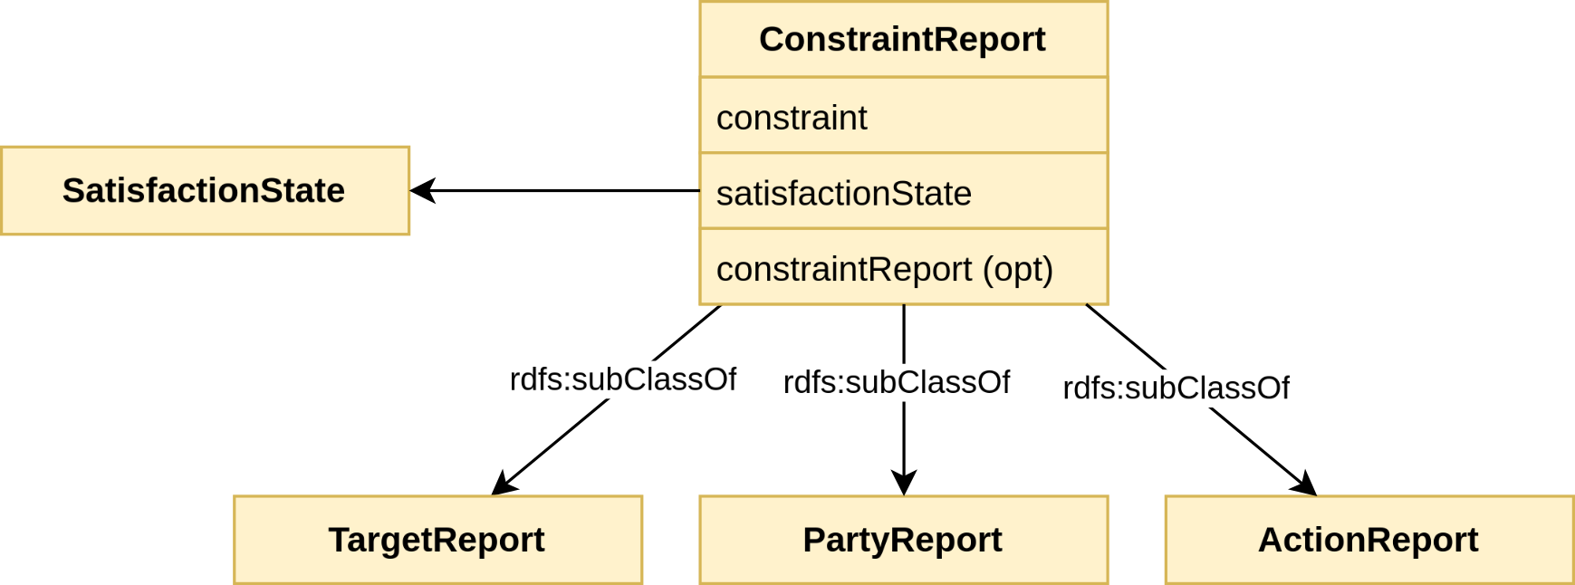
Compliance Report Model
Notes:
Transparency & Auditability: When was the policy evaluated -> Check!
Explainability:
Which policy -> Check!
Access Control request scenario: Which request -> Check!
Which rule -> Check!
What is the evaluation state -> Check!
Which constraints -> Check!
What is the satisfaction state -> Check!

Slide 19
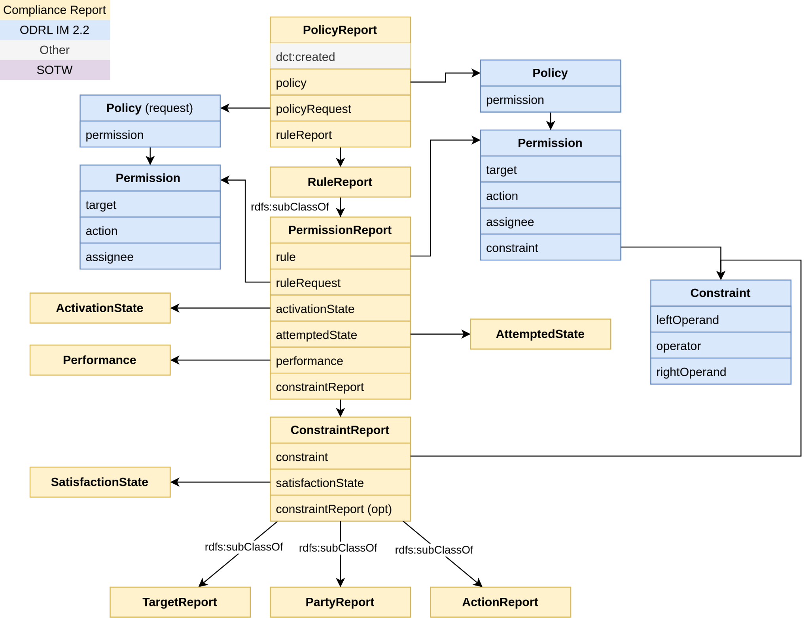
Notes:
Interoperability: Machine-readable with semantics -> RDF model with proper descriptions and implications
Transparency & Auditability: When was the policy evaluated -> Check!
Explainability:
Which policy -> Check!
Access Control request scenario: Which request -> Check!
Which rule -> Check!
What is the evaluation state -> Check!
Which constraints -> Check!
What is the satisfaction state -> Check!

Slide 20
Agenda
Motivation
Compliance Report Model
ODRL Evaluator
Test Suite
Demo
Future Work

Slide 21
Assumptions and considerations
Current time must be part of the state of the world
Multiple constraints without logical operand are interpreted as odrl:and
Performance state is not decided by the ODRL Evaluator
As request odrl:Request is used
Collection (Party/Asset) membership (odrl:partOf) must be part of the state of the world
It is up to the user of the ODRL Evaluator to provide a correct state of the world and relevant policies
When a usage control scenario is envisioned, a Compliance Report could be added to the state of the world to show which actions were executed when [9]
[9] How to represent executed actions in the state of the world: https://github.com/w3c/odrl/issues/61
Notes:
Assumptions
State of the world and evaluation time: The ODRL Evaluator MUST not generate the time at evaluation, it MUST always be in the state of the world. Note: For debugging reasons and forgetfulness, this might be nice to have.
Reason: otherwise, re-evaluation might be impossible
Multiple constraints behaviour: When having multiple constraints, the ODRL Evaluator it will be interpreted as being a logical constraint and refinement. Either you have a logical constraint refinement about multiple constraints or they MUST be interpreted as and.
Performance state:The ODRL Evaluator does not decide on whether an action will be PERFORMED. Reason: an ODRL Evaluator might be part of a usage control system. It provides a decision that some action MAY be performed (when the permission is active). The usage control system might know that the action is later performed. If so, it must then add this to the state of the world. Note: a permission can only be performed if the report states it is both ACTIVE and ATTEMPTED.
State of the world and Collections: Collections (odrl:PartyCollection and odrl:AssetCollection) MUST be part of the state of the world (see examples 16 and 17). The ODRL evaluator is NOT responsible for getting it there.
Requests: In case of the access control scenario, requests MUST be modelled as odrl:Request. The motivation is that a vocabulary is required anyway and re-use of ODRL makes sense + Beatriz has used it the following paper: ODRL Profile for Expressing Consent through Granular Access Control Policies in Solid on how to express application information (listing 3, though the general odrl:Policy is used there, odrl:Request makes more sense).
Note: in the OAC specification, examples requests are using odrl:Request (e.g. example 5.4)
Considerations when using an ODRL evaluator
State of the world in usage control scenario: When using an ODRL evaluator in a usage control scenario, it is up to the implementer to provide a correct state of the world for the evaluator. That is picking the relevant policy compliance reports that might influence current policy
see usage control constraint explanation for more information.
Policy fetching: It is important that for a given request, the appropriate policy/policies are fetched. It might be required to take into account the state of the world first (regarding membership in collections) and perform queries of the form (party, action, target) (if present). Refinements in policies would have to be dealt with executing those queries. Furthermore, as currently inter policy conflict resolution is out of scope it is up to implementers to deal with inconsistent resulting evaluations.

Slide 22
Extra assumptions for first version of an ODRL Evaluator
Focus on Permission Rule only
Focus on access control scenario
Goal:
Given an ODRL policy, a request and the state of the world, Determine which rules are active and present that with a machine-readable model (i.e. Compliance Report).
Notes:
Note: for a first version focus on one policy and one request at a time

Slide 23
Our take on an ODRL Evaluator
Standardized
Our proposal
Formalizing
ODRL Policy
ODRL Evaluator
ODRL Request
Compliance Report
State of the world

Slide 24
Compliance Report Model as output of an ODRL evaluation
ODRL Policy
ex:policy a odrl:Set;
odrl:uid ex:policy;
odrl:permission ex:permission.
ex:permission a odrl:Permission;
odrl:target ex:x;
odrl:assignee ex:alice;
odrl:action odrl:read.
ODRL Request
ex:request a odrl:Request;
odrl:uid ex:request;
odrl:permission ex:permissionRequest.
ex:permissionRequest a odrl:Permission;
odrl:target ex:x;
odrl:assignee ex:alice;
odrl:action odrl:read.
State of the world
temp:currentTime dct:created "2024-02-12T11:20:10Z"^^xsd:dateTime.

Slide 25
Compliance Report Model as output of an ODRL evaluation
ex:policy a odrl:Set;
odrl:uid ex:policy;
odrl:permission ex:permission.
ex:permission a odrl:Permission;
odrl:target ex:x;
odrl:assignee ex:alice;
odrl:action odrl:read.
ex:policyReport1 a report:PolicyReport;
report:policy ex:policy;
report:request ex:request;
dct:created "2024-02-12T11:20:10Z"^^xsd:...;
report:ruleReport ex:permissionReport1.
ex:permissionReport1 a report:PermissionReport;
report:activationState report:Active .
What does it mean to be active?

Slide 26
When is a permission active?
A permission is active [10]
All its constraints are satisfied
All its duties are fulfilled or inactive (not applicable for first version)
All the existing refinements of the Action, AssetCollection, PartyCollection are satisfied by the attempted action.
[10] https://w3c.github.io/odrl/formal-semantics/#sectionPermissions

Slide 27
Compliance Report Model as output of an ODRL evaluation
ex:policy a odrl:Set;
odrl:uid ex:policy;
odrl:permission ex:permission.
ex:permission a odrl:Permission;
odrl:target ex:x;
odrl:assignee ex:alice;
odrl:action odrl:read.
ex:policyReport1 a report:PolicyReport;
report:policy ex:policy;
report:request ex:request;
dct:created "2024-02-12T11:20:10Z"^^xsd:...;
report:ruleReport ex:permissionReport1.
ex:permissionReport1 a report:PermissionReport;
report:activationState report:Active;
report:constraintReport ex:partyReport, ex:targetReport, ex:actionReport.
ex:partyReport a report:PartyReport;
report:satisfactionState report:Satisfied.
...

Slide 28
Architecture of our ODRL Evaluator
Validation
Ensure triples
SHACL validation -> Are the policy and request valid ODRL?
Cardinality check: at least one ODRL policy
State of the world check: Is the current time present?
Policy decomposition
Evaluation
Create the Compliance Report based on the validated input
Note: not all validation steps are currently implemented
Notes:
https://github.com/woutslabbinck/UCR-test-suite/blob/be-comments/documentation/ODRL-Evaluator.md#how-does-the-odrl-evaluator-work

Slide 29
Agenda
Motivation
Compliance Report Model
ODRL Evaluator
Test Suite
Demo
Future Work

Slide 30
Why a Test Suite?
Want to have an overview of which ODRL example policies can be evaluated
Want to make it possible for other implementations of an ODRL evaluator to guarantee to reproduce the same result

Slide 31
How does one test case look like?
Example test case
<TestCaseIdentifier> a ex:Testcase;
dct:title "Title of the test case.";
ex:policy <PolicyIdentifier>; ex:request <RequestIdentifier>;
ex:sotw <StateOfTheWorldIdentifier>;
ex:expectedReport <ReportIdentifier>.
Test Case
ODRL Policy
State of the world
ODRL Request
Expected Compliance Report
Notes:
First and foremost, the code written requires a test case

Slide 32
How does the test suite look like?
Test Suite
Test Case
ODRL Evaluator
Test Case
Test Case
ODRL Policy
State of the world
ODRL Request
Expected Compliance Report

Slide 33
How does the test suite look like?
Test Suite
Test Case
ODRL Evaluator
Test Case
Test Case
ODRL Policy
State of the world
Comparator of compliance Reports
ODRL Request
Expected Compliance Report
✅
❌

Slide 34
Comparison of expected and evaluated compliance report
Compare rule reports
Activation state
Attempted state
Referenced policy rule
Referenced request rule
Compare amount of constraint reports
Compare constraints
Satisfaction state
(optionally) referenced constraint (of the policy)

Slide 35
Agenda
Motivation
Compliance Report Model
ODRL Evaluator
Test Suite
Demo
Future Work

Slide 36
Live Demonstration
ODRL evaluation
Test Case evaluation using the ODRL Evaluator
Test Suite evaluation using the ODRL Evaluator
Notes:
https://github.com/woutslabbinck/UCR-test-suite/tree/main
See readme at 24-10-02_ODRL-Formal-Semantics

Slide 37
Agenda
Motivation
Compliance Report Model
ODRL Evaluator
Test Suite
Demo
Future Work

Slide 38
Current and Future Work
ESWC paper
Compliance report model
ODRL evaluator implementation
Test suite
Do research on a proper policy engine
Conflict resolution
Other type of rules (prohibition, obligation)
Usage control

