Slide 1
Lite/Quick App API proposal
Merging of Web and Mobile APP CG
https://www.w3.org/community/mwma/

Slide 2
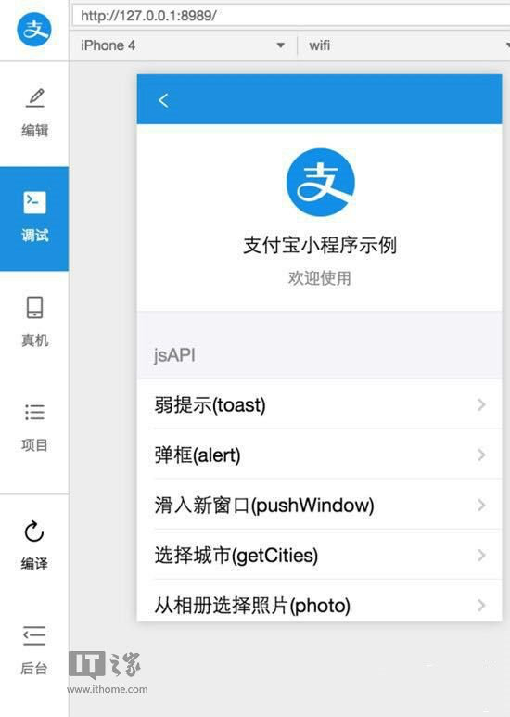
What is Lite/Quick App
A new form of mobile App
Install-free
Richer UI and function than Web
Lite/Quick App carrier:
Can be within Native App
Can be on OS level

Slide 3
What is the problem
Various Lite/Quick App platforms provide different APIs to developers
High cost to developers, have to maintain multiple codes
Cause fragmentation

Slide 4
Goal of this work
Collaborate and discuss how to define a standardized Lite/Quick App API for developers

Slide 5
What kind of API
Network API: Websocket management
User Interaction API: page scroll, alert, prompt, navigation, redirect, tabBar, etc.
Device API: clipboard, phone call, screen control
Location API: user location
Storage/File API: file, storage data management

Slide 6
Network API
LiteApp.connectSocket
LiteApp.onSocketOpen/offSocketOpen
LiteApp.onSocketError/offSocketError
LiteApp.sendSocketMessage
LiteApp.onSocketMessage/offSocketMessage
LiteApp.closeSocket
LiteApp.onSocketClose/offSocketClose

Slide 7
User Interaction API
LiteApp.pageScrollTo
LiteApp.alert
LiteApp.confirm
LiteApp.prompt
LiteApp.navigateTo/navigateBack
LiteApp.redirectTo
LiteApp.tabBar

Slide 8
Device API
LiteApp.getClipboard/setClipboard
LiteApp.makePhoneCall
LiteApp.setKeepScreenOn
LiteApp.getScreenBrightness/setScreenBrightness

Slide 9
Location API
LiteApp.getLocation

Slide 10
Storage/File API
LiteApp.saveFile
LiteApp.getFileInfo
LiteApp.removeSavedFile
LiteApp.setStorage/getStorage
LiteApp.removeStorage

