Slide 1
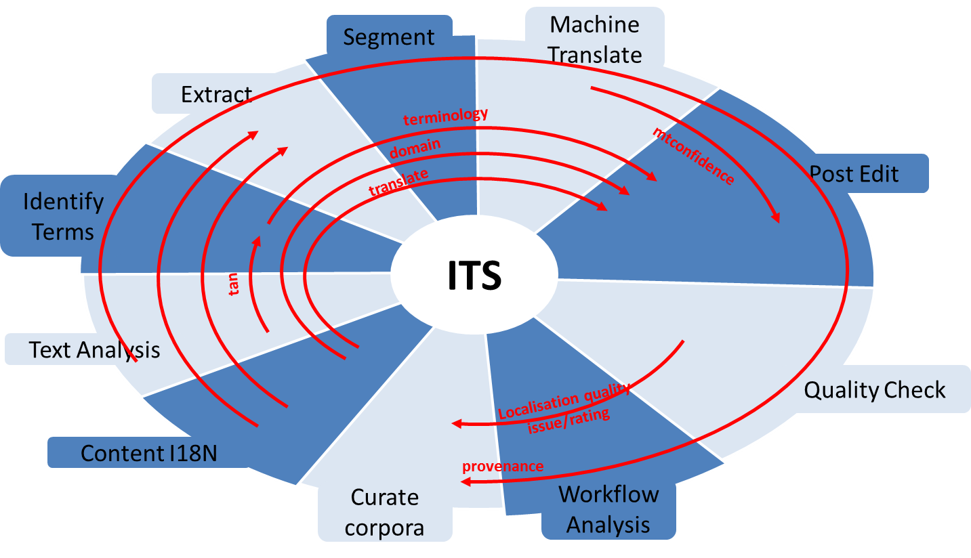
XLIFF Roundtrip Using ITS 2.0 Metadata CMSL10n<->SOLAS
Integration of ITS2.0 with XLIFF 1.2 and 2.0
Roundtrip of metadata introduced in CMS
Enrichment with new metadata throughout the cycle
Modular architecture of specialized XLIFF and ITS aware components
OASIS XML Localisation Interchange File Format (XLIFF)
Multiple ITS aware input points
OKAPI Tikal extraction/merge service
TCD CMS L10n
Consuming and Introducing MT related ITS metadata via M4Loc
Consumption of ITS Test Suite files
CMSl10n extracts Provenance Info
Consumption of Text Analytics metadata, localisable content extraction driven by ITS categories
Data categories:
Translate – drives extraction
Localization Note – passing on prose notes
Terminology – identification of terms in source
Directionality – support for BiDi throughout the roundtrip
Language Information – driving extraction
Elements Within Text – driving extraction
Domain – resolving domain information to assist human and machine translators
TAN – metadata from text analytics services to assist human and machine translators
Locale Filter – drives extraction
Provenance – tracking participation of component services
External Resource – referencing external resources
Target Pointer – ensure that target is populated according to format restrictions
Id Value – preservation of source Id values
Preserve Space – passing on source format restrictions
Localization Quality Issue – introducing quality data during the roundtrip
Localization Quality Rating – introducing quality data during the roundtrip
MT Confidence – introducing MT metadata during the roundtrip
Allowed Characters – passing on source format restrictions
Storage Size – passing on source format restrictions

