Slide 1
Can RDFa and friends enrich presentation MathML to support accessibility and search?
Schubotz, Moritz, 17.12.2020

Slide 2
Status Quo
The W3C MathML community group discussed the introduction of a new HTML attribute called intent to specify mathematical intent without using content MathML.
The goal of this presentation is to understand, if concepts from
Schema.org (https://schema.org/)
Microdata HTML (https://www.w3.org/TR/microdata/)
HTML+RDFa (https://www.w3.org/TR/html-rdfa/)
can be used to transport the same information in a more standardized way.

Slide 3
Agenda 1) schema.org 2) microdata 3) RDFa

Slide 4
Schema.org
Schema.org provides a collection of shared vocabularies webmasters can use to mark up their pages in ways that can be understood by the major search engines: Google, Microsoft, Yandex and Yahoo! (https://schema.org/docs/gs.html)
Vocabularies in Microdata, RDFa, JSON-LD at lowest level of content or as invisible HTML meta-tags.
type Thing (name, description, url, image, identifier, disambiguatingDescription)
https://schema.org/Mass (fatContent)
https://schema.org/ComputerLanguage (programmingLanguage)
DataType
Boolean
Number
Text (CssSelectorType, PronounceableText, URL, XPathType )
Time

Slide 5
Microdata
Exact quote from https://en.m.wikipedia.org/wiki/Microdata_(HTML)

Slide 6
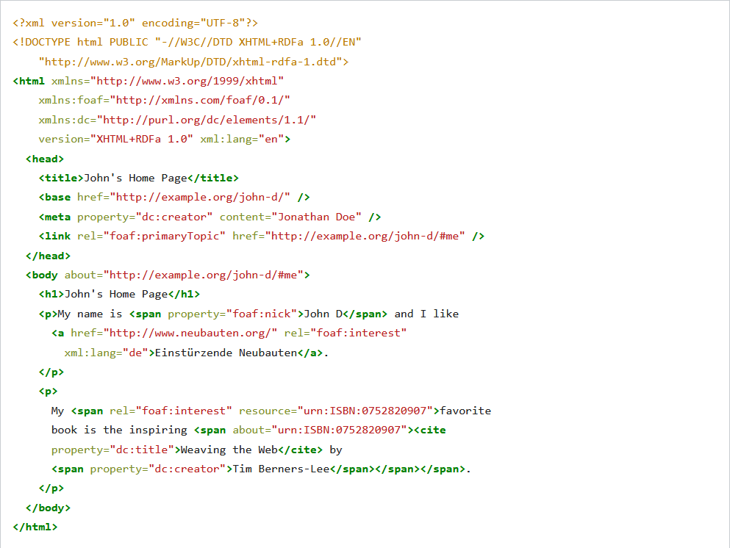
RDFa
W3C recommendation from 2015 to combine RDF with (X)HTML (5)
Also used from within SVG images
In principal compatible with MathML
Example from https://en.m.wikipedia.org/wiki/RDFa

Slide 7
Discussion / Ideas
<math>
<mrow>
<semantics>
<mi>sin</mi>
<annotation-xml encoding="MathML-Content"> <sin /> </annotation-xml>
</semantics>
<mfenced>x</mfenced>
</mrow>
</math>
<math>
<mrow>
<mi about=“https://www.openmath.org/cd/transc1.html#sin“>sin</mi>
<mfenced>x</mfenced>
</mrow>
</math>

Slide 8
Moritz Schubotz
Department of Mathematics
Moritz.schubotz@fiz-karlsruhe.de

