Slide 1
Severity Questionnaire – Results and Resolution Proposal

Slide 2
Goal
Goal – obtain anonymous feedback on alternatives
  Option 1) “Seriousness” and “Severity”
  Option 2) “Life-Threatening” and “Intensity”
  Option 3) “Criticality” and “Severity”
  Option 4) Operational classification based on management criteria that apply to a risk pathway.
  Option 5) Use a scale from another organization

Slide 3
Participation and Overall Results
28 participants completed all questions
 | Option 1 | Option 2 | Option 3 | Option 4 | Option 5
Strongly Disagree | 17.86% | 22.22% | 28.57% | 3.57% | 7.41%
Disagree | 17.86% | 29.63% | 25.00% | 7.14% | 22.22%
Neutral | 10.71% | 18.52% | 25.00% | 14.29% | 37.04%
Agree | 39.29% | 22.22% | 21.43% | 42.86% | 22.22%
Strongly Agree | 14.29% | 7.41% | 0.00% | 32.14% | 11.11%
  Option 1) “Seriousness” and “Severity”
  Option 2) “Life-Threatening” and “Intensity”
  Option 3) “Criticality” and “Severity”
  Option 4) Operational classification based on management criteria that apply to a risk pathway.
  Option 5) Use a scale from another organization

Slide 4
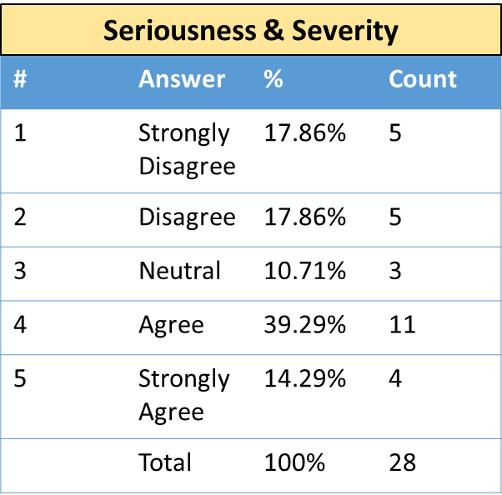
Results - Option 1) “Seriousness” and “Severity”
Advantages:
"Seriousness" and "Severity" are widely used in categorizing adverse events in clinical trials
Use of severity as defined commonly used
Disadvantages:
Terms are too similar possibly causing confusion when communicating with clinicians.
seriousness (like criticality) is describing a POTENTIAL impact, whereas severity characterizes a reaction that has been realized in an individual.
  Since the project is focused on potential drug-drug interactions, you cannot then include an attribute (severity) that is describing a realized reaction because you are then no longer in the realm of the potential.

Slide 5
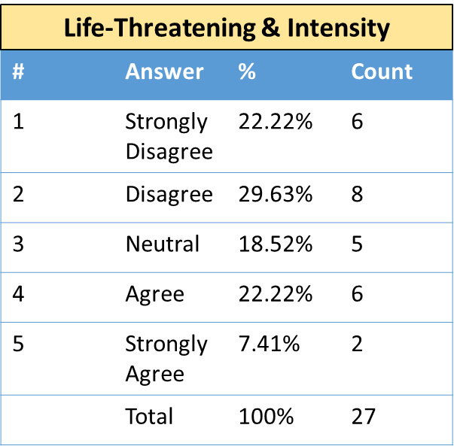
Results - Option 2) “Life-Threatening” and “Intensity”
Advantage:
Intensity is a more acceptable use for varying degrees, such as mild or moderate.
Disadvantage:
“Life-Threatening” captures one aspect of harm, the likelihood of death, therefore term is too restrictive.
In terms of semantics, I see a circular relation between severity and intensity: Severity: "The intensity of a drug-drug interaction clinical consequence." Intensity: "The measurement of severity of a drug-drug interaction clinical consequence.“
No prior precedent. Adopting new terms will just add to confusion.

Slide 6
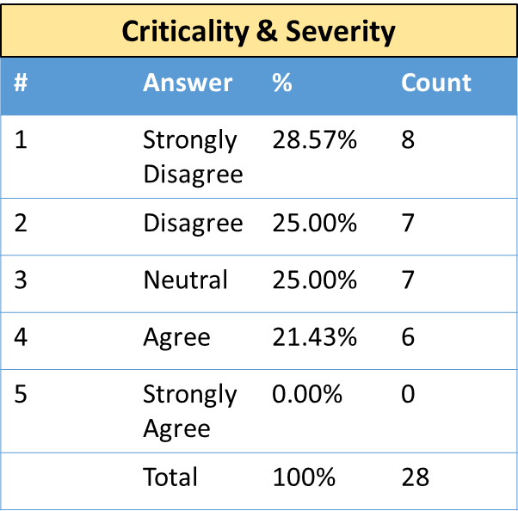
Results - Option 3) “Criticality” and “Severity”
Advantage:
Criticality comes from the realm of allergy and intolerance (established) and is a binary artifact ("high" or "low")
Make sense when situation-agnostic and situation-dependent are included in their definitions, and "Criticality" may align better with clinical decision making.
Disadvantage:
Hard to distinguish between these two terms.
“Severity" is an attribute of the reaction and therefore has no place in a model about potential interactions

Slide 7
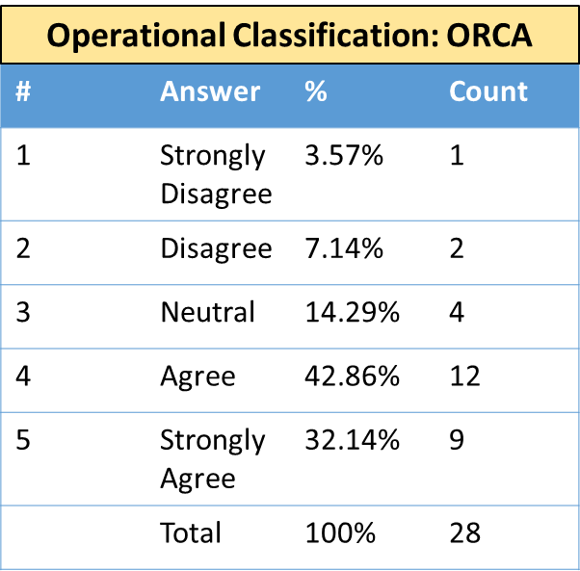
Results - Option 4) Operational classification based on management criteria that apply to a risk pathway.
Advantage:
Operational classifications have actionable information, which could be useful in driving decision support.
ORCA, “Does the thinking for you”.
Well accepted in many organizations.
Using risk to assess management
For those that involve a clinician-patient encounter the more directive nature of these classifications is helpful.
Disadvantage:
May not fully capture the potential effect of the drug-drug interaction on the patient.
It should be considered that different scales can be used and that the same pair of drugs can be classified in very different ways in two sources.

Slide 8
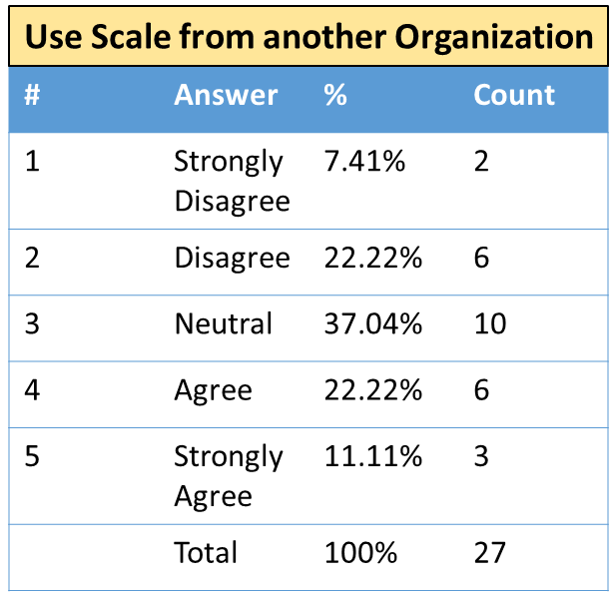
Results - Option 5) Use a scale from another organization
Advantage:
Scales have been established in the community.
Providing information about the ratings for a pair of drugs in different scales can provide a global overview of the potential risk of the DDI.
Disadvantage:
Some [scales] blend concepts that would be better assessed independently and none present a clear advantage over the other proposals.
Making clinicians learn an additional grading system on the user end may be difficult.
General terms without clear definitions
Use of odd limitations
Reliance on degree of documentation
Use of criteria that does not predict outcomes
Overly complex

Slide 9
Proposed Solution
All three of the following:
Do not use Severity.
Keep Seriousness as a categorical concept (Yes or No) indicating the potential for one of the serious outcomes defined by FDA and WHO (death, hospitalization or extension of hospital stay, persistent or significant disability or incapacity, life-threatening).
Use the OpeRational ClassificAtion (ORCA) System within the framework of context/modifying factors.
  Example: https://dbmi-icode-01.dbmi.pitt.edu/dikb-evidence/hcls-drug-drug-interaction/index.html#ex-warfarin-nsaids
Class 1: | Avoid Combination (Risk of combination outweighs benefit)
Class 2: | Usually Avoid Combination (Use only under special circumstances) Interactions for which there are clearly preferable alternatives for one or both drugs. Interactions to avoid by using an alternative drug or other therapy unless the benefit is judged to outweigh the increased risk.
Class 3: | Minimize Risk (Assess risk and take one or more of the following actions if needed) Consider alternatives: Alternatives may be available that are less likely to interact. Circumvent: Take action to minimize the interaction (without avoiding combination). Monitor: Early detection can minimize the risk of an adverse outcome.
Class 4: | No Special Precautions (Risk of adverse outcome appears small)
Class 5: | Ignore (Evidence suggests that the drugs do not interact)

Slide 10
Vote by 10/4!
https://survey.zohopublic.com/zs/AHCsfr

