Slide 1
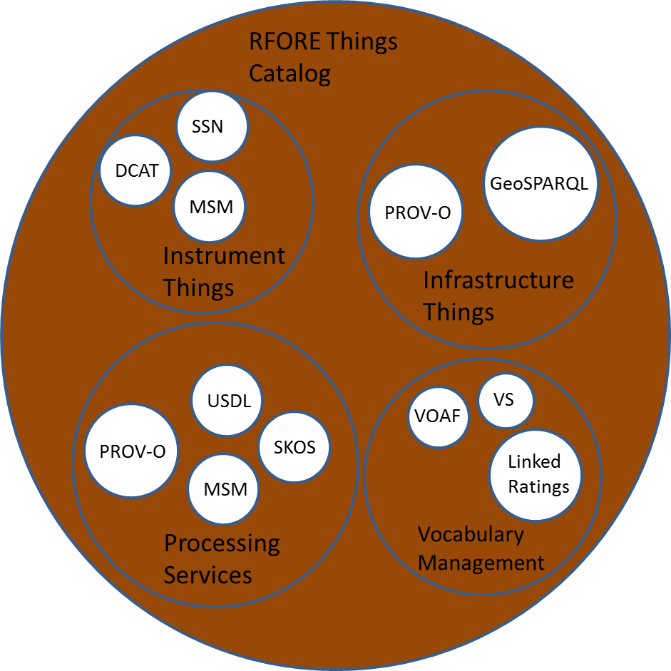
Linked Open Data (LOD) and Community Vocabularies: Its better than Hot Cocoa and Mini Marshmallows
Notes:
EERE Reference Facility Things Category

