Slide 1
The Human Operating System (HumanOS)
Notes:
Expanding the community; sub teacher and we’re going to watch a movie
- Vittorio needs a drink
- Justin 1st Gift for Jane Goodall being brought up at IIW. Joyce said it was a stand up act.
Handles on thoughts with words
Language in development so please contribute and send me an email as ideas occur.
Story Time via Brene Brown- Story is data
Pat & Her Cat
Elaine and Save As

Slide 2
Welcome to what “I.T.” was like being a Computer Guy - 1988
In 1988 I learned Emperor has no clothes. OG IT saw tech support being born.
Hardware compatibility and software OS & Apps (resource leaks) stability and workflow was the challenge.

Slide 3
Computer Guy
In 1988 I learned Emperor has no clothes. We saw tech support being born. Hardware compatibility and software OS & Apps (resource leaks) stability and workflow was the challenge.
IT Roadie in the businesses, homes and lives of clients, 3 generations.

Slide 4
Computer Guy / DAC (Digital Analog Converter)
In 1988 I learned Emperor has no clothes. We saw tech support being born. Hardware compatibility and software OS & Apps (resource leaks) stability and workflow was the challenge.
IT Roadie in the businesses, homes and lives of clients, 3 generations
The Disco Ball: My mission is to reflect on, and reflect outwardly, as I’ve been invited to do today, 35 years of experiences witnessing people being pulled from their familiar world into an other worldly realm.

Slide 5
Computer Guy / Digital Culture Anthropologist
In 1988 I learned Emperor has no clothes. We saw tech support being born. Hardware compatibility and software OS & Apps (resource leaks) stability and workflow was the challenge.
IT Roadie in the businesses, homes and lives of clients, 3 generations
Disco Ball: My mission is to reflect on, and reflect outwardly, as I’ve been invited to do today, 35 years of experiences witnessing people being pulled from their familiar world into an other worldly realm.
This has created an awareness story and intention practice I refer to as Real-IT®. A person’s Real-IT® is the relationship they choose to have, or not have, with IT systems. Those Real-IT® choices will reflect into their Reality.

Slide 6
Computer Guy / Digital (Culture) Anthropologist
In 1988 I learned Emperor has no clothes. We saw tech support being born. Hardware compatibility and software OS & Apps (resource leaks) stability and workflow was the challenge.
IT Roadie in the businesses, homes and lives of clients, 3 generations
Disco Ball: My mission is to reflect on, and reflect outwardly, as I’ve been invited to do today, 35 years of experiences witnessing people being pulled from their familiar world into an other worldly realm.
This has created an awareness story and intention practice I refer to as Real-IT®. A person’s Real-IT® is the relationship they choose to have, or not have, with IT systems. Those Real-IT® choices will reflect into their Reality.
Our Human Nature has dependable exploits in the sense of vulnerabilities. Those seductions may be exploited by systems leveraging design forces. These often offer convenience, sex, free, self-aggrandizement, voyeurism, power (in the form of force, info, finance, control) or some combination thereof. Which affect has the force of persuasion or not is somewhat variable because people and cultures are different.

Slide 7

people
systems

Slide 8
- The HumanOS – Extending Ourselves Across The IRL/DL Boundary
KY-Platform/OS: Human Creature / running Human Nature. The code and everything you all write runs on top of Human sensibilities. Witnessing how intention is forged from shear intellect into Code Is Law is quite informative.

Slide 9
- The HumanOS – Extending Ourselves Across The IRL/DL Boundary
KY-Platform/OS: Human Creature / running Human Nature. The code and everything you all write runs on top of Human sensibilities. Witnessing how intention is forged from shear intellect into Code Is Law is quite informative.
Human eXperience (HX) has examples of the Human Creature extending itself into realms we are not built for. Air Flight. Space. Deep Sea. Bio-hazard. Fire. Each of these realms demands we apply amendments to our body to not only function, but to not die while being “there”.

Slide 10
- The HumanOS – Extending Ourselves Across The IRL/DL Boundary
KY-Platform/OS: Human Creature / running Human Nature. The code and everything you all write runs on top of Human sensibilities. Witnessing how intention is forged from shear intellect into Code Is Law is quite informative.
Human eXperience (HX) has examples of the Human Creature extending itself into realms we are not built for. Air Flight. Space. Deep Sea. Bio-hazard. Fire. Each of these realms demands we apply amendments to our body to not only function, but to not die while being “there”.
The HumanOS is an emulator mode which does its best to align sensibilities of known IRL lessons “through the glass” on the Digital Landscape.

Slide 11
- The HumanOS – Extending Ourselves Across The IRL/DL Boundary
KY-Platform/OS: Human Creature / running Human Nature. The code and everything you all write runs on top of Human sensibilities. Witnessing how intention is forged from shear intellect into Code Is Law is quite informative.
Human eXperience (HX) has examples of the Human Creature extending itself into realms we are not built for. Air Flight. Space. Deep Sea. Bio-hazard. Fire. Each of these realms demands we apply amendments to our body to not only function, but to not die while being “there”.
The HumanOS is an emulator mode which does its best to align sensibilities of known IRL lessons “through the glass” on the Digital Landscape.
As we operate and cross back and forth through the glass what amendments are helpful, if not foundational, to manifesting our intention.

Slide 12
- The HumanOS – Extending Ourselves Across The IRL/DL Boundary
Human eXperience (HX) has examples of the Human Creature extending itself into realms we are not built for. Air Flight. Space. Deep Sea. Bio-hazard. Fire. Each of these realms demands we apply amendments to our body to not only function, but to not die while being “there”.
The HumanOS is an emulator mode which does its best to align sensibilities of known IRL lessons “through the glass” on the Digital Landscape.
As we operate and cross back and forth through the glass what amendments are helpful, if not foundational, to manifesting our intention.
Real-IT + Aikido = Real-ITdo, the Martial Art of The Digital Landscape
Notes:
Phi & Instagram “like” via text thread not App
Web pages thru secure device rather than install app

Slide 13
Real-ITdo MDMA - Mixed Digital Martial Arts A Game Space Of Chutes & Ladders
Forces: Know Who/What Is In The Room With You
Terms & Conditions
EvE (Ethics vs. Economics which leads)
Shadow System
Lack of Awareness
Trust Challenge
Spidey Senses Dulled
Notes:
Phi & Instagram “like” via text thread not App
Web pages thru secure device rather than install app

Slide 14
Real-ITdo MDMA - Mixed Digital Martial Arts A Game Space Of Chutes & Ladders
Forces: Know Who/What Is In The Room With You
Stages: KY-S,D,P,T, = Self, Device, Platform, Terms
Terms & Conditions
EvE (Ethics vs. Economics which leads)
Shadow System
Lack of Awareness
Trust Challenge
Spidey Senses Dulled
0
1
2
3
4

Slide 15
Real-ITdo MDMA - Mixed Digital Martial Arts A Game Space Of Chutes & Ladders
Forces: Know Who/What Is In The Room With You
Stages: KY-S,D,P,T, = Self, Device, Platform, Terms
Terms & Conditions
EvE (Ethics vs. Economics which leads)
Shadow System
Lack of Awareness
Trust Challenge
Spidey Senses Dulled
0 - Dirt, Gravity, Food, etc. No presence of technology
1
2
3
4
Notes:
Take of your clothes and go stand in nature. That and everything that comes with it is what we are built for.

Slide 16
Real-ITdo MDMA - Mixed Digital Martial Arts A Game Space Of Chutes & Ladders
Forces: Know Who/What Is In The Room With You
Stages: KY-S,D,P,T, = Self, Device, Platform, Terms
Terms & Conditions
EvE (Ethics vs. Economics which leads)
Shadow System
Lack of Awareness
Trust Challenge
Spidey Senses Dulled
0 - Dirt, Gravity, Food, etc. No presence of technology
1 - Awareness: General Real-IT®
2
3
4

Slide 17
Real-ITdo MDMA - Mixed Digital Martial Arts A Game Space Of Chutes & Ladders
Forces: Know Who/What Is In The Room With You
Stages: KY-S,D,P,T, = Self, Device, Platform, Terms
Terms & Conditions
EvE (Ethics vs. Economics which leads)
Shadow System
Lack of Awareness
Trust Challenge
Spidey Senses Dulled
0 - Dirt, Gravity, Food, etc. No presence of technology
1 - Awareness: General Real-IT®
2 - Savvy: experience/knowledge
3
4

Slide 18
Real-ITdo MDMA - Mixed Digital Martial Arts A Game Space Of Chutes & Ladders
Forces: Know Who/What Is In The Room With You
Stages: KY-S,D,P,T, = Self, Device, Platform, Terms
Terms & Conditions
EvE (Ethics vs. Economics which leads)
Shadow System
Lack of Awareness
Trust Challenge
Spidey Senses Dulled
0 - Dirt, Gravity, Food, etc. No presence of technology
1 - Awareness: General Real-IT®
2 - Savvy: experience/knowledge
3 - Real-ITdo: crafting & building the functional persona: H.OS tools
4

Slide 19
Real-ITdo MDMA - Mixed Digital Martial Arts A Game Space Of Chutes & Ladders
Forces: Know Who/What Is In The Room With You
Stages: KY-S,D,P,T, = Self, Device, Platform, Terms
Terms & Conditions
EvE (Ethics vs. Economics which leads)
Shadow System
Lack of Awareness
Trust Challenge
Spidey Senses Dulled
0 - Dirt, Gravity, Food, etc. No presence of technology
1 - Awareness: of General Real-IT®
2 - Savvy: experience / knowledge
3 - Real-ITdo: crafting & building the functional persona: H.OS tools
4 - You-X ™ : the individual’s outcome of Real-IT + Being Human

Slide 20
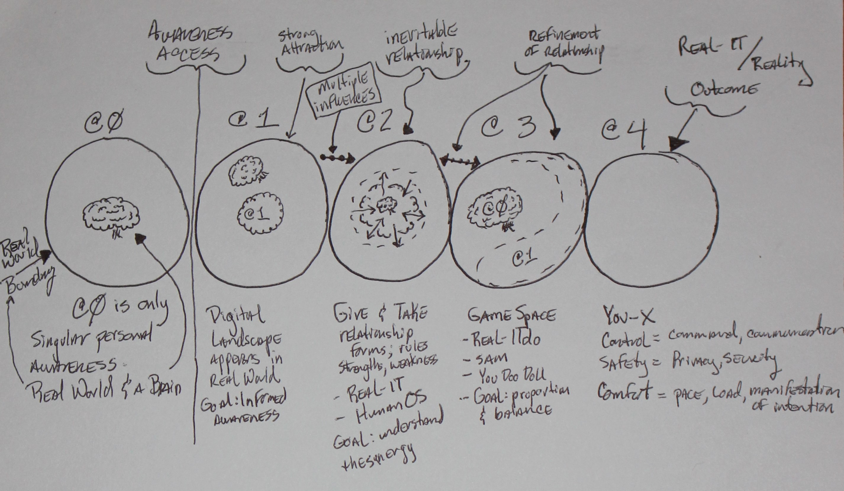

Slide 21
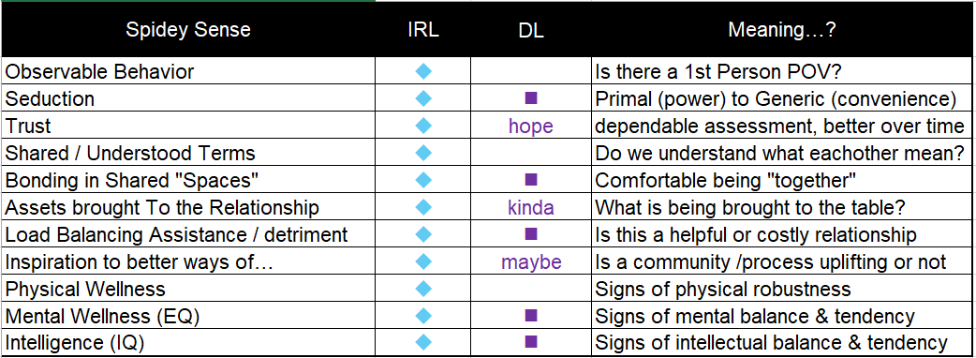
Relationship Assessment Stringencies

Slide 22
Jeff Orgel
jeffo@whatisyourrealit.com

