Slide 1
OpenAttestation EmbeddedRenderer
W3C CCG Sharing
Kyle Huang, Phan Shi Yu, Calvin Cheng
30 July 2024

Slide 2
CONTENTS
Overview
Demo
Design
Q & A

Slide 3
Who Are We?
Kyle Huang
Phan Shi Yu
Yvonne Chia
Calvin Cheng
Notes:
Mention people who are on the call continually to contribute.

Slide 4
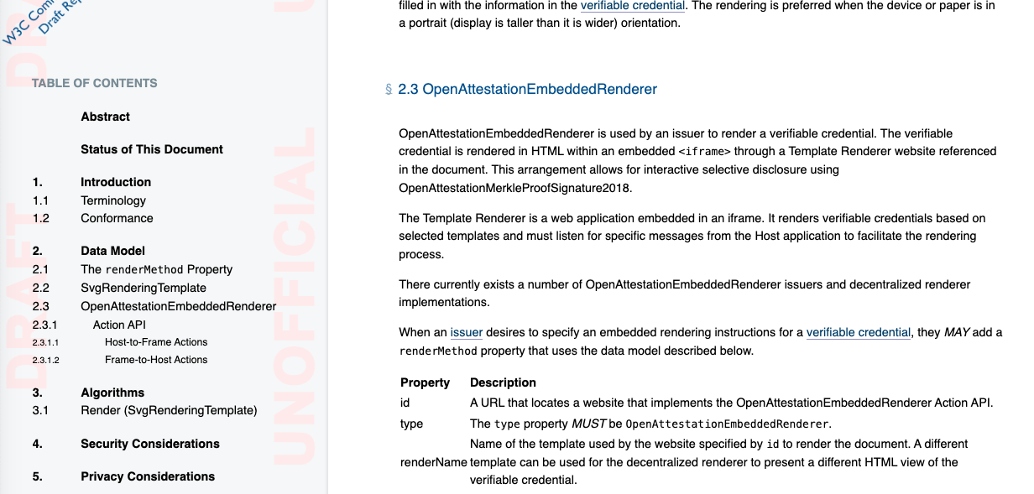
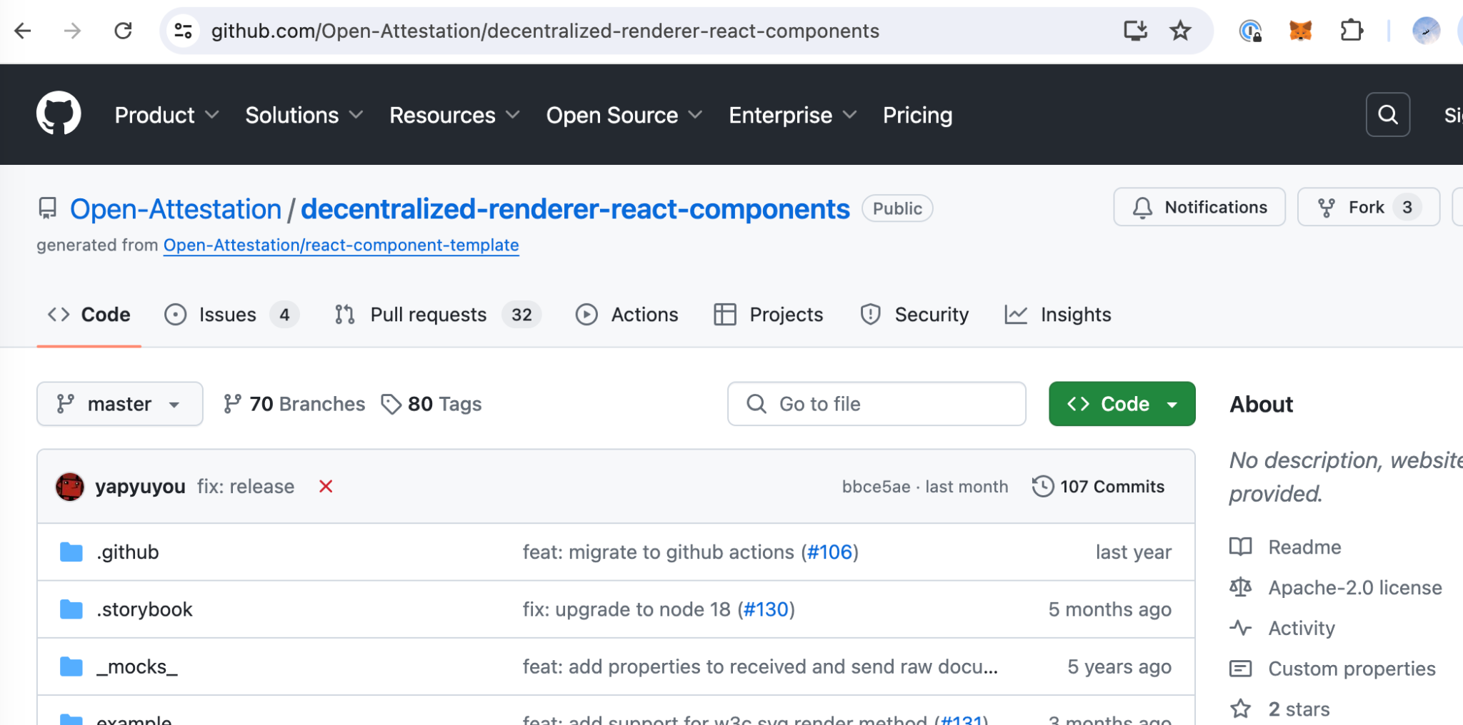
OpenAttestationEmbeddedRender
Created alongside OpenAttestation framework.
Decentralized renderer web application that renders a VC Data Model 2.0-conformant document in an IFRAME.
Merged into VC Render Method Spec.
Reference implementation on Github.

Slide 5
OpenAttestation
Millions of verifications and counting:
Open source Verifiable Credentials framework by the Government of Singapore.
In production since 2018.
W3C VC Data Model 2.0-conformant.
Render method is independent of OpenAttestation.
Notes:
Why not TrustDocs? Notarise?

Slide 6
Demo

Slide 7
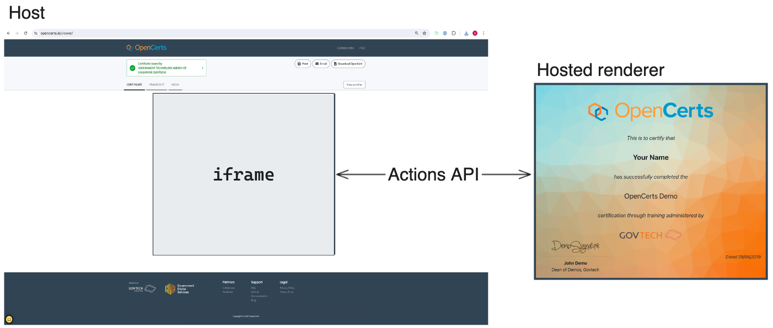
Design

Slide 8
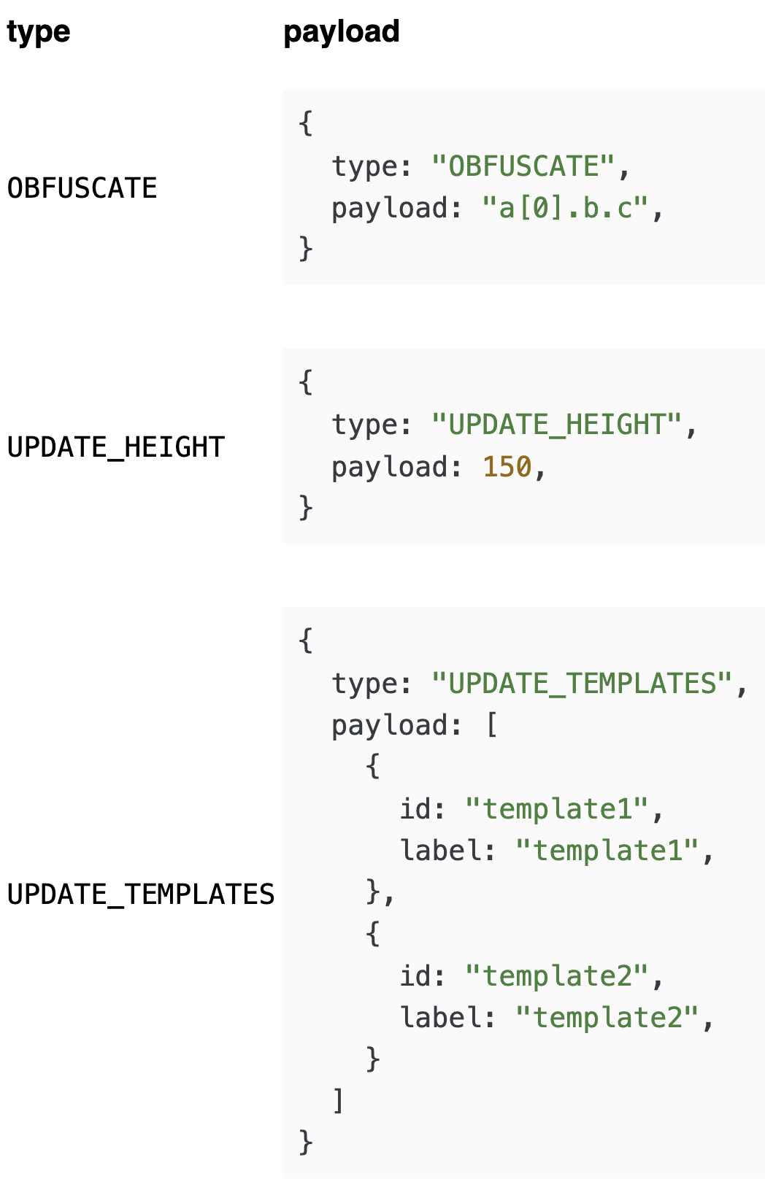
Actions API
Host to Frame
Frame to Host

Slide 9
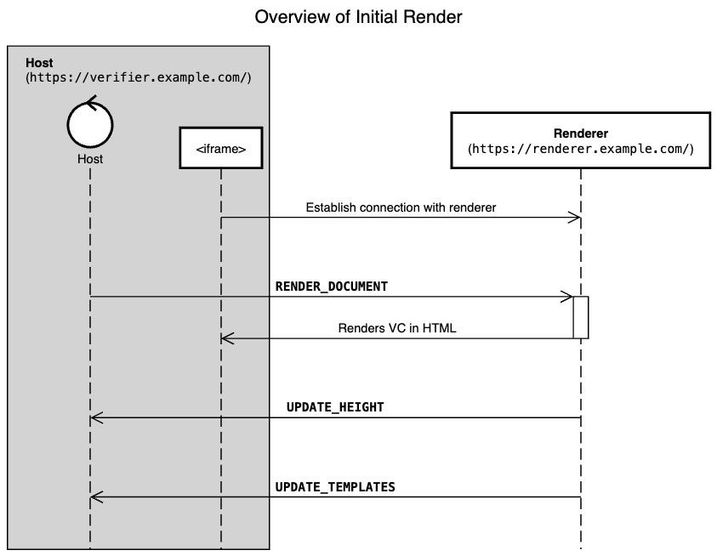
Actions API Initial Render

Slide 10
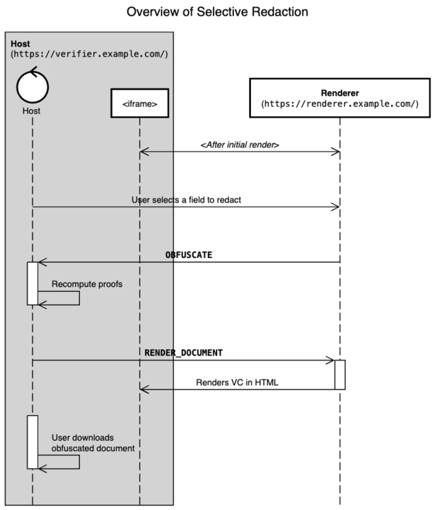
Actions API Selective Redaction
Notes:
Do not talk about undo obfuscate. Check if we need to re-render.

Slide 11
Why OpenAttestationEmbeddedRenderer?
User interactivity and animation.
Multiple ways to render a VC using templates.
Each issuer can take ownership of their renderer.
Sandboxed from the Host for more security.
Notes:
User interactivity and animation.
Multiple ways to render a VC using templates.
Each issuer can take ownership of their renderer.
Sandboxed from the Host for more security.

Slide 12
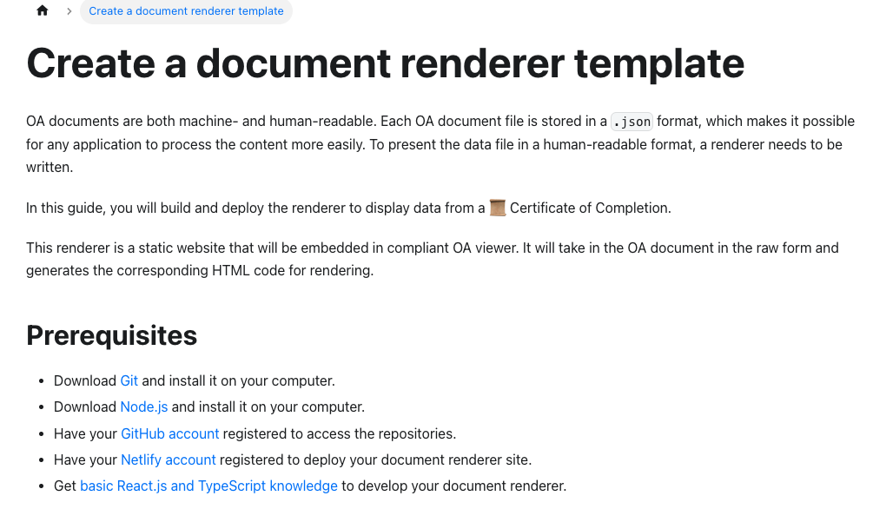
Working with OpenAttestationEmbeddedRenderer
Get Started
Host
Renderer
Render logic
Register the template

Slide 13
Q&A

Slide 14
Closing Words
Send us your feedback on OpenAttestation v4.
Publish our OpenAttestation securing mechanism.

