Slide 1
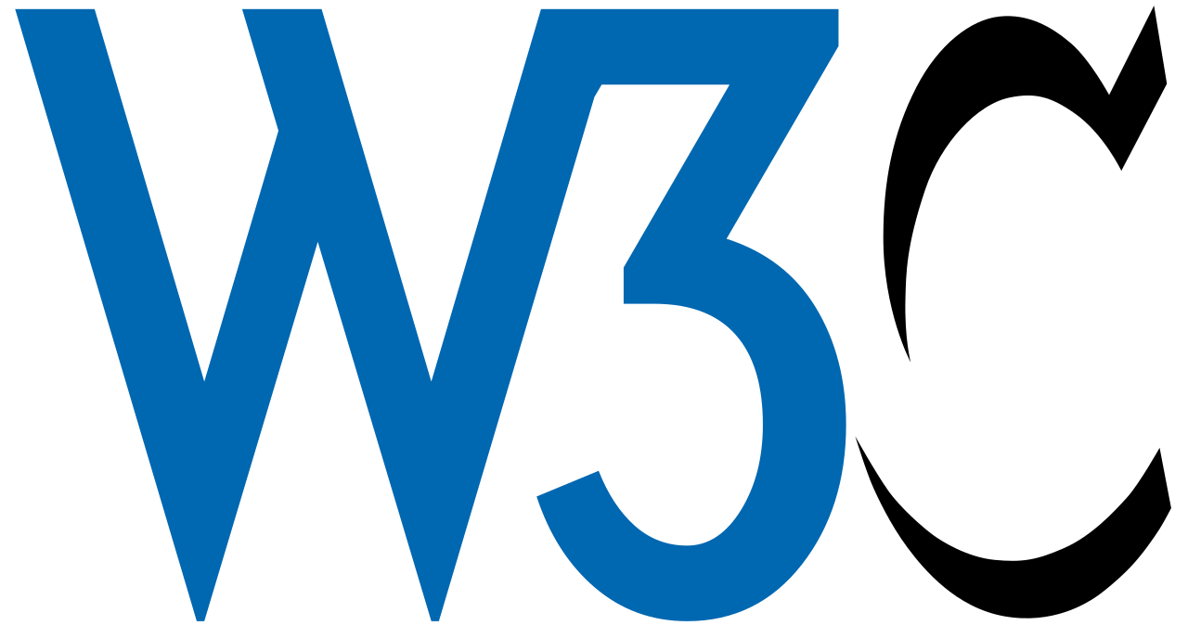
Attaining Digital Trust
Mathieu Glaude, CEO of Northern Block
W3C Credentials Community Group - November 22nd,2022

Slide 2
Sovereignty in a Digital World
How does a sovereign nation ensure their sovereignty remains in a digital world?
In the digital space, the private sector has moved ahead of government (generally speaking).
Digital ID → Digital Trust → Sovereignty
If digital trust will bring sovereignty to states and citizens, how do we attain digital trust?

Slide 3
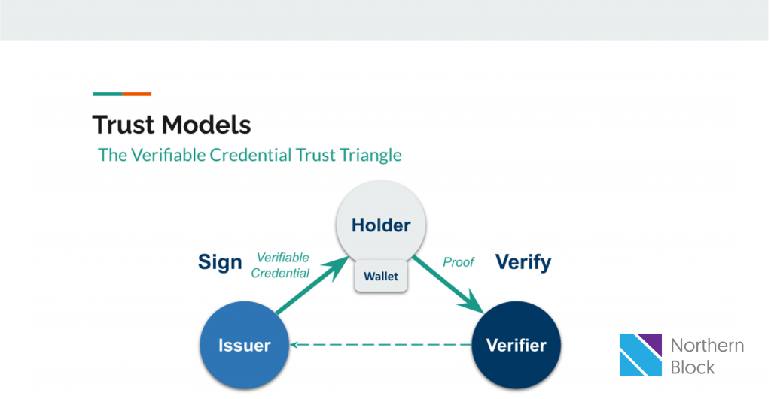
Attaining Digital Trust
Introduction to Digital Trust shorturl.at/ATU15
What does it mean to ensure trust is baked into a digital interaction?
New Questions
How can I trust any type of claim made digitally, independent of my role within the trust triangle? (Hint: using cryptographic proofs alone aren’t enough)
What infrastructure is needed to support this?
Who should build, deploy and maintain this infrastructure?

Slide 4
Question 1 What infrastructure is needed so that I trust any type of claim made digitally?
When an entity is presented with a verifiable claim, there are three things they will want to ensure:
That the claim hasn’t been altered/falsified at any point in time
That the claim has accurate representation
That the claim have authoritativeness

Slide 5
A. Ensuring a claim isn’t altered when presented
Through cryptographic proofs, we are today able to guarantee to a verifier that the claim being presented to them is based on unchanged data that was issued to the presenting party of this claim.
W3C JSON-LD, AnonCreds, etc.
Verifying the claim hasn't been altered, not the legitimacy of the data attributes itself.

Slide 6
B. Ensuring that the claim has accurate representation
We’re now verifying that the data beneath the claim was issued to the holder by an accurately represented entity, and that the holder is accurately represented as well (and the same is true for other relationships in the trust triangle)
This is an authentication challenge.
There are different methods of authenticating for accurate representation, depending on the use case, or depending on what's available (e.g., DNSSEC, FIDO, Google Account, etc.)

Slide 7
C. Ensuring the claim is authoritative
Lists that can contain information such as:
Who are the authoritative issuers in an ecosystem?
Is the verifier accurate and authoritative to ask what they're asking for?
What credential types are used in an ecosystem?
What wallets are approved for use in an ecosystem?
What uses of credentials are normal/abnormal?

Slide 8
✅ Question 1 What infrastructure is needed so that I trust any type of claim made digitally?

Slide 9
Question 2 What ramp is needed to maximize the benefits of the infrastructure?
Comparison to roads
"It was evident we needed better highways. We needed them for safety, to accommodate more automobiles. We needed them for defense purposes, if that should ever be necessary. And we needed them for the economy. Not just as a public works measure, but for future growth."

Slide 10
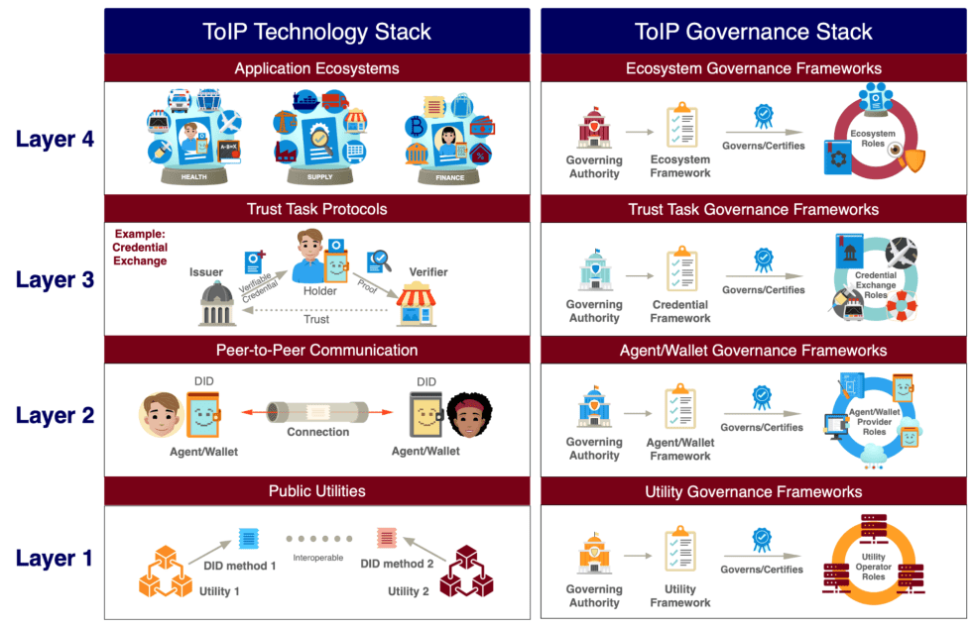
Question 2 What ramp is needed to maximize the benefits of the infrastructure?

Slide 11
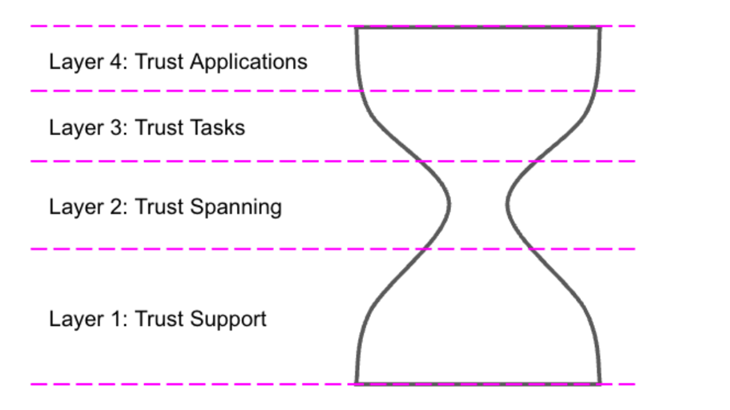
Question 2 What ramp is needed to maximize the benefits of the infrastructure?

Slide 12
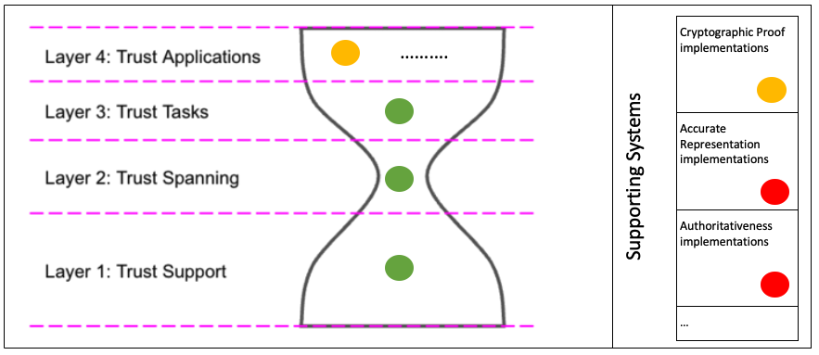
Question 2 What ramp is needed to maximize the benefits of the infrastructure?

Slide 13
✅ Question 2 What ramp is needed to maximize the benefits of the infrastructure?

Slide 14
Question 3 Who should build, deploy and maintain this infrastructure?
Digital ID → Digital trust → Sovereignty
The end goal of the infrastructure is foundational ID
Why won’t the private sector build a foundational ID?
Why shouldn’t Big Tech build it?
Why shouldn’t NFPs build it?
Why should Government build it?
Because it’s infrastructure
Because it’s not a use case
Deploy and maintain? (still being worked on)

Slide 15
Attaining Digital Trust
W3C Credentials Community Group
November 22nd,2022

