Slide 1
Pull Requests, Part I
Dan Burnett
Verifiable Claims
13 December 2016

Slide 2
Git and GitHub
Git is a revision control system, primarily command-line driven
GitHub is a site that hosts git repositories

Slide 3
Git
Revision control system
  Tracks changes to a collection of files
  Each saved change is called a 'commit'
    represented and referenced by a hash value
    usually containing a (brief) commit message explaining what the commit is for

Slide 4
Repositories
All commits apply to a specific 'repository'
A repository can be cloned to form a brand new (separate) repository
When I clone your repository I really do have my own separate copy

Slide 5
Branches
All work (i.e., commits) within a repository is done on a branch
Normal default branch is 'master', but most W3C specs use 'gh-pages' as the default branch
It is trivially easy to create new branches
After working on a new branch, you can then merge your changes (your commits) onto a different branch
A common workflow is to branch from the default, edit and commit your changes, then merge the changes into the default branch

Slide 6
GitHub
Web hosting for git repositories
Adds some magic to repositories and branches to enable the 'fork and pull' model
  Why? To make it easier for contributors without edit access to the main repository to propose changes
Provides only limited document editing and committing capabilities
  Why? Because the details of branching, commits, and merging can get quite complicated

Slide 7
Repositories
In github, you 'fork' to create a clone, a new copy of the current repository, in your account.
Your copy knows where it was forked from. This is used in creating pull requests.
All PRs are created from YOUR fork
More details on forking vs. cloning: http://bryanpendleton.blogspot.com/2014/07/git-clone-vs-fork.html

Slide 8
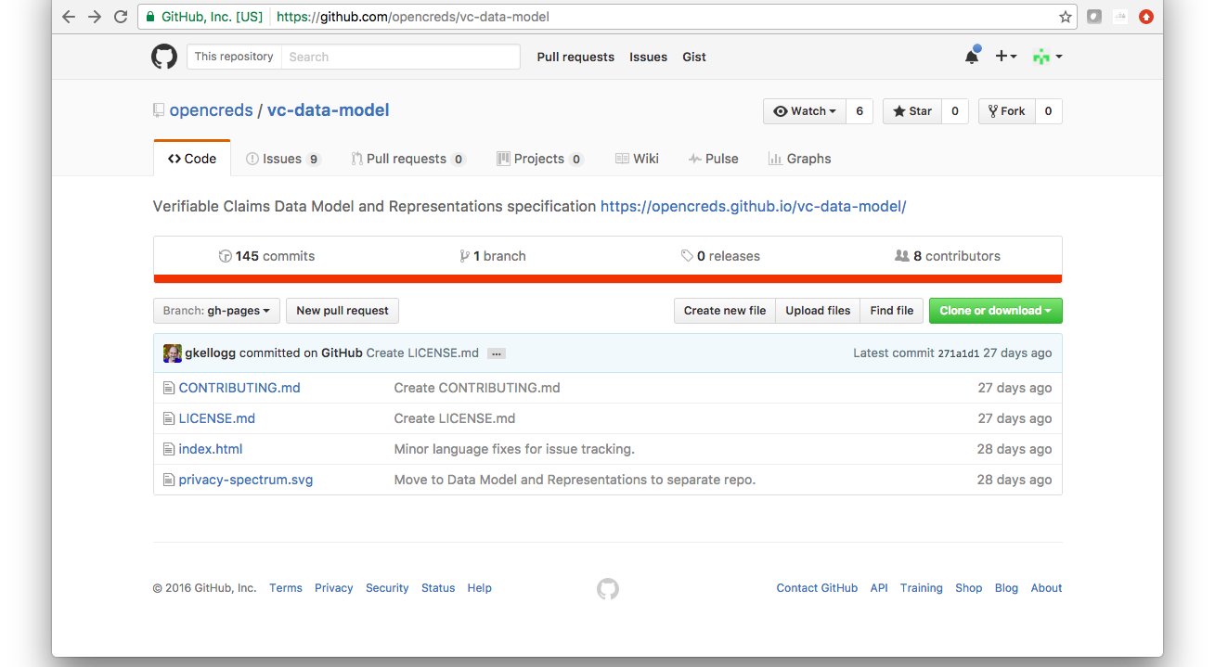
Original repo

Slide 9
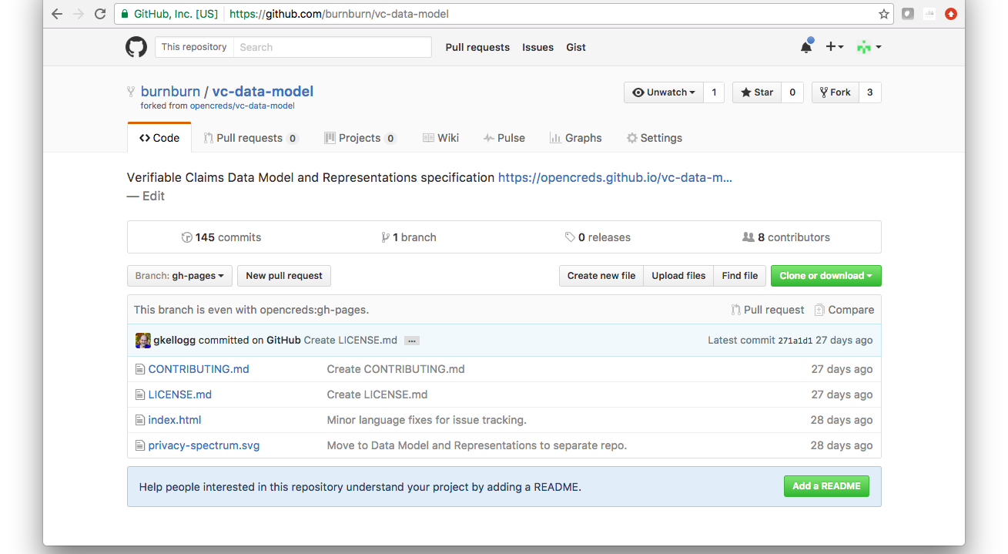
My forked repo

Slide 10
Pull Requests
A 'pull request' is a collection of changes to the original repository
It can often be easily 'pulled in', or merged, into the original repository by the maintainers of that repo

Slide 11
Branches and Pull Requests
A pull request is created from a branch in your repository
GitHub figures out the diffs between the original repo and your current branch in your repo and makes it a Pull Request
Any changes you make to your own branch are automatically updated in the PR

Slide 12
Creating a single simple PR in GitHub
https://help.github.com/articles/github-flow-in-the-browser/
  Create a branch
  Edit the file(s) and commit
  Create a PR

Slide 13
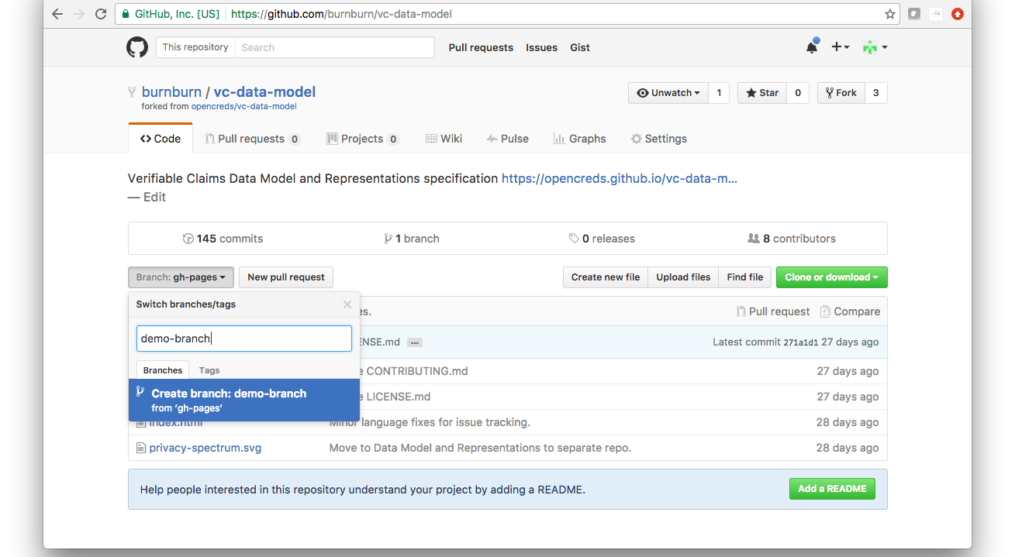
Create a branch

Slide 14
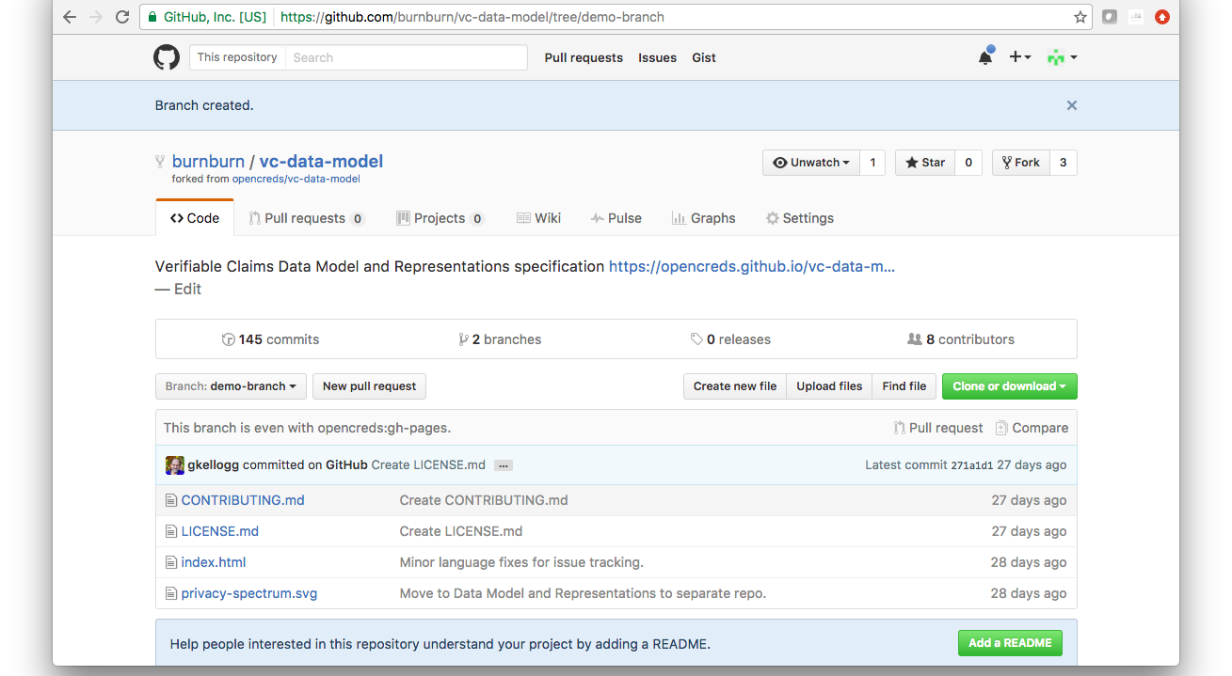
Select the file to edit

Slide 15
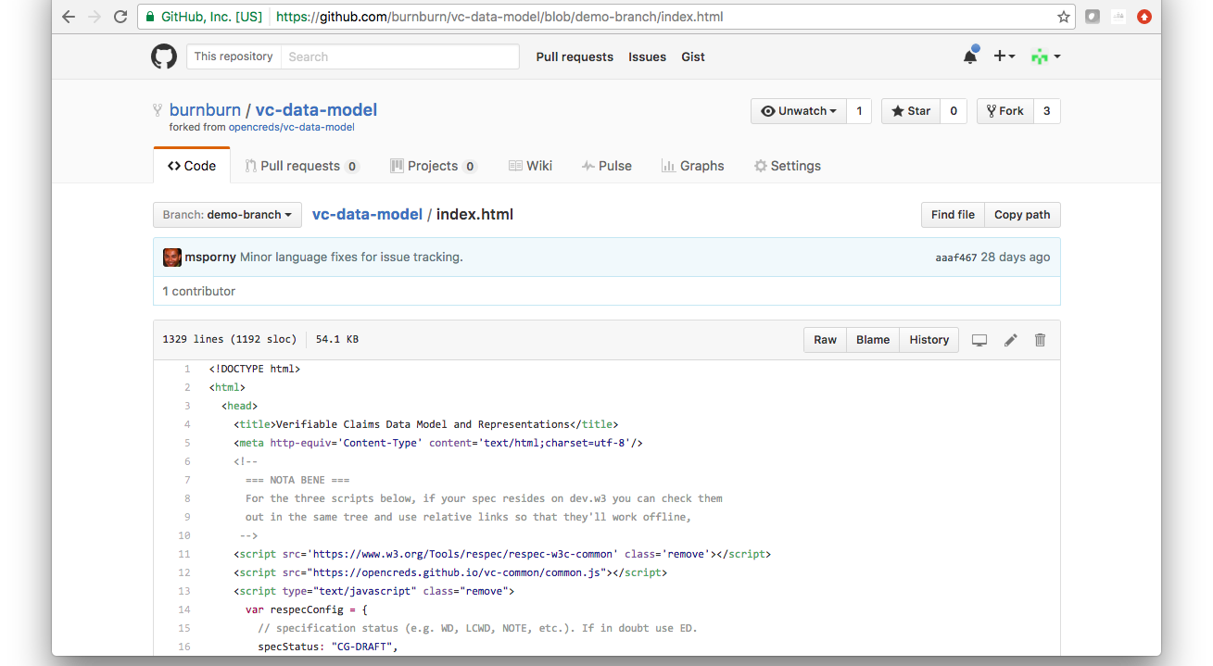
Click the edit icon

Slide 16
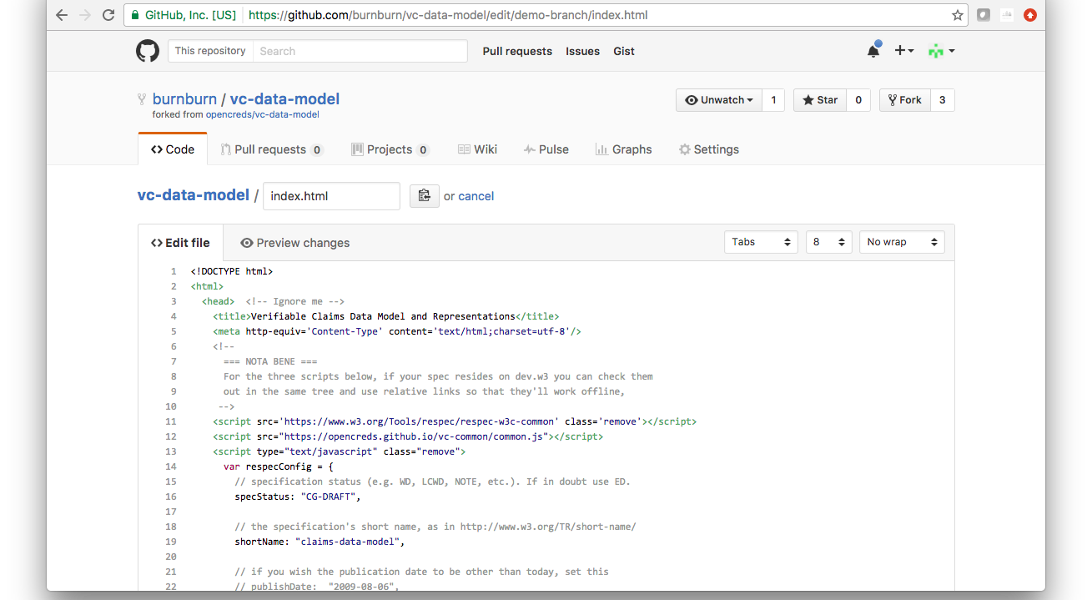
Make your edits and click the Preview Changes tab

Slide 17
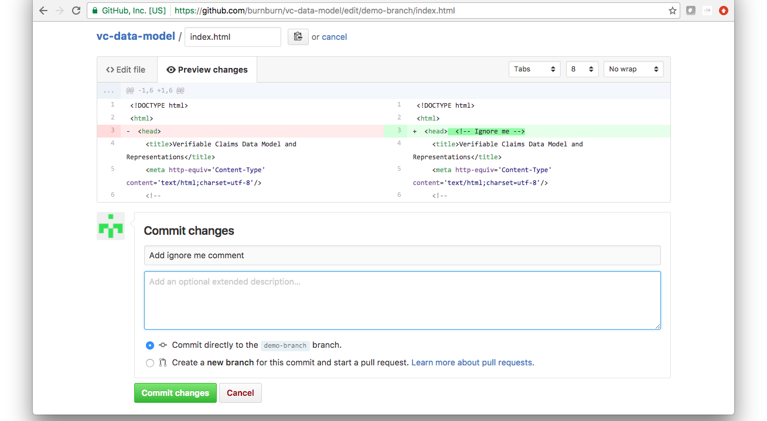
Fill in commit message and commit

Slide 18
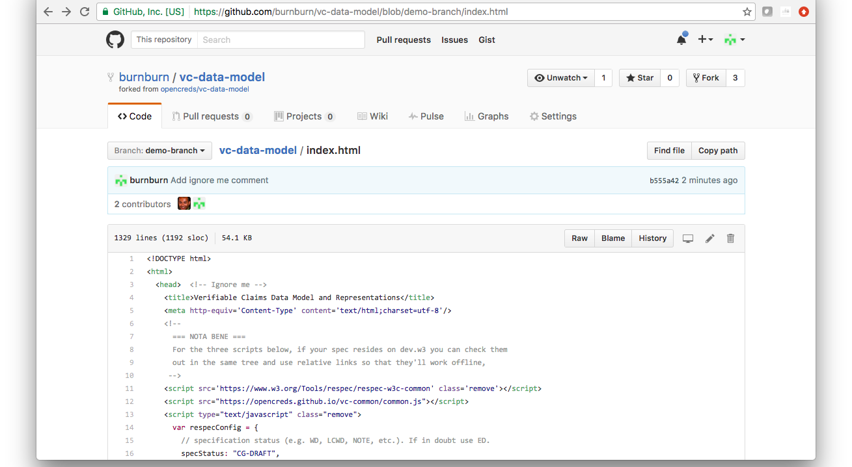
Return to the head of your repository

Slide 19
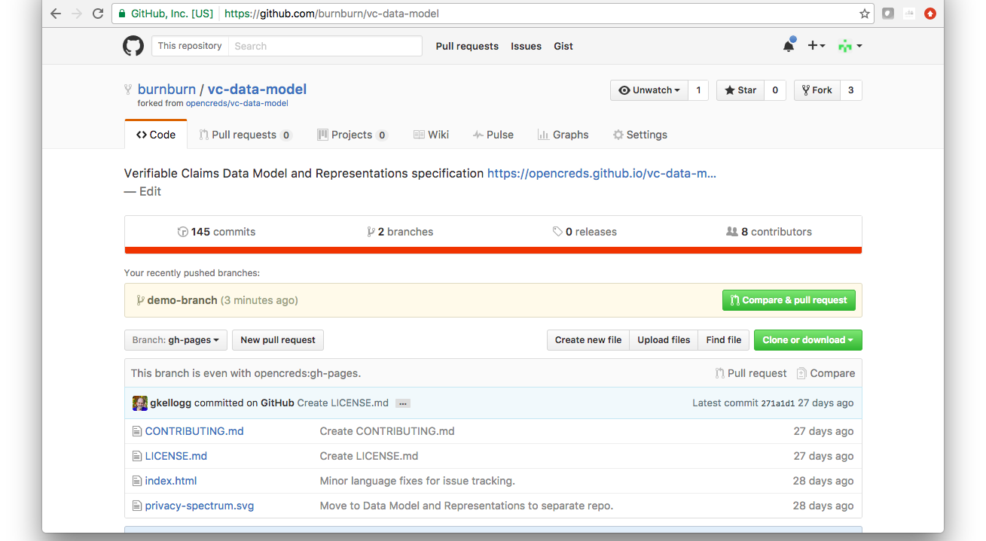
Compare and Pull Request

Slide 20
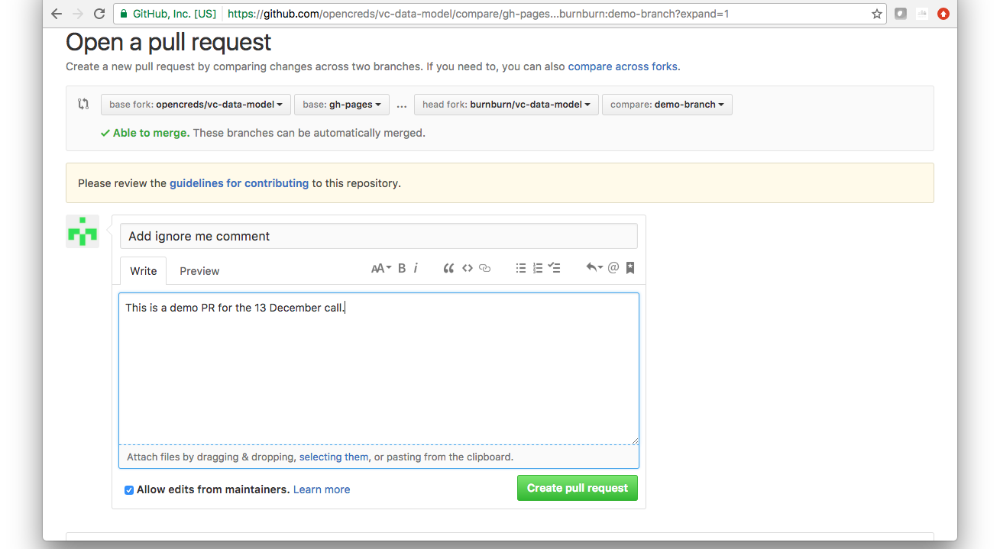
Update title, add description, and create PR

Slide 21
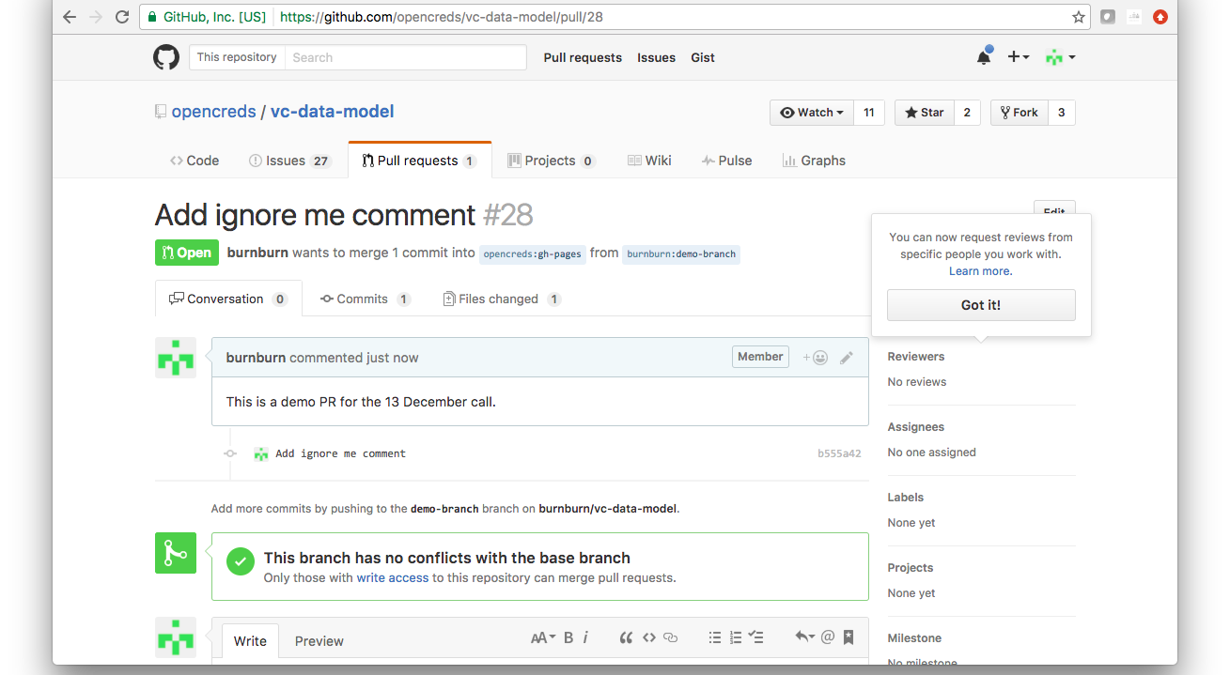
Note that you are now viewing the PR in the original repo

Slide 22
Upstreams . . .
There's a problem with this . . .
What if you do this, then the original repo is modified, then you want to do another PR?
  In this case your repo doesn't match the original, so your edits are based on an out-of-date copy
  If your edits are in an unchanged section it may work
  Otherwise, stay tuned for Part II . . .

