Slide 1
Proposed Applications of MathML to Chemistry Pedagogy
Stefan M. Kilyanek
Associate Professor (as of 8-20-2020)
Department of Chemistry and Biochemistry
University of Arkansas

Slide 2
Standardization of symbols in chemistry are well established
Symbols in chemistry are standardized internationally.
The International Union of Pure and Applied Chemistry (IUPAC) founded in 1919 (101 years ago)
American Chemical Society (ACS) founded 1876 (144 years ago)
Royal Society of Chemistry (RSC) predecessor was founded in 1844 (176 years ago)
  ACS and RSC both have standards and symbols committees which interact with the IUPAC.
Our recommendations are to use IUPAC abbreviations for chemical symbols and expressions along with naming conventions and standards.
Standards and examples can be found in the CRC handbook (100th ed. 1532 pages).

Slide 3
“Chemistry equations” can mean many things
Equations used in Chemistry
Chemical Equations
Algebraic expressions
Algebraic expressions that use chemical symbols
Algebraic expressions that use chemical concepts

Slide 4
Proposed “wrappers” for chemistry in MathML
“Chemical equation”
  Sub-wrapper : “organic chemistry”
  Sub-wrapper : “biochemistry”
  These are specialized abbreviations that are sub-field specific and go beyond the IUPAC element symbols
“Chemistry” equations that use chemical concepts that require a consistent “character”
“Units”
“Chemical formulas” (used in other equations)
  Sub-wrapper : “organic chemistry”
  Sub-wrapper : “biochemistry”
  These are specialized abbreviations that are sub-field specific and go beyond the IUPAC element symbols

Slide 5
Chemical equations are different from mathematical equations
Chemical equations have a different form than mathematical equations.
This is what we call a “balanced chemical equation”
FeCl₃ (aq) + 3 AgNO₃ (aq) → 3 AgCl (s) + Fe(NO₃)₃ (aq)
We suggest this would be identified as a chemical equation using a “wrapper” which would be read as…
“cap F e cap C l sub 3 aqueous Plus 3 Cap A g Cap N Cap O sub 3 aqueous reacts to form 3 Cap A g Cap C l solid Plus Cap F e open paren Cap N Cap O sub 3 close paren sub 3 aqueous”

Slide 6
Chemical equations are diverse in scope
Here are two “half reactions” used in introductory electrochemistry
Cu²⁺ (aq) + 2 e⁻ → Cu (s)
Zn (s) → Zn²⁺ (aq) + 2 e⁻
These should be read as “Cap C u sup two plus aqueous plus two electrons reacts to form Cap C u solid” and “Cap Z n solid reacts to form cap Z n sup two plus aqueous plus two electrons”
When combined these “half reactions” create the balanced reaction
Cu²⁺ (aq) + Zn (s) → Zn²⁺ (aq) + Cu (s)
This reaction should be read as “Cap C u sup two plus aqueous plus Cap Z n solid reacts to form Cap Z n sup two plus aqueous plus Cap C u solid”

Slide 7
Simple Expressions in Chemistry : PV=nRT
Simple algebraic expressions can be handled by using the content wrapper “chemistry”
PV=nRT
Contextual knowledge and the text of a book or webpage will allow the student know that this expression is the ideal gas law and means “pressure times volume is equal to the number of moles of an ideal gas times the universal gas constant times temperature in Kelvin”
The speech engine should render this as “Cap P times Cap V equals n times Cap R times Cap T

Slide 8
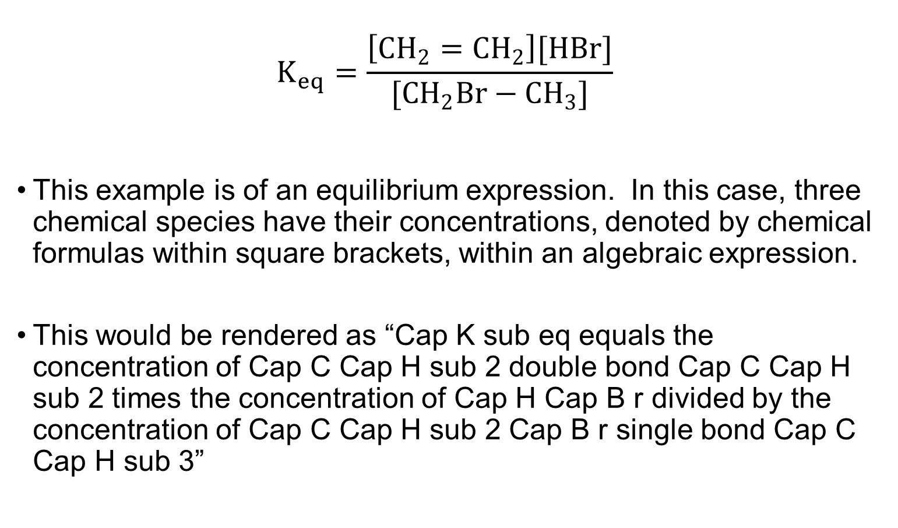
Chemical formulas often appear in algebraic expressions
$$K_{eq}=\frac{\left[CH_{2}=CH_{2}\right][HBr]}{[CH_{2}Br−CH_{3}]}$$
This example is of an equilibrium expression. In this case, three chemical species have their concentrations, denoted by chemical formulas within square brackets, within an algebraic expression.
This would be rendered as “Cap K sub eq equals the concentration of Cap C Cap H sub 2 double bond Cap C Cap H sub 2 times the concentration of Cap H Cap B r divided by the concentration of Cap C Cap H sub 2 Cap B r single bond Cap C Cap H sub 3”

Slide 9
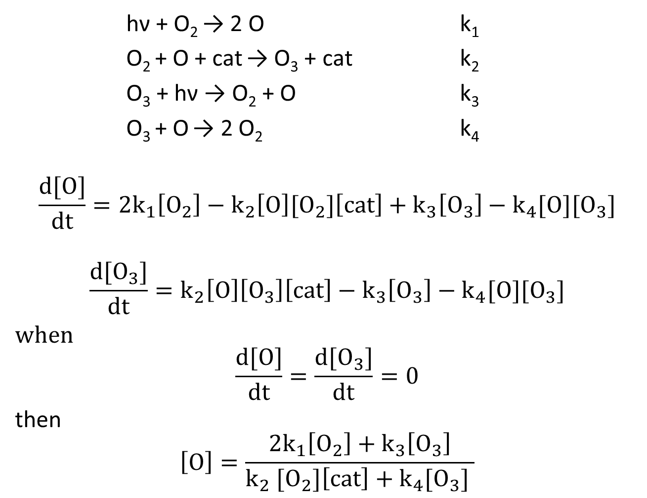
Kinetics of ozone layer depletion
hν + O₂ → 2 O k₁
O₂ + O + cat → O₃ + cat k₂
O₃ + hν → O₂ + O k₃
O₃ + O → 2 O₂ k₄
$$\frac{d[O]}{dt}=2k_{1}\left[O_{2}\right]−k_{2}\left[O\right][O_{2}]\left[cat\right]+k_{3}\left[O_{3}\right]−k_{4}[O][O_{3}]$$
$$\frac{d[O_{3}]}{dt}=k_{2}\left[O\right]\left[O_{3}\right]\left[cat\right]−k_{3}\left[O_{3}\right]−k_{4}[O][O_{3}]$$
when
$$\frac{d[O]}{dt}=\frac{d[O_{3}]}{dt}=0$$
then
$$\left[O\right]=\frac{2k_{1}\left[O_{2}\right]+k_{3}\left[O_{3}\right]}{k_{2} [O_{2}]\left[cat\right]+k_{4}[O_{3}] }$$

Slide 10
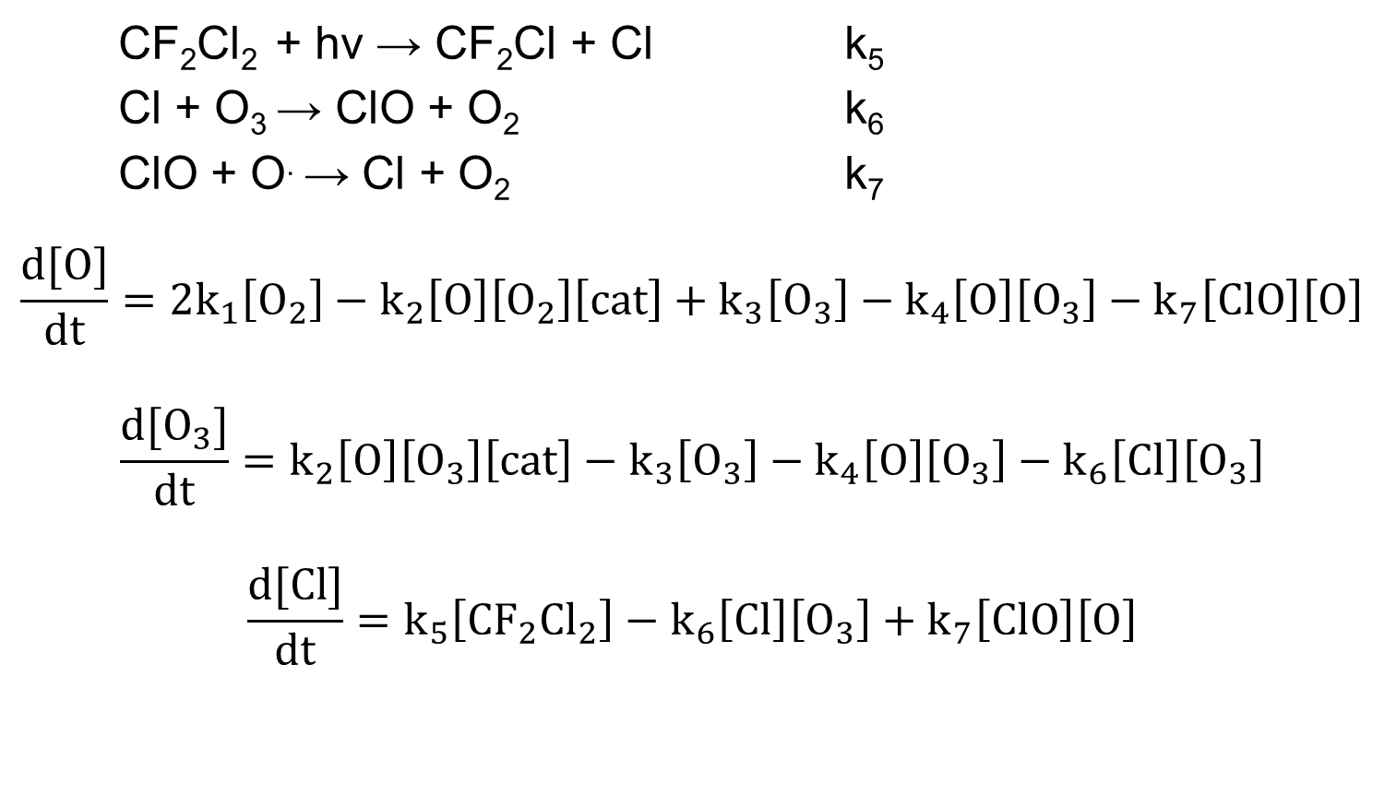
Kinetics of ozone layer depletion continued
CF₂Cl₂ + hv → CF₂Cl + Cl k₅
Cl + O₃ → ClO + O₂ k₆
ClO + O. → Cl + O₂ k₇
$$\frac{d[O]}{dt}=2k_{1}\left[O_{2}\right]−k_{2}\left[O\right]\left[O_{2}\right]\left[cat\right]+k_{3}\left[O_{3}\right]−k_{4}\left[O\right]\left[O_{3}\right]−k_{7}\left[ClO\right]\left[O\right]$$
$$\frac{d[O_{3}]}{dt}=k_{2}\left[O\right]\left[O_{3}\right]\left[cat\right]−k_{3}\left[O_{3}\right]−k_{4}\left[O\right]\left[O_{3}\right]−k_{6}\left[Cl\right]\left[O_{3}\right]$$
$$\frac{d[Cl]}{dt}=k_{5}\left[CF_{2}{Cl}_{2}\right]−k_{6}\left[Cl\right]\left[O_{3}\right]+k_{7}\left[ClO\right]\left[O\right]$$

Slide 11
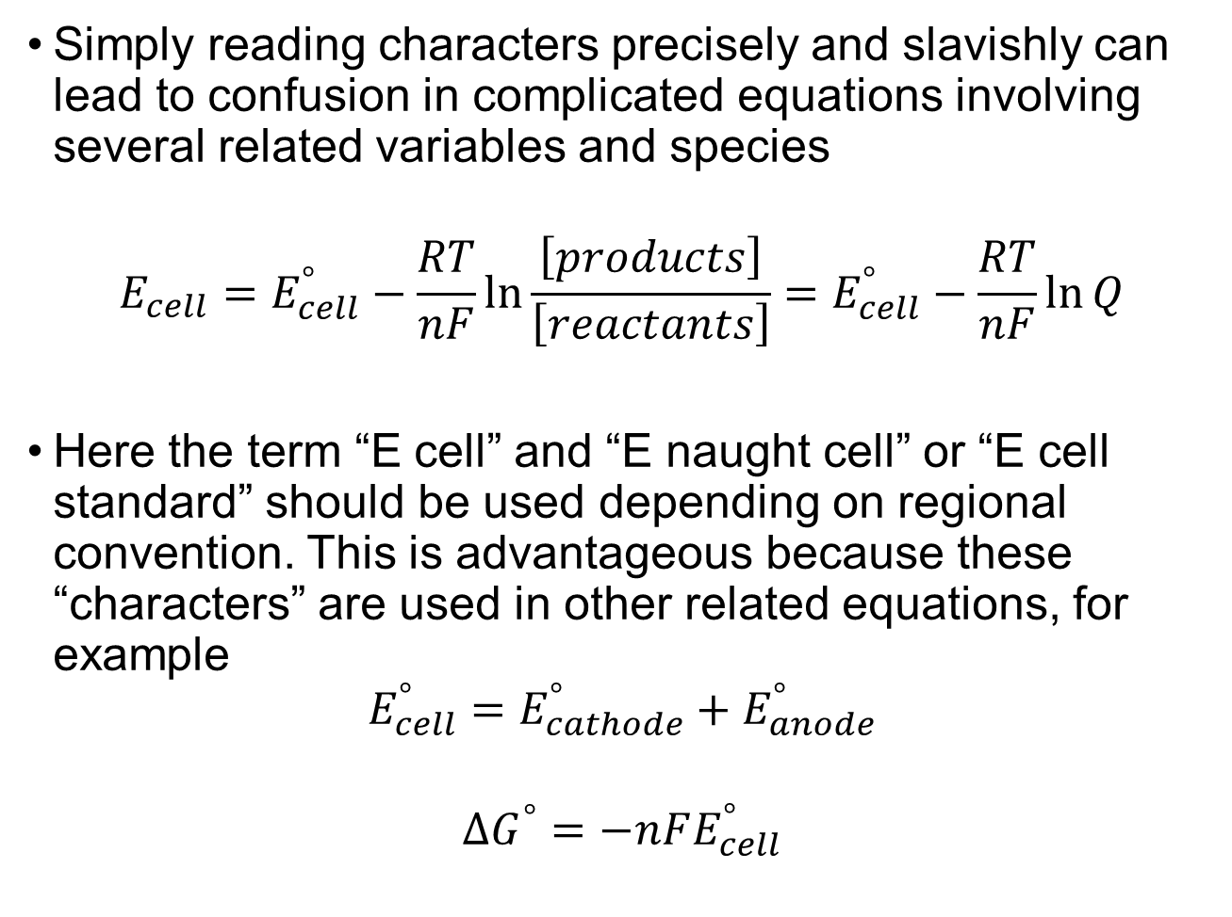
The Nernst equation : When “characters” matter
Simply reading characters precisely and slavishly can lead to confusion in complicated equations involving several related variables and species
$$E_{cell}=E_{cell}^{°}−\frac{RT}{nF}\text{ln}\frac{\left[products\right]}{\left[reactants\right]}=E_{cell}^{°}−\frac{RT}{nF}\ln{Q}$$
Here the term “E cell” and “E naught cell” or “E cell standard” should be used depending on regional convention. This is advantageous because these “characters” are used in other related equations, for example
$$E_{cell}^{°}=E_{cathode}^{°}+E_{anode}^{°}$$
$$ΔG^{°}=−nFE_{cell}^{°}$$

Slide 12
Conclusions
Chemical equations and chemical formulas are NOT the same thing and must be treated differently.
Chemical equations have different formalisms than mathematical equations.
Chemical formulas are commonly used in algebraic expressions.
Equations used in chemistry have common features or “characters” that should be pronounced in a specific way for the purposes of disambiguation and convention.
Units must have their own tag for disambiguation
Organic Chemistry and Biochemistry need their own wrappers / sub-wrappers due to specialized abbreviations.

Slide 13
Acknowledgments
Dan Barrett, Eleanor Crabb, B.S.M. Kumar, Elaine Moore, Ashley Neybert, Cary Supalo
Met for over 16 h over the course of the last few months mostly on Saturday mornings / afternoons (depending on which side of the Atlantic ocean we live on).
We have reached consensus as a group of chemists and educators on how we feel this should be read and taught.

