Slide 1
A change of paradigm: how does Distributed Ledger fit with existing standards?
Distributed Ledger technology offers a single, consistent and shared view of the state of a business process. It eliminates the need to pass information between actors, and for individual actors to maintain independent copies of the data in their own systems. DL can therefore eliminate much of the point-to-point messaging and other processing required to keep data synchronized and reconciled. Smart Contracts can provide further efficiencies by moving business logic that requires complex interactions amongst many actors to self-executing processes deployed on the ledger.
So we have to think differently about formalizing and standardizing Distributed Ledger and Smart Contract implementations…

Slide 2
DLT is not messaging... …but we can benefit from shared business content
Business / Conceptual
Logical
Physical
Defines financial concepts, e.g., ‘Credit Transfer’ and business processes
Defines e.g. credit transfer messages, to serve the business process
Defines physical syntax, e.g. XML
ISO 20022 as a
messaging standard
The logical message
layer references the
business layer for
semantic definitions
Imagine:
ISO 20022 for DL
The logical DL
implementation re-uses
business concepts to
ensure interoperability
with messaging
Shared
business
definitions
Business / Conceptual
Logical
Physical
Defines financial concepts, e.g., ‘Credit Transfer’ and business processes
A ‘logical’ implementation’ – defines data and behaviour based on new paradigm assumptions
A physical implementation using e.g. Hyperledger, Ethereum

Slide 3
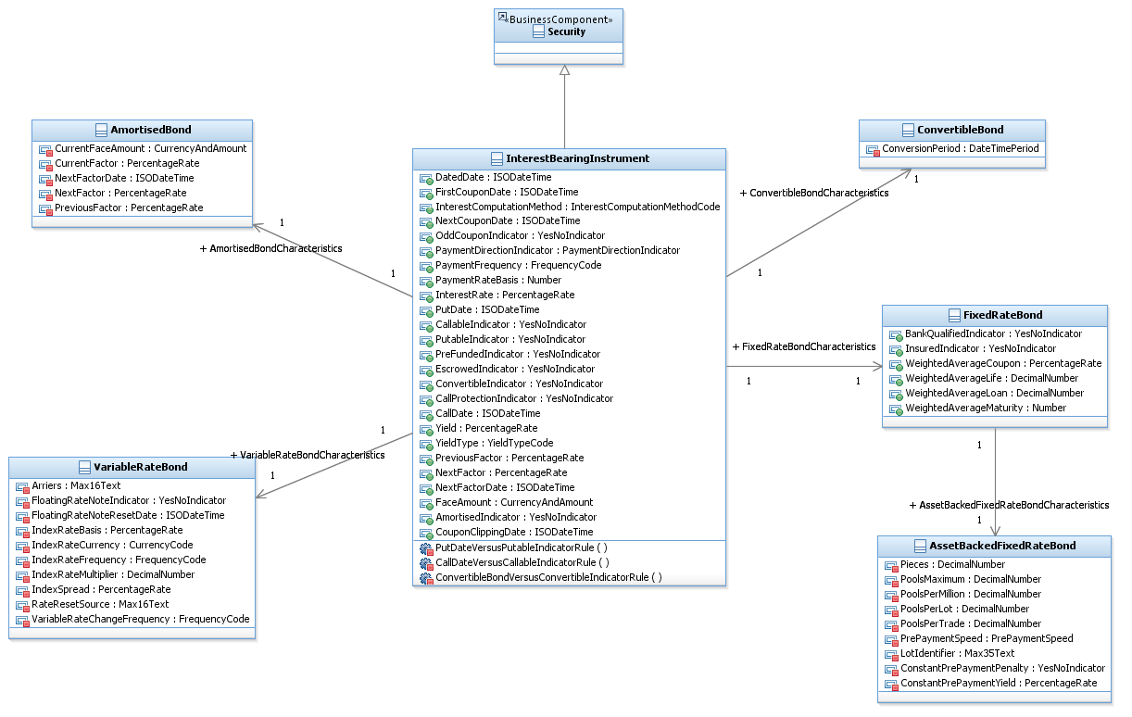
Re-use of business model content Bonds
Business / Conceptual
ISO 20022 Definition
ConversionPeriod
Period during which a convertible security may be converted according to the terms of the issue.
Takeaways:
ISO 20022 includes complete formal definitions for a wide range of financial instruments;
Definitions are sourced from the industry and formalized and ratified according to an open process;
Content is maintained and published by SWIFT as ISO 20022 Registration Authority;
Re-use of ISO 20022 definitions leverages existing industry best-practice and will facilitate interoperability with legacy processes and systems.

Slide 4
Imagine
DLT Logical Layer
Formal specifications describe:
Data and behaviour (processing) required to realize a business process;
The roles played by parties involved in a transaction: who can see what and who can do what;
Data definitions re-used from ISO 20022 business/conceptual
Behaviour derived from ISO 20022 business process definitions
Work will be required to adapt ISO 20022 to the new paradigm

Slide 5
Imagine
DLT Physical Layer
Physical layer is a technical implementation derived from logical layer
ISO 20022 data structures represented physically on ledger
Data encapsulated according to Object Oriented principles
Behaviour implemented as Smart Contracts
Access rights enforced through Role Based Access Controls
Users authenticated by the platform

