Slide 1
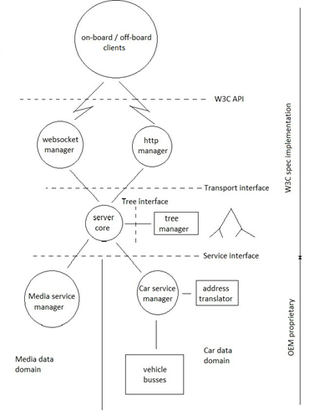
Gen2 server architecture

Slide 2
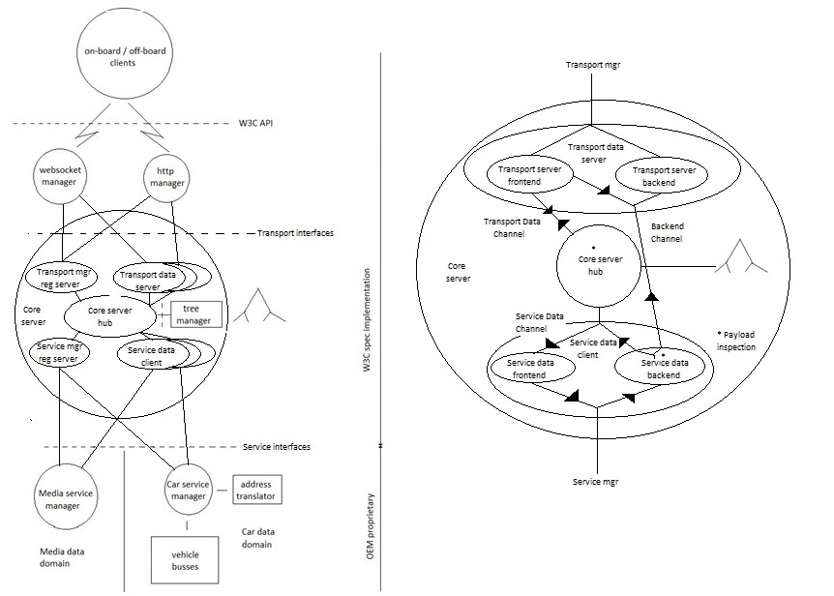
Core server

Slide 3
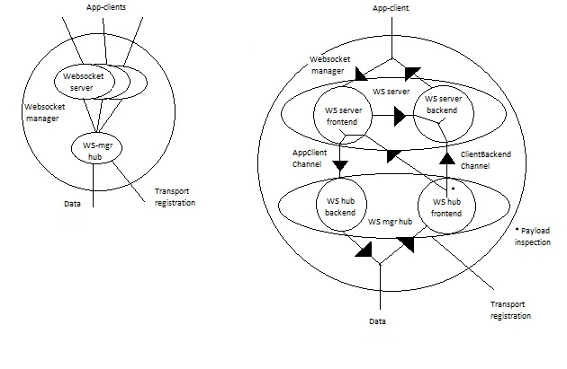
Websocket manager

Slide 4
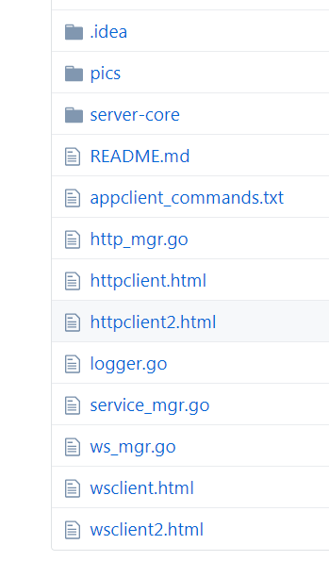
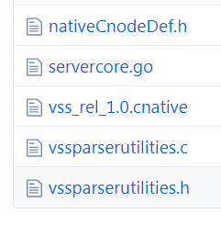
Gen2 implementation file structure
https://github.com/UlfBj/W3C_VehicleSignalInterfaceImpl/tree/master/server/Go/server-1.0
https://github.com/UlfBj/W3C_VehicleSignalInterfaceImpl/tree/master/server/Go/server-1.0/server-core

