Slide 1
Vehicle Signal
Specification
2016-04-28 10:30 – 11:30
Magnus Feuer
Head System Architect | Expert Group LEad
Jaguar Land Rover
This work is licensed under a Creative Commons Attribution-Share Alike 4.0 (CC BY-SA 4.0)
GENIVI is a registered trademark of the GENIVI Alliance in the USA and other countries
Copyright © GENIVI Alliance 2016
Apr 25, 2016

Slide 2
The Problem
Vehicle state is being off boarded to Internet services
There is no standard / process that fits the bill
No public forum where changes can be processed in a lightweight manner
One format does not suit all
Decouple IVI from electric architecture
GENIVI is a registered trademark of the GENIVI Alliance in the USA and other countries
Copyright © GENIVI Alliance 2016

Slide 3
VSS - Introduction
Standardizing signal specification
YAML subset
Minimum attributes
Lightweight change process
Single source – multiple targets
Feed other standardization organizations (W3C, etc)
Technically simple
GENIVI is a registered trademark of the GENIVI Alliance in the USA and other countries
Copyright © GENIVI Alliance 2016

Slide 4
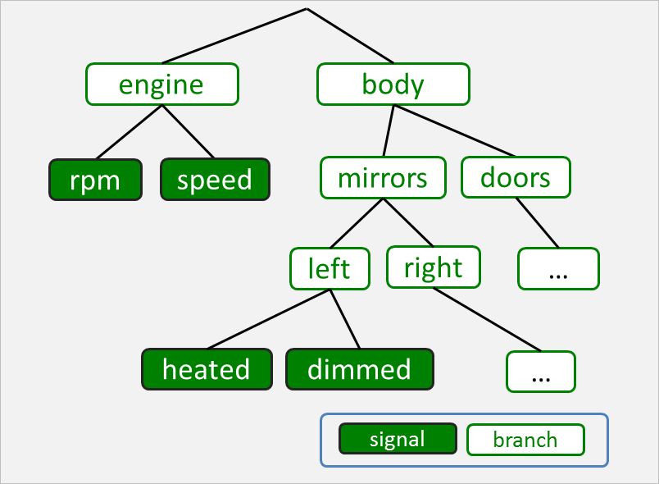
VSS Signal structure

Slide 5
Naming Convention
body.mirrors.left.heated
body.mirrors.right.heated
body.door.front.left.open
body.door.back.left.open
Dot notated name path
Last component is signal

Slide 6
Specification source format: Branches
- transmission:
type: branch description: Transmission-specific data, stopping at the drive shafts.
YAML list
Only type and description mandatory

Slide 7
Specification source format: Signals
- speed:
type: Uint16
unit: km/h
min: 0
max: 350
description: Vehicle speed
Uses Franca typing
Optional interval
Optional SI unit type
Can be enumerated

Slide 8
Signal source format
root.vspec
root.vspec
engine.vspec
VSS spec
#include engine.vspec
#include nav.vspec
#include ivi.vspec
nav.vspec
ivi.vspec
Multiple files aggregated together to a uniform specification
YAML-compliant include directives used to aggregate spec fragments
Facilitates git(hub) working model
Minimizes commit conflicts

Slide 9
Spec file re-use
body
door.vspec
door
locked: …
win_pos: …
open: …
front
back
right
left
right
left
root.vspec
#include door.vspec body.door.front.left
#include door.vspec body.door.front.right
#include door.vspec body.door.back.left
#include door.vspec body.door.back.left
locked
locked
locked
locked
win_pos
win_pos
win_pos
win_pos
open
open
open
open
YAML-compliant include directives used to aggregate specification fragments
An update to a fragment is propagated to all locations where it is used
Facilitates git(hub) working model

Slide 10
Private extensions
private
oem_x
#include vss_1.2.vspec
private.oem_x.anti_gravity.power: …
private.oem_x.teleport.target_loc: …
…
body
engine
anti_gravity
teleport
hmi
....
oem_x_proprietary.vspec
power
…
target_loc
…
vss_1.2.vspec
oem_x_proprietary.vspec
A proprietary signal specification can use the GENIVI VSS as a starting point
Can be used in production project to integrate with vendors
Mature private extensions can be submitted for VSS inclusion

Slide 11
Generating target specifications
Markdown
generator
Markdown
Specification
root.vspec
engine.vspec
FrancaIDL
generator
FrancaIDL
Specification
VSS parser
nav.vspec
JSON
generator
JSON
Specification
ivi.vspec
…
…
Parser loads and interprets specification files
Generators produces target documents and specifications
Targets can be used as input to production projects and other organizations
Additional generators can be added as needed.

Slide 12
Release management
V1.0
V1.1
V1.2
V2.0
master
develop
PR#1
PR#2
PR#3
PR#4
PR#5
Mail thread
Mail thread
Mail thread
x
Mail thread
Mail thread
Pull requests submitted by anyone
Mail discussion on genivi-projects list to approve request into develop branch
Develop branch merged into master prior to tagged release
Major number changes when existing tree structure is changed

Slide 13
More Info
github.com/PDXostc/vehicle_signal_specification
Demo time

