Slide 1
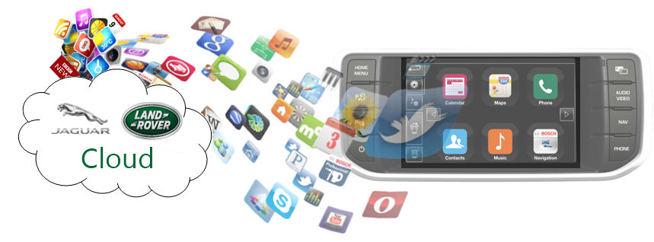
W3C Automotive and Web Platform Working Group
Overview of Security Challenges – Implementing Vehicle and Data APIs

Slide 2
Document Summary
Purpose: Provide an overview of the security challenges associated with implementing W3C Automotive & Web Platform Business Group and Vehicle and Data APIs
Audience: W3C Working Group. JLR Management, Teams working on Connected Infotainment, Connected Services etc.
Status: DRAFT v0.1 04 April 2015
Author: Dr. Kevin Gavigan, Software Architect,
Connected Infotainment, Electrical Product Development, Jaguar LandRover

Slide 3
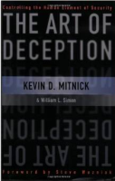
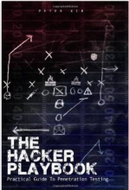
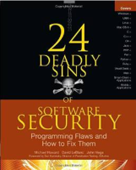
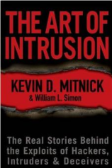
Contents
Threat Surface
Potential Attackers
Use Cases
Access Control
References

Slide 4
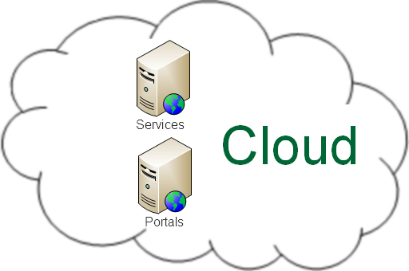
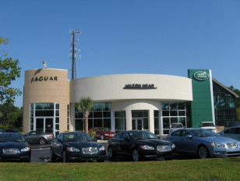
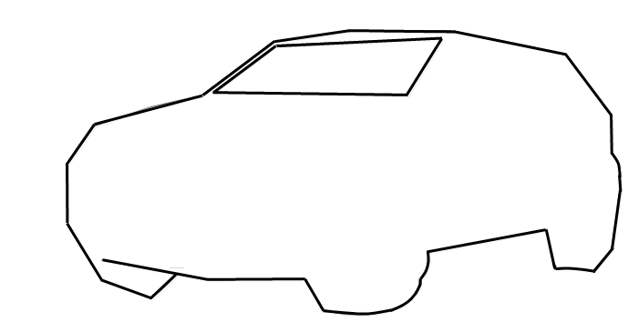
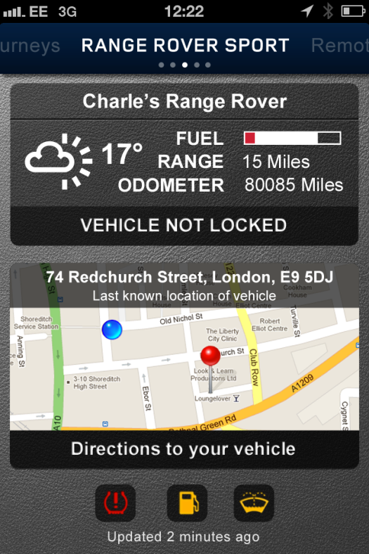
Threat Attack Surface
Driver
Passengers
Dealership
Infotainment
Vehicle Network #1
Vehicle Ordering
ADAS
Vehicle Network #2
National Sales Centre
Vehicle API
etc…
Vehicle Network #n
Factory
Smart Homes,
Smart Cities
Threat Attack Surface

Slide 5
Potential Attackers
External
Cyber-criminals (professional hackers)
Non-professional hackers
Malware (virus/worm/etc.) authors
Industrial Spies
Activists
Criminal fraternity
Social Engineers
Independent Dealers
State Sponsored Agents
Internal
Rogue employees
Contractors and vendors
OEM Partners with rogue employee(s)
Espionage
Eavesdropping
Tampering

Slide 6
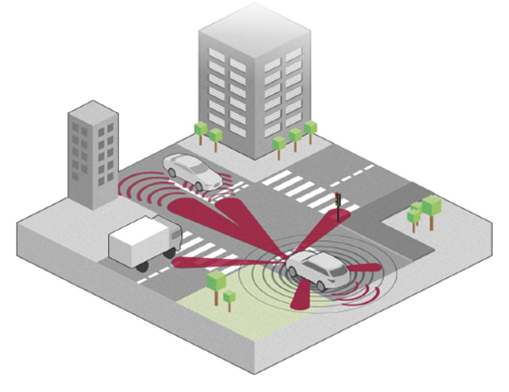
Example Use Case
Advanced Driver Assistance System (ADAS) – Controller setting safety critical controls
When ADAS is active, steering wheel, accelerator and brake pedal position should only be able to be set by a suitably authorised source e.g. ADAS Controller Electronic Control Unit (ECU)
N.B. It is imperative that steering wheel, accelerator and brake position can only be set by a trusted source.
[Diag. Source: JLRPW1]

Slide 7
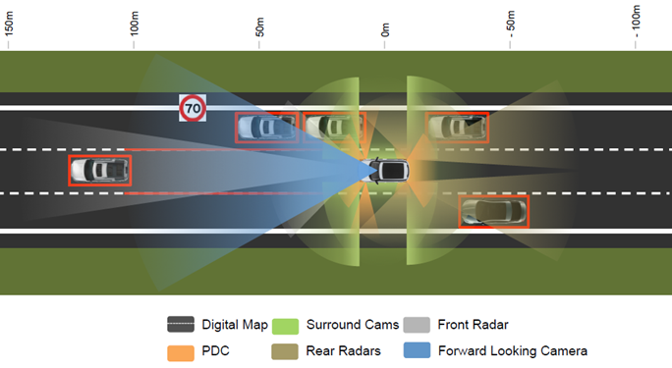
Example Use Case
ADAS – Driving using valid inputs from internal sensors.
Inputs into the ADAS Control Module should be from valid sensors only and should not be able to be interrupted e.g. by a Denial of Service (DOS) attack or be tampered with/modified.
N.B. A possible Attack Vector that needs to be mitigated would be to replace/spoof inputs from one or more sensors to trick the Control Module into behaving incorrectly.
[Diag. Source: JLRPW1]

Slide 8
Example Use Case
ADAS – Travelling in convoy, accepting speed input from other vehicles in convoy
The ADAS Controller unit in a vehicle may use real-time speed data from vehicles in front of it in
convoy as one of the inputs in determining the vehicles speed (e.g. to prepare for emergency braking)..

Slide 9
Example Use Case
Passenger(s) in car share journey with virtual passenger(s) that are not in car
One or more passengers travelling in a vehicle want to communicate and ‘share their journey’ with family, friends, business associates etc. who are either in other vehicles, at other locations (e.g. home, office) or using mobile devices.
Enabled by outputs from internal (and optionally external) camera and microphone feeds being passed and audio/visual feeds received to/from one or more authenticated and authorised:
Vehicles
Users
Smart Homes
Consumer Electronics

Slide 10
Context: Web / Internet of Things (IoT)
Cars will be amongst the most expensive discrete ‘devices’ in the ‘Internet of Things’
Customer will have very high expectations.
Experiences will need to flow and to ‘just work’ securely and seamlessly with other devices in:
Smart Homes
Smart Offices
Smart City infrastructure
Smart Home / Office will be composed of smaller IoT sub-systems
Infotainment Centres
Security Cameras / Alarms
Smart White Goods / Appliances etc
Mobile Devices
Etc etc…

Slide 11
Access Control
Authentication and Authorization
Need to establish identity (authenticate) in order:
Authorize access to data
Authorize inputs and instructions
So which entities will need to authenticate?
People → anyone that participates in the IoT
Vehicles
Vehicle Modules / Electronic Control Units (ECUs)
At least safety and security critical ones
Organisations
Manufacturers, Dealers, Finance Company,
Gov. Agencies, Police, Trusted Infrastructure
Smart Homes and Offices and their sub-systems
Security Systems, Entertainment Systems, Appliances, Mobile Devices etc. etc.

Slide 12
Summary and Conclusions
Standards based APIs are likely to emerge for other IoT domains
Defining equivalents of the Automotive Working Group Vehicle API
These are likely to face the similar security (trust, identity, authorization) challenges and issues
IoT Security Challenges are varied and complex
How to decide that the vehicle at front of convoy is a source that can be trusted
How does my vehicle know it is not receiving input from a hacker or a hacker’s vehicle?
Federations of Trust
Will each car, smart houses etc. have its identity established using PKI?
Will devices within a car / house prove their identity and obtain security tokens from local Trust Authority whose identity is validated by PKI?
Will we need graduated/earned trust and hence trust histories (similar to a credit history)?
Will higher level of trust be needed e.g. to lead high speed vehicle convoy
W3C Web of Things (IoT)
Vehicle API is an example of an IoT API
Suggest Automotive WG considers collaborating with other W3C groups on ‘Security for IoT devices’:

Slide 13
Further Reading
24 Deadly Sins of Software Security, M. Howard, D. LeBlanc, J. Viega, McGraw Hill, 2010
Cryptography Engineering, N. Ferguson, B. Schneier, T. Kohno, Wiley, 2010
Hacking Exposed Mobile: Security Secrets and Solutions, N. Bergman et al, McGraw-Hill, 2013
Hacking Exposed 7: Network Security Secrets & Solutions, S. McClure et al, McGraw-Hill, 2012
High Assurance Design, C.J. Berg, Addison Wesley, 2006
Metasploit – The Penetration Tester’s Guide, D. Kennedy et al., No Starch Press, 2011
Secrets and Lies, Bruce Schneier, Wiley, 2002
Software Security: Building Security In, G. McGraw, Addison-Wesley, 2006
The Art of Deception, Kevin Mitnick, Wiley, 2002
The Art of Intrusion, Kevin Mitnick, Wiley, 2005
The Basics of Hacking and Penetration Testing, P. Engebretson, Syngress (Elsevier), 2013
The Car Hackers Manual 2014, Craig Smith, TheiaLabs Publication, 2014
The Hacker Playbook, P. Kim, Secure Planet LLC, 2014
The Web Application Hackers Handbook, D. Stuttard, M. Pinto, Wiley, 2011
Threat Modelling, Frank Swiderski, Window Synder, Microsoft Press, 2004
Threat Modelling – Designing for Security, Adam Shostack, Wiley, 2014
Understanding Cryptography, C. Paar, J. Pelzl, Springer-Verlag, 2010

Slide 14
References
Ref. | Source
JLR_PW1 | Sensing for ADAS & Automated Driving – a vision of present and future needs, Paul Widdowson, JLR Research, https://connect.innovateuk.org/documents/2864009/22346187/JLRADAS_Auto_sense.pdf/d39c5195-64df-4c65-907c-40f9705c8272
WIFI | https://www.iconfinder.com/icons/174752/wifi_icon#size=128
MS_IOT1 | http://www.microsoft.com/en-gb/server-cloud/internet-of-things.aspx#Fragment_Scenario1
BOSCH1 | https://www.bosch-si.com/contact-forms/wp-iot-platforms/contact-form.php?ref=ga-global-2014h2-iot-technology-whitepaper
WIKI_TRF | Trust Federations, Wikipedia, http://en.wikipedia.org/wiki/Trust_federation
IBM_SM1 | Smarter Cities, http://www.ibm.com/smarterplanet/us/en/smarter_cities/overview/
 | DTLS-based Security with two-way Authentication for IoT, https://tools.ietf.org/html/draft-schmitt-two-way-authentication-for-iot-00
 | Leveraging Public-Key-Based Authentication for the Internet of Things, Hossein Shafagh, http://www.inf.ethz.ch/personal/mshafagh/master_thesis_Hossein_Shafagh_PKC_in_the_IoT.pdf

