Slide 1
KR & StratML
Knowledge for Results in the *Strategic* Semantic Web

Slide 2
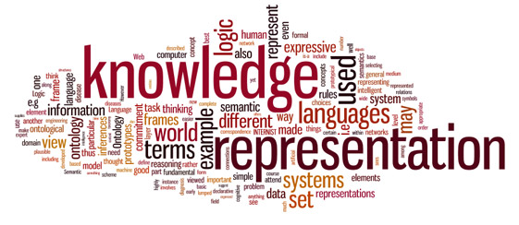
Knowledge Representation
Early work in knowledge representation focused on problem solvers
Data structures for planning and decomposition
Begin with a goal
Decompose into sub-goals
Construct strategies to accomplish each subgoal
Semantic Web
Integrates concepts from knowledge representation and reasoning with markup languages based on XML
Source: https://en.wikipedia.org/wiki/Knowledge_representation_and_reasoning

Slide 3
Strategy Markup Language
XML Vocabulary & Schema for Strategic & Performance Plans & Reports
Core Elements:
Mission
Vision
Values
Goals
Objectives (sub-goals)
Stakeholders (performers & beneficiaries)
Performance Indicators (inputs, processes, outputs & outcomes)
Enables the *Strategic* Semantic Web
Linked Open Data for the Realization of Human Objectives
Truly Connected Communities

Slide 4
More Information
https://en.wikipedia.org/wiki/Strategy_Markup_Language
https://en.wikipedia.org/wiki/Machine-readable_document
http://stratml.us/
https://www.iso.org/standard/59859.html
https://www.linkedin.com/pulse/consciously-connected-communities-owen-ambur/
https://www.linkedin.com/pulse/i-only-had-brain-evolving-prefrontal-core-text-internet-owen-ambur/
Owen.Ambur@verizon.net

