Slide 1
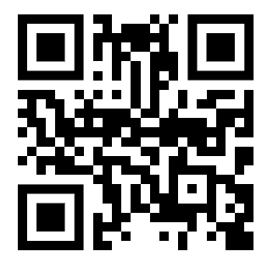
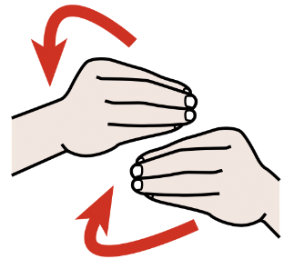
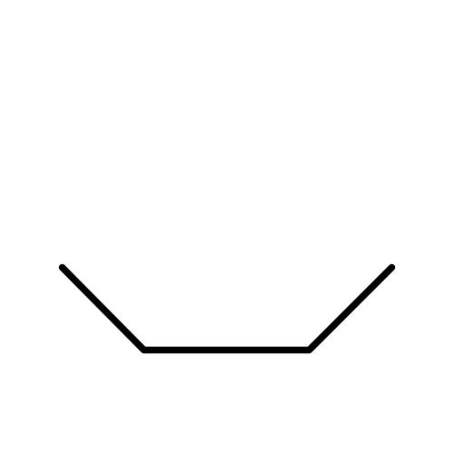
WAI-Adapt Task Force
Accessibility Platform Architectures WG
WAI-Adapt Task Force
Accessibility Platform Architectures WG
Many people benefit from symbols with text.
WAI-Adapt enables authors to add symbolic data to content.
Many people benefit from symbols with text.
WAI-Adapt enables authors to add symbolic data to content.
Example: Using ARASAAC
Example: Using Blissymbolics
My Favorite Recipe Video (chapter list)
My Favorite Recipe Video (chapter list)
Ingredients
Prepping
Cooking
Plate and taste
Ingredients
Prepping
Cooking
Plate and taste
Questions? See, https://www.w3.org/WAI/adapt/
Questions? See, https://www.w3.org/WAI/adapt/

