Slide 1
W3C Accessibility 4 Children 26.05.2022
Global Report on
Assisitive Technology
By World Health Organization
& Unicef

Slide 2
Outline
Definitions Messages Barriers Systemic improvements Children: emerging tech, convention, robotics Pre condictions UDL, Accessibility Benefits Steps Measures & regulations

Slide 3
A11Y4Children
Focus on children | limited users (disability only) | lack of literacy (need for survey)
Robotics AI: importance of trust and capacity building
Position of :UDL| Accessibility| AT

Slide 4
Definitions
WHO
assistive technology application of organized knowledge and skills related to assistive products
including systems and services
subset of health technology Assistive product (including devices, equipment, instruments or software) produced or generally available, purpose =maintain or improve an individual’s functioning and independence, and thereby promote their well-being. Prevent impairments and secondary health conditions. ISO any product (including devices, equipment, instruments and software)
produced or generally available, used by or for persons with disability for participation; to protect, support, train, measure or substitute for body functions/structures and activities prevent impairments, activity limitations or participation restrictions.

Slide 5
Key messages
Umbrella term for assistive products and their related systems and services
Enables and promotes the inclusion, participation and engagement of persons with disabilities,
Access to assistive technology is a human right, and a precondition for equal opportunities and participation
Need for AT is rising BUT majority of people who would benefit from it do not have sufficient access 1/3 people (more than 2.5 billion) globally need at least one assistive product need of one or more assistive products likely to rise to 3.5 billion by 2050
Assistive technology is estimated to result in a 9:1 return on investment, with positive ripple effects across communities.

Slide 6
Barriers
high cost - low availability - lack of support
Three types of barriers to enabling environments: infrastructural, informational & attitudinal.
Majority of people obtained their assistive products from the private sector, paid for either by themselves, or with financial support from family and friends
More than 50% of people found their assistive products were suitable for different environments and activities, and were satisfied with the related services

Slide 7
Systemic Improvements needed
Economic and social benefits make the case for health and welfare systems to invest in assistive products and related services.
Improving the assistive technology systems, products, provision, personnel and policies.
Where possible, assistive technology should be integrated within health and social care systems.
Establish standards, guidelines, regulations bylaws that ensure that environments are truly enabling, welcoming and can be used by all people, to the greatest extent possible, without the need for adaptation or specialized designs. Regularly review standards and guidelines to ensure that they match ongoing technical developments, especially in the areas of digital and emerging technologies

Slide 8
Children
Nearly 240 million children have disabilities. 1/10 worldwide
Denying children the right to the products they need to thrive doesn’t only harm individual children, it deprives families and their communities of everything they could contribute if their needs were met,” “Without access to assistive technology, children with disabilities will continue to miss out on their education, continue to be at a greater risk of child labor and continue to be subjected to stigma and discrimination, undermining their confidence and wellbeing.”
UNICEF Executive Director Catherine Russell.
Press release

Slide 9
Emerging Tech AI 4 children
The World Intellectual Property Organization (WIPO)
report on developments in the field of assistive technology presents an overwhelming number of advances in seven major emerging technology domains that will very likely have an impact on the field of assistive technology:
artificial intelligence
human–computer interfaces (CCI)
sensor technologies; robotics
advances in computing and connectivity
additive manufacturing
new materials
About WIPO

Slide 10
Robotics
Most rapidly developing technologies: robotics -assistive robots – autonomous systems that can ‘live’ with a person
assist in all kinds of daily life activities like dressing, toileting, eating, fetching things, and non-physical activities like interpersonal interaction
used in health care, educational and social settings purposes:
• Supporting, caring for and educating children with autism
• Facilitating play for children with physical disabilities • Providing distraction for children during medical treatment, rehabilitation, training South Korea |Japan: national programmes to stimulate development of robot systems for health and social care, including for people living with functional difficulties.

Slide 11
Link convention
Link with The Convention on the Rights of the Child (CRC) Rights relevant to assistive technology: to the protection and care necessary for well-being; to survival and the highest attainable standard of health; to facilities for the rehabilitation of health; to develop to the fullest; to education; to freedom of expression;
to access information and material from a diversity of sources; and to participate fully in family, cultural and social life. In Article 23, the CRC specifically recognizes the right of children with disabilities to special care and assistance, free of charge whenever possible

Slide 12
Conditions
• Accessible, inclusive, barrier-free or age friendly environments can enable the use of assistive products and make life easier for everyone, including users and their caregivers.
• Enabling environments are essential for users to access buildings, transport systems, digital spaces, etc. • Universal design helps increase the range of people who can access and make use of mainstream products, spaces and services.

Slide 13
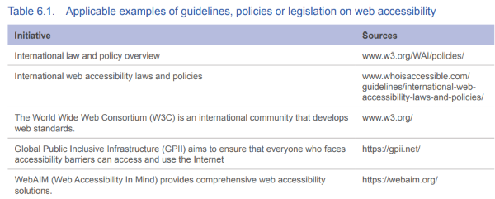
Reference 2 Accessibility guidelines

Slide 14
Innovation high end vs simple needs
When looking at technological developments in recent years, innovation potential lies mainly in high-end, high-tech solutions, while global needs for assistive products are mostly general and often simple. This calls for innovation to be directed towards practical and affordable solutions, including developing innovative service delivery models.

Slide 15
Recommendations
1: Improve access to assistive technology within all key development sectors. -health, education, labour and social care- 2: Ensure that assistive products are safe, effective & affordable 3: Enlarge, diversify and improve workforce capacity. The WHO Training on Assistive Products (TAP) and other similar materials can be used for training of the workforce. 4: Actively involve users of assistive technology and their families 5: Increase public awareness and combat stigma. 6: Invest in data and evidence-based policy The WHO rapid assistive technology assessment (rATA) tool can be used to collect population-based data 7: Invest in research, innovation and an enabling ecosystem 8: Develop and invest in enabling environments. 9: Include assistive technology in humanitarian responses. 10: Provide technical and economic assistance through international cooperation to support national efforts

Slide 16
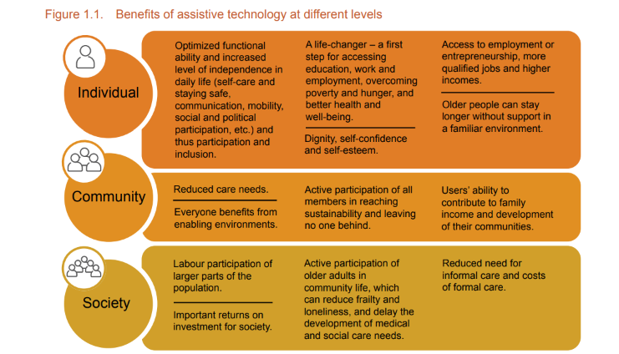
Benefits of AT Individual, community, society

Slide 17
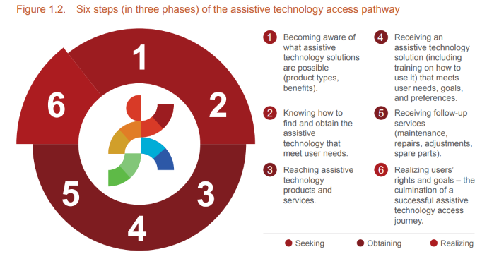
Steps

Slide 18
Partnerships
AT2030 seeks to transform access to life-changing assistive technology (AT) by creating partnerships with the private sector to build and shape markets testing innovative approaches and backing ‘what works' to get AT to those who need it the most ATscale, the Global Partnership for Assistive Technology was launched in 2018 with the ambitious goal of catalysing action to reach 500 million more people with life-changing assistive technology (AT) by 2030. Eastin information service on assistive technology (AT) serving older and disabled people, their families and carers across the globe.

Slide 19
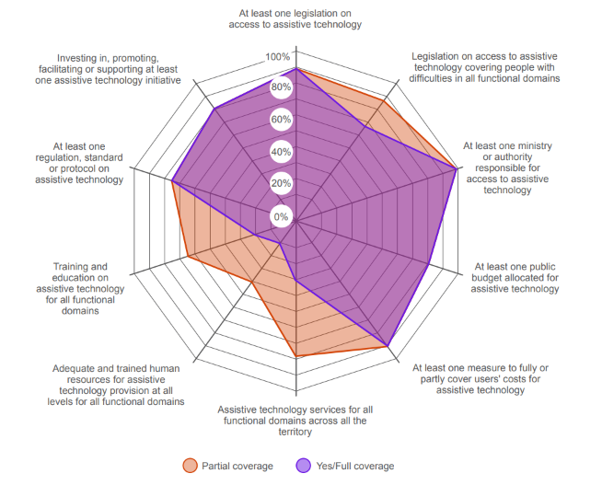
Measures
&
regulations

Slide 20
Thank you
Contact:
maud.stiernet@alittleliningcomes.com

