Slide 1
CSS Line Module
Processing Model
Steve Zilles

Slide 2
Basic Processing Model
Text processing (i.e., line breaking and justification).
For each line constructed in step 1., the components of the line are given their half-leading and are aligned, vertically, with respect to its neighbors
Having aligned all the components, compute the vertical extent of the line. This vertical extent determines the top and bottom of the line box (and Text Processing determined its horizontal extent)
If alignment to a line grid is not specified, then the top of the current line box is aligned to the bottom of the previous line box if there is one and, otherwise, at the top of the block box in which the line box occurs.
If alignment to a named line grid is specified, then a relevant baseline in the current line box is aligned with the relevant baseline in the next line alignment table in the line grid.
If the line, thus position has any component which collides with a float, then, shorten the line to avoid the collision and repeat above steps.

Slide 3
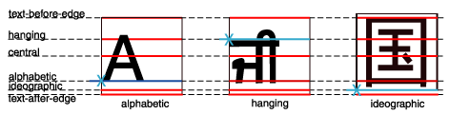
Baseline Tables
Based on the “dominant baseline” a scaled table of baselines is created for each element
Different baselines may have different tables
Not all baselines come from the font

Slide 4
Topics of Concern – Line Box
Determining the position of the “top” and “bottom” baselines
Determining where the dominant baseline is within the line box
Can half-leading be “turned-off” at the top of a container?

Slide 5
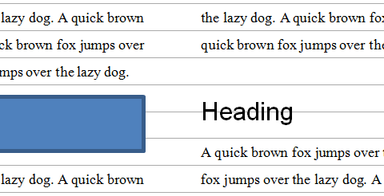
Line Grids
Specify an alignment grid for a given container

Slide 6
Topics of Concern: Line Grid
The line grid is based on the font, font-size and line-height used when It is defined
Is the position of the (then) dominant baseline sufficient or is a full baseline table per line needed?
What control over the alignment of blocks of text is needed: top, bottom, center or TeX-like?
How is the line grid offset from element in which it is defined?

Slide 7
Proposed Plan
Update the current draft to current template, dropping all out of scope material
Re-do the introduction to describe the processing model
Implement the resolution moving the Line Grid description into this spec
Discuss at Hamburg F2F

