Slide 1
Curtsy Web
http://html5labs.com/cu-rtc-web/cu-rtc-web.htm
Notes:
Not my name, nor is it especially apt, but it’s a name.

Slide 2
Do you think that’s air you’re breathing?
PeerConnection is…
RFC 3264, except with provisional and final answers
…and with some application tweaking
ICE, except with trickle candidates
…and continuing consent checks
DTLS-SRTP, except with identity assertions
RTP, except for multiplexing
…and the data channel
+ New congestion control

Slide 3
More SDP
Media stream ID
BUNDLE groupings
IdP assertions (base64 of JSON (of base64 of JSON))
…and more needed
What version of SDP will browsers implement?
What mutations to that SDP will browsers permit?

Slide 4
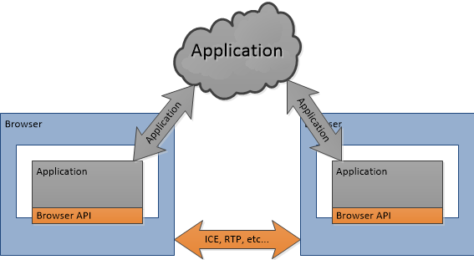
API, not protocol

Slide 5
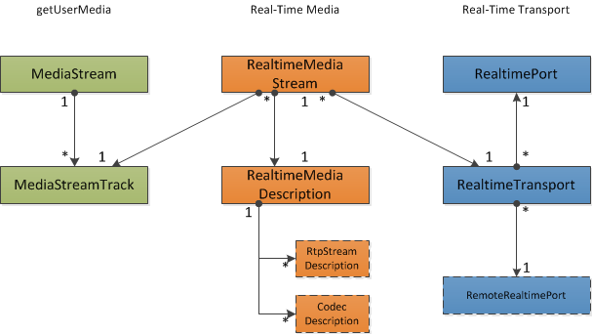
Architecture

Slide 6
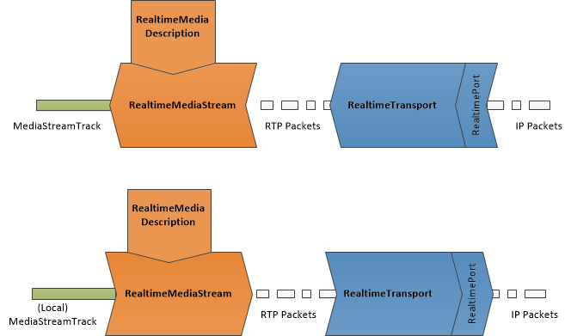
Operation

Slide 7
RealtimePort
A local transport endpoint
IP + port + username fragment + password
…for host and relay candidates
STUN checking for liveness and consent
…and for server and peer reflexive addresses
Everything needed for ICE
…or not-ICE (plain ol’ NAT traversal)
…or just talking to a media source or sink

Slide 8
RealtimeTransport
A secured UDP flow
Binds local RealtimePort to some remote analogue
Adds SRTP (SDES or DTLS key negotiation)
Handles ongoing consent checking
Provides feedback on bandwidth (and congestion)

Slide 9
RealtimeMediaStream
A unidirectional flow of media
…as RTP packets
Connects MediaStreamTrack to a RealtimeTransport
…uses a RealtimeMediaDescription
Manages updates to
…transport
…codec
…stream bandwidth and priority

Slide 10
RealtimeMediaDescription
Describes how to turn abstract MediaStreamTrack
…into a concrete RTP packet stream
Describes semantics of each packet type
Provides stream identification
Sets available RTP and RTCP features
Provides a simple negotiation feature (update ≡ ∩)

Slide 11
Data Channel
Not included in the proposal
Could use RealtimeTransport directly
Wouldn’t be affected by all that media rubbish
Not included in the proposal
A MediaStream(Track) problem
DTMF

Slide 12
Shorthand
RealtimePort ≈ Candidate
RealtimeTransport ≈ UDP Flow w/Security
RealtimeMediaStream ≈ RTP stream
RealtimeMediaDescription ≈ SDP m= line¹†‡*

Slide 13
Δ
Testing of connection liveness
Are MediaStreams mutable?
Provide congestion feedback API for flows
Serialization of duplicated tracks
Rollback of offers
Programmatic description of described streams
Learning of network change events
Learn what ICE candidates are in use
Pausing and muting of streams
Description of state/behavior is currently incomplete
Priority allocation
DTMF onTone event
Control connection establishment based on certificate
API for discovering capabilities
Bandwidth allocation
Bandwidth estimation feedback
Expose additional ICE state
Document how the different state machines interact
Interoperability with varying ICE and ICE-like agents
H.264 SVC support
Set Security Description
Remove offer/answer
Split SDP between PeerConnection and MediaStream
Remove SDP

