Slide 1



Developing and Integrating a Semantic
Interoperability Testing Tool in F-Interop Platform
Soumya Kanti Datta*, Christian Bonnet*, Hamza Baqa**, Mengxuan Zhao**, Frank Le-Gall**
* EURECOM, Sophia Antipolis, France
** Easy Global Market, Sophia Antipolis, France
Contact – dattas@eurecom.fr

Slide 2
Roadmap
Introduction
SemTest Implementation and Integration
Demonstrations
Community Feedback
Conclusion

Slide 3
Introduction
Interoperability - key to achieve the full potential of the IoT market.
Due to the highly dynamic nature of the IoT, a strong need of interoperability at data level has emerged so that it becomes easier to combine/aggregate, process, manage and store the data/event coming from heterogeneous data sources.
Semantic interoperability is a way to address the problem.

Slide 4
Introduction
We need tests that validate the semantic compliance and interoperability among IoT systems.
  To boost the acceptance and adoption of the semantic technologies by the IoT market.
Testing semantic interoperability is identified as a gap in the current IoT research and industrial initiatives.
SemTest, an Industrial Extension of EU H2020 F-Interop project addresses this part.

Slide 5
Current Status in Semantic Interoperability
IoT architecture and framework aspects
Ontologies and semantic modelling
Semantic interoperability in application layer
IoT platform interoperability
Very few tools allow testing semantic interoperability

Slide 6
SemTest Tool
Conformance Test
  Lexical check
  Syntactic check
    Untyped of resources and literals
    Ill-formed URIs
    Problematic prefix and namespaces
    Unknown classes and properties
  Semantic checks
    Cardinality inconsistency
    Problematic relationship or inheritance
Semantic Interoperability Test
  Communication level check
  Lexical/format level check
  Data processing level check

Slide 7
F-Interop Platform

Slide 8
Roadmap
Introduction
SemTest Implementation and Integration
Demonstrations
Community Feedback
Conclusion

Slide 9
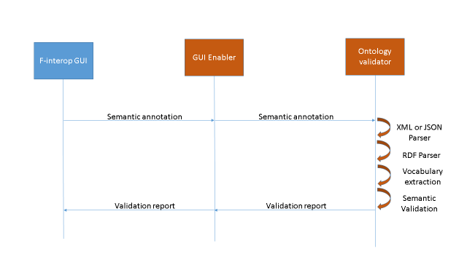
Conformance Testing Steps

Slide 10
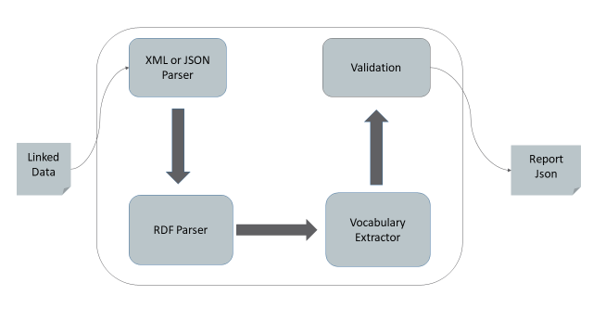
Ontology Validator Web Architecture

Slide 11
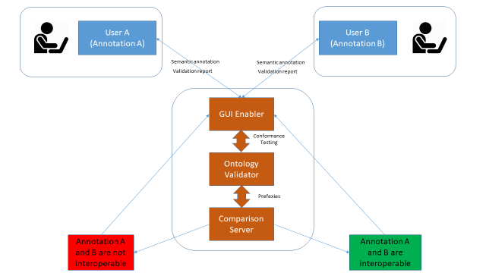
User to User Interoperability Testing
Users can be the IoT devices submitting their semantically annotated data to the F-interop platform for semantic testing.

Slide 12
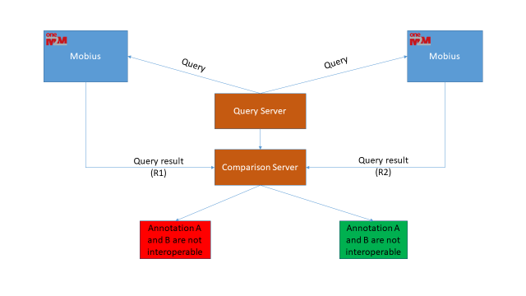
SUT to SUT Interoperability Testing

Slide 13
Roadmap
Introduction
SemTest Implementation and Integration
Demonstrations
Community Feedback
Conclusion

Slide 14
Three Scenarios to Demonstrate

Slide 15
Roadmap
Introduction
SemTest Implementation and Integration
Demonstrations
Community Feedback
Conclusion

Slide 16
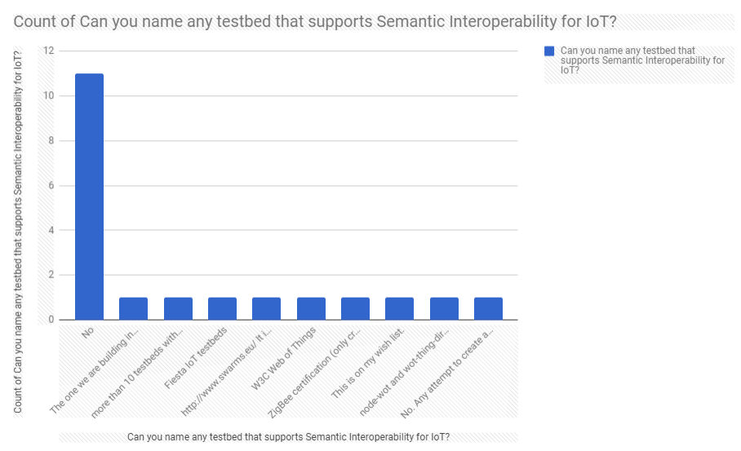
Prior Semantic Interoperability Testbeds

Slide 17
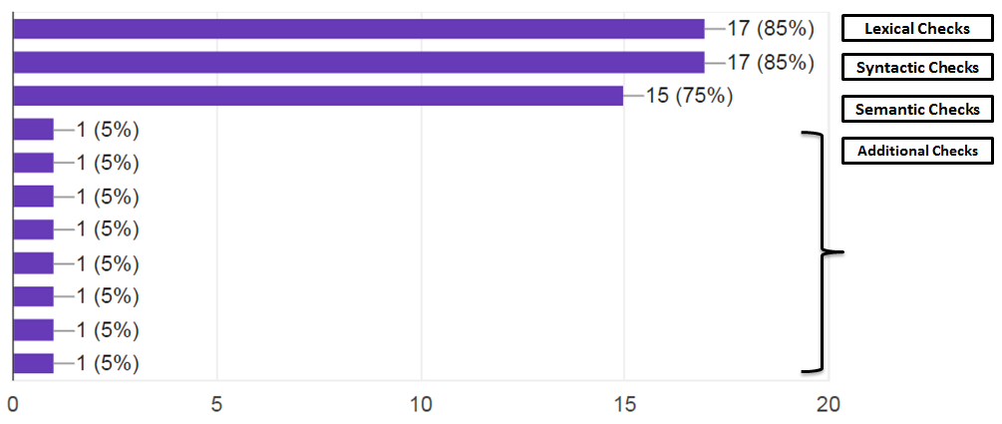
Feedback – Conformance Test

Slide 18
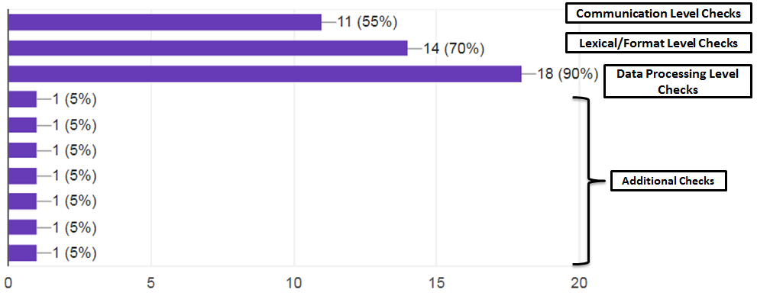
Feedback – Semantic Interoperability Test

Slide 19
Roadmap
Introduction
SemTest Implementation and Integration
Demonstrations
Community Feedback
Conclusion

Slide 20
Conclusion
Proposed and implemented a semantic interoperability testing tool called SemTest
  Measure and improve interoperability level.
Integrate the tool on F-Interop platform
  Validate the integration.
Added value
  The testing tool and scenarios add the semantic testing capability to the F-interop platform.

Slide 21
Acknowledgement
SemTest is an Industrial Extension of F-Interop EU H2020 Project.
F-Interop has received funding from the European Union’s Horizon 2020 research and innovation programme under grant agreement No 687884.

Slide 22


Thank You
Email: dattas@eurecom.fr
Website: http://iot.eurecom.fr/

