Slide 1
Issues for TPAC Plugfest
September 20th, 2017
Ryuichi Matsukura
Fujitsu Laboratories Ltd. / Fujitsu Ltd.
See IG issue #346, https://github.com/w3c/wot/issues/346

Slide 2
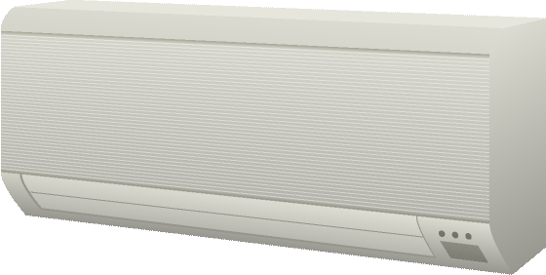

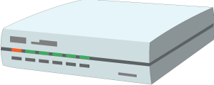

Use Case (example)
New scenario: Two and more Servients collaborations, especially between the Internet and local networks
  Application on Smartphone connected to Internet can operate air conditioner on local network. Agent and gateway relay messages between application and device.
Agent
Gateway
Electronic
appliance
Remote controller

Slide 3
Functional roles of WoT Servients
3 types of WoT Servients we suppose
  WoT Servient with ExposedThing, e.g. device
  WoT Servient with ConsumedThing, e.g. application
  WoT Servient with Exposed/ConsumedThing, e.g. gateway
Integration model
3-layer model
4-layer model
Serivent w/ C
application
Serivent w/ C
application
Servient w/ CE
gateway
(internet)
Servient w/ CE
gateway
Bridge Servients on Internet and local
gateway
(local)
Servient w/ CE
Servient w/ E
device
Servient w/ E
device

Slide 4
Issues for TPAC plugfest
Interface between Servients
  Authentication
  Discovery and exchange TDs
  Firewall and NAT traversal
  Add “Event” operation for inter-Servient interface
Thing Description management
  Management
    How to create URI. A WoT Servient on the Internet cannot access Servients on local networks, because local Servients URI are assigned to the local address.
    Who and how to manage TDs. If many servients connect to networks, the management function is necessary to easily search TD someone want to connect.

Slide 5
Call for participants
Please share the information of your Servients and legacy devices if you have a plan to participate.
Examples from past plugfest
Servient
(application)
Servient (application)
Scripting runtime (Siemens, Fujitsu)
Node-RED (Fujitsu)
Servient
on Internet
Cloud gateway (Panasonic, Fujitsu)
Firewall / NAT
Local gateway (Siemens, Fujitsu)
Servient
on local NW
Servient
on local NW
Air conditioner (Panasonic)
BACnet device (Siemens)
OCF device (Intel)
Lemonbeat device? (Lemonbeat)
IPSO device (SmartThings)
Blind, LED light (Fujitsu)
Servient
(device)
Servient (device)
Legacy device
Legacy device

Slide 6
Additional specifications for plugfest (overview)
Architecture (integration model)
Sequence diagrams among Servients
Inter-Servient Interface
  Authentication : ACE (see in Current Practice)
  Discovery and exchange TD : NEW
  Firewall and NAT traversal : NEW
  “Event” operation with subscription : NEW
TD Management
  Life cycle management
  URL naming convention

Slide 7
Basic sequence diagram (1 of 4)
Shows interaction example between Servients
  Authentication
  Discovery/Register & Lookup
Servient w/ E
Servient w/ CE
Servient w/ C
Authentication
Authentication
Register w/ TD
OK
Look up thing
OK w/ TD

Slide 8
Basic sequence diagram (2 of 4)
  “Set” operation
  “Get” operation
Servient w/ E
Servient w/ CE
Servient w/ C
Get w/ property
Get w/ property
OK w/ value
OK w/ value
Set w/ property
Set w/ property
OK
OK

Slide 9
Basic sequence diagram (3 of 4)
  “Subscribe” operation
  “Event” operation
Servient w/ E
Servient w/ CE
Servient w/ C
Subscribe
Subscribe
OK
OK
Event
…
Event
Event
…
Event
Unsubscribe
Unsubscribe
OK
OK

Slide 10
Basic sequence diagram (4 of 4)
  Delete TD
  Deauthentication
Servient w/ E
Servient w/ CE
Servient w/ C
Unregister w/ TD
OK
Delete w/ TD
OK
Deauthentication
OK
Deauthentication
OK

Slide 11
Authentication
IETF ACE
Best practice 8 described in Current Practice

Slide 12
Discovery and delivery of TD
2 Diagrams of PlugFest setting
  (1) the one in the past and (2) the expected next version at TPAC
Need for TD management in the future
(1) Diagram for the past plugfest
(2) Diagram for the next plugfest
Same network that broadcast packet can reach
Two networks that broadcast packet cannot reach
Servient
(app)
Servient
(app)
Servient
(app)
(2)Lookup TD(device) to gateway
Broadcast packet cannot reach
Servient
(gateway)
TD repo.
(1)Broadcast TD(device) to gateway
(1)Broadcast TD(device) to others
Servient
(device)
Servient
(device)
Servient
(device)
url=http;//192.168.0.1/LED
url=http;//192.168.0.1/LED

Slide 13
Need for managing multiple Servients
Point 1: Need to manage multiple Servients for multiple Applications on the remote side
Point 2: Need to manage multiple Servients for multiple Devices on the local side
Servient
(Cloud Application1)
Servient
(Cloud
Application2)
ISSUE: The URL of the local Device 4 below (url=192.168.0.1/LED)
is not available for the remote Applications.
Need to identify the URL of the local Devices from the remote side
How to generate URI
How to deliver the TD to the other side
How to search the TD
Remote side:
Servient
(Cloud Gateway)
(2)Lookup TD (device) to cloud gateway
TD repo.
Internet
Firewall/NAT
Servient
(Local
Application1)
Firewall/NAT
Local side:
Servient
(Local Gateway)
Servient
(Local Gateway)
(1)Send TD(device) to cloud gateway
Servient
(Device1)
Servient
(Device2)
Servient
(Device3)
Servient
(device4)
url=http;//192.168.0.1/LED

Slide 14
NAT Traversal
TBD

Slide 15
Need to collaborate
Architecture TF
  Add the integration model and the roles of Servients
  Sequence diagrams for the interactions: “authentication”, “read”, “write”, “subscribe”, and “event”.
Thing Description TF
  Discovery and exchange TD
  TD management

